Slide 1

QEP Best Start Activity:
Post Courses in My Planner

Slide 2
What You Will Need to Get Started
Degree Plan from the university you will be transferring to, specific to your major.
or
AAS or Certificate you will be pursuing at LSCS.
or
If you are undecided, use the list of “safer” classes from the Associate of Arts Degree.

Slide 3
Class List
Make a list of classes from your degree plan that you want to take at LSCS.
Be sure to take your developmental classes first!

Slide 4
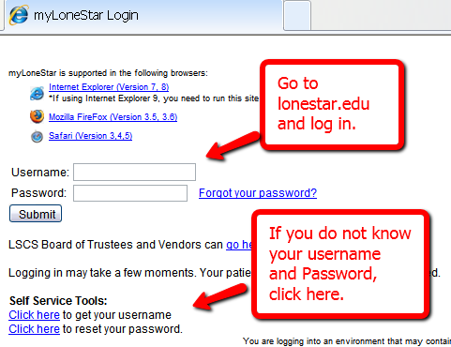
Log in to MyLoneStar

Slide 5
If you have difficulty obtaining your
User Name and Password, you will
need to see an advisor.
You will need your User Name and
Password to access the Student
Center to obtain your grades,
register for classes, and many other
tasks.

Slide 6
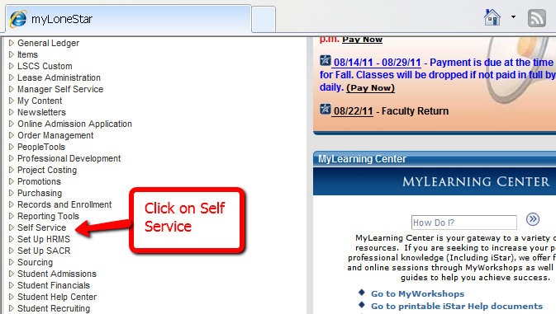

Slide 7
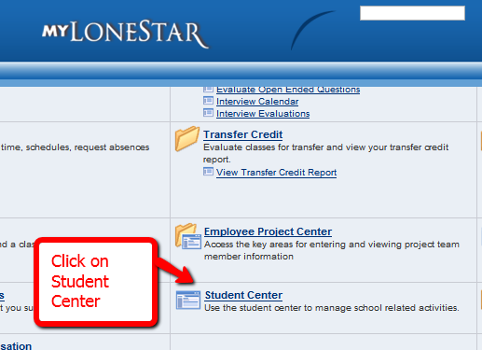

Slide 8
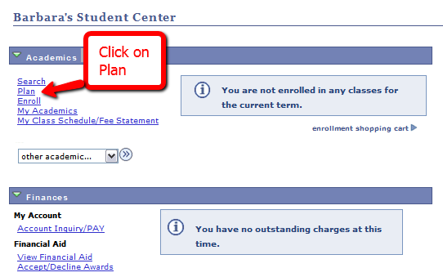

Slide 9
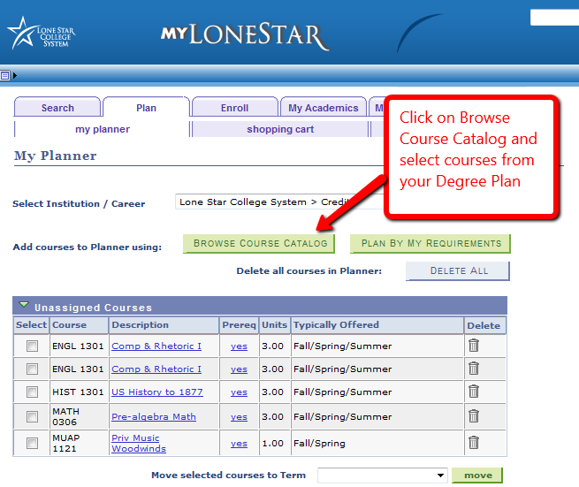

Slide 10
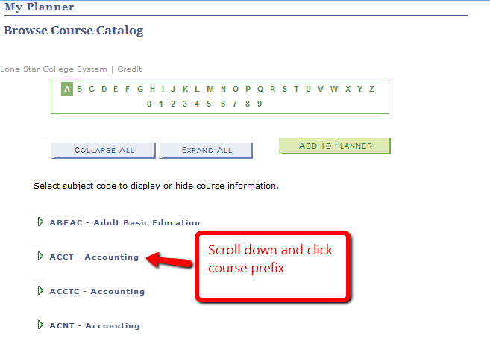

Slide 11
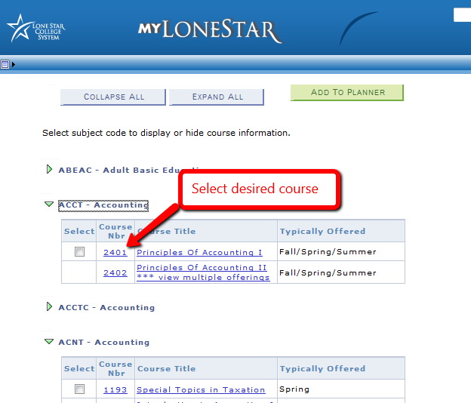

Slide 12
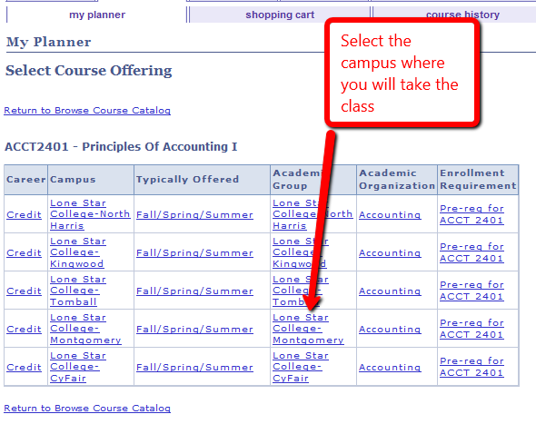

Slide 13
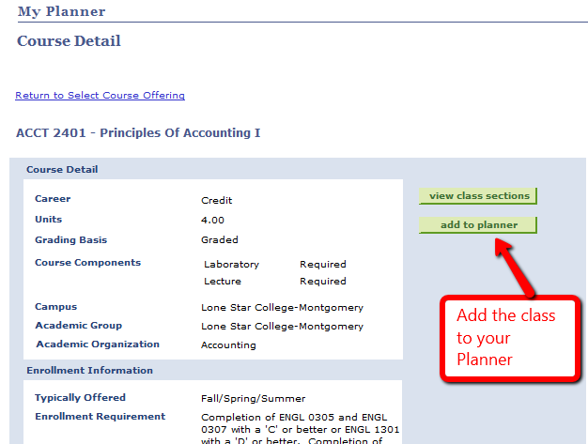

Slide 14
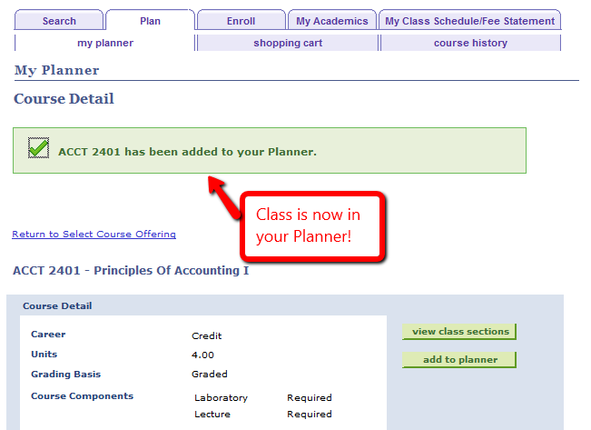

Slide 15
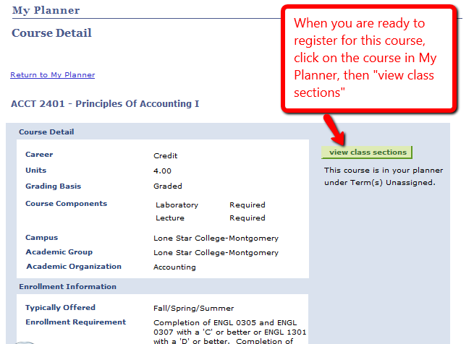

Slide 16
