Slide 1
Lab Ex. 44 Blood Vessels

Slide 2
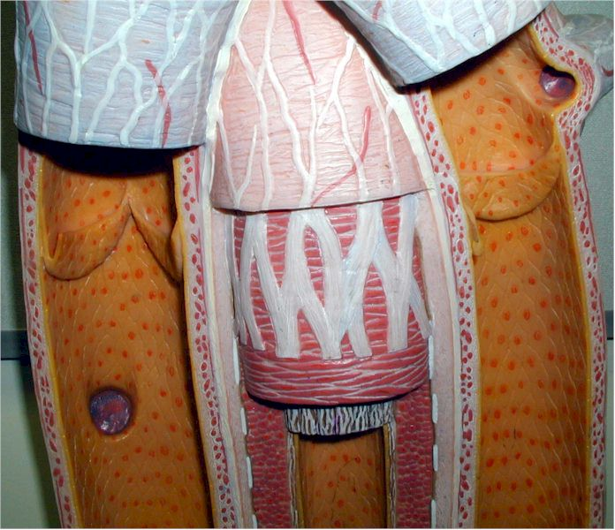
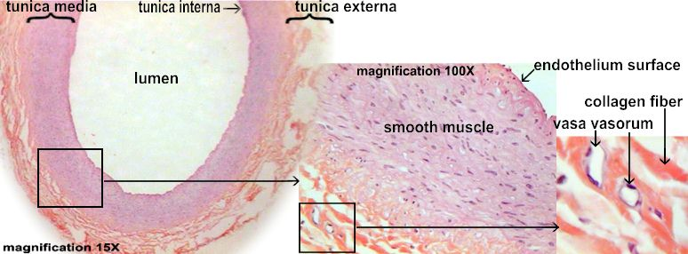
Tunica interna (intima) – entire layer

Slide 3
Endothelium (type of tissue is simple squamous)

Slide 4
Tunica media (tissue is smooth muscle)

Slide 5
Tunica externa (adventitia) – tissue is connective tissue

Slide 6
artery

Slide 7
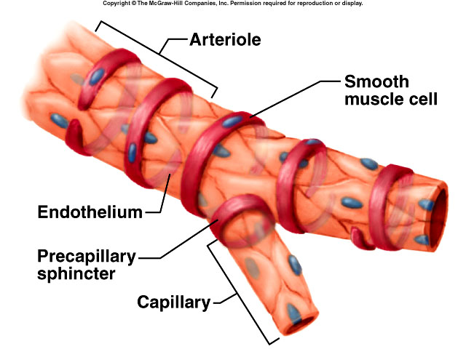
arteriole

Slide 8
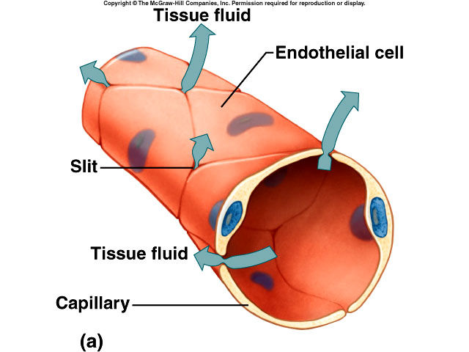
capillary

Slide 9
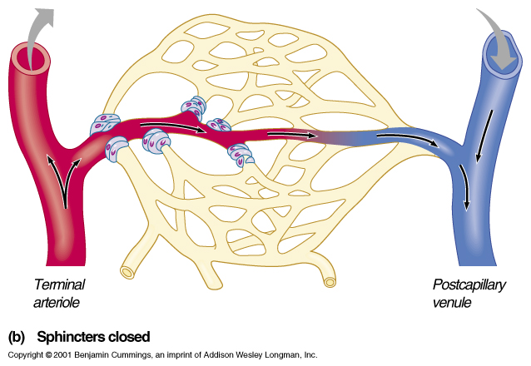
venule

Slide 10
vein

Slide 11
One-way valve

Slide 12
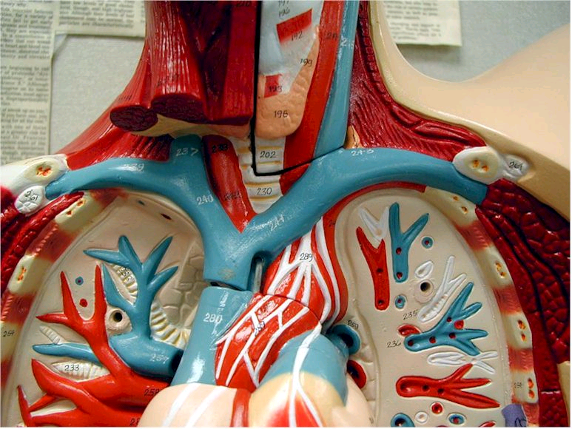
Oxygenated blood (red vessels)

Slide 13
Deoxygenated blood (blue vessels)

