Slide 1
LSC-TOMBALL
EDUCATION, ENGLISH & MATHEMATICS DIVISION
FALL 2009 & SPRING 2010
Division Report

Slide 2
EEM MISSION STATEMENT
The EEM Division’s Mission is to promote and inspire learning in a collaborative, mutually-respectful environment.
We do this by designing rigorous and relevant learning experiences, by providing guidance for students, by practicing and promoting teaching excellence, and by supporting each other with continuous professional development.

Slide 3

NEW YEAR, NEW THEME!
Share Your Gifts!

Slide 4
NEW YEAR, NEW THEME!
----“The gift”- what we see in master teachers who have that profound “teaching” talent …… we also want to help our students find “their gifts” and use them to their fullest potential…..
Mary Ann Jackson – from Never Work Harder book
I, personally, like the gift idea…
Lujan Barbara - Counselor
I like the “open your gifts” metaphor…
Betty Burdett – Associate Professor, English/DS

Slide 5
NEW FACES, NEW TALENTS!
Kathy Sanchez was our English Department Chair for six years before she became our new EEM Dean.
Amber Mestayer was an LSC-Kingwood Math adjunct for six years before she joined the EEM team.
Devika Lalsinghani was an LSC-Cy-Fair Math adjunct for five years before she joined our team.
Susan Mueller applied for the Education adjunct position, but her talent in Reading made her become our top choice to fill Pamela Womack’s place while she is serving HETI.
Maria Del Carmen Marin-Ocana, Ph.D. was an English adjunct for University of Houston and also at LSC-North Harris before she joined the Tomball faculty.
Suzanne Weatherly was our DS English adjunct before she joined our team full time.
Julialicia Case was English faculty at the University of California- Davis before she joined our EEM Tomball team.

Slide 6

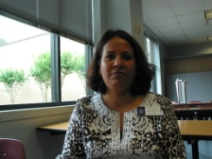
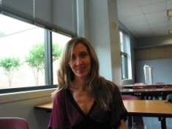
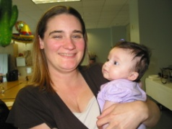
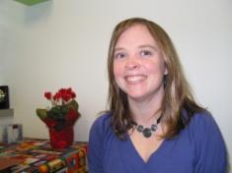
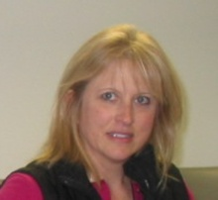
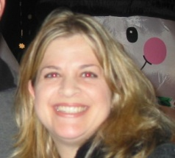
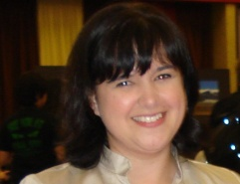
Welcome Aboard!

Slide 7
MILESTONES REACHED!!!
Rebecca Tate – 20 Years of Services
Pamela Womack – 20 Years of Services
Jeff Norem – 5 Years of Services

Slide 8
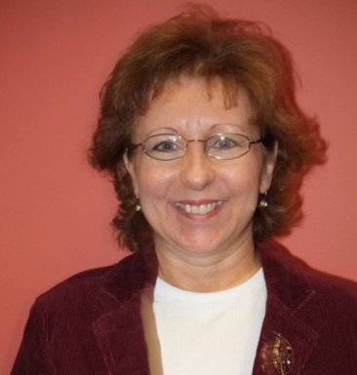
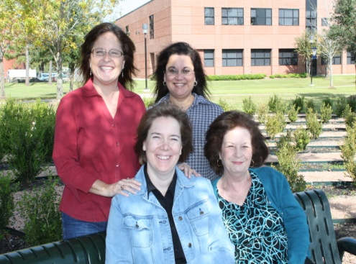
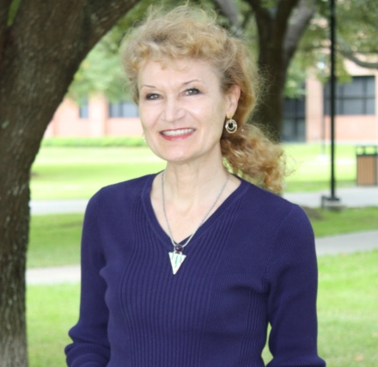
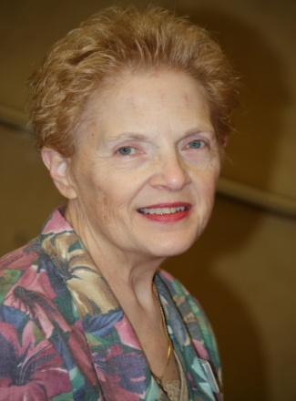
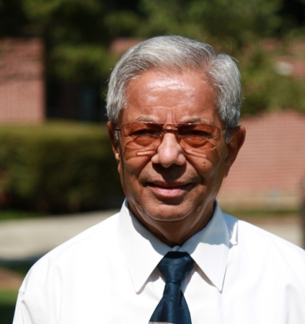
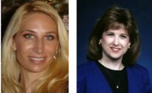
AND THE WINNER GOES TO…
Suzanne Mattair – Adjunct Faculty Excellence Award
Marva Pixton – Staff Excellence Award
Irina Nizova – Faculty Excellence Award
Judy Harris – Faculty Excellence Award
VC Patel – Faculty Excellence Award
These individuals go above and beyond their job description by providing all of us (and our students) excellent service …
Dr. Karr, LSC-Tomball President
Melissa Studdard and Dr. Becky Tate are the 2010-2011 sabbatical recipients for LSC-Tomball

Slide 9
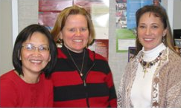
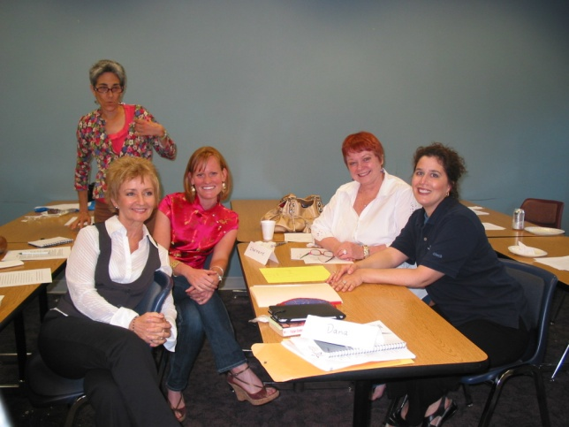
Melissa Studdard won the FIE (Faculty International Exploration) Grant.
Rachel Whitten, Katie Olson, and Duy Nguyen are the 2009 Mini Grant recipients.
Adjunct Certification Program
Participants and Corresponding Chairs
Ginger Fray – Kim Carter
Betty Linder – Kim Carter
Ruth Stitt – Barbara Lujan
Charmaine Fritchey – Kim Carter
Dana Rizzo – Kim Carter
Ava Veselis – Kim Carter
Lorraine Tischler – Kim Carter
Sonny King – Claudia Davis
Beverly Mackie – Claudia Davis

Slide 10
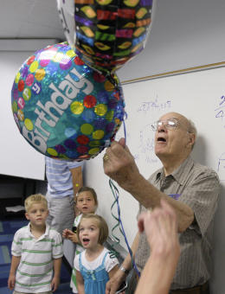
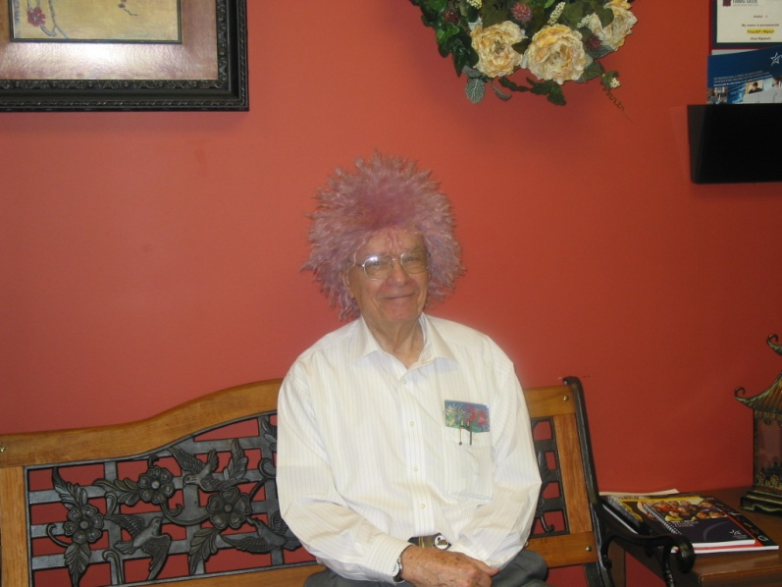
AND THERE IS NO ONE ELSE…
The years add up for math teacher
He spends 90th birthday in favorite place, the classroom
By RENEE C. LEE
Copyright 2009 Houston Chronicle
July 9, 2009, 11:07PM
"This young man is a very dear friend of my family. In fact, he is the very first school principal that I worked for in my teaching career and I must add one of the BEST administrators and educators in this world! 90 years old and still teaching at the junior college level. Amazing man!"
He said the math department chairwoman recently asked him how long he planned to keep teaching.
“I told her as long as I am able to and able to help students,” he said. Hemingway joined the Lone Star College System 20 years ago, after his retirement from a private Christian school in northwest Harris County, where he was a superintendent and teacher for nine years.

Slide 11
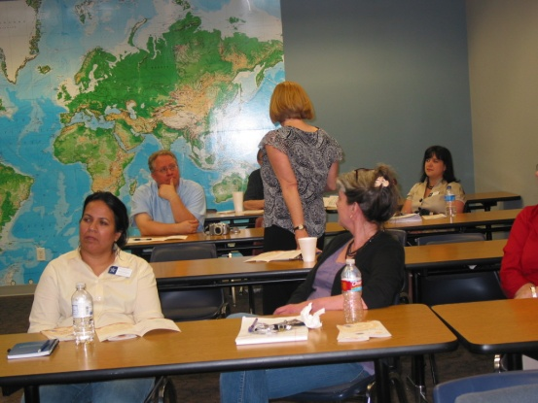
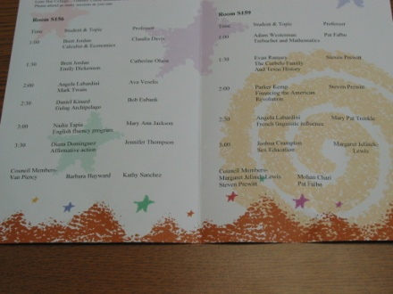
OUR STUDENTS……..
First Annual LSCS Calculus Contest:
First place (Calculus I Division): Le Thi My Do, a student of Rick Smalley’s class
Third place (Calculus II Division): Pham Khanh, a student of Scott Travis’ class.
Wonderful! Dr. Karr- President of LSC- Tomball
Second Annual LSCS Calculus Contest:
First place (Calculus I Division): Duy Ngo, a student of Mark Hammerbacher’s class
Fifth place (Calculus II & Up Division): Steven Hansberger, a student of Abraham Haje’s class
Division scholarship recipients:
Math Excellence Endowment Scholarship : Khanh Pham
LSC-Tomball Mathematics Department Endowment Scholarship : Linh Nguyen
LSC-Tomball Mathematics Faculty Endowment Scholarship: Jason Kaplan
“Thanks for sharing the wonderful news. Congratulations to the students for an excellent performance and to Math faculty for support, encouragement and excellent Math instruction.” Dr. Judy Murray – Former Vice President of Instruction
Honors Presentation Day

Slide 12
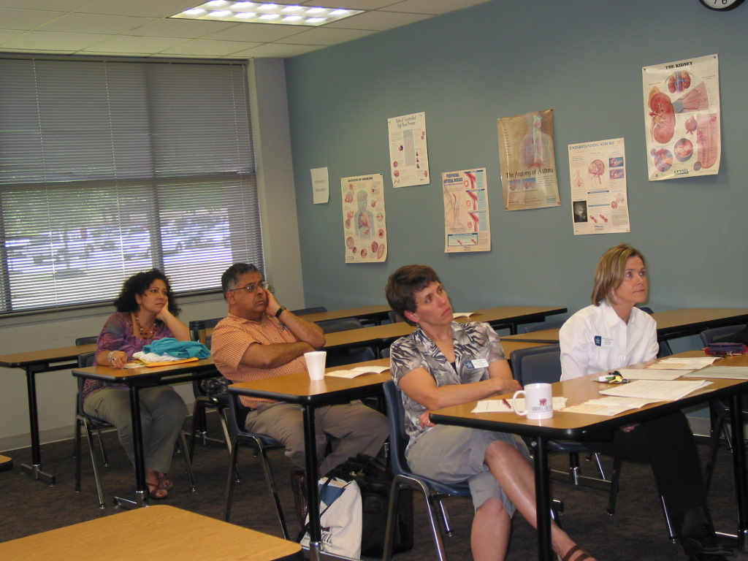
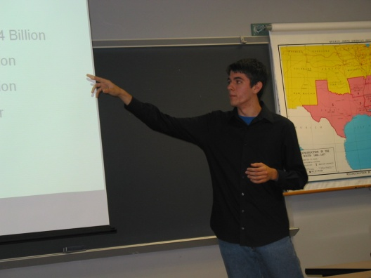
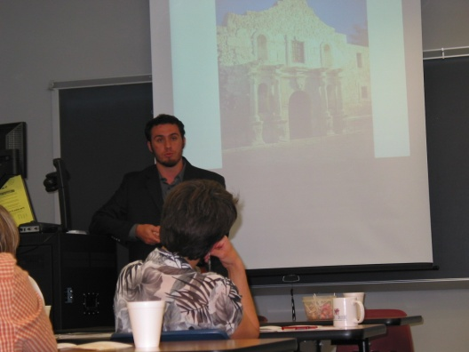
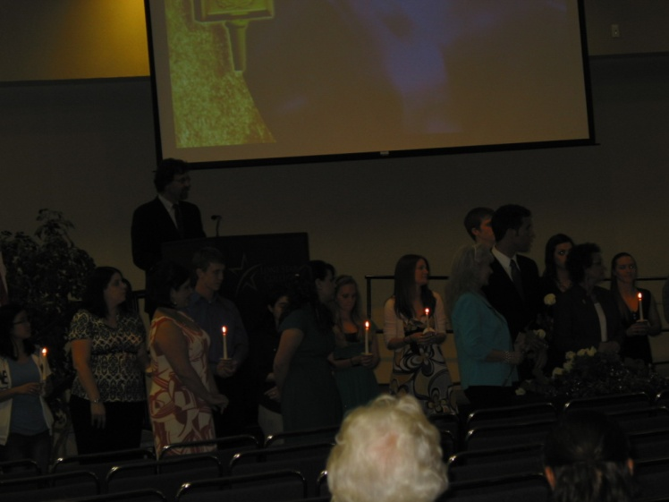
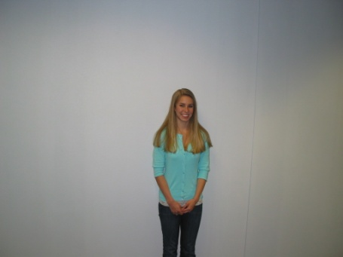
Honors Students Presentation:
Brett Jordan (Faculty Sponsor: Claudia Davis and Catherine Olson)
Angela Labardini (Faculty Sponsor: Ava Veselis)
Nadia Tapia (Faculty Sponsor: Mary Ann Jackson)
Adam Westerman (Faculty Sponsor: Patti Falbo)
3rd place winner of SML contest – Spring 2010
PTK Spring 2010 Induction

Slide 13
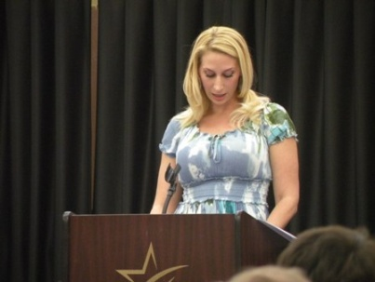
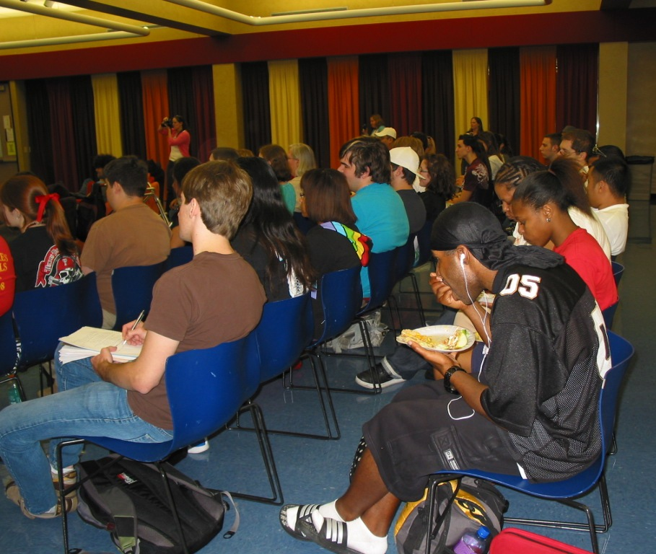
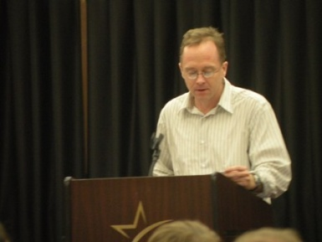
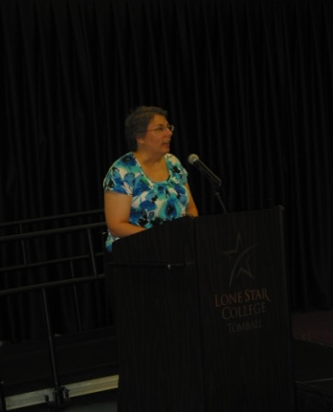
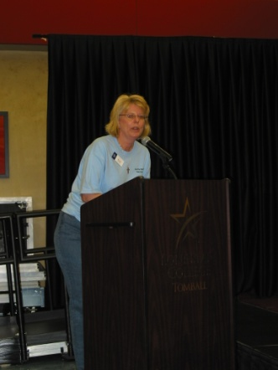
OUR TEACHERS…
Melissa Studdard, LSC-Tomball. Her work has appeared in numerous journals including Boulevard, Connecticut Review, Gradiva and Chelsea. She is a contributing editor for Tiferet and The Criterion, and a reviewer for The National Poetry Review.
Greg Oaks, LSC-Tomball. Greg Oaks has been published in the Gettysburg Review, The Cimarron Review and elsewhere. He is one of the founders of Houston's Poison Pen Reading Series.
LSC- Tomball Faculty Reading
Katherine Reynolds, LSC-Tomball. Her poetry has appeared in Poetry Northwest, The Paris Review, Western Humanities Review and Slipstream. She is currently working on her memoir.
Mary Ann Jackson participated on Kujawa Elem. and Kujawa Early Childhood Centers International Baccalaureate’s review panel as community partner.

Slide 14
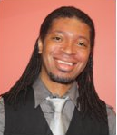
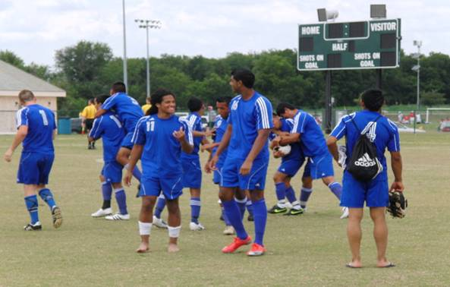
Our Division got kudos from both Dr. Karr and Dr. Murray –
Kathy Sanchez
A student’s mother called with RAVING reviews of David Maslane.
Her daughter was in his ENGL 1301 class.
Our DS English adjunct, Latoya Hardman, received NCTE’s “Early Educator of Color Leadership Award” in 2009 (1 of 6 people nationwide)
“Doug Boyd is my favorite teacher.”
Stephanie Bostwick, former President of LSC-Tomball SGA
Congratulations to English professor Brian Reeves, whose work was recently published by the Two-Year College English Association, featuring an online audio reading.
Donna Willingham’s proposal submitted to NADE for the system wide reading assessment (SCF) was accepted.
“Congratulations!” Kathy Buttermore – NADE 2010 Conference Chair.
“I am even happier that our assessment system/strategies will benefit DS reading across the country.” Dr. Donna Willingham, Lead Faculty
“Congratulations!...You will represent us and the assessment process well.” David Dahnke – Department Chair, LSC-NH
LSC- Tomball Men’s Soccer Club won the 28th Annual Metro Tournament – Abraham Haje is the proud Soccer coach.

Slide 15

ABOVE AND BEYOND…
Claudia Davis is one of 7 faculty members system-wide to complete an alignment of the College math outcomes, TEKS, and college readiness standards.
Rachel Whitten, Mary Ann Jackson, and Donna Willingham presented in 2010 LSCS Conference Day
Melissa Studdard read her favorite Emily Dickinson’s poems in 2009 Annual Emily Dickinson Birthday Celebration.
Kathy Sanchez and Linda Garcia co-chair the ESSI committee
Department Chair, English – Kim Carter
Department Chair, Mathematics – Claudia Davis
Please join me in congratulating them and, when you have an opportunity, thank them for dedicating themselves to this task as we begin a new academic year.
Dr. Susan Karr
Pamela Womack accepted her new appointment as Faculty Fellow of LSC- Higher Education Teaching Institute as of July 2009.
Patti Falbo – BETA tester for Faculty website on wordpress.com
Mary Ann Jackson attended training as a community partner representative . She also served on a peer review team in the semester for the high school in Aldine ISD
“The college makes a difference in people’s lives, and your being a part of it makes a difference in mine. Many thanks.” Dr. Cher Brock, Interim Vice President of Instruction

Slide 16
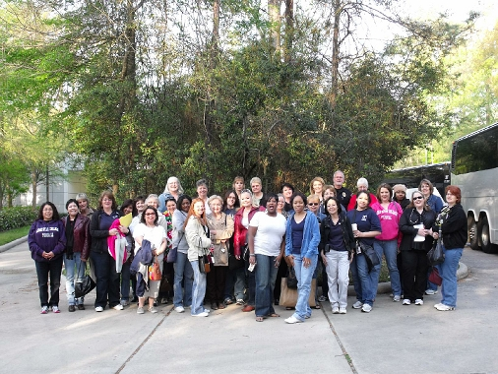
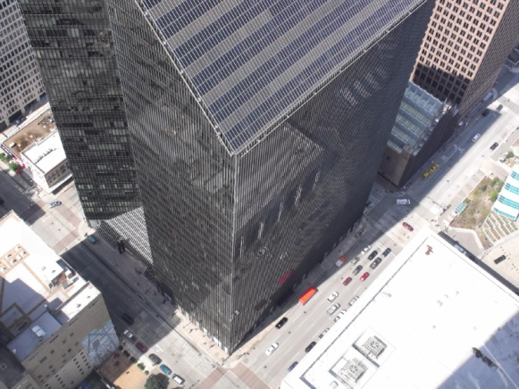
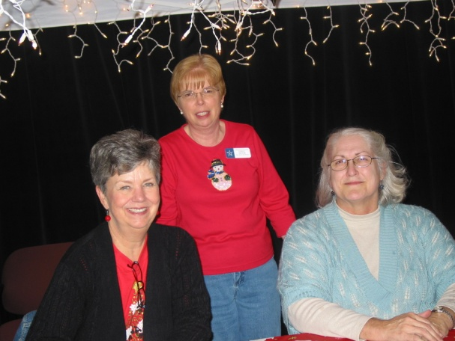

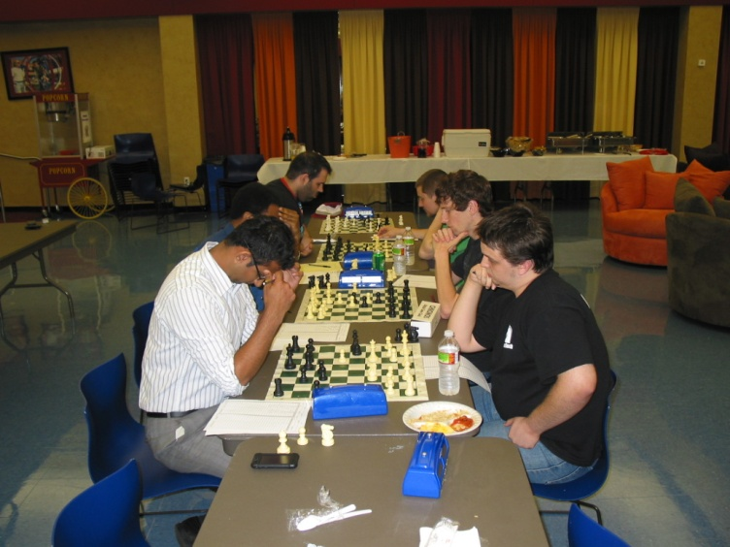
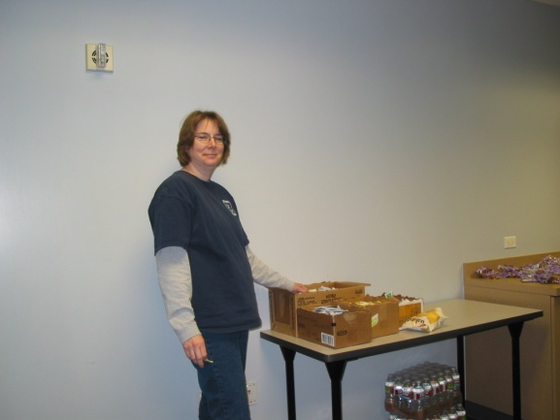
OUR STAFF…
Patty Krugh coordinated with PSSA officers to take a group of 50+ members to Downtown Houston on a tunnel tour.
Marva pioneered in uploading the Syllabi & Vitae for our teachers in Fall 2009.
Winter Wonderland
Marva Pixton assumed the chess club co-advisor duties in the Summer and Fall 2009.
Winter Wonderland

Slide 17

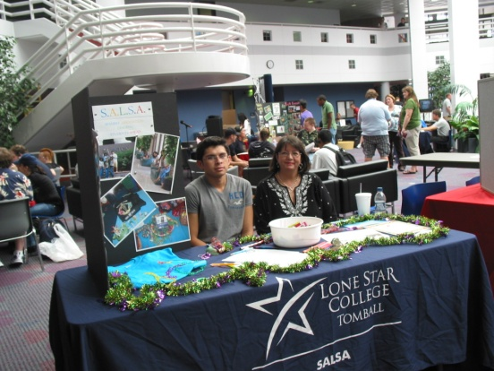
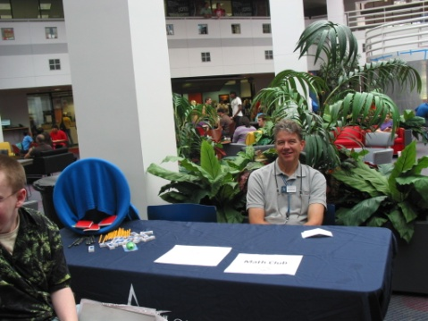
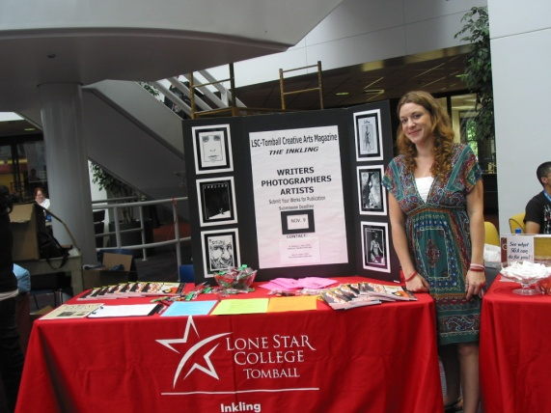
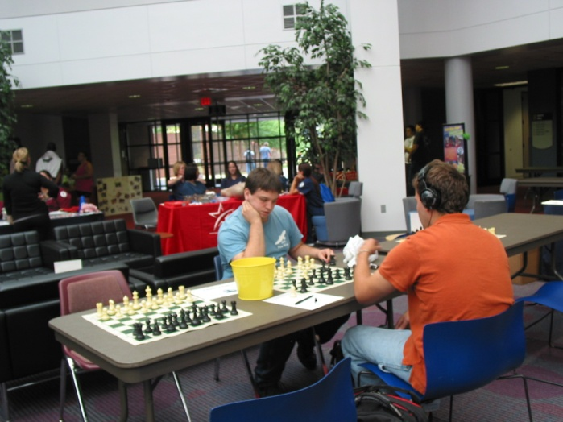
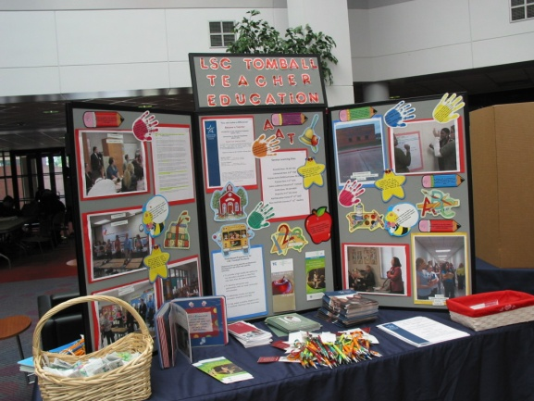
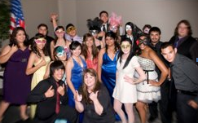
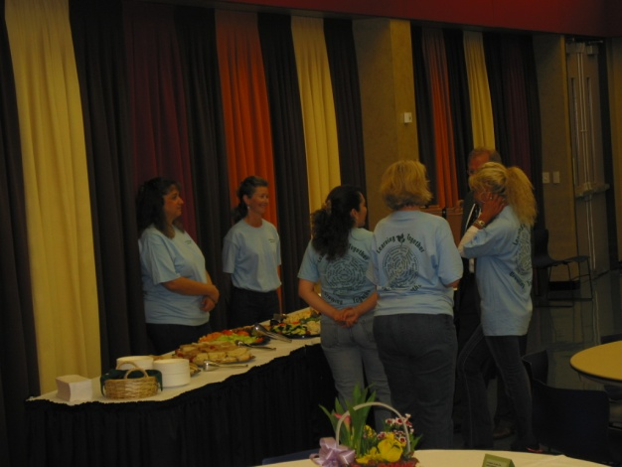
OUR STUDENT CLUBS…
During 2009-2010 EDUC students and Future Teacher Club gave over 2100 hours or $44,100 dollars worth of service to the community through our service learning program.
My congratulations go out specifically to:
The Inkling and Future Teachers Club – Community Service/Humanitarian Award
Math Club – Emerging Organization Award
PTK and ECO Club – Collaborative Programming Event, High Island Clean-up
PTK – Outstanding Student Organization
Robin Arcia (Inkling student) – Leadership Award
Kathy Sanchez

Slide 18
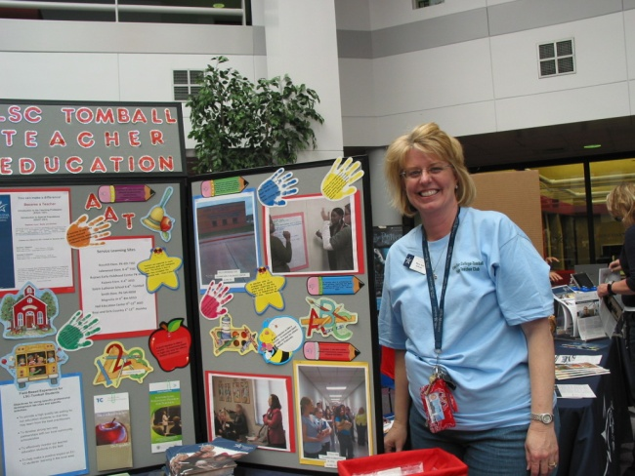
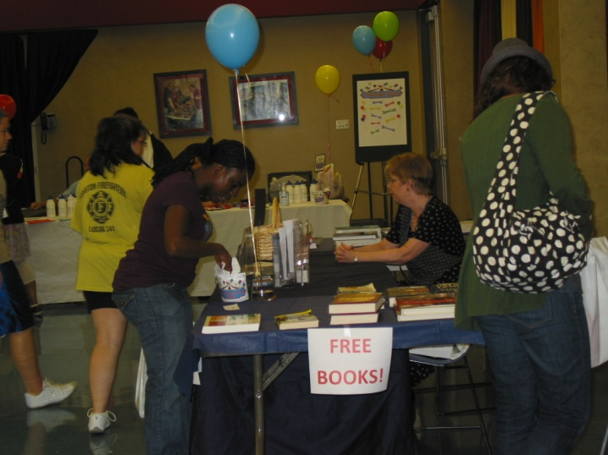
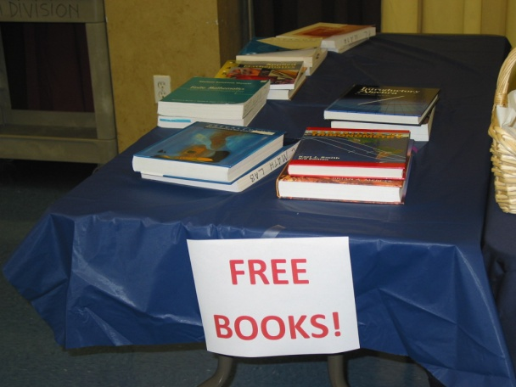
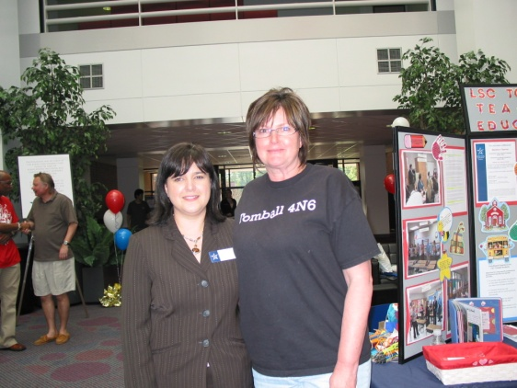
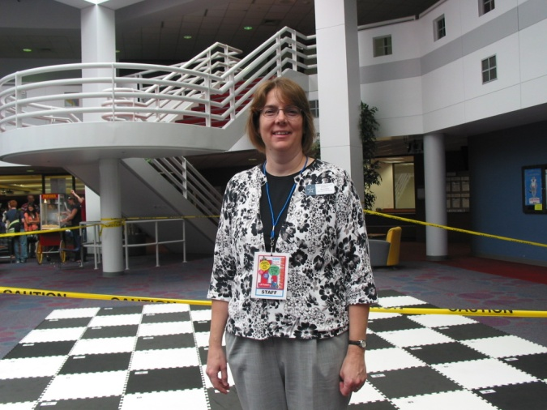
COLLEGE EVENTS and EEM…
Sneak Peak

Slide 19
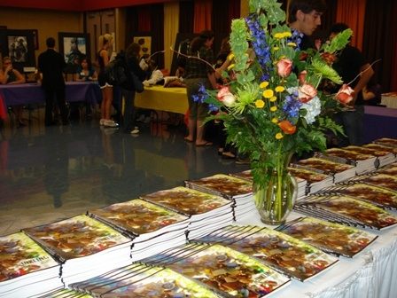
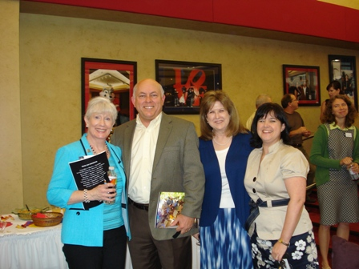








INKLING Party

Slide 20







International Education Week

Slide 21








Slide 22







Slide 23








Slide 24





This is a wonderful opportunity for LSC- Tomball ….. Get more ideas on using their handbook - Kathy Sanchez, Dean of EEM Division
Laurie Kirszner & Stephen Mandell’s workshop
Calculus Musical

Slide 25











Inkling Reading 2010
“I just wanted to congratulate Becky on the Inkling Reading…This was a wonderful display of the creative work of our students. I also wanted to thank Katie, Greg, Doug, and Bo…”
Kathy Sanchez
“Come hear Professors Sherri White, Bo Rollins, Doug Boyd, Katie Olson, and Greg Oaks reading pieces from the most recent issue of the Inkling.”
Dr. Becky Tate, Inkling Advisor

Slide 26
PROFESSIONAL DEVELOPMENT
Below is a list of Professional Development activities that our EEM faculty attended this past year.
4th Annual Math/Science Articulation Conference – Nacagdoches, TX
Claudia Davis Patricia Falbo
Mark Hammerbacher Roger Jay
ALP Conference – Baltimore, MD AMATYC – Las Vegas, NV
Brian Reeves Mindy Coleman
Judy Harris Rick Smalley
AWP Conference – Denver, CO CEA Conference – San Antonio, TX
Juli Case Van Piercy
AtD Strategy Institute – Charlotte, NC HETI – Houston, TX
Claudia Davis Juli Case Amber Mestayer
Kathy Sanchez Devika Lalsinghani Suzanne Weatherly
Mari Carmen Marin-Ocana

Slide 27
PROFESSIONAL DEVELOPMENT – cont’d
Cengage Learning Conference – Austin TX
Donna Willingham
College & Career Readiness Community College Symposium – Various Locations
Kim Carter Claudia Davis
Mark Hammerbacher Kathy Sanchez
IAL Conference – Houston, TX e-Symposiums – Various Locations
Judy Harris Kim Carter
Mary Ann Jackson Mary Ann Jackson
Van Piercy
Falling in Love with Success – Houston TX NACCTEP Conference – Baltimore, MD
Mary Ann Jackson Mary Ann Jackson
ICTCM Conference – Chicago, IL National Reading Conference – Albuquerque, NM
Brandi Cline Donna Willingham
Increasing Student Success – Houston, TX
Mark Hammerbacher
V.C. Patel

Slide 28
PROFESSIONAL DEVELOPMENT – cont’d
NADE Conference – Columbus, OH Great Teaching Round Up – Kernvill, TX
Donna Willingham Jeff Norem
NISOD Conference – Austin, TX Phi Theta Kappa Int’l. Conference – Orlando, FL
Kim Carter Judy Harris Bo Rollins
Pam Womack V.C. Patel
Kathy Sanchez
PTK Leadership Conference – Tyler, TX Starting Right - SENSE
Bo Rollins Mindy Coleman
TCCTA – Leading From the Middle – Dallas, TX TYCA-SW – Little Rock, AR
Duy Nguyen Van Piercy
TCCTA – Houston, TX
Patricia Falbo
Mark Hammerbacher
Roger Jay
Devika Lalsinghani

Slide 29



EEM family news…
Our Division participated the “Share Your Blessing- Adopt a Family for Thanksgiving 2009.” We adopted 2 families of 7 persons and provide each of them with Thanksgiving Dinner and $25.00 gift card .
Name: Amanda Nicole
Born: 2/11/10 at 8:08 pm
Weight: 6 lb 8 oz
Length: 19”
Full head of black hair
(Daughter of Amber Mestayer)
Our Division ‘s email address: EEM_Division@ LoneStar.edu

Slide 30




“Mathly” in love!!!
Meghan – the ninth grandchild of the proud GrandMa Patti Falbo
Laura Boercker will tie the knot on May 30, 2010
Jackson Edward Dietert
Born on November 14, 2009 at 10:31am
Weight: 7 lbs1oz.
Length: 19 and a half inches
First son of the proud parent Mari Del Carmen-Ocana

Slide 31












End of Year luncheon
Christmas Luncheon
Adjunct Faculty Excellence
Wedding Bell!
Baby Showers

Slide 32
Five Years - Enrollment Trends per Discipline

Slide 33




Foreign Language Communicators in our Division
Abraham Haje Arabic
Rui-Xiu Dai Chinese (Mandarin)
Duy Nguyen French Merçi beaucoup!
Juli Case German Guten Tag!
VC Patel Gujarati (India) Tame kem chho?
Abraham Haje Hebrew
VC Patel Hindi (India) Main achha hoon
Devika Lalsinghani Hindi (India)
Irina Nizova Russian
Mari Carmen Marin-Ocana Spanish Mucho Gracias!
Roger Jay Spanish
Barbara Lujan Spanish
Patricia Falbo Spanish
Duy Nguyen Vietnamese Cám Ón!

Slide 34
We presented the featured selection entitled “He” from Professor Brian Reeves
He
He looks in the mirror
And he hates what he sees:
“I’m too skinny, I’m too fat”
“My ears are too big; my hands are too little”
He wants perfection at any cost
-Even if he is the cost
People love him though
He loves what he sees in the reflection of their eyes
They are the mountain he stands upon
They squeeze his heart so that Life
Flows through his body
He is empty without them
And he doesn’t even know it
Is he you?
More than likely: YES
WOW Brian, what a voice! What a great reader you are! I wish I could send you as my proxy to all of my readings!!
Melissa Suddard
Bravo Brian. I love that deep sounding voice of yours. Very powerful! Kathy Sanchez

Slide 35





LSC-Tomball
Coming Fall 2010!
HONORS COURSES
HISTORY 1301*31061
ENGLISH 1301*31060
Professor Approval Required
Contact
Honors Director Prof. Steven Prewitt
TomballHonorsProgram@LoneStar.edu
Gallery of our Division Flyers

