Slide 1
Formatting a Novel
Making your fiction stand out

Slide 2
Where do you start?
Fonts
Font Size
Readers find it hard to get through fancy fonts, even if they look cool.
Use a Serif font like Baskerville or Century Schoolbook
E-BOOKS: A Sans-Serif font is arguably better than Serif: Verdana, Optima and Arial
Make sure you have no more than twelve words per line
12 point font is the best size for reading, so you may have to adjust your margins

Slide 3
Chapters
Your chapters should always start on a new page
Headings should be set half-way down the page
Optional: Put CHAPTER ONE in all caps
Also, it’s a good idea to spell out your chapter headings

Slide 4
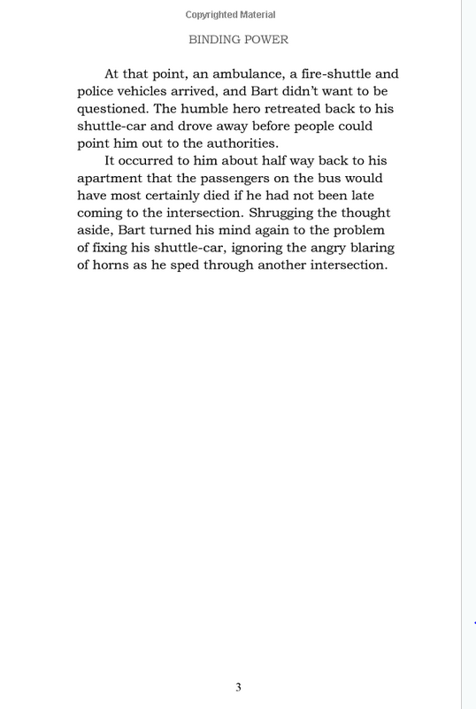
Headers and Footers
Your last name and the title of the book should alternate on each page
The page number should be centered on the bottom of each page

Slide 5
The Title and Copyright Page

