Slide 1

Becoming the Teacher Students Remember
Creating Meaningful Learning Experiences that Last
Faculty Focus: Innovative Teaching Techniques for College Success Series
Notes:
Think back to your own education for a moment. Most of us do not remember every lecture, assignment, or exam we completed. What we remember most clearly are the teachers who made learning meaningful. These instructors did more than deliver content. They challenged us, supported us, and helped us see possibilities we had not considered before. Their influence often lasted long after the course ended. The goal of this session is to explore practical strategies that help you create the kinds of learning experiences students remember—not because they were easy, but because they were meaningful.

Slide 2
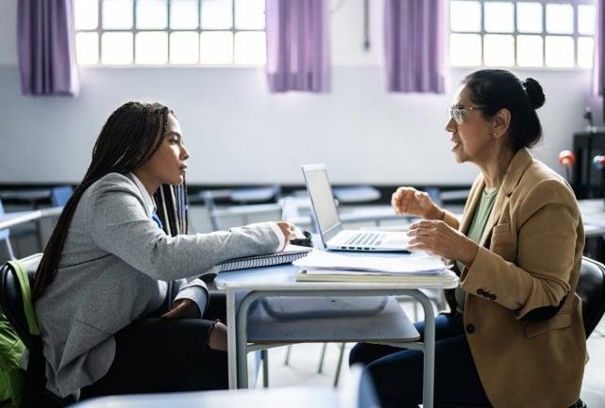
What Students Remember Most
Students rarely remember:
Every lecture
Every assignment
Every test question
Students often remember:
How a professor treated them
Moments when learning felt meaningful
When someone believed in their ability
Experiences that connected learning to life
Notes:
Research on teaching and learning consistently shows that the experiences students remember most are not specific lecture slides or test questions. Instead, students remember the moments when learning felt meaningful. They remember when a professor challenged them to think differently, when an instructor helped them understand a difficult concept, or when someone showed genuine interest in their success. In other words, memorable teaching is less about delivering information and more about shaping experiences that influence how students see themselves as learners.

Slide 3

Memorable instructors often:
Show genuine interest in students
Make complex ideas understandable
Connect learning to real life
Encourage curiosity and exploration
Inspire confidence in students' abilities
The Lasting Influence of Great Teachers
Notes:
The instructors students remember most often share several common characteristics. First, they demonstrate genuine interest in students. They learn names, listen to questions, and treat students as individuals rather than anonymous participants in a class. Second, they help students make sense of complex ideas. They break down challenging concepts and guide students toward deeper understanding. Finally, they help students see why learning matters. When students understand how knowledge connects to real-world issues, careers, or personal interests, learning becomes more meaningful.

Slide 4

Teaching Is More Than Delivering Content
Notes:
This section explores the idea that teaching is more than delivering content. While explaining material is an important part of instruction, effective teaching also involves creating opportunities for students to engage with ideas, apply concepts, and develop lasting skills. The strategies that follow offer practical ways to move beyond information delivery and design learning experiences that promote deeper understanding and meaningful student engagement.

Slide 5
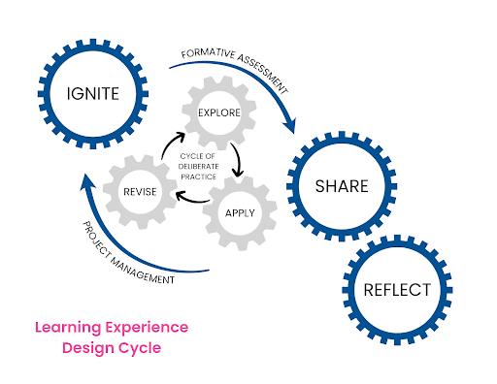
Design Meaningful Learning Experiences
Meaningful learning experiences often include:
Real-world problems or scenarios
Opportunities to analyze, discuss, and question ideas
Activities that require students to apply concepts
Assignments that connect knowledge to practice
Structured opportunities for reflection
When students actively work with ideas rather than simply hearing about them, learning becomes more engaging, memorable, and transferable.
Notes:
One of the most important shifts in effective teaching is moving from delivering information to designing meaningful learning experiences. While lectures can introduce ideas, deeper learning occurs when students have opportunities to interact with those ideas in purposeful ways. Designing meaningful learning experiences means thinking carefully about what students will do with the content. Instead of only listening, students might analyze a case study, interpret data, debate an issue, solve a problem, or apply concepts to real-world situations. These activities encourage students to actively process information, which strengthens understanding and retention.
Meaningful learning experiences also help students connect course material to broader contexts. When students see how ideas apply beyond the classroom—to professional fields, current issues, or everyday decisions—they are more likely to view learning as relevant and valuable. In this way, your role shifts from simply presenting information to guiding students through experiences that help them build knowledge, develop skills, and think more deeply about the subject.

Slide 6
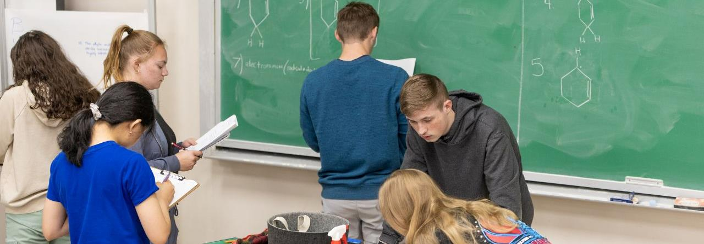
Ask open-ended questions
Use brief discussions or think–pair–share
Incorporate small group activities
Invite students to explain their reasoning
Use quick polls or reflection prompts
 Active participation helps students process ideas, clarify understanding, and stay engaged in the learning process.
Encourage Active Participation
Notes:
Encouraging active participation is an important part of moving beyond content delivery. When students only listen to information, their engagement and retention may be limited. However, when students are asked to discuss ideas, answer questions, or solve problems, they become active participants in the learning process.
Active participation can take many forms. You might ask students to briefly discuss a question with a partner, explain their reasoning behind an answer, or work together to analyze a scenario. Even short activities during a lecture—such as polling questions or quick reflection prompts—can help students process information more deeply. These opportunities for participation allow students to clarify their thinking, hear different perspectives, and practice applying concepts. As a result, learning becomes more interactive, and students are more likely to remain engaged throughout the class session.

Slide 7

Guide Students Through Challenges
Ways to guide students:
Break complex ideas into manageable steps
Model how to approach difficult problems
Provide examples and guided practice
Encourage persistence when concepts are challenging
Offer feedback that helps students improve
 Supporting students through challenges helps build confidence, resilience, and deeper understanding.
Notes:
Learning new material, especially complex concepts, can be challenging for students. Effective teaching involves guiding students through these challenges rather than simply presenting information and expecting immediate understanding.
You can support students by breaking complex ideas into smaller steps, modeling how to approach difficult problems, and providing opportunities for guided practice. Demonstrating how to think through a problem or analyze a concept helps students develop strategies they can use independently.
Encouraging persistence is also important. When students encounter difficulty, supportive feedback and structured guidance can help them stay engaged rather than become discouraged. By helping students work through challenges, you not only improve understanding of the material but also help students build confidence in their ability to learn and succeed.

Slide 8
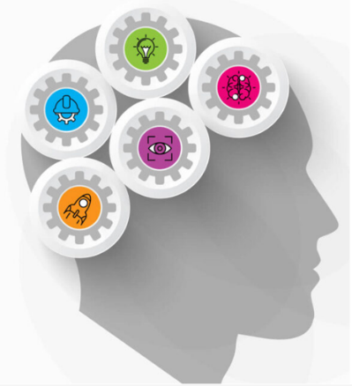
Help Students Make Connections
Ways to support connections:
Link new concepts to prior knowledge
Highlight relationships between course topics
Use examples from real-world situations
Encourage students to compare ideas or perspectives
Ask students to explain how concepts relate
 Making connections helps students build a stronger, more integrated understanding of the subject.
Notes:
Helping students make connections is an important part of effective teaching. Learning becomes more meaningful when students can see how ideas relate to one another rather than viewing each topic as separate or isolated.
You can support this process by explicitly linking new material to concepts students have already learned. Drawing connections between course topics, previous lessons, or real-world examples helps students organize information in ways that are easier to understand and remember.
Encouraging students to compare ideas, identify patterns, or explain how different concepts relate can also strengthen learning. When students make these connections, they begin to develop a deeper understanding of the subject and are better able to apply what they have learned in new situations.

Slide 9

Creating Moments of Discovery
Notes:
Creating moments of discovery helps transform learning from simply receiving information into actively uncovering ideas. When students have opportunities to explore questions, analyze problems, or work through challenges on their own, they experience the satisfaction of figuring something out rather than just being told the answer.
This section highlights strategies that allow students to investigate ideas, test their thinking, and arrive at insights through guided exploration. These moments of discovery often lead to deeper understanding because students are actively involved in the learning process.

Slide 10

Solve a
Challenging Problem
Ways to incorporate this approach:
Present a problem before explaining the solution
Use real-world scenarios that require analysis
Ask students to propose possible solutions
Encourage collaboration when tackling difficult questions
 Working through challenging problems helps students think critically and experience the satisfaction of discovery.
Notes:
One powerful way to create moments of discovery is to give students the opportunity to solve a challenging problem. When students grapple with a problem before being shown the solution, they become actively involved in the learning process. Rather than simply hearing an explanation, they must analyze the situation, apply what they know, and test possible approaches.
These experiences encourage deeper thinking and help students develop problem-solving skills. Even if students do not immediately arrive at the correct answer, the process of exploring different possibilities strengthens their understanding of the concepts involved.
Providing guidance and encouraging collaboration can make these challenges more productive. When students work together to explore ideas and discuss possible solutions, they not only learn the material more deeply but also experience the satisfaction that comes from discovering an answer through their own effort.

Slide 11
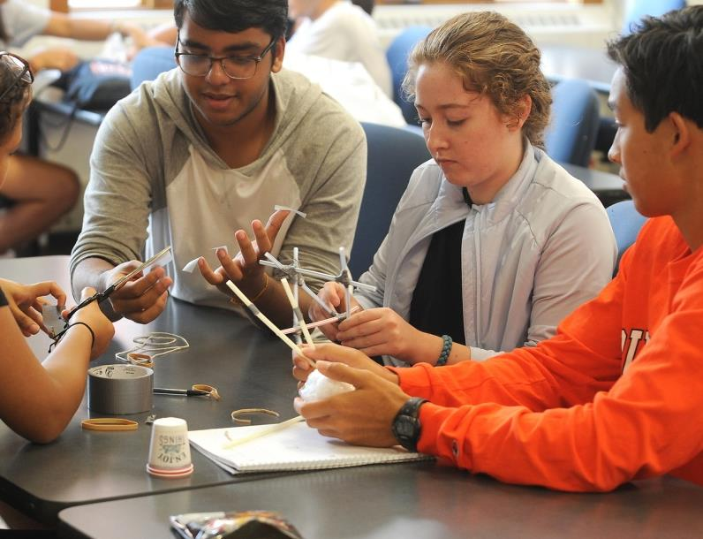
Discover a New Perspective
Ways to encourage new perspectives:
Present multiple viewpoints on an issue
Use debates or structured discussions
Analyze contrasting case studies or texts
Ask students to explain different interpretations
Encourage students to reconsider initial assumptions
 Exploring different perspectives helps students think more critically and develop a deeper understanding of complex ideas.
Notes:
Another way to create moments of discovery is to help students encounter new perspectives. When students are exposed to different interpretations, viewpoints, or ways of thinking about an issue, they begin to recognize that knowledge is often more complex than it first appears.
You can encourage this discovery by presenting contrasting arguments, analyzing different case studies, or asking students to consider how various stakeholders might approach the same problem. Discussions, debates, and reflective questions can help students explore these differences and examine their own assumptions.
These experiences encourage students to think more critically and develop a deeper understanding of the subject. By engaging with multiple perspectives, students learn not only what to think about a topic, but how to evaluate ideas and form thoughtful conclusions.

Slide 12

Connect Ideas Across Topics
Ways to support connections:
Refer back to previously learned concepts
Highlight patterns across units or topics
Use examples that integrate multiple ideas
Ask students to explain how concepts are related
Encourage students to apply earlier knowledge to new situations
 Connecting ideas helps students build a more complete and lasting understanding of the subject.
Notes:
Another way to create moments of discovery is to help students connect ideas across topics. Learning becomes more meaningful when students recognize that concepts are not isolated pieces of information but part of a larger framework of knowledge.
You can support this process by referring back to earlier lessons, highlighting patterns across topics, and asking students to apply previously learned concepts to new situations. These strategies help students see how ideas build on one another and contribute to a deeper understanding of the subject.
When students begin to recognize these relationships, they often realize that what they learned earlier can help them make sense of new material. These connections strengthen understanding and help students retain and apply knowledge more effectively.

Slide 13

Encourage an “Aha” Moment
You can encourage these moments by:
Asking questions that lead students to uncover the answer
Letting students explore ideas before explaining them
Using examples that reveal patterns or relationships
Encouraging students to explain their thinking
Giving time for reflection and discussion
 These moments of realization make learning more engaging and memorable.
Notes:
Some of the most memorable learning experiences occur when students have an “aha” moment—when a concept suddenly becomes clear. These moments often happen when students actively work through ideas rather than simply receiving an explanation.
You can encourage these insights by asking guiding questions, presenting examples that reveal patterns, or giving students time to explore a problem before providing the solution. When students begin to see the relationships between ideas on their own, understanding becomes more meaningful.
Providing opportunities for reflection and discussion can also help these moments emerge. When students explain their thinking or hear how others approached the same concept, they often recognize connections they had not previously considered. These moments of realization deepen understanding and make learning far more memorable.

Slide 14
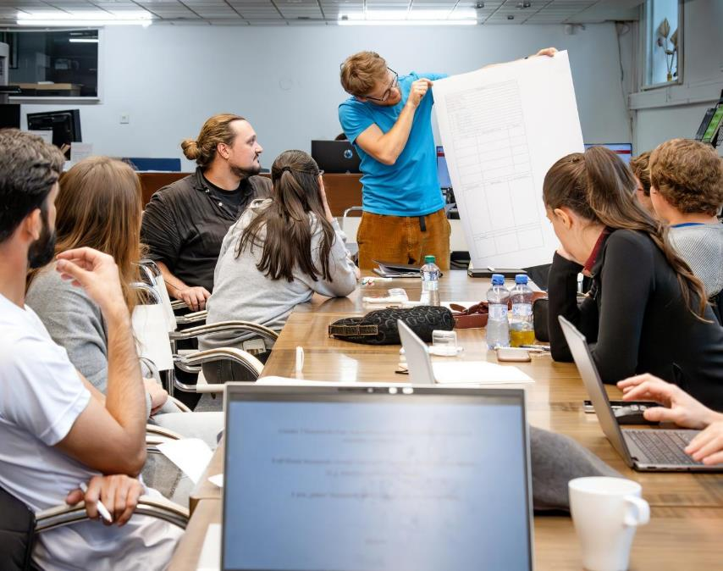
Connecting Learning to the Real World
Notes:
Connecting learning to the real world helps students see why what they are learning matters. When course concepts are linked to real situations, careers, or current issues, students are more likely to engage with the material and recognize its relevance beyond the classroom. This section explores ways you can connect course content to authentic contexts. By using real-world examples, scenarios, and applications, you help students see how ideas apply outside the course and how the knowledge they are developing can be used in meaningful ways.

Slide 15

Use Real-World Examples
You can:
Illustrate concepts using real situations
Share examples from professional fields
Connect ideas to current events or issues
Use practical scenarios students may encounter
Ask students to identify examples from their own experiences
 Real-world examples make abstract ideas clearer and more meaningful.
Notes:
Using real-world examples is one of the simplest ways to connect learning to authentic contexts. When students see how concepts appear in everyday life, professional practice, or current events, the material becomes more relevant and easier to understand.
You can incorporate real-world examples by describing how a concept is used in a particular field, referencing current issues related to the topic, or presenting practical situations where the idea applies. These examples help students move beyond abstract explanations and see how knowledge functions in real settings.
Encouraging students to identify examples from their own experiences can also deepen learning. When students recognize how course ideas appear in the world around them, they begin to understand the practical value of what they are learning.

Slide 16

Use Current Events
You can:
Link course topics to recent news stories
Discuss how current issues relate to course concepts
Analyze real situations using course ideas
Ask students to bring examples from the news
Encourage discussion of different perspectives
 Connecting learning to current events helps students see how ideas apply in the world today.
Notes:
Current events are another effective way to connect learning to the real world. When you link course concepts to recent news stories or ongoing issues, students can see how the ideas they are studying relate to real situations unfolding around them.
You might begin a class discussion with a news article related to the topic, analyze a recent development using course concepts, or ask students to identify examples in the news that connect to what they are learning. These activities help students apply their knowledge to real-world situations and encourage them to think critically about how ideas operate beyond the classroom.
Discussing current events can also expose students to multiple perspectives and encourage thoughtful dialogue. When students analyze real issues using the concepts they are learning, the material becomes more relevant, engaging, and meaningful.

Slide 17

Highlight Career Connections
You can:
Explain how concepts are used in professional fields
Share examples from industry or workplace settings
Discuss skills used in different careers
Invite students to consider how the material applies to their goals
Highlight transferable skills developed in the course
 Career connections help students understand how learning prepares them for future opportunities.
Notes:
Connecting course content to careers helps students see how what they are learning can be used beyond the classroom. When students understand how concepts relate to professional fields or workplace situations, the material becomes more relevant and meaningful.
You can highlight career connections by discussing how ideas are applied in different professions, sharing examples from industry or practice, or explaining how certain skills are used in real work environments. Even brief references to how a concept is used in a particular field can help students see the practical value of the material.
These connections also help students recognize the transferable skills they are developing, such as problem solving, communication, analysis, and collaboration. When students see how course content supports their future goals, they are often more motivated to engage in the learning process.

Slide 18
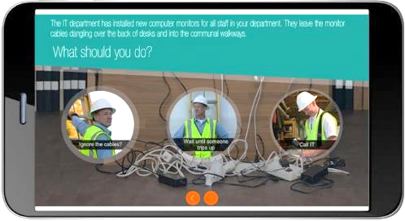
Use Case Studies or Scenarios
You can:
Present a real or simulated situation to analyze
Ask students to propose solutions to a problem
Encourage discussion of different approaches
Have students apply course concepts to the scenario
Use short scenarios to start discussion or activities
 These activities help students practice using knowledge in practical contexts.
Notes:
Case studies and scenarios provide an effective way to connect learning to real-world situations. Instead of simply discussing concepts in the abstract, you present students with a realistic situation that requires them to apply what they are learning.
You might describe a professional dilemma, a community issue, or a practical problem related to the course topic. Students can then analyze the situation, discuss possible solutions, and apply relevant concepts to explain their reasoning. This process helps students see how ideas function in real contexts.
Case studies and scenarios also encourage deeper thinking because there is often more than one possible response. When students evaluate different approaches and explain their reasoning, they strengthen their analytical and decision-making skills while making the material more meaningful.

Slide 19

Connect Course Content to Community Issues
You can:
Discuss local or regional challenges related to the topic
Analyze community problems using course concepts
Explore how different groups are affected by an issue
Encourage students to propose possible solutions
Connect course ideas to civic or community engagement
 Examining community issues helps students see how knowledge can contribute to real change.
Notes:
Connecting course concepts to community issues helps students see how learning relates to the world around them. When students explore challenges affecting communities—such as environmental concerns, public health issues, economic development, or social questions—they begin to see how academic knowledge can help address real problems.
You can introduce community issues through examples, discussions, or short case analyses that relate directly to course topics. Students might examine how a concept applies to a local challenge, analyze how different groups are affected, or consider possible approaches to addressing the issue.
These experiences help students recognize that learning is not limited to the classroom. By connecting course concepts to community concerns, you help students understand how knowledge can be used to better understand issues, make informed decisions, and contribute to meaningful solutions.

Slide 20

Show Students That You Believe in Them
Notes:
Showing students that you believe in their ability to succeed can have a powerful influence on their motivation and persistence. When students sense that you expect them to grow, improve, and overcome challenges, they are more likely to engage with the learning process and continue working even when the material is difficult. This section explores simple ways you can communicate confidence in your students’ potential. Through encouragement, supportive feedback, and high expectations paired with guidance, you help students build confidence in their abilities and develop a stronger sense of academic capability.

Slide 21

Encourage Effort and Improvement
You can:
Acknowledge progress, not just final results
Encourage persistence when work is challenging
Emphasize learning as a process
Highlight improvement over time
Reinforce that mistakes are part of learning
 Recognizing effort helps students build confidence and stay engaged.
Notes:
Encouraging effort and improvement is an important way to show students that you believe in their potential. When students see that their progress is recognized—not just their final performance—they are more likely to remain motivated and continue working through challenges.
You can support this by acknowledging growth, highlighting improvements in understanding, and emphasizing that learning often happens through practice and revision. When students understand that effort plays a key role in success, they are more willing to take on difficult tasks and persist when the material becomes challenging.
This approach also helps students develop a stronger sense of confidence in their ability to learn. By reinforcing that improvement is possible and that mistakes are part of the learning process, you create an environment where students feel supported as they develop their skills and understanding.

Slide 22

Provide Constructive Feedback
You can:
Highlight what students are doing well
Offer clear suggestions for improvement
Focus feedback on specific aspects of the work
Encourage revision and continued effort
Frame feedback as guidance for growth
 Constructive feedback helps students see challenges as opportunities to improve.
Notes:
Providing constructive feedback is another important way to show students that you believe in their ability to grow and improve. Feedback that clearly explains strengths and areas for development helps students understand how to move forward in their learning.
Effective feedback focuses on specific aspects of a student’s work and offers guidance on how it can be strengthened. By pointing out what students are doing well while also identifying areas for improvement, you help them see that progress is possible and that their efforts matter.
Constructive feedback also encourages students to view learning as an ongoing process. When students see feedback as support rather than criticism, they are more likely to revise their work, apply suggestions, and continue developing their skills.

Slide 23

Recognize Progress
You can:
Highlight improvements in understanding or skills
Point out growth over time
Celebrate small successes along the way
Encourage students to reflect on how they have improved
Reinforce that learning develops through practice
 Recognizing progress builds confidence and motivates continued effort.
Notes:
Recognizing progress is another meaningful way to show students that you believe in their ability to grow. When students see that their improvement is noticed, they are more likely to stay motivated and continue investing effort in their learning.
You can support this by highlighting changes in students’ work over time, acknowledging when a concept that was once difficult becomes clearer, or pointing out improvements in writing, analysis, or problem-solving. Even small gains can reinforce the idea that learning is developing step by step.
Encouraging students to reflect on their own progress can also strengthen this effect. When students recognize how far they have come, they build confidence in their ability to continue improving and tackling new challenges.

Slide 24
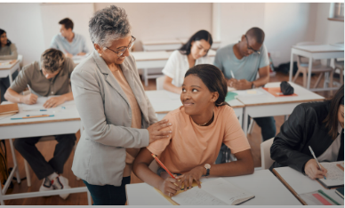
Build a Supportive Learning Environment
Notes:
A supportive learning environment helps students feel comfortable participating, asking questions, and engaging with challenging ideas. When students believe that their contributions are valued and that they are part of a respectful learning community, they are more likely to take intellectual risks and stay involved in the learning process. This section explores ways you can create a classroom climate where students feel encouraged to share ideas, explore different perspectives, and support one another’s learning. By fostering respect, openness, and collaboration, you help create conditions where meaningful learning can take place.

Slide 25

Foster Respectful Interactions
You can:
Model respectful communication
Acknowledge student contributions
Respond thoughtfully to different viewpoints
Encourage constructive dialogue
Set clear expectations for respectful discussion
 Respectful interactions build trust and encourage engagement.
Notes:
Respectful interactions are the foundation of a supportive learning environment. When students feel that their ideas are acknowledged and treated with respect, they are more willing to participate, share perspectives, and engage in discussion.
You can foster respectful interactions by modeling thoughtful communication, acknowledging student contributions, and encouraging constructive dialogue among classmates. Setting clear expectations for how students should interact with one another also helps establish a positive classroom culture. When respect becomes part of the classroom environment, students are more comfortable participating and exploring ideas, which strengthens both engagement and learning.

Slide 26
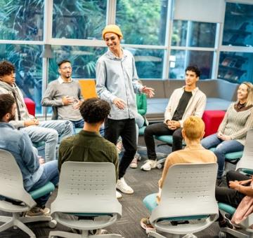
Provide Opportunities for Participation
You can:
Include discussions and small-group activities
Ask open-ended questions
Use brief interactive activities
Invite students to share ideas or examples
Rotate participation opportunities
 Regular participation helps students stay engaged and connected to the learning process.
Notes:
Providing opportunities for participation helps students become active members of the learning environment. When students are invited to contribute ideas, respond to questions, or engage in discussions, they feel more connected to the course and the learning process.
You can create these opportunities by incorporating discussions, small-group activities, or brief interactive tasks during class. Asking open-ended questions and inviting students to share examples or perspectives encourages broader participation. These opportunities help students develop confidence in expressing their ideas and contribute to a classroom environment where learning is collaborative and engaging.

Slide 27

Encourage Questions
You can:
Encourage students to ask questions during class
Create time for clarification and discussion
Respond positively to student curiosity
Reinforce that questions support learning
Provide multiple ways for students to ask questions
 A classroom that welcomes questions promotes deeper understanding.
Notes:
Openness to questions is an essential element of a supportive learning environment. When students feel comfortable asking questions, they are more likely to clarify misunderstandings and deepen their understanding of the material.
You can encourage questions by responding positively to student curiosity and creating regular opportunities for clarification. Allowing time for questions during discussions or after explanations signals that inquiry is a valuable part of the learning process. Providing multiple ways for students to ask questions—whether during class discussions, through online platforms, or during office hours—also helps ensure that all students feel comfortable seeking clarification when they need it.

Slide 28

Foster Diverse Perspectives
You can:
Invite students to share different viewpoints
Include materials representing varied perspectives
Encourage respectful discussion of ideas
Ask students to consider multiple interpretations
Highlight the value of different experiences
 Exploring diverse perspectives strengthens critical thinking and discussion.
Notes:
Encouraging diverse perspectives helps students see that complex ideas often have multiple interpretations. When students encounter different viewpoints, they learn to examine issues more carefully and consider ideas from a variety of angles.
You can encourage this by inviting students to share perspectives, presenting materials that represent different viewpoints, and asking students to analyze issues from multiple positions. These discussions help students practice evaluating ideas thoughtfully and respectfully. When students see that different perspectives are welcomed and valued, they are more likely to engage in meaningful discussions and develop stronger critical thinking skills.

Slide 29
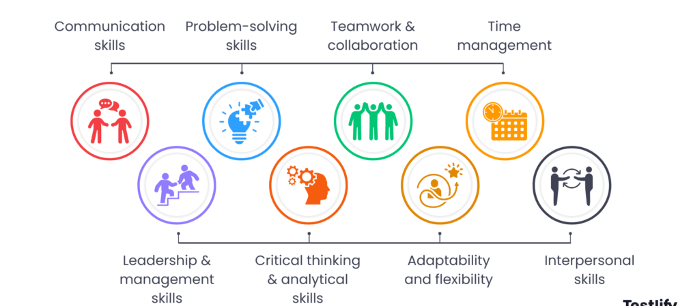
Leaving Students with Lasting Skills
Notes:
Leaving students with lasting skills means helping them develop abilities they can use long after the course ends. While students may not remember every detail of the content, they often retain the ways of thinking and working that they practiced during the course. This section focuses on how you can help students build transferable skills such as critical thinking, problem solving, communication, and collaboration. By intentionally incorporating these skills into learning activities and assignments, you help students apply knowledge more effectively and prepare for future academic, professional, and real-world challenges.

Slide 30
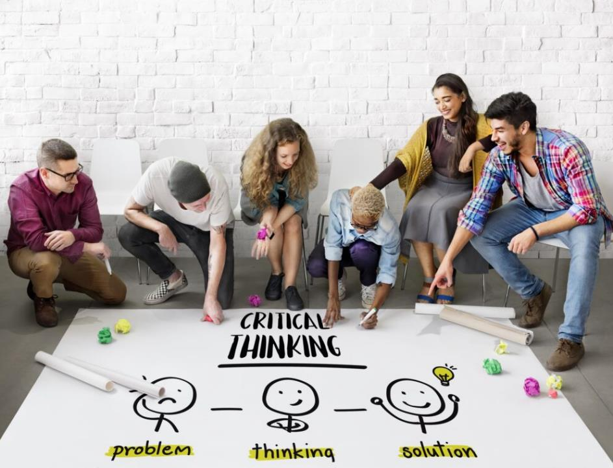
Critical Thinking
You can:
Ask students to analyze evidence
Encourage comparison of different viewpoints
Use questions that require explanation and reasoning
Ask students to evaluate arguments or interpretations
Include assignments that require justification of conclusions
 Critical thinking helps students move beyond memorization to deeper understanding.
Notes:
Critical thinking is one of the most important skills students develop in college. It involves examining information carefully, evaluating evidence, and forming reasoned conclusions. When students practice critical thinking, they learn how to question assumptions, compare ideas, and assess the strength of different arguments.
You can support the development of critical thinking by asking questions that require explanation and analysis rather than simple recall. Activities such as evaluating arguments, comparing perspectives, or analyzing evidence encourage students to think more deeply about the material. As students practice these skills, they become better able to interpret information, make thoughtful decisions, and apply their knowledge in new situations.

Slide 31
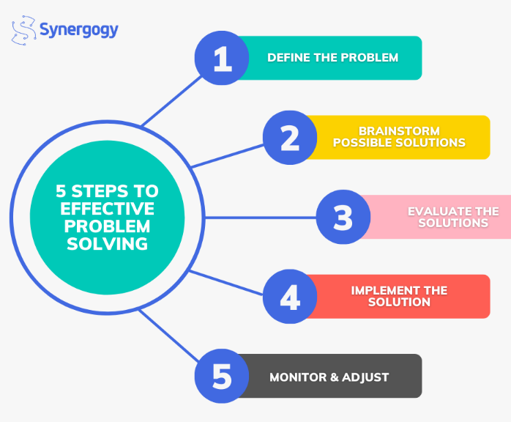
Problem Solving
You can:
Present real or simulated problems
Ask students to develop and test solutions
Encourage exploration of multiple approaches
Discuss reasoning behind different solutions
Guide students through complex tasks step by step
 Problem-solving experiences help students apply concepts in meaningful ways.
Problem Solving
Notes:
Problem solving helps students learn how to apply knowledge rather than simply recall information. When students encounter a challenge that requires them to think through possible solutions, they must draw on what they have learned and apply it in new ways.
You can encourage problem solving by presenting real or simulated problems related to course content. Asking students to propose solutions, explain their reasoning, and consider alternative approaches helps them develop stronger analytical and decision-making skills. These experiences prepare students to use what they learn in practical situations and help them build confidence in their ability to address complex challenges.

Slide 32
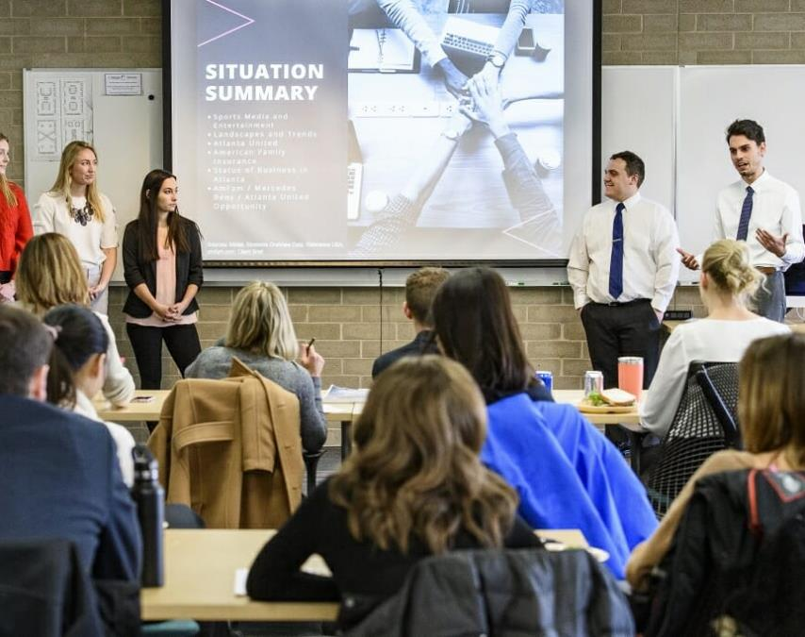
Communication
You can:
Include written assignments that explain ideas
Encourage class discussions and presentations
Ask students to explain concepts in their own words
Provide feedback on clarity and organization
Create opportunities for students to share their thinking
 Communication skills support success across academic and professional settings.
Notes:
Communication is an essential skill in nearly every field. Students benefit from opportunities to clearly express ideas, explain their reasoning, and present information in organized ways.
You can support communication development through writing assignments, discussions, presentations, and activities that require students to explain concepts in their own words. These opportunities allow students to practice organizing ideas and conveying them effectively.
Providing feedback on clarity, organization, and reasoning also helps students refine their communication skills. Over time, these experiences help students become more confident in expressing their ideas in both academic and professional contexts.

Slide 33

Collaboration
You can:
Use small-group discussions or activities
Assign collaborative projects
Encourage students to share ideas and perspectives
Ask groups to work together to solve problems
Reflect on how teamwork contributed to learning
 Collaborative learning helps students build communication and teamwork skills.
Notes:
Collaboration allows students to learn from one another while developing important teamwork skills. When students work together, they share ideas, compare perspectives, and build on one another’s thinking.
You can encourage collaboration through group discussions, problem-solving activities, or projects that require students to work together toward a common goal. These experiences help students practice listening, explaining ideas, and negotiating different viewpoints.
Working collaboratively also prepares students for professional environments where teamwork is essential. Through these experiences, students learn how to contribute effectively and benefit from the perspectives of others.

Slide 34
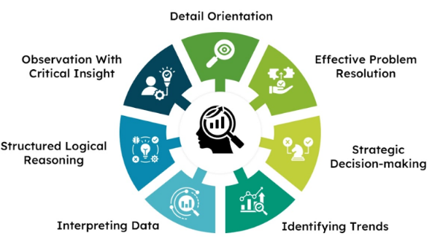
Analytical Reasoning
You can:
Ask students to interpret data or evidence
Use activities that require identifying patterns or relationships
Encourage evaluation of information sources
Ask students to explain how they reached a conclusion
Use assignments that require structured analysis
 Analytical reasoning strengthens students’ ability to evaluate complex information.
Notes:
Analytical reasoning involves examining information carefully, identifying patterns or relationships, and drawing logical conclusions based on evidence. This skill helps students move beyond surface-level understanding to deeper analysis.
You can support analytical reasoning by asking students to interpret data, evaluate sources, analyze case studies, or explain how they reached a particular conclusion. These activities encourage students to think systematically about information and evidence. As students develop analytical reasoning skills, they become better equipped to interpret complex information, evaluate arguments, and apply knowledge in thoughtful and informed ways.

Slide 35

Small Actions,
Lasting Impact
Notes:
Small actions in the classroom can have a lasting impact on students’ learning experiences. While large instructional changes can be valuable, many meaningful improvements come from simple practices that shape how students experience a course. This section highlights small actions you can take to strengthen engagement, build connections with students, and support learning. Simple practices—such as learning students’ names, asking thoughtful questions, and showing enthusiasm for the subject—can make a significant difference in how students experience the course and how deeply they engage with the material.

Slide 36

Learn Students’ Names
You can:
Use name tents or name cards early in the semester
Refer to students by name during discussions
Greet students as they enter the classroom
Encourage students to learn one another’s names
Use seating charts or photos if helpful
 Using students’ names helps build connection and encourages participation.
Notes:
Learning students’ names may seem like a small action, but it can significantly influence the classroom environment. When students hear their names used in class, they feel recognized as individuals rather than anonymous members of a group.
You can make this easier by using strategies such as name tents, seating charts, or brief introductions early in the semester. Referring to students by name during discussions also helps create a more welcoming and interactive classroom atmosphere.
When students feel recognized and acknowledged, they are often more comfortable participating and engaging with the learning process. This simple practice helps strengthen the sense of connection within the class.

Slide 37
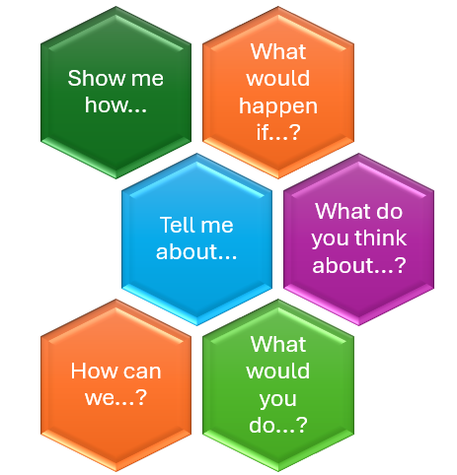
Ask Thoughtful Questions
You can:
Ask open-ended questions that require explanation
Encourage students to support their ideas with evidence
Invite multiple perspectives on a topic
Ask follow-up questions that deepen discussion
Give students time to think before responding
 Thoughtful questions help students explore ideas more deeply.
Notes:
Asking thoughtful questions can transform a class session from a one-way presentation into an engaging learning experience. Questions that require explanation, interpretation, or reasoning encourage students to think more carefully about the material.
Open-ended questions allow students to explore ideas rather than simply recall information. Follow-up questions can help deepen discussions by encouraging students to explain their reasoning or consider alternative viewpoints.
Allowing a moment of thinking time after asking a question can also improve participation. These small adjustments help create an environment where students actively engage with ideas and contribute to the learning process.

Slide 38

Show Enthusiasm for the Subject
You can:
Share why the subject matters to you
Highlight interesting ideas or discoveries
Connect topics to meaningful questions or issues
Use examples that show the value of the field
Express curiosity and excitement about the material
 Enthusiasm can inspire students to engage more deeply with the subject.
Notes:
Showing enthusiasm for the subject can strongly influence how students experience a course. When you demonstrate genuine interest in the material, students often become more curious and engaged as well.
You can express enthusiasm by sharing why certain ideas are interesting, highlighting meaningful questions in the field, or connecting concepts to real-world issues. Even small expressions of curiosity or excitement about a topic can make a difference.
Enthusiasm helps communicate that the subject is valuable and worth exploring. When students sense that the material matters, they are more likely to approach learning with interest and motivation.

Slide 39

Small Practices, Lasting Influence
You can create lasting learning experiences by:
Designing meaningful learning opportunities
Connecting ideas to real-world contexts
Encouraging participation and curiosity
Supporting students through challenges
Helping students develop lasting skills
 Small actions in the classroom can have a lasting impact on how students learn and how they see themselves as learners.
Notes:
In conclusion, teaching that students remember is rarely defined by a single lecture or activity. Instead, it is shaped by the overall learning experience you create throughout the course. When students are encouraged to think deeply, engage with ideas, and apply what they learn, the classroom becomes a place where meaningful learning takes place.
The strategies discussed in this resource highlight ways you can move beyond simply delivering content and create experiences that support engagement, discovery, and growth. By connecting ideas to real-world contexts, encouraging active participation, and helping students develop important skills, you help students see the value of what they are learning and how it applies beyond the classroom.
Even small actions can have a powerful impact. Learning students’ names, asking thoughtful questions, providing meaningful feedback, and showing enthusiasm for the subject all contribute to a classroom environment where students feel supported and motivated. When students feel encouraged and challenged, they are more likely to engage deeply with the material and carry what they have learned into future courses, careers, and experiences.

Slide 40

Agrawal, A. What Students Remember Most About Teachers.
Bain, K. (2004). What the Best College Teachers Do. Harvard University Press.
Chickering, A. W., & Gamson, Z. F. (1987).“Seven Principles for Good Practice in Undergraduate Education.” AAHE Bulletin.
Duckworth, A. What Your Students Will Remember About You. Education Week.
Felten, P., & Lambert, L. M. (2020). Relationship-Rich Education: How Human Connections Drive Success in College. Johns Hopkins University Press.
Fuentes Morgan, D. What a Humanities Professor Taught Me About Being Human; Or Why I Remember the Day Arthur Miller Died. Center for the Arts and Humanities. Santa Clara University.
Griffin, T. Learning That Lasts: Helping Students Remember and Use What You Teach. Higher Education Teaching and Learning. Faculty Focus. Magna.
Kuh, G. D. (2008). High-Impact Educational Practices. American Association of Colleges and Universities (AAC&U).
Lang, J. M. (2016). Small Teaching: Everyday Lessons from the Science of Learning. Jossey-Bass.
Shipp, J. 12 Thing Students Remember Most About Good Teachers. Open Colleges.
“Small Teaching” Tips – The Beginning, Middle, and End of Class. Center for Educational Innovation, Penn State University.
Widman, C. The Teacher Who is Remembered. The Modern Language Journal, Vol. 26, No. 8 (Dec.,1942), pp. 564-572 (9 pages).
References

