Slide 1

Building Student Rapport Practical Strategies for Creating a Supportive Classroom Climate
Faculty Focus: Innovative Teaching Techniques for College Success Series
Notes:
Think back to your most memorable teacher. Was it their deep knowledge that stuck with you—or how they made you feel seen, heard, and valued?
Research shows that students are more motivated, engaged, and resilient when they feel connected to their instructors. Rapport isn’t just a “nice-to-have”—it’s the foundation of a thriving classroom. In this session, we’ll explore how intentional, authentic relationship-building can transform your teaching and create an environment where every student feels they belong.

Slide 2

What Is Student Rapport?
Connection is key: Trust, respect, and understanding between instructors and students.
Foundation for learning: Supports persistence, participation, and engagement.
Beyond friendliness: Fosters a culture of care and academic risk-taking.
Active learning: Students become partners in their own education.
Faculty benefits: Creates communities of inquiry and professional satisfaction.
Notes:
Every effective classroom begins with connection. Before content mastery or assessment design, before lectures or learning management systems, the most essential ingredient in successful teaching is human rapport. Building student rapport—the mutual trust, respect, and understanding between instructors and students—is the foundation upon which all learning rests. In higher education, where students navigate demanding coursework alongside jobs, family obligations, and financial pressures, rapport can make the difference between persistence and withdrawal, between participation and silence.
Creating a supportive classroom climate is about more than friendliness or charisma; it is about fostering a culture of care that encourages students to take academic risks, ask questions, and engage with material at a deeper level. A climate grounded in rapport helps students see themselves as active participants in their own learning. It also enhances faculty satisfaction, turning classrooms into communities of inquiry rather than isolated spaces of instruction. The faculty-student relationship becomes a partnership, rooted in shared commitment to growth and discovery.

Slide 3

The Importance of Rapport
Connection is key: Trust, respect, and understanding between instructors and students.
Foundation for learning: Supports persistence, participation, and engagement.
Beyond friendliness: Fosters a culture of care and academic risk-taking.
Active learning: Students become partners in their own education.
Faculty benefits: Creates communities of inquiry and professional satisfaction.
Notes:
Rapport is not a peripheral component of teaching—it is central to student success. When rapport exists, students perceive the instructor as approachable, fair, and invested in their learning. This perception directly influences motivation, engagement, and overall academic performance. Research in higher education consistently finds that students who feel connected to at least one faculty member demonstrate higher retention rates, improved self-efficacy, and greater satisfaction with their educational experience.
In classrooms characterized by strong rapport, participation tends to be livelier, discussions richer, and feedback exchanges more meaningful. Students are more likely to attend class, contribute to discussions, and persist through challenges. They view mistakes not as failures but as opportunities for growth because the instructor has cultivated an atmosphere of psychological safety.
This emotional connection also supports cognitive development. When students feel comfortable with their instructors, they are more likely to engage in higher-order thinking, question assumptions, and collaborate with peers. In contrast, when rapport is weak, even the most carefully designed lessons may fall flat. Students may perceive the class as impersonal, leading to disengagement or passive learning.

Slide 4

Helps students feel seen, valued, and supported.
Small gestures—kind words, emails, genuine interest—make a big impact.
Fosters belonging, engagement, and academic success.
Supporting Diverse Students
Notes:
For first-generation, multilingual, or underrepresented students, building rapport can be particularly crucial as they navigate the complexities of higher education. These students often face unique challenges, including feelings of isolation, uncertainty, and pressure to succeed in an environment that may feel unfamiliar or unwelcoming. In such cases, rapport acts as an anchor, providing a sense of security and connection in an otherwise intimidating academic landscape. A kind word, a thoughtful email, or simply taking the time to show genuine interest in their experiences can help these students feel seen, heard, and valued.
Faculty who take the initiative to connect with students on a personal level communicate that they see them not just as learners who must perform academically, but as individuals with unique backgrounds, strengths, and perspectives. This kind of human connection not only nurtures a sense of belonging but also provides both academic and emotional support, which can be transformative for students struggling with the pressures of higher education. When students feel that their instructors truly care about their success and well-being, they are more likely to engage, persist, and achieve their academic goals.

Slide 5
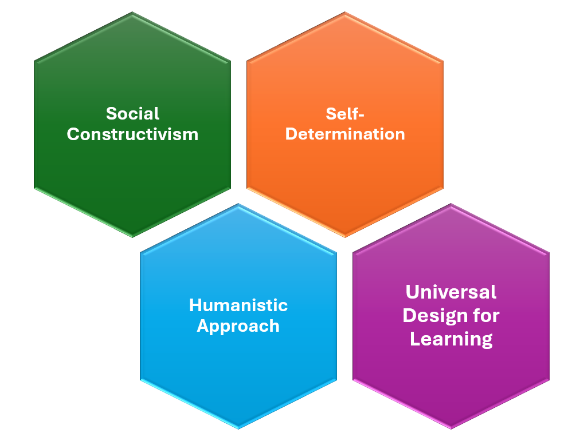
Theories Supporting Rapport
Notes:
While rapport is deeply relational, its importance is grounded in well-established educational and psychological theory. These frameworks provide a lens for understanding why rapport influences learning so profoundly and how instructors can cultivate it intentionally.

Slide 6
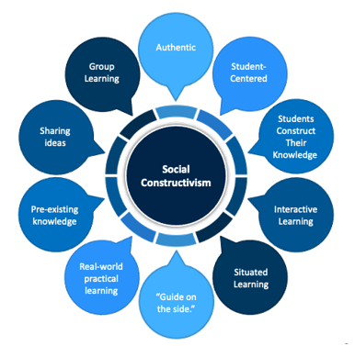
Social Constructivism
Learning is social (Vygotsky)
Knowledge is built through interaction
Rapport creates a safe, supportive environment
Students engage, share ideas, and take intellectual risks
Strong relationships → deeper understanding
Notes:
Social Constructivism, rooted in the work of Lev Vygotsky, emphasizes that learning is inherently social and context-dependent. Knowledge is not simply transmitted from instructor to student; rather, it is actively constructed through interaction—between learners, between instructors and learners, and with the broader learning environment. In this framework, rapport is more than just a positive relationship—it is the essential mechanism that enables meaningful, collaborative learning.
When students feel safe, respected, and valued, they are more likely to share ideas, ask questions, and challenge assumptions without fear of judgment. This openness allows them to test their thinking, receive feedback, and refine their understanding. For example, in a literature class, a student who feels connected to the instructor and peers may be more willing to propose an unconventional interpretation of a text, sparking rich discussion and prompting others to reconsider their own perspectives.
A supportive classroom climate—characterized by empathy, trust, and mutual respect—transforms learning from passive reception into active participation. Students are no longer simply memorizing information; they are engaging in a dynamic process of constructing knowledge together. Rapport facilitates this process by fostering psychological safety, encouraging collaboration, and promoting intellectual risk-taking. In essence, the stronger the relational foundation between instructor and students, the more robust the opportunities for deep, meaningful learning become.

Slide 7
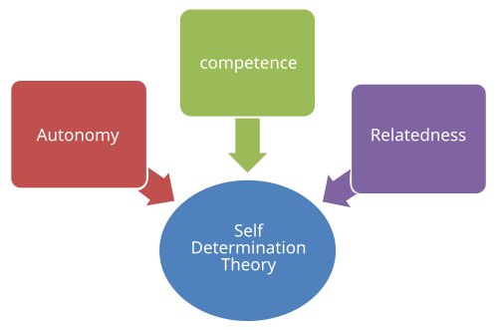
Self-Determination Theory (SDT)
Motivation thrives when three needs are met:
Autonomy – choice in learning
Competence – feeling capable
Relatedness – feeling connected
Rapport fulfills relatedness by:
Creating a supportive, inclusive classroom
Showing genuine interest in students’ experiences
Encouraging meaningful interactions
Strong rapport → intrinsic motivation, engagement, and persistence
Notes:
Self-Determination Theory (SDT), developed by Deci and Ryan, emphasizes that motivation is most effective when three fundamental psychological needs are met: autonomy (the ability to make choices in learning), competence (feeling capable and effective), and relatedness (feeling connected to others). Of these, relatedness is where rapport plays a central role.
When instructors intentionally build rapport with students—through personal recognition, empathetic communication, and genuine interest in their experiences—they directly address the need for relatedness. Students who feel connected to their instructors and peers perceive the classroom as a supportive community, which strengthens their intrinsic motivation. Rather than completing tasks simply to earn a grade, they engage in learning because they feel valued, understood, and supported in their growth.
For example, in a psychology seminar, an instructor who takes time to ask students about their perspectives on a topic, remembers their previous contributions, and encourages respectful dialogue helps students feel a sense of belonging. This connection increases participation, persistence, and enthusiasm for learning.
Rapport, therefore, is not just a social nicety—it is a motivational lever. By nurturing meaningful relationships, instructors create an environment where students are more likely to take initiative, embrace challenges, and invest in their learning with purpose.

Slide 8
Humanistic Approach
Listen Attentively
Communicate Sincerity
Express Sympathy
Inspired by Carl Rogers: emphasizes empathy, authenticity, and unconditional positive regard
Learning thrives when students feel accepted and valued
Rapport mirrors this approach by:
Listening attentively
Showing genuine empathy
Communicating sincerity
Creates a safe, supportive environment → students take risks, engage, and invest in learning
Notes:
Humanistic Education, inspired by Carl Rogers, provides a learner-centered approach that emphasizes the whole person—mind, emotions, and experiences. Rogers highlighted three essential elements in education: empathy, authenticity, and unconditional positive regard. He argued that meaningful learning occurs only in environments where students feel accepted, respected, and valued for who they are, rather than judged solely on performance or conformity.
Rapport in the classroom directly mirrors Rogers’ vision. When instructors actively listen, express genuine empathy, and communicate sincerity, they create a space where students feel safe to take intellectual risks, ask questions, and explore new ideas. For instance, an instructor who notices a student struggling with a concept might check in privately to offer support and guidance, acknowledging both the student’s effort and their challenges. This gesture signals that the instructor sees the student as a whole person, not just a grade.
Such relational practices foster trust, engagement, and motivation. Students are more likely to participate in discussions, share unique perspectives, and invest in their learning when they feel understood and accepted. By integrating empathy and authenticity into everyday teaching, instructors align with Rogers’ principles, creating a classroom culture that nurtures both academic growth and personal development.

Slide 9
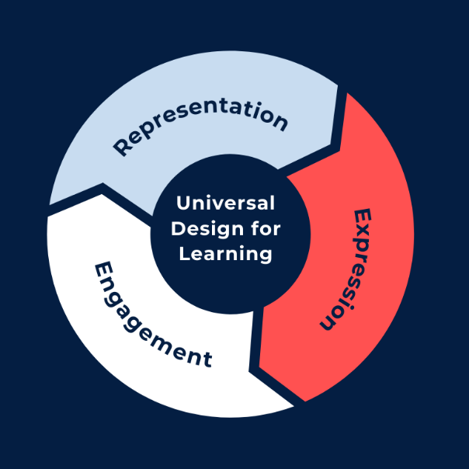
Universal Design for Learning (UDL)
UDL promotes flexible teaching to meet diverse learner needs
Rapport-rich classrooms provide emotional and motivational access
Students who feel connected are more likely to:
Ask questions and seek clarification
Persist through challenges
Engage fully in learning
Rapport + UDL = inclusive, supportive, and effective learning environments
Demonstrates that rapport is a deliberate pedagogical strategy, not just personality
Notes:
Finally, Universal Design for Learning (UDL) extends the concept of rapport to the realm of accessibility and inclusive pedagogy. UDL advocates for flexible teaching practices that accommodate the diverse needs, abilities, and backgrounds of all learners. This includes offering multiple ways to engage with content, express understanding, and participate in learning activities.
A rapport-rich classroom naturally aligns with this philosophy. When instructors build genuine connections with students, they provide more than just academic support—they create emotional and motivational access to learning. Students who feel seen, heard, and valued are more likely to ask questions, seek clarification, and persevere when faced with challenging material. For example, a student who struggles with course content may be more willing to request alternative resources or feedback if they trust that their instructor genuinely cares about their success.
Integrating UDL principles and rapport demonstrates that accessibility is not only about providing varied materials or assignments—it also includes creating an environment where students feel supported, understood, and encouraged. In this way, rapport functions as a bridge between instructional flexibility and student engagement, helping all learners reach their potential.
Together, the theories of Social Constructivism, Self-Determination, Humanistic Education, and UDL illustrate that rapport is far more than personality or charm. It is a deliberate pedagogical strategy, backed by decades of research, that forms the emotional architecture of an effective and inclusive learning environment.

Slide 10
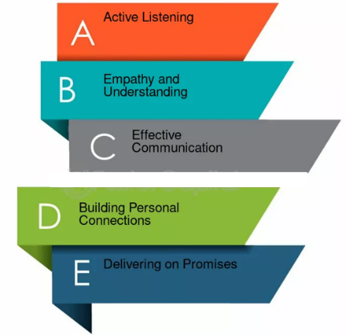
Strategies for Building Rapport
Notes:
Building rapport is both an art and a science, requiring intentional actions, consistent effort, and authentic communication. In this section, we’ll explore practical strategies that instructors can use to cultivate strong connections with their students. These strategies go beyond basic friendliness and are rooted in research-based practices that enhance trust, engagement, and a positive classroom climate. Let’s dive into effective, actionable approaches for building lasting rapport with your students.

Slide 11

First-day interactions set the tone for the semester
Greet students at the door and learn their names
Share enthusiasm for the subject to communicate warmth
Small gestures matter:
Arrive early to chat informally
Ask about students’ interests or experiences
Ongoing approachability:
Respond promptly to questions
Be available and patient during office hours
Signals care, builds trust, and fosters engagement
Approachability
Notes:
One of the most powerful strategies for fostering rapport begins with approachability. The first day of class is particularly critical, as it sets the tone for the semester and signals the kind of learning environment students can expect. Instructors who greet students at the door, learn their names quickly, and express genuine enthusiasm for the subject communicate warmth, accessibility, and investment in their students’ success.
Even small, seemingly simple gestures can have a meaningful impact. Arriving a few minutes early to chat with students informally, asking about their interests, or making light conversation about shared experiences can help break the initial ice and reduce anxiety. These moments demonstrate that the instructor is not only knowledgeable but also present and attentive to students as individuals, creating an atmosphere where learners feel comfortable asking questions and participating in discussions.
Beyond the first day, maintaining approachability is equally important. Responding to emails promptly, being available for office hours, and showing patience when students struggle all reinforce that the instructor is approachable and invested in their growth. By prioritizing approachability, you lay the foundation for trust, engagement, and a positive classroom culture, enabling students to feel safe, supported, and motivated throughout the semester.

Slide 12

Transparency
Clearly explain the purpose of assignments, assessments, and activities
Show how tasks connect to course objectives and real-world applications
Helps students see value in their work and understand expectations
Signals respect for students’ time, effort, and goals
Encourages motivation, engagement, and confidence
Fosters trust and a sense of partnership in the classroom
Notes:
Transparency is a highly effective strategy for building rapport because it fosters trust, respect, and a sense of partnership between instructors and students. When instructors clearly communicate the purpose behind assignments, assessments, and classroom activities, students no longer feel like passive recipients of directives—they understand the “why” behind the work.
For example, an instructor might explain that a group project is designed not just to assess knowledge, but also to develop skills in collaboration, critical thinking, and real-world problem solving.
Connecting assignments to course objectives and practical applications helps students see the relevance of their efforts and understand how the tasks contribute to both academic growth and future career readiness.
This level of openness signals that you value students’ time, effort, and aspirations, creating an environment of mutual respect. When students recognize that expectations are clear and purposeful, they are more likely to stay motivated, engage actively, and approach challenges with confidence. Transparency reduces frustration, encourages ownership of learning, and strengthens rapport by fostering a genuine sense of partnership in the classroom.

Slide 13
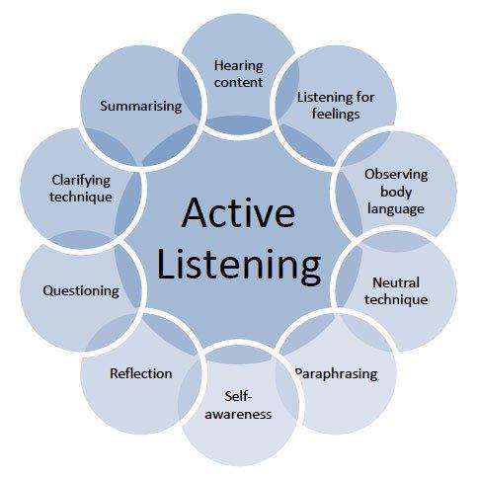
Active Listening
Demonstrates genuine care and attentiveness
Involves listening to words, tone, and body language
Communicates respect and empathy
Helps students feel heard and valued
Creates a safe space for questions and ideas
Strengthens trust and classroom communication
Allows instructors to adjust teaching based on feedback
Models respectful dialogue and collaboration
Notes:
Active listening is another essential component of building rapport with students, as it demonstrates genuine care and attentiveness. When instructors truly listen—not only to students’ words but also to their tone, body language, and unspoken concerns—they communicate respect and empathy. This mindful engagement helps students feel heard and valued as individuals rather than as passive participants in the classroom.
Active listening also builds trust, creating a safe environment where students are comfortable asking questions, sharing ideas, and expressing confusion without fear of judgment. Over time, this open exchange strengthens communication, deepens understanding, and enhances the overall learning experience. Moreover, active listening allows instructors to identify patterns in student feedback, adapt their teaching strategies, and address misunderstandings before they become barriers to learning. By modeling attentive, respectful communication, you also encourage students to practice these same skills with their peers—fostering a more collaborative and supportive classroom culture.

Slide 14
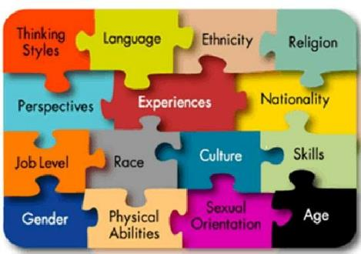
Inclusive Language
Shows students they are seen, valued, and respected
Reflects diverse cultural backgrounds, experiences, and identities
Strategies include:
Gender-neutral language
Examples from multiple perspectives
Acknowledging diverse viewpoints in discussions
Helps dismantle barriers and prevent exclusion
Cultivates belonging, trust, and engagement
Reinforces that every student’s voice matters
Notes:
Inclusive language is a critical strategy for fostering rapport because it communicates to students that they are seen, valued, and respected within the learning environment. When instructors intentionally choose words, examples, and references that reflect the diverse cultural backgrounds, experiences, and identities of their students, they create a classroom where all learners can see themselves represented. This goes beyond avoiding offensive language; it involves actively integrating varied perspectives into lessons, discussions, and materials.
Practical strategies include using gender-neutral language, incorporating examples from multiple cultural or social contexts, and explicitly acknowledging diverse viewpoints during class discussions. For instance, when discussing historical events, an instructor might highlight contributions from underrepresented groups alongside traditional narratives, signaling that multiple voices are valued. These deliberate choices help dismantle subtle barriers that can make students feel overlooked, excluded, or marginalized.
When students experience a classroom that reflects their identities and respects their perspectives, they are more likely to feel a sense of belonging and trust. Inclusive language not only supports emotional and social engagement but also strengthens the relational foundation between instructor and students. By prioritizing representation and respect in communication, you reinforce the message that every student’s voice and experience matters, fostering a supportive, collaborative, and connected learning community.

Slide 15
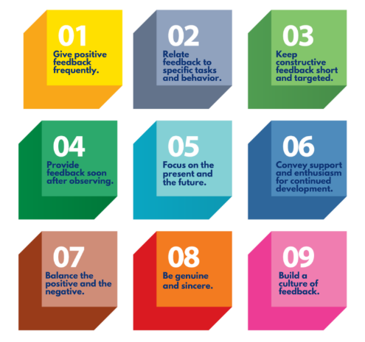
Feedback
Balance critique with encouragement
Highlight strengths before suggesting improvements
Use constructive, respectful language
Shows students you are invested in their growth
Builds trust, motivation, and engagement
Notes:
Feedback is one of the most powerful strategies for building rapport with students because it communicates that you are invested in their learning and growth, not just their grades. When instructors provide feedback that balances critique with encouragement, they demonstrate that they see students as capable individuals whose efforts and progress matter. Effective feedback goes beyond pointing out errors—it highlights what is working well while offering constructive, respectful guidance for improvement.
For example, an instructor might write, “You’ve made a strong argument here—consider expanding this point with additional evidence or examples.” This phrasing simultaneously recognizes the student’s achievement, reinforces confidence in their abilities, and provides a clear path for development. Such feedback signals that the instructor believes in the student’s potential and is committed to helping them succeed.
Over time, consistent, thoughtful feedback fosters trust and motivation. Students are more likely to engage actively with the material, seek clarification when needed, and embrace challenges without fear of judgment. By showing that you care about their growth, you create a classroom environment where students feel supported, respected, and empowered—strengthening both rapport and the overall learning experience.

Slide 16

Humor and Authenticity
Use appropriate humor to ease tension and connect
Share lighthearted personal stories to show you are approachable
Admit when you don’t know something—model curiosity and humility
Remind students learning is human, exploratory, and imperfect
Creates a safe, engaging environment → students participate more openly
Notes:
Humor and authenticity are powerful tools for creating a warm, human-centered classroom environment. When instructors incorporate appropriate humor or share lighthearted personal stories, they help students see the instructor as approachable and genuine, reducing anxiety and building trust. A well-timed joke, a funny anecdote about a classroom mishap, or a relatable story from one’s own experiences can break the ice, ease tension, and foster a sense of connection among students.
Sharing personal experiences, even small ones, reminds students that learning is a human endeavor, full of challenges, mistakes, and moments of discovery. Equally important is modeling authenticity in intellectual pursuits: admitting when you don’t know an answer, asking questions alongside students, or showing curiosity about a topic demonstrates intellectual humility and a commitment to lifelong learning. These behaviors communicate that the classroom is a safe space for exploration, experimentation, and growth, rather than a place where perfection is expected.
When humor and authenticity are consistently integrated into teaching, they strengthen rapport by creating a classroom culture where students feel comfortable taking risks, asking questions, and engaging deeply. By showing your human side, you encourage students to do the same, fostering connection, collaboration, and a more vibrant learning community.

Slide 17
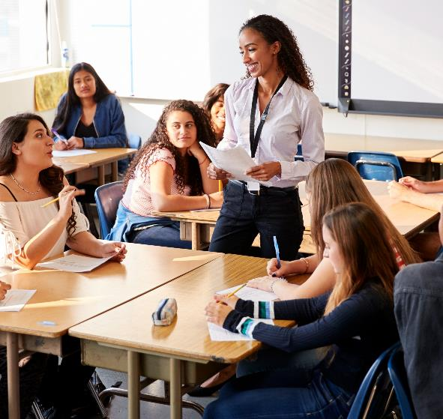
Student Voice
Ask for input on discussion topics, projects, and class norms.
Encourage student ownership and agency in learning.
Collect anonymous feedback to hear all perspectives.
Make small adjustments to show responsiveness and care.
Build a collaborative, inclusive classroom environment.
Notes:
Inviting student voice is a highly effective strategy for strengthening rapport and creating a more inclusive and engaging learning environment. When instructors ask for input on discussion topics, project formats, or even classroom norms, they empower students with a sense of ownership and agency over their learning. This approach communicates that students’ perspectives, preferences, and experiences are valued, fostering motivation and encouraging active participation.
Beyond structured choices, instructors can also solicit anonymous feedback mid-semester, giving students a safe space to express concerns, suggestions, or ideas they might be hesitant to share publicly. Responding thoughtfully to this input—whether by adjusting assignments, clarifying instructions, or modifying classroom practices—demonstrates flexibility, attentiveness, and genuine care. It reinforces the message that learning is not a one-way process but a collaborative effort in which every student has a meaningful role.
When students see that their voices shape the classroom experience, they are more likely to engage fully, take intellectual risks, and feel a deeper connection to both the instructor and their peers. Inviting student voice thus strengthens rapport while also promoting a culture of mutual respect, shared responsibility, and inclusive learning.

Slide 18

Send brief emails after challenging tests or assignments
Offer notes of encouragement for effort and progress
Connect students with campus resources (tutoring, counseling, career services) Shows students they are seen, supported, and valued
Small gestures leave lasting impressions
Strengthens trust, engagement, and persistence
Beyond the Classroom
Notes:
Rapport is not confined to interactions during class time; it extends into the broader context of students’ academic and personal experiences. Small, intentional gestures outside the classroom can have a profound impact on students’ sense of being seen, supported, and valued. For example, sending a brief email after a challenging test to acknowledge effort and offer encouragement shows students that their instructor notices their struggles and cares about their progress. Similarly, a handwritten note congratulating a student on improvement, or proactively connecting a student with a campus resource—such as tutoring, counseling, or career services—demonstrates attentiveness to their overall well-being.
These actions communicate that the instructor views students as whole individuals, not just as learners completing assignments or earning grades. Even brief interactions can leave lasting impressions, often remembered long after the course ends. By extending rapport beyond the classroom, you reinforce a sense of trust, support, and connection that strengthens engagement, fosters resilience, and encourages students to persist in their academic journey.

Slide 19
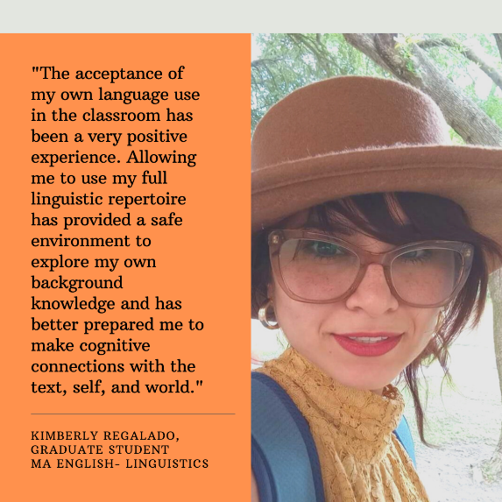
Student Testimonials
Show real-world impact of rapport-building on learning.
Highlight strategies that resonate with students.
Provide insight on how instructor efforts are perceived.
Examples:
Feeling comfortable participating after instructors learn and use names.
Reduced anxiety from engaging first-day icebreakers.
Notes:
One of the most effective ways to highlight the importance of building rapport in the classroom is through student testimonials. These personal accounts can provide valuable, real-world examples of how rapport-building practices contribute to a positive learning experience. Testimonials help demonstrate the tangible impact of connection and can offer insights into what strategies resonate most with students.
They can also give you a better understanding of how your efforts are perceived and how you can improve your approaches. For example, students might share how they felt more comfortable participating in class discussions after their instructor made a consistent effort to learn and use their names, or how feeling welcomed on the first day of class through an engaging icebreaker activity helped ease their anxiety.

Slide 20

Recognizing Success
Recognize improvement, participation, creativity, and effort
Use verbal praise, written comments, or class mentions
Boosts student confidence and motivation
Reinforces that effort and growth matter, not just grades
Demonstrates attentiveness and investment in students
Strengthens rapport and fosters a supportive classroom culture
Notes:
Finally, acknowledging student success is a powerful way to strengthen the bond between instructor and learner. Recognition of improvement, active participation, creativity, or persistence communicates that the instructor notices and values student effort, not just outcomes. Such acknowledgment can take many forms, from verbal praise during class discussions to written comments on assignments or even brief mentions in class highlighting noteworthy contributions.
This positive reinforcement serves multiple purposes. It boosts student confidence, encouraging learners to continue taking intellectual risks and engaging more deeply with the material. It also signals that effort and growth are as important as grades, fostering a classroom culture where students feel supported and motivated. By consistently recognizing achievement, you demonstrate attentiveness, respect, and investment in the students’ success, which in turn strengthens rapport and nurtures a collaborative, encouraging learning environment.

Slide 21
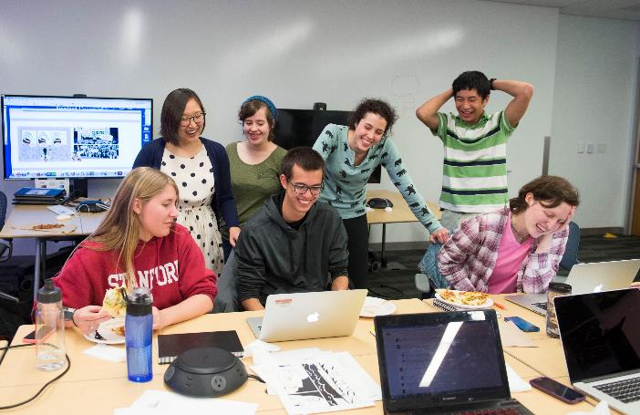
Benefits of a Supportive Classroom Climate
Notes:
A classroom environment grounded in strong rapport and mutual respect offers far-reaching benefits for both students and instructors. In this section, we will explore how creating a supportive climate not only enhances academic outcomes but also fosters emotional well-being. From increased student engagement to a stronger sense of belonging, a positive classroom climate can transform learning experiences, making the classroom a dynamic space for growth, collaboration, and deeper connections. Let’s delve into the key benefits of nurturing such an environment.

Slide 22

Builds a sense of safety, support, and value
Encourages active participation and curiosity
Transforms learning into a shared, dynamic process
Fosters respect, collaboration, and open dialogue
Inspires persistence and deeper investment in learning
Increased Engagement
Notes:
The most immediate and visible benefit of building rapport is increased student engagement. When students feel safe, supported, and valued, they are more willing to participate actively—sharing ideas, asking questions, and collaborating with classmates. Engagement shifts from being a mere requirement to a natural expression of curiosity and trust in the learning environment. In this context, the classroom evolves into a dynamic community where dialogue flows freely, diverse perspectives are welcomed, and learning becomes a shared, interactive process. This sense of connection not only enhances academic outcomes but also fosters a culture of mutual respect and enthusiasm for discovery. Moreover, engaged students are more likely to take intellectual risks, persist through challenges, and view learning as a rewarding, collaborative journey rather than a solitary task. As rapport deepens, participation becomes self-sustaining—students invest more in the class, and the instructor, in turn, gains richer insight into their needs, strengths, and motivations, further fueling a cycle of engagement and growth.

Slide 23

Academic Achievement
Builds students’ confidence and self-efficacy
Encourages persistence through challenges
Promotes help-seeking and active learning
Strengthens motivation and commitment
Leads to higher performance and long-term success
Notes:
Strong rapport not only enhances engagement but also directly supports academic achievement. When students perceive that you genuinely care about their learning and are invested in their success, they develop greater self-efficacy—the belief in their own ability to succeed. This confidence encourages them to take on challenging tasks, persevere through difficulties, and seek clarification when they encounter confusion, rather than withdrawing or giving up. As students consistently engage in these proactive learning behaviors, their skills, understanding, and performance improve. Over time, this supportive dynamic contributes to higher academic outcomes, greater persistence, and a more resilient approach to learning, creating a cycle where trust, effort, and achievement reinforce one another. Additionally, students who experience strong rapport with their instructors often report higher motivation and satisfaction, leading to improved attendance, participation, and overall commitment to the course. In essence, rapport lays the foundation for both emotional security and academic confidence—two powerful drivers of long-term student success.

Slide 24

Emotional Safety
Creates a supportive, judgment-free environment
Helps students manage stress and anxiety
Encourages openness, questions, and risk-taking
Builds trust through empathy and respect
Promotes well-being and deeper learning
Notes:
Rapport plays a crucial role in fostering emotional safety in the classroom. College students today navigate increasing stress, anxiety, and uncertainty, which can interfere with their ability to learn and thrive. By cultivating a supportive and respectful learning environment, you create a stable psychological space where students feel comfortable expressing concerns, asking questions, and even admitting mistakes without fear of judgment or embarrassment. When students trust that you will respond with empathy, understanding, and respect, they are more likely to seek help early, engage honestly with the material, and take intellectual risks.
This emotional security not only enhances well-being but also strengthens the overall learning experience, allowing students to focus on growth and exploration rather than managing fear or stress. In such an environment, students learn that vulnerability is part of the learning process and that mistakes are opportunities for development, not failure. Ultimately, rapport transforms the classroom into a community of trust—where emotional safety fuels confidence, curiosity, and authentic learning.

Slide 25

Benefits for Instructors
Makes teaching more satisfying and rewarding
Reduces behavioral and engagement challenges
Encourages positive, collaborative interactions
Strengthens professional purpose and connection
Lowers stress and fosters instructor well-being
Notes:
The benefits of building rapport extend beyond students to enrich your own experience as an instructor. When you cultivate meaningful connections, teaching often becomes more satisfying and rewarding. You may notice fewer behavioral issues, as students who feel respected and understood are more engaged, cooperative, and motivated to learn. Interactions become more positive and collaborative, transforming the classroom into a space of mutual trust and shared purpose. This sense of connection can also strengthen your professional identity and purpose, reminding you why you chose to teach and reaffirming the value of your work.
Moreover, rapport can reduce stress and burnout by creating a more supportive atmosphere where teaching feels less like managing and more like mentoring. Ultimately, rapport fosters a healthier, more harmonious classroom environment—enhancing both student success and instructor well-being, and making teaching a more meaningful and impactful experience.

Slide 26

Nurturing Belonging
Fosters a supportive, inclusive classroom climate
Helps students feel seen, valued, and empowered
Especially transformative for underrepresented or marginalized students
Encourages participation, collaboration, and confidence
Promotes social equity and a stronger learning community
Notes:
Perhaps most importantly, rapport nurtures a deep sense of belonging, which is essential for student success and well-being. In today’s higher education landscape, many students experience feelings of disconnection, invisibility, or marginalization, which can hinder both their academic performance and personal development. By fostering a supportive and inclusive classroom climate, you send a clear message that every student matters and that their voices and contributions are valued. This sense of belonging can be particularly transformative for students from underrepresented or historically marginalized groups, helping them feel recognized, respected, and empowered within the academic community. When you create learning spaces grounded in trust, respect, and openness, students are more likely to participate actively, collaborate with peers, and pursue challenges confidently. Beyond engagement, this inclusive rapport promotes social equity and strengthens the broader learning community, positioning you not only as an instructor but also as a catalyst for meaningful inclusion, opportunity, and lasting impact in higher education.

Slide 27

Building Support: Challenges and Solutions
Notes:
Creating meaningful connections with students is a cornerstone of effective teaching, but it is not without its obstacles. Instructors often face challenges such as large class sizes, diverse student backgrounds, varying levels of engagement, and the pressures of balancing course content with personal connection. Understanding these barriers is the first step toward overcoming them. This section explores common challenges educators encounter when building rapport and offers practical, research-informed strategies to foster trust, respect, and engagement in the classroom. By addressing both the hurdles and the solutions, faculty can cultivate a learning environment where students feel seen, supported, and motivated to succeed.

Slide 28
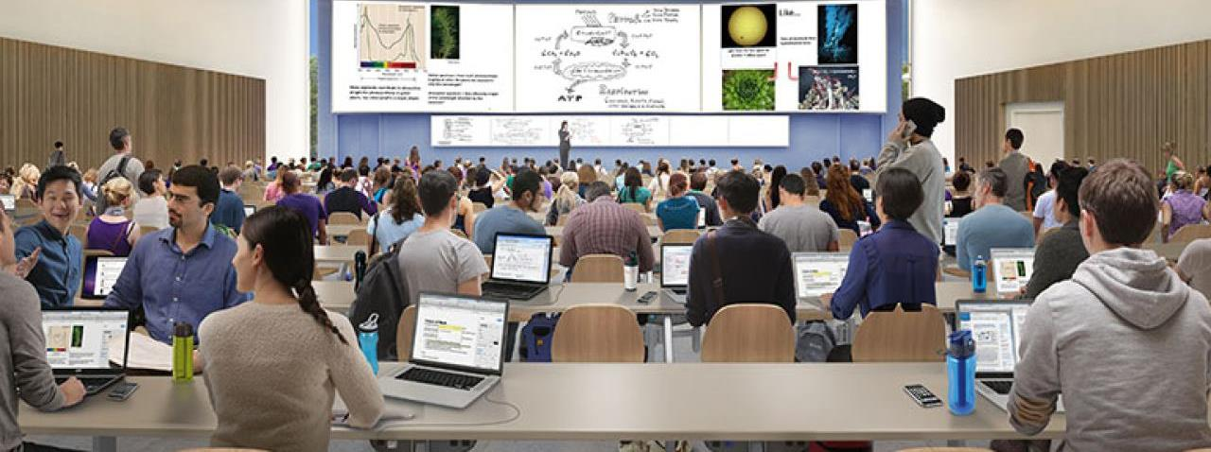
Large Class Sizes
Solutions
Use small-group activities, polls, and reflective assignments.
Collect “get-to-know-you” surveys early in the semester.
Tailor examples, discussions, and feedback to student interests.
Leverage digital tools for personalized messages and recognition.
Small gestures help students feel seen, valued, and engaged.
Strengthens belonging and participation in large lecture settings.
Challenge
Personal connections are harder in large lecture courses.
Notes:
In large lecture courses, connecting personally with every student can feel daunting, yet building micro-rapport is both feasible and highly impactful for student engagement and learning. Instructors can foster these connections through carefully designed strategies such as small-group activities, interactive polls, or brief reflective assignments, which encourage participation, dialogue, and peer-to-peer engagement even in crowded classrooms. These activities give students opportunities to share their perspectives, interact meaningfully with classmates, and feel that their contributions matter. Early in the semester, collecting short “get-to-know-you” surveys offers valuable insight into students’ backgrounds, interests, and learning preferences. This information allows instructors to tailor examples, discussions, and feedback in ways that resonate personally, making learning more relevant and accessible.
Additionally, understanding students’ individual contexts enables instructors to anticipate potential challenges, provide targeted support, and highlight connections between course material and students’ experiences or goals. By intentionally cultivating micro-rapport, instructors can transform large lecture environments from impersonal spaces into more connected, responsive, and inclusive classrooms, fostering engagement, trust, and a stronger sense of belonging among students.

Slide 29

Online and Hybrid Courses
Challenge
Building rapport without in-person interactions.
Solutions
Establish presence with video introductions sharing professional and personal interests.
Personalize discussion replies and provide timely feedback.
Send weekly announcements acknowledging student progress.
Recognize contributions in discussion boards and via targeted messages.
Small gestures—thoughtful responses, follow-ups—build trust and engagement.
Leverage digital tools to create a connected, supportive, and inclusive learning environment.
Notes:
Online and hybrid courses present unique challenges for rapport because students may never meet the instructor in person. In these environments, rapport must be built through intentional digital presence. Video introductions that share both professional background and personal interests help humanize the instructor. Personalized discussion replies, timely feedback, and weekly announcements that acknowledge student progress demonstrate care and attentiveness. Even small gestures—like a message saying, “I noticed many of you excelled in explaining X concept—great job!”—can build trust and reinforce engagement in virtual settings.
Digital tools, such as learning management systems, offer additional avenues for connection, including personalized announcements, recognition of contributions in discussion boards, and targeted messages to individuals or small groups. Even small gestures—like acknowledging a student’s comment in class, responding thoughtfully to questions, or following up on challenges they mention—can make a significant difference. These strategies help students feel seen, respected, and valued, reinforcing engagement, participation, and a sense of belonging even in the context of large, impersonal lecture settings. Over time, consistent micro-rapport can transform the learning environment, making it feel more connected, supportive, and responsive to individual needs.

Slide 30

Challenge
Balancing multiple responsibilities limits time for relationship-building.
Solutions
Build connections within existing teaching activities.
Express empathy in feedback and acknowledge effort.
Begin class with brief check-ins or reflective prompts.
Use office hours or quick one-on-one conversations strategically.
Small gestures (names, follow-ups) reinforce care and trust.
Enhance engagement and learning without adding workload.
Time
Constraints
Notes:
Many faculty balance teaching with research, service, advising, and administrative responsibilities, which can make finding time for relationship-building feel daunting. However, building rapport does not necessarily require additional hours; rather, it requires intentionality and mindfulness within existing routines. Simple, thoughtful actions—such as expressing empathy in feedback, acknowledging student effort during class, or beginning sessions with a brief check-in—can integrate rapport seamlessly into daily teaching practices.
Strategic use of office hours or brief one-on-one conversations after class provides opportunities to deepen connections without creating a significant extra workload. Even small gestures, like remembering a student’s name, noting their progress, or following up on a previous conversation, can convey genuine care and foster trust. By embedding these practices into regular interactions, you can cultivate meaningful relationships that enhance engagement, motivation, and learning outcomes, all while maintaining balance with their broader professional responsibilities.

Slide 31

Cultural and Generational Differences
Solutions
Recognize diverse expectations about authority and participation.
Consider cultural and generational communication preferences.
Approach differences with curiosity, not assumptions.
Ask students about learning styles and experiences.
Encourage sharing of perspectives to foster mutual respect.
Strengthen rapport and engagement through inclusive communication.
Challenge
Varying expectations on communication and participation styles across cultures and generations.
Notes:
Faculty and students may hold varying expectations about communication styles, authority, and participation, which can influence classroom dynamics and the development of rapport. For example, some students may come from cultural backgrounds where questioning an instructor is considered disrespectful, while others may anticipate open debate, dialogue, and collaborative discussion. Similarly, generational differences can affect communication preferences, with some students favoring email, others preferring text messages, or even video-based communication. Recognizing these differences is crucial, but assumptions can lead to misunderstandings or disengagement.
The key is approaching these differences with curiosity and openness rather than judgment. By asking students about their preferred learning styles, checking in regularly about their classroom experiences, and inviting them to share their perspectives, instructors can better align expectations and create a more inclusive environment. This intentional effort not only bridges cultural and generational gaps but also fosters a climate of mutual respect, understanding, and trust, ultimately strengthening rapport and supporting deeper engagement in learning.

Slide 32

Balancing Approachability and Authority
Challenge
Fear that approachability may undermine authority.
Solutions
Rapport and respect can coexist.
Combine warmth with consistency and fairness.
Set clear expectations and enforce policies equitably.
Communicate transparently to establish credibility.
Model professionalism while showing care.
Empathy supports guidance, not leniency.
Notes:
Some instructors worry that being approachable and friendly could undermine their authority or make it more difficult to manage the classroom. In reality, rapport and respect are not mutually exclusive—they can coexist and even reinforce one another. Students often respond positively to instructors who combine warmth with consistency, fairness, and clear expectations. By establishing guidelines from the first day of class, enforcing policies equitably, and communicating transparently, you create a framework of credibility and authority while remaining approachable.
Faculty can model professionalism while demonstrating genuine care, showing that empathy and support do not equate to leniency or lowered standards, but rather reflect thoughtful guidance and commitment to student success. In this way, you build trust, maintain classroom order, and foster an environment where students feel both supported and accountable, ultimately enhancing learning outcomes and engagement.

Slide 33

Navigating Sensitive Discussions
Challenge
Navigating discussions on identity, equity, and personal experiences can be difficult.
Solution
Enrich learning through identity, equity, and personal experience topics.
Handle conversations with sensitivity and care.
Establish ground rules for respectful dialogue.
Actively listen and validate student experiences.
Respond promptly and fairly to conflicts or challenges.
Maintain trust, safety, and a supportive classroom climate.
Notes:
Discussions about identity, equity, and personal experiences can greatly enrich learning by encouraging critical thinking, empathy, and a deeper understanding of diverse perspectives. However, these conversations can also challenge rapport if they are mishandled or if students feel dismissed, misunderstood, or unsafe. Faculty must navigate such topics with care and intentionality, fostering an environment where all voices are respected.
Establishing clear ground rules for respectful dialogue, actively listening to student contributions, and validating experiences—even when they differ from one’s own—helps maintain trust and encourages open, honest participation. When difficult situations arise, such as conflicts between students or moments of misunderstanding, prompt and fair responses are essential. Addressing concerns calmly, mediating respectfully, and reinforcing classroom norms demonstrate that the learning environment is safe, equitable, and supportive. By thoughtfully managing these discussions, you not only preserve rapport but also model the skills of empathy, critical reflection, and constructive dialogue, enriching the overall classroom experience for all students.

Slide 34

Practical Examples of Rapport in Action
Notes:
Building rapport is not just a theoretical concept—it’s something that can be actively practiced and integrated into your everyday teaching. In this section, we’ll explore real-world examples and strategies for fostering strong connections with students. These practical approaches highlight how rapport can be nurtured in various classroom settings, whether in person, online, or hybrid formats. By observing these examples in action, you'll see how small, intentional gestures can have a profound impact on student engagement, motivation, and academic success. Let’s take a closer look at how rapport can transform your classroom environment.

Slide 35

First-Day Connections
Start class with an icebreaker to encourage students to share something personal.
Foster community and belonging by making students feel seen and valued.
In subsequent weeks, reference students’ interests during examples or discussions to reinforce connection.
Show that you care about their contributions and build trust throughout the semester.
Notes:
On the first day of Professor Martinez’s history course, she wanted to establish a welcoming and inclusive classroom environment. Instead of diving straight into the syllabus, she began with a simple icebreaker: each student shared one personal interest, hobby, or meaningful aspect of their background. Some students mentioned family traditions, others shared favorite books or sports, and a few revealed unique cultural experiences.
This brief activity immediately helped students feel seen and valued. They began recognizing common interests among peers, which sparked informal conversations and set a positive tone for collaboration. Professor Martinez made notes of key details and intentionally referenced them throughout the semester—for example, tying a historical event to a student’s hobby or inviting a student to share a relevant perspective during discussions.
As the semester progressed, students reported feeling more connected to both the instructor and their peers. Those who were initially shy became more willing to contribute, and class discussions grew richer and more engaged. By actively integrating students’ interests into lessons and acknowledging their individual contributions, Professor Martinez demonstrated that she cared about them as people, not just learners.
This case illustrates how first-day connections, coupled with ongoing attention to students’ experiences, can foster trust, inclusion, and engagement—laying the foundation for a positive and collaborative classroom culture.

Slide 36
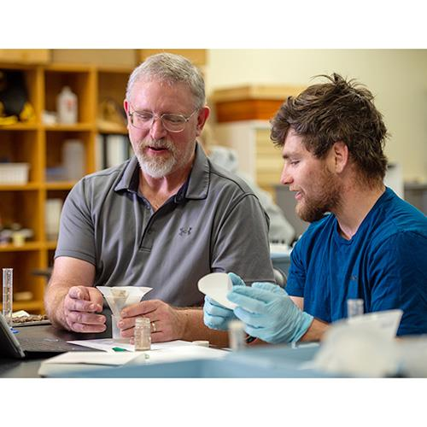
First-Generation College Student
Julio, first-generation biology student, hesitant to participate.
Instructor greets by name, checks in during group work, provides personalized feedback.
Result: Increased participation, office hour visits, and sense of support.
Notes:
Julio, a first-generation biology student, began the semester sitting quietly in the back of the classroom. Though attentive, he rarely participated in discussions and often hesitated to ask questions. Coming from a family without college experience, Julio worried that his comments might sound uninformed or that he might make mistakes in front of his peers.
Noticing his reluctance, Dr. Clarke made a conscious effort to connect. He greeted Julio by name at the start of class, stopped by his group during lab activities to check in, and provided personalized, encouraging feedback on his first exam. His comments highlighted both his analytical strengths and specific strategies for improvement, showing that he valued his effort and potential.
Gradually, Julio’s confidence grew. He began volunteering answers during class discussions, attending office hours to review material, and even mentoring a peer who was struggling with similar concepts. By semester’s end, Julio shared that he felt “seen and supported” for the first time in his college journey.
Dr. Clarke’s deliberate efforts—personal recognition, constructive feedback, and consistent encouragement—helped transform Julio’s experience. This case highlights how small, intentional gestures can make a profound difference for first-generation students, fostering belonging, confidence, and active participation in the learning process.

Slide 37

Humor and Personal Stories
Sharing personal anecdotes humanizes instruction.
Reduces anxiety and encourages questions.
Builds connection and approachability.
Notes:
In his college algebra class, Professor Li noticed that many students approached math with anxiety, often staying silent for fear of getting answers wrong. To make the subject feel more approachable, he began weaving humor and personal anecdotes into his lessons. One morning, after accidentally miswriting an equation on the board, he laughed and said, “See? Even math professors make arithmetic mistakes before coffee!” The class chuckled, and the moment instantly lightened the atmosphere.
From then on, Professor Li regularly shared short, relevant stories—like how he once spent an entire weekend solving a problem only to realize he had copied one number incorrectly. These small, self-deprecating moments helped students see that errors are part of the learning process, not something to be embarrassed about.
As the semester progressed, students became more willing to ask questions and admit when they didn’t understand something. The laughter and storytelling built a sense of community and normalized vulnerability in learning. By integrating humor and authentic personal stories, Professor Li created a classroom culture where students felt comfortable, supported, and engaged. His approach not only reduced anxiety but also modeled resilience and humility—reminding students that learning, like life, is both challenging and deeply human.

Slide 38

Online Course Connection
Instructor responds personally to forum posts.
Weekly video updates and optional Zoom check-ins.
Personalized attention increases engagement and participation.
Notes:
When teaching his fully online literature course, Professor James noticed that students often treated discussion forums as assignments to complete rather than opportunities to engage. The conversations felt transactional, and many students reported feeling isolated from their peers and instructor. Determined to create a more connected environment, Professor James focused on building a strong digital presence.
Each week, he posted short video updates where he summarized key themes, addressed common questions from the discussion boards, and shared a few words of encouragement. He also made a point to personally respond to several student posts each week, not just to grade them, but to engage with their ideas—often asking follow-up questions or drawing connections to broader course themes. In addition, he offered optional Zoom “coffee chats” where students could drop in to discuss assignments or simply talk about how the course was going.
Over time, participation increased dramatically. Students began replying to one another’s posts more thoughtfully, referencing points made in the video updates, and even forming informal study groups outside of class. Many shared that they felt “seen” and supported, even though the course was entirely online.
By maintaining a consistent and genuine online presence, Professor James demonstrated that rapport and community can flourish in virtual spaces. His intentional approach turned a potentially impersonal format into a welcoming, engaging environment where students felt connected, valued, and motivated to learn.

Slide 39
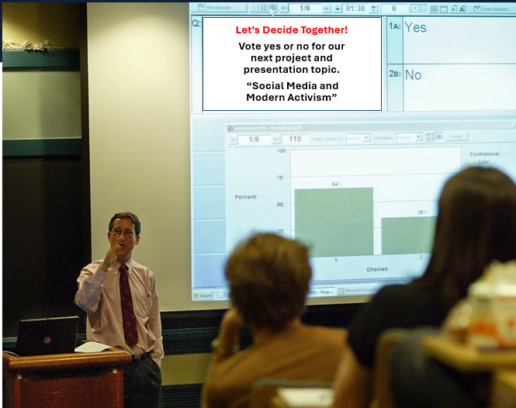
Encouraging Student Voice
Students vote on research topics.
Previously silent students share presentations.
Ownership and participation are increased.
Notes:
In Dr. Caruso’s sociology course, he wanted students to feel more invested in their learning. While his lectures were well-received, class discussions often felt one-sided, with only a handful of students regularly participating. To shift the dynamic, he decided to give students more ownership over the direction of the course.
At the start of the semester’s major research project, Dr. Caruso invited students to propose and vote on potential topics for their presentations. The list ranged from social media activism to urban inequality to gender representation in pop culture. Once the votes were tallied, students formed groups based on shared interests and began planning their projects.
The change was immediate. Students who had previously been quiet started speaking up—eager to share perspectives on topics they had personally chosen. Class discussions grew livelier and more collaborative, with students drawing connections between course theories and real-world examples.
By giving students a voice in shaping their learning, Dr. Caruso demonstrated respect for their agency and perspectives. The classroom became a more inclusive, participatory space where students felt heard, valued, and intellectually engaged. In turn, this approach deepened rapport between instructor and students, transforming the course into a shared learning experience rather than a one-way exchange of information.

Slide 40

Handling Mistakes
Chemistry lab spill used as a teaching moment.
Instructor responds calmly and guides clean-up.
Students became more confident asking questions and collaborating.
Empathy and composure build trust and a safe learning environment.
Notes:
During a first-year chemistry lab, one of Ms. Wright’s students accidentally spilled a solution while preparing an experiment. The student immediately looked embarrassed and apologized, expecting frustration or reprimand. Instead, Ms. Wright stayed calm, reassuring the student that mistakes are a normal part of scientific work. Together, they followed the cleanup procedure, reviewing each step to ensure safety and proper disposal.
Rather than treating the spill as a setback, Ms. Wright turned it into a teachable moment. She gathered the class and briefly discussed how such errors occur in real research settings and how scientists use them to refine procedures and improve accuracy. Her composed response modeled professionalism and curiosity, reinforcing that the lab was a space for learning—not fear of failure.
Afterward, students reported feeling more comfortable asking questions and admitting when they were unsure about a step in the experiment. Over time, this openness translated into more confident participation and stronger collaboration among lab partners.
By responding to mistakes with empathy and composure, Dr. Martinez created an atmosphere of psychological safety. Students learned that errors were not personal failures but valuable opportunities for growth—building both scientific competence and mutual trust within the classroom community.

Slide 41

Bridging Cultural Differences
Adjust group size, examples, participation methods
Inclusive strategies increase engagement
Promotes belonging and mutual respect
Notes:
When teaching an introductory business course, Professor Savage quickly recognized that her class represented a wide range of cultural and linguistic backgrounds. During early discussions, she noticed that some international students hesitated to participate, while others—accustomed to more direct communication styles—often dominated conversations. Rather than interpreting this as disengagement or overconfidence, she saw it as an opportunity to adapt her teaching to better support all voices.
To create a more inclusive environment, Professor Savage began adjusting group sizes to pair quieter students with supportive peers and rotated participation formats, such as written reflections, small-group discussions, and digital polls. She also made an effort to incorporate globally relevant examples—like marketing campaigns from different regions—and invited students to share insights from their own cultural perspectives.
These changes transformed classroom dynamics. Students who had once been hesitant began contributing more frequently, often drawing connections between their experiences and course concepts. Others developed greater cultural awareness and appreciation for different communication styles.
By intentionally bridging cultural differences, Professor Savage not only increased participation but also cultivated a classroom atmosphere rooted in respect, curiosity, and belonging. Her culturally responsive approach showed students that their identities and experiences were valued—strengthening rapport and enhancing the overall learning experience for everyone.

Slide 42
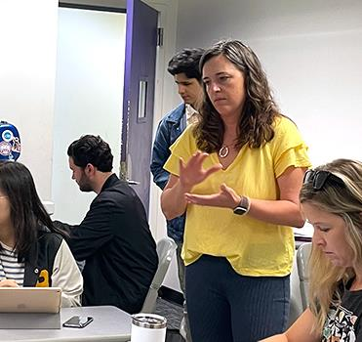
Feedback with Care
Start with strengths: Acknowledge what the student did well.
Be specific: Highlight particular achievements (e.g., “I appreciate how you incorporated multiple perspectives”).
Show investment: Personalize feedback to demonstrate care for the student’s growth.
Foster growth mindset: Encourage improvement and learning through constructive suggestions.
Notes:
In Professor Rivera’s introductory sociology class, providing feedback is more than just a grading task—it’s an opportunity to strengthen connections with students. After the first major essay, she noticed that many students had strong ideas but struggled to organize them clearly. When returning the graded papers, she began each set of comments by highlighting something positive about the student’s work. For example, she wrote, “I really appreciate how you incorporated multiple perspectives on social inequality—your analysis shows real curiosity and depth.”
Only after recognizing these strengths did she offer targeted suggestions for improvement, such as ways to structure arguments more effectively. This balance of encouragement and constructive feedback helped students see that she valued their effort and insight, not just their final product.
Over time, students began approaching Professor Rivera during office hours to discuss feedback and ask for strategies to strengthen their writing. Many shared that her detailed, thoughtful responses motivated them to revise with confidence. By personalizing her feedback, Professor Rivera fostered a classroom culture grounded in trust, growth, and mutual respect—transforming assessment into an act of rapport building.

Slide 43
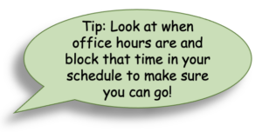
Frame office hours as an opportunity for both academic and personal support.
Use inviting messages like, “Stop by if you want to discuss ideas or get help with the assignment—I’d love to hear your thoughts.”
Reduce barriers to engagement and encourage students to attend.
Foster deeper connections and provide tailored support through one-on-one interactions.
Encouraging Office Hours
Notes:
In Dr. Chen’s psychology course, she noticed that few students attended her office hours, even though several struggled with key concepts early in the semester. When she asked why, many admitted they thought office hours were “only for students in trouble” or that they didn’t want to “bother the professor.” Recognizing this, Dr. Chen decided to reframe how she presented her office hours.
At the end of class, she began saying, “Come by if you’d like to talk through your research ideas or just chat about how class is going—I’d love to hear your thoughts.” She also included a similar message in her syllabus and course announcements, emphasizing that office hours were a time for connection and idea-sharing, not just academic troubleshooting.
Within a few weeks, attendance grew. Students stopped by to discuss upcoming assignments, share research interests, or simply check in about balancing coursework and life. These informal conversations helped Dr. Chen learn more about her students’ goals and challenges, allowing her to tailor examples and feedback in class to their interests.
By transforming office hours into a welcoming and supportive space, Dr. Chen built meaningful rapport with her students. They came to see her not just as an instructor but as a mentor genuinely invested in their success—creating a classroom culture of trust, openness, and mutual respect.

Slide 44

Peer Collaboration
Assign Rotating Roles Give each student different responsibilities (e.g., facilitator, note-taker, timekeeper) to promote collaboration and skill development.
Encourage Reflection Use group debriefs or individual reflections to strengthen trust and improve interpersonal skills.
Foster Positive Social Interaction Create an environment where students work together to build relationships and deepen their understanding.
Notes:
In Dr. Patel’s biology course, he noticed that group projects often resulted in uneven participation—some students dominated the discussion while others remained quiet. To promote more balanced engagement and strengthen class community, he redesigned his approach to group work by assigning rotating roles such as facilitator, note-taker, and timekeeper. Each week, students switched roles so that everyone could experience different responsibilities and develop new skills.
At the end of each lab activity, Dr. Patel guided students through a brief reflection, asking them to consider questions like, “What worked well in your group today?” and “How did your role help the team succeed?” These structured reflections encouraged students to think about their communication styles, teamwork strategies, and how they could improve future collaboration.
Over time, students began to appreciate the value of diverse perspectives and the importance of equitable participation. The rotating roles helped quieter students gain confidence, while stronger communicators learned to listen more effectively. As students became more comfortable working together, Dr. Patel noticed a marked improvement in both group performance and overall class cohesion.
By intentionally structuring peer collaboration and emphasizing reflection, Dr. Patel not only strengthened students’ interpersonal and problem-solving skills but also built trust and rapport within the classroom. The result was a more supportive, inclusive, and engaged learning environment where students felt accountable to one another and connected to their instructor’s commitment to their success.

Slide 45

Classroom Check-Ins
Start or end class with a quick check-in about students’ experiences or challenges.
Shows the instructor values both academic and emotional well-being.
Encourages openness and builds a supportive classroom environment.
Provides insight into student stress levels or areas needing support.
Notes:
In Professor Olson’s composition course, he began noticing that student participation dropped midway through the semester. Rather than assume disengagement, he decided to start each class with a brief “check-in.” Sometimes it was as simple as asking, “How’s everyone doing today?” or “What’s one word that describes how you’re feeling about this week’s essay draft?”
At first, students responded hesitantly, offering short answers like “tired” or “okay.” But as the routine continued, their responses grew more open. One student shared feeling overwhelmed by balancing classes and work, while another mentioned struggling with writer’s block. These moments helped Professor Olson better understand the factors affecting his students’ learning and adjust his instruction accordingly—building in extra time for brainstorming or peer review when needed.
Over time, the check-ins became a valued part of class. Students began initiating them, asking each other how things were going or celebrating small victories, such as completing a difficult draft. This simple, consistent practice helped transform the classroom into a community where students felt seen, supported, and comfortable sharing their experiences.
By taking just a few minutes for check-ins, Professor Olson showed that he cared not only about his students’ academic growth but also their well-being—fostering trust, empathy, and stronger engagement throughout the semester.

Slide 46
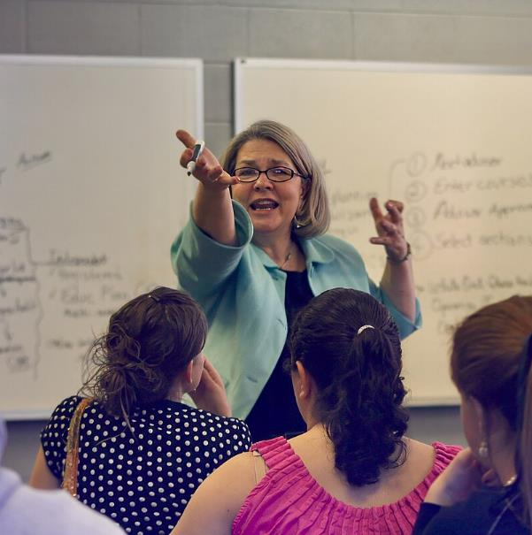
Conclusion
Building Rapport
Rapport forms the foundation of a supportive, engaging classroom. Small gestures—personalized feedback, active listening, brief check-ins—signal care and respect.
Challenges like large classes or diverse student needs can be managed with practical strategies: structured activities, collaborative learning, and intentional communication.
Intentional rapport-building enriches both student success and teaching experience, fostering trust, respect, and a culture of shared learning.
Notes:
In conclusion, building rapport is more than a teaching technique—it is the foundation of a supportive and engaging classroom climate. When instructors take the time to connect with students as individuals, they signal respect, care, and investment in each learner’s success. Even small gestures, like personalized feedback, active listening, or brief check-ins, can create meaningful connections that enhance motivation, participation, and overall learning outcomes.
While challenges such as large class sizes, diverse student needs, and time constraints can make rapport-building seem daunting, practical strategies can help overcome these barriers. Structured activities, collaborative learning opportunities, and intentional communication practices allow educators to create micro-rapport moments that resonate with students. By embedding these strategies into everyday teaching practices, faculty can foster an environment where students feel valued, understood, and empowered to engage fully with the learning process.
Ultimately, rapport is both an art and a science—it requires awareness, consistency, and adaptability. Faculty who intentionally cultivate these connections not only improve student success but also enrich their own teaching experience. By prioritizing relationships alongside academic rigor, educators lay the groundwork for a classroom culture marked by trust, respect, and a shared commitment to learning.

Slide 47

Brookfield, S. D. (2015). The skillful teacher: On technique, trust, and responsiveness in the classroom (3rd ed.). Jossey-Bass.
Building Rapport With Your Students. University Center for Teaching and Learning. University of Pittsburgh
Cavanagh, S. R. (2016). The spark of learning: Energizing the college classroom with the science of emotion. West Virginia University Press.
Cornelius-White, J. (2007). Learner-centered teacher-student relationships are effective: A meta-analysis. Review of Educational Research, 77(1), 113–143.
Frisby, B. N., & Martin, M. M. (2010). Instructor-student and student-student rapport in the classroom. Communication Education, 59(2), 146–164. Hooks, B. (1994). Teaching to transgress: Education as the practice of freedom. Routledge.
Lang, J. M. (2016). Small teaching: Everyday lessons from the science of learning. Jossey-Bass.
Myers, S. A. (2004). The relationship between perceived instructor credibility and college student in-class and out-of-class communication. Communication Reports, 17(2), 129–137.
Shaping a Positive Learning Environment. Teaching and Learning Resource Center, The Ohio State University.
Smith, A. Building and Maintaining Rapport in the Classroom. Texas Tech University.
Titsworth, S., McKenna, T. P., Mazer, J. P., & Quinlan, M. M. (2013). The bright side of emotion in the classroom: Do teachers’ behaviors predict students’ enjoyment, hope, and pride? Communication Education, 62(2), 191–209.
The Importance of Professor-Student Rapport. Center for Faculty Innovation. James Madison University.
Wilson, J. H., Ryan, R. G., & Pugh, J. L. (2010). Professor–student rapport and its effect on student attitudes and behaviors. Teaching of Psychology, 37(4), 246–251.
What is Rapport? Office of Teaching Effectiveness and Innovation. Clemson University.
References

