Slide 1
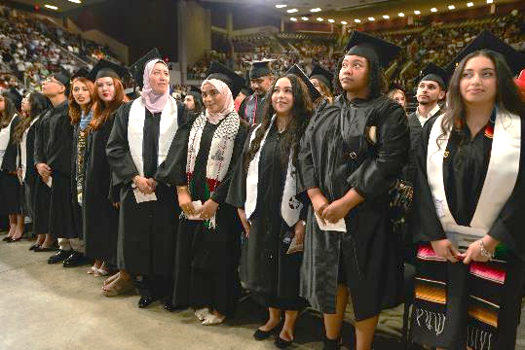
Doing the Thing: From Promise to Practice
Connecting Commitments, Goals, and KPIs to Student Success
Faculty Focus: Innovative Teaching Techniques for College Success Series
Notes:
We often think of strategy as something that lives in plans, dashboards, and reports. But strategy lives in classrooms, conversations, and daily decisions. The strategic goals are not separate from what we do—they reflect it. Every time you engage a student, design an assignment, or provide feedback, you are influencing retention, completion, and career outcomes. This presentation is about connecting those daily actions to the bigger picture—and showing how each of us plays a critical role in moving the institution forward.

Slide 2

Why
This Matters
Institutional goals become real through daily practice.
KPIs translate priorities into measurable outcomes.
Alignment Ensures:
Student success (retention, course success, completion)
Financial sustainability (fill rates, efficiency, stability)
Workforce impact (career readiness, transfer, credentials)
Bottom Line:
Your daily decisions directly influence institutional goals
Notes:
Institutional goals only have meaning when they are translated into daily practice. While strategic plans outline priorities at a high level, their success depends on what happens in classrooms, advising sessions, and student interactions every day. Each decision—how content is delivered, how feedback is provided, how students are supported—directly contributes to whether students persist, succeed, and complete their programs.
Key Performance Indicators (KPIs) serve as the bridge between strategy and action. They take broad institutional priorities—such as improving retention, increasing completion, and strengthening workforce outcomes—and convert them into measurable results. KPIs allow the institution to monitor progress, identify gaps, and make informed decisions, but more importantly, they highlight where everyday practices are making a difference.
Alignment is what ensures these efforts lead to meaningful outcomes. When teaching practices, support services, and institutional priorities are working in sync, the impact is amplified. This alignment drives student success by improving course outcomes and persistence, supports financial sustainability through stable enrollment and efficient course delivery, and strengthens workforce impact by preparing students with the skills and credentials needed for career advancement. Your role is central to this process—what you do in your course is not separate from institutional goals; it is how those goals are achieved.

Slide 3
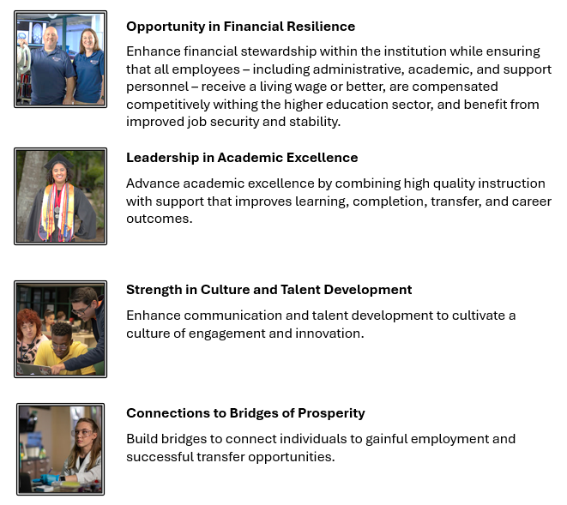
The Four Strategic Goals
Notes:
The four goals provide a clear, integrated framework for advancing the institution’s mission and ensuring long-term impact. Each goal represents a critical dimension of success, but they are not independent—they are deeply interconnected and mutually reinforcing.
Opportunity in Financial Resilience focuses on sustaining the institution through responsible stewardship, efficient operations, and a commitment to supporting employees with competitive compensation and stability. Leadership in Academic Excellence centers on delivering high-quality instruction and support systems that improve learning, completion, transfer, and career outcomes. Strength in Culture and Talent Development emphasizes the importance of communication, professional growth, and a collaborative environment that fosters innovation and engagement across the college. Finally, Connections to Bridges of Prosperity highlights the institution’s role in connecting students to meaningful careers and transfer opportunities that lead to long-term economic mobility.
Together, these goals form a comprehensive strategy that connects what happens in classrooms and departments to broader institutional and community impact. They ensure that financial sustainability, academic quality, employee engagement, and workforce alignment are all working in concert. Understanding these goals is the first step in aligning daily practices with institutional priorities and creating measurable, lasting outcomes for students and the communities the college serves.

Slide 4

Sustainable growth, efficiency, and employee support
Competitive compensation and job stability
Financial efficiency and revenue stability
Strategic use of courses, spaces, and resources
GOAL 1
Opportunity in Financial Resilience
Notes:
Opportunity in Financial Resilience is about creating a stable, sustainable foundation that allows the institution to serve students effectively while also supporting the people who make that work possible. Financial resilience is not limited to budgets and revenue—it reflects how well resources are aligned to priorities, how efficiently operations are managed, and how consistently the institution can invest in its mission over time.
A key component of this goal is ensuring that all employees—across academic, administrative, and support roles—are compensated fairly, receive a living wage or better, and experience a sense of stability and security in their work. When employees feel supported and valued, the institution is better positioned to retain talent, maintain continuity, and deliver high-quality services to students.
Equally important is the focus on financial stability and efficiency. This includes optimizing course offerings, improving fill rates, and making strategic use of physical and virtual spaces. Resource optimization ensures that every investment—whether in instruction, support services, or facilities—contributes directly to student success and institutional effectiveness. Ultimately, financial resilience enables the college to remain responsive, adaptable, and forward-looking while maintaining a strong commitment to both students and employees.

Slide 5
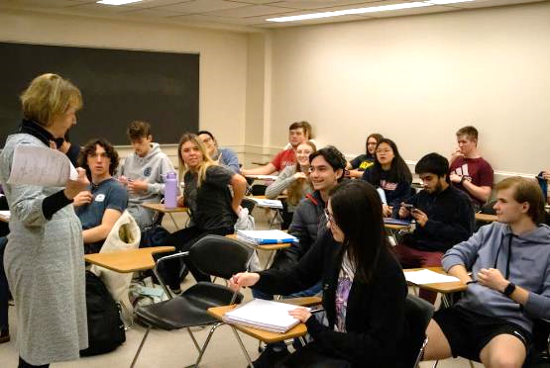
GOAL 1
Opportunity in Financial Resilience
What Matters Most for Faculty
Revenue Stability
Student retention and course success sustain enrollment.
Enrollment and Persistence Connection Students must be in the seats for teaching to happen—and what you do in the classroom influences whether they return next semester.
Employee Support
Competitive, stable environments strengthen teaching and learning.
Why It Matters: Student success → Enrollment stability → Financial sustainability
Bottom Line: What happens in your classroom directly supports institutional stability.
Notes:
Opportunity in Financial Resilience is not just about budgets—it is about creating the conditions that allow teaching and learning to thrive. While some financial metrics operate at the system level, several directly connect to the classroom experience and student success.
Two of the most relevant areas for faculty are revenue stability and the effective use of instructional space. Revenue in higher education is closely tied to enrollment, retention, and course completion. When students persist and succeed in courses, it strengthens enrollment stability, which in turn supports staffing, course offerings, and academic resources. In this way, what happens in the classroom directly contributes to the institution’s financial health.
In addition, enrollment and persistence are interconnected. Filling seats ensures efficient use of institutional resources while the quality of the learning experience influences whether students persist from term to term. Faculty are central to both outcomes.
Finally, the commitment to livable and competitive wages reinforces that financial resilience includes investing in people. When faculty and staff are supported, institutions are better able to retain talent, maintain program quality, and provide consistent learning experiences for students.
Ultimately, financial resilience is strengthened through student success. Retention, engagement, and course completion are not just academic outcomes; they are also key drivers of institutional sustainability.

Slide 6
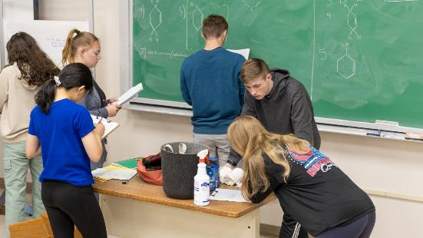
Teaching and Enrollment The Foundation of Financial Sustainability
Focus
Retention – Build connection and clarity
Course Success – Reduce D/F/W rates
Engagement – Use active learning
Persistence – Connect students to support
Impact: Student Success → Enrollment Stability → Financial Sustainability
Bottom Line: Your teaching drives the outcomes that sustain the institution.
Notes:
Faculty influence financial resilience every day—often without thinking about it in financial terms. The strongest drivers of institutional stability are not budget decisions, but student behaviors: enrolling, staying enrolled, and successfully completing courses. These behaviors are directly shaped by the learning environment faculty create.
Retention begins with connection. When students feel supported, experience clear course structure, and receive timely feedback, they are more likely to persist. Reducing D/F/W rates has a direct impact on both student momentum and enrollment stability, as students who succeed are far more likely to continue into the next term. Small instructional choices—such as early low-stakes assessments, clear expectations, and regular communication—can significantly influence these outcomes.
Engagement is another critical factor. Active learning, relevant content, and opportunities for participation increase both attendance and persistence. When students see value in the course and feel capable of succeeding, they are more likely to remain enrolled and complete successfully. Referring students to academic support services, such as tutoring or learning centers, further strengthens this effect by providing additional layers of support.
Ultimately, financial resilience is built through student success. Every time a student stays, succeeds, and continues, it contributes to enrollment stability and institutional sustainability. Faculty are at the center of this process—your daily decisions shape not only learning outcomes, but also the long-term strength of the institution.

Slide 7
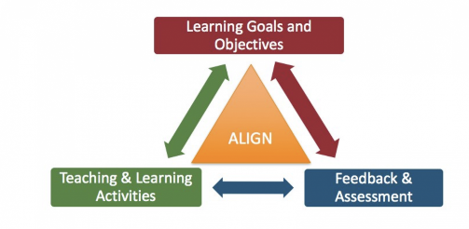
GOAL 2
Leadership in Academic Excellence
Focus
High-quality instruction and improved student outcomes
Strong course alignment (outcomes, activities, assessments)
Effective teaching strategies
Integrated academic support
Clear pathways to completion and transfer
Bottom Line: Clear, aligned teaching drives student success.
Notes:
Leadership in Academic Excellence centers on delivering high-quality instruction supported by systems that improve learning, persistence, completion, and transfer outcomes. At its core, this goal is about ensuring that every student has access to meaningful, well-designed learning experiences that prepare them for the next step—whether that is continued education or entry into the workforce.
Academic excellence is achieved through alignment. When learning outcomes, instructional activities, and assessments are clearly connected, students are better able to understand expectations and demonstrate their learning. This clarity reduces confusion, increases engagement, and improves overall course success. Equally important is the integration of academic support services, which provide students with the additional structure and assistance needed to succeed in challenging courses.
For faculty, this goal is directly tied to daily practice. Teaching strategies, course design, feedback, and student interaction all play a critical role in shaping outcomes. Academic excellence is not a separate initiative—it is the result of intentional, consistent instructional decisions that promote deeper learning and sustained student progress.

Slide 8

G2-KPI1,G2-KPI2: Retention – Students return next term
G2-KPI3: Gateway Course Success – Students pass critical entry courses
G2-KPI5: Wraparound Services- Students earn A/B/C and build momentum through Wraparound Services
What They Measure: Student learning, progression, and success
Bottom Line: Student success in your course drives long-term outcomes.
Improving Learning, Completion, Transfer, and Career Outcomes
Notes:
Academic excellence is measured through key indicators that reflect how well students are learning, progressing, and completing their academic goals. While multiple metrics exist, the most relevant for faculty are those tied directly to classroom experience: retention, course success, and progression through gateway courses.
Retention (G2-KPI1, G2-KPI2) reflect whether students continue from one term to the next and is often influenced by their early experiences in the classroom. Gateway course success (G2-KPI3) measures performance in critical entry-level courses that serve as milestones for academic progression. Success in these courses is essential, as they often determine whether students can move forward in their programs. In addition, Wraparound Services (G2-KPI5) play a direct, operational role in normalizing, integrating, and reinforcing student use of support services (tutoring, advising, library, career, etc.). Wraparound services are most effective when they are part of the course design. When you intentionally connect students to support—and show them how to use it—you increase the likelihood that they persist, succeed, and continue to the next semester.
These KPIs highlight that academic excellence is not measured solely by what is taught, but by how well students are able to learn, apply, and progress. Faculty play a central role in shaping these outcomes through course design, engagement strategies, and support for student learning.

Slide 9

Instruction as the Driver of Student Success and Progression
Focus
Alignment – Connect outcomes, activities, assessments
Clarity – Set clear expectations
Feedback – Provide timely, meaningful input
Engagement – Use active, relevant learning
Impact: Learning → Course Success → Completion → Transfer/Career
Bottom Line: Your teaching directly shapes student success.
Notes:
Faculty influence academic excellence through the design and delivery of learning experiences that support student understanding and success. Small, intentional choices—such as clearly aligning assignments to outcomes, providing timely and meaningful feedback, and incorporating active learning—can significantly improve how students engage with and master course content.
One of the most powerful ways to support academic excellence is by creating clarity. When students understand what they are expected to learn and how they will be assessed, they are more likely to succeed. Frequent, low-stakes opportunities to practice and receive feedback help students build confidence and correct misunderstandings before they impact performance.
Engagement also plays a critical role. When instruction is interactive, relevant, and connected to real-world applications, students are more likely to persist and perform well. In addition, connecting students to academic support services strengthens their ability to succeed in challenging courses. Together, these practices create a learning environment where students can thrive, progress, and achieve their academic goals.

Slide 10
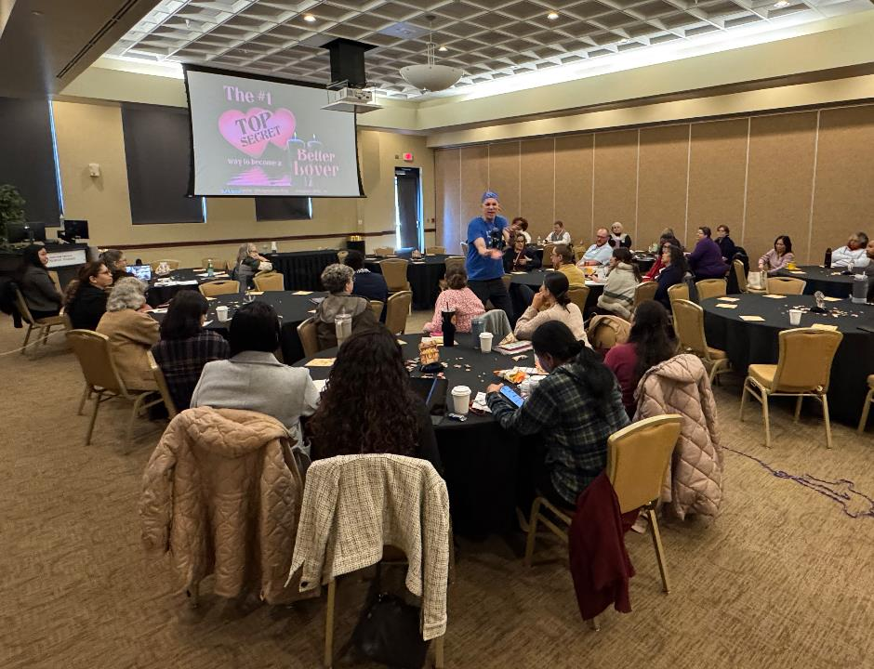
Goal 3
Strength in Culture and Talent Development
Focus:
Engagement, communication, and professional growth
Ongoing professional development
Faculty collaboration and mentoring
Clear communication and shared purpose
Culture of innovation and support
Bottom Line: A strong culture supports strong teaching and learning.
Notes:
Strength in Culture and Talent Development focuses on creating an environment where faculty and staff feel supported, connected, and empowered to grow. A strong institutional culture is built through clear communication, shared purpose, and opportunities for continuous professional development. When employees are engaged and supported, they are better equipped to contribute to student success and institutional effectiveness.
This goal emphasizes collaboration and innovation. Faculty do not work in isolation—teaching improves when ideas, strategies, and experiences are shared across departments and disciplines. Professional development, mentoring, and cross-campus engagement create opportunities for faculty to refine their practice and stay current in both pedagogy and content.
For faculty, culture directly impacts the teaching experience. A positive, supportive environment fosters creativity, reduces burnout, and encourages continuous improvement. When faculty feel connected to the institution and to one another, it strengthens both teaching quality and the overall student experience.

Slide 11
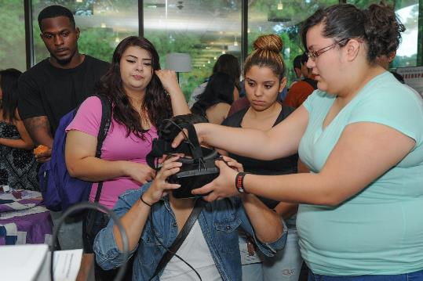
Cultivating a Culture of Engagement and Innovation
G3-KPI1: Employee Engagement
G3-KPI2: Professional Development Participation
What They Measure: Engagement, growth, and institutional culture
Bottom Line: Faculty participation and collaboration strengthen teaching, retention, and institutional effectiveness.
Notes:
Culture and talent development are reflected in indicators that measure engagement, growth, and participation across the institution. While some metrics are broad, the most meaningful for faculty are those connected to professional development, collaboration, and retention.
Participation in professional development (G3-KPI2) and mentoring initiatives reflects a commitment to continuous improvement. Faculty who engage in these opportunities are more likely to adopt effective teaching strategies, stay current in their disciplines, and contribute to institutional initiatives. Retention of faculty and staff is also a key indicator, as stable, experienced teams contribute to consistency and quality in the student experience.

Slide 12
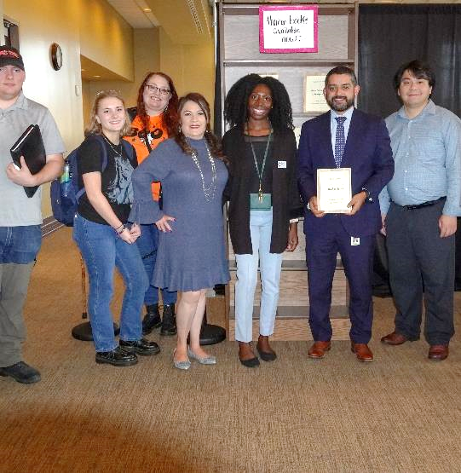
Faculty Engagement as the Core of Institutional Culture
Focus:
Engage – Participate in professional development
Collaborate – Share strategies and ideas
Mentor – Learn from and support peers
Contribute – Engage in institutional initiatives
Impact: Faculty Growth → Stronger Teaching → Better Student Experience
Bottom Line: Your engagement shapes the culture of the institution.
Notes:
Faculty shape institutional culture through everyday interactions, collaboration, and engagement in professional learning. Participating in mentoring—whether as a mentor or mentee—creates opportunities to share knowledge, reflect on teaching practices, and build stronger connections across the institution.
Engagement in professional development allows faculty to refine their instructional strategies and bring new ideas into the classroom. Even small changes, informed by shared practices or new learning, can have a meaningful impact on student outcomes. Collaboration with colleagues—through conversations, shared resources, or joint initiatives—further strengthens teaching and promotes consistency across courses and programs.
Ultimately, culture is built through participation. When faculty actively engage with one another and with the institution, it creates a supportive environment that benefits both instructors and students.

Slide 13

Goal 4
Connections to Bridges of Prosperity
Focus:
Career readiness, transfer, and economic mobility
Workforce-aligned curriculum
Clear transfer pathways
Career-connected learning
Real-world application of content
Bottom Line: Learning is strongest when connected to students’ futures.
Notes:
Connections to Bridges of Prosperity focuses on ensuring that students leave the institution prepared for meaningful careers or successful transfer. This goal emphasizes the importance of aligning academic programs with workforce needs and creating clear, structured pathways that guide students toward their goals.
Education is most impactful when students can see its relevance. When courses connect to real-world applications, career pathways, and transfer opportunities, students are more engaged and motivated to persist. This alignment helps students understand not only what they are learning, but why it matters.
For faculty, this goal highlights the importance of integrating career and transfer connections into the classroom. Whether through examples, assignments, or discussions, faculty play a key role in helping students see the connection between their coursework and their future.

Slide 14
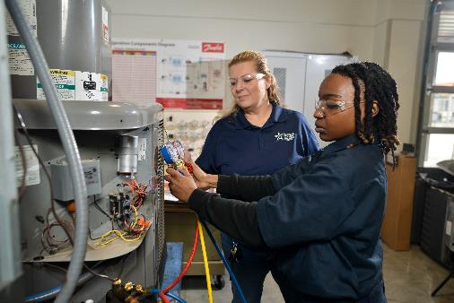
Connecting to Gainful Employment/ Successful Transfer Opportunities
G4-KPI1: Graduation Rates
G4-KPI5: Transfer Rates
G4-KPI2: Job Placement Outcomes
G4-KPI4: Internships and Apprenticeships
What They Measure: Student readiness for careers and transfer
Bottom Line: Course success leads to career and transfer success.
Notes:
This goal is measured through indicators that reflect how effectively students transition from education to careers or further academic study. The most relevant for faculty include graduation, transfer, job placement outcomes., and job placement.
Graduation rates indicate whether students are successfully progressing through and finishing their programs. Transfer rates reflect how well students are prepared to continue their education at four-year institutions. Job placement and internships and apprenticeships measure how effectively programs prepare students with the skills needed for employment.
These indicators demonstrate that success is not only about course completion, but about long-term outcomes. Faculty contribute to these metrics by ensuring that learning is rigorous, relevant, and aligned to real-world expectations.

Slide 15

Faculty Expanding Pathways and Strengthening Community Impact
Focus:
Connect – Link content to careers and transfer
Apply – Use real-world examples and tasks
Guide – Highlight pathways and next steps
Prepare – Build skills for work and further study
Impact: Learning → Skills → Completion → Career/Transfer Success
Bottom Line: You help students see where learning leads.
Notes:
Faculty play a critical role in helping students connect their learning to future goals. One of the most effective strategies is embedding real-world applications into instruction. When students see how concepts apply to careers or further study, they are more engaged and better prepared to use their knowledge beyond the classroom.
Assignments that mirror real-world tasks—such as case studies, projects, or problem-based learning—help students develop practical skills alongside content knowledge. Highlighting transfer pathways and discussing how courses fit into broader academic, or career plans also supports student decision-making and motivation.
Even small adjustments such as connecting a lesson to a career example, discussing industry expectations, or recommending a student to an internship or apprenticeship can help students see the value of their learning. These connections build confidence, clarify purpose, and support long-term success.

Slide 16
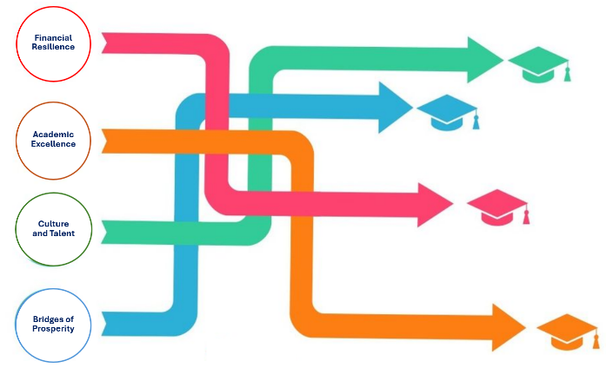
How the Goals Work Together
Retention → Financial Stability
Academic Success → Completion and Workforce Readiness
Culture → Faculty Effectiveness
Workforce Alignment → Community Impact
Big Picture: Each goal strengthens the others—they work as a system
Impact Cycle: Teaching → Student Success → Completion → Career → Institutional & Community Strength
Bottom Line: When these align, student success and institutional impact increase together.
Notes:
While each of the strategic goals focuses on a specific area, their true impact comes from how they work together as an integrated system. None of these goals operate in isolation—progress in one area strengthens outcomes in the others.
Retention is a key driver of financial stability. When students persist from term to term, enrollment becomes more predictable, course offerings are more sustainable, and resources can be allocated more effectively. In this way, student success directly supports institutional resilience.
Academic success extends beyond individual courses. When students succeed in gateway and program courses, they build momentum toward graduation and are better prepared for transfer or entry into the workforce. This progression is essential for both individual student outcomes and broader institutional goals.
Culture plays a critical role in sustaining these efforts. A strong, supportive environment—where faculty are engaged, collaborate, and continue to grow professionally—enhances teaching effectiveness and consistency across courses. This, in turn, improves student learning and success.
Finally, workforce alignment ensures that learning leads to meaningful outcomes beyond the institution. When programs and courses are connected to real-world applications, students are better prepared to contribute to their communities and achieve economic mobility.
Together, these elements form a continuous cycle: effective teaching supports student success, student success strengthens institutional stability, and strong alignment ensures lasting impact for both students and the community.

Slide 17
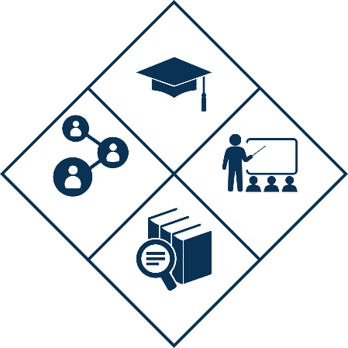
Faculty Qualities of Excellence (FQEs)
What They Do: Translate the Institutional goals into daily teaching practice
Connection to Outcomes:
Student-Invested → Retention
Content Expert → Workforce readiness
Pedagogically Excellent → Course success
Institutionally Dedicated → Persistence and completion
Bottom Line: FQEs are how strategy becomes action in the classroom.
Notes:
The Faculty Qualities of Excellence (FQEs) provide a practical framework for translating the strategic goals into daily teaching and institutional practice. While the goals define what the institution aims to achieve, the FQEs define how those outcomes are realized through faculty work.
Each quality represents a critical dimension of effective teaching. Student-Invested faculty create inclusive, supportive environments that foster belonging and persistence, directly influencing retention. Content Expert faculty bring depth of knowledge and real-world relevance to their discipline, strengthening workforce readiness and transfer preparation. Pedagogically Excellent faculty design aligned, engaging learning experiences that improve course success and completion. Institutionally Dedicated faculty connect students to resources, contribute to institutional initiatives, and support pathways that enhance persistence and long-term success.
Together, these qualities operationalize the Chancellor’s goals by connecting high-level strategy to classroom-level action. They ensure that institutional priorities—such as student success, financial sustainability, and workforce alignment—are embedded in everyday teaching practices. In this way, the FQEs serve as the mechanism through which faculty impact not only student learning, but also broader institutional and community outcomes.

Slide 18
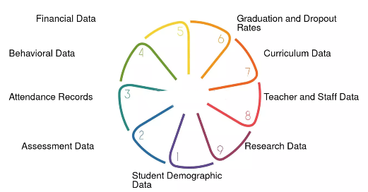
Start Small – Focus on one high-impact change
Use Data – Let outcomes guide decisions
Align Teaching – Connect outcomes, activities, assessments
Collaborate – Work with colleagues and support services
Impact: Small changes → Better learning → Stronger outcomes
Bottom Line: Strategy becomes real through what you do every day.
Turning Strategy into Practice
Notes:
Turning strategy into practice begins with recognizing that meaningful change does not require large-scale redesign—it starts with small, intentional decisions that have a clear impact on student learning. Faculty do not need to overhaul entire courses to align with institutional goals; instead, focusing on one or two targeted adjustments can significantly improve student outcomes.
Using data is a critical part of this process. Course-level insights—such as patterns in student performance, common areas of difficulty, or D/F/W rates—help identify where changes will have the greatest effect. When instructional decisions are guided by evidence, efforts become more focused, efficient, and impactful.
Alignment is equally important. Ensuring that learning outcomes, instructional activities, and assessments are clearly connected creates a more transparent and supportive learning environment for students. This clarity reduces confusion, improves engagement, and increases the likelihood of success.
Finally, collaboration strengthens these efforts. Working across units—whether through faculty peer mentoring, partnerships with tutoring centers, or coordination with advising—creates a more cohesive student experience. When instruction and support systems are aligned, students receive consistent guidance, which reinforces learning and persistence. Together, these practices turn high-level strategy into daily actions that drive measurable results.

Slide 19
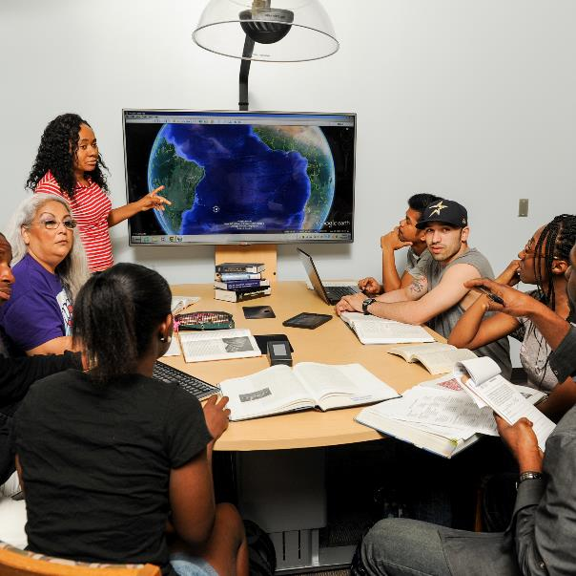
High-Impact Strategies
Active Learning
Clear Course Structure
Frequent Feedback
Early Intervention
Academic Support Referrals
Impact: Engagement → Success → Persistence
Bottom Line: Small, intentional strategies lead to significant gains in student success.
Notes:
High-impact strategies are the practical actions that translate effective teaching into measurable student success. These approaches are well-supported by research and consistently show strong results in improving engagement, retention, and course completion. The key is not adding more work but focusing on practices that have the greatest return on effort.
Active learning shifts students from passive recipients to active participants, increasing understanding and retention of content. A clear course structure—through consistent organization, transparent expectations, and aligned activities—reduces confusion and helps students stay on track. Frequent, meaningful feedback allows students to monitor their progress and make adjustments before high-stakes assessments.
Early intervention is especially critical. Identifying and supporting students within the first few weeks of the term can prevent small challenges from becoming barriers to success. Finally, connecting students to academic support services, such as tutoring and learning centers, extends learning beyond the classroom and provides additional reinforcement.
Together, these strategies create a learning environment where students are engaged, supported, and positioned to succeed. Even implementing one or two of these practices can lead to noticeable improvements in student outcomes.

Slide 20
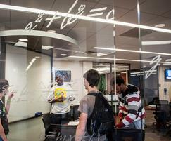
Small Changes, Big Impact
Add one early assignment
Use one reflection activity
Implement one exam wrapper
Refer one student to tutoring
Send one early progress message (week 2–3)
Clarify one assignment with a model/example
Impact: Early action → Better habits → Stronger outcomes
Bottom Line: Small, intentional moves create measurable gains.
Notes:
Improving student outcomes does not require a complete course redesign—small, intentional changes can have a significant impact. The key is to focus on strategies that influence student behavior early and consistently throughout the course.
Adding one early assignment helps students engage with the course right away and provides an opportunity to identify challenges before they escalate. A brief reflection activity encourages students to think about how they are learning, not just what they are learning, strengthening metacognition and study habits. Implementing a simple exam wrapper or practice prompt helps students connect preparation strategies to performance, turning assessments into learning opportunities rather than endpoints.
Even small actions, such as referring a student to tutoring or another support service, can make a meaningful difference. These moments of intervention often help students regain momentum and stay on track. When combined, these small changes create a ripple effect—improving confidence, increasing persistence, and ultimately strengthening course success and graduation.

Slide 21

Small Changes That Move KPIs
Retention (G2-KPI1, G2-KPI2)) → Early outreach + first assignment
Course Success (G2-KPI3) → Feedback + exam wrappers
Persistence → Tutoring referrals + check-ins
Graduation (G4-KPI1) → Clear expectations + structured course design
Impact: Small actions → Targeted outcomes → Measurable gains
Bottom Line: What you do in your course directly moves key student success metrics.
Notes:
Small instructional changes become even more powerful when they are intentionally aligned with key performance indicators. Rather than viewing KPIs as abstract institutional metrics, faculty can think of them as outcomes that are directly influenced by specific teaching practices.
Retention (G2-KPI1) is often shaped in the first few weeks of the semester. Early outreach and a meaningful first assignment help students engage quickly, establish expectations, and feel connected to the course. These early signals can determine whether a student stays or disengages.
Course success (G2-KPI3), particularly in gateway courses, is strongly influenced by feedback and opportunities for reflection. Providing timely, targeted feedback and using tools like exam wrappers helps students understand how to improve, turning performance into learning.
Persistence is reinforced through consistent support. Referring students to tutoring and checking in when challenges arise helps maintain momentum and prevents small difficulties from becoming reasons to withdraw.
Completion is supported through clarity and structure. When courses are well-organized and expectations are clear, students are better able to manage their time, understand requirements, and successfully complete their coursework.
By aligning small, intentional actions with these outcomes, faculty can directly influence the metrics that matter most—turning everyday teaching practices into measurable gains in student success.

Slide 22
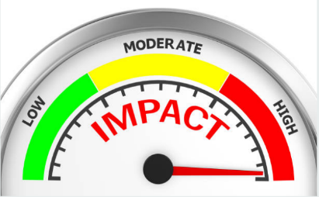
From Strategy to Impact
Chancellor’s Goals become real through daily teaching.
FQEs and small strategies turn goals into action.
Student success drives institutional strength.
Big Idea: Teaching → Student Success → Completion → Institutional and Community Impact
Final Thought: One intentional change can make a lasting difference.
Notes:
In conclusion, the strategic goals provide a clear vision for student success, institutional strength, and community impact, but their success depends on what happens in everyday practice. From financial resilience to academic excellence, from culture to workforce alignment, each goal is connected—and each is influenced by the teaching, support, and decisions that occur daily across the college. These priorities are not separate from the classroom; they are realized through it.
The Faculty Qualities of Excellence and the strategies explored in this resource demonstrate how large-scale goals become actionable. Through alignment, engagement, feedback, and collaboration, faculty translate institutional priorities into meaningful learning experiences. Small, intentional changes—especially when guided by data and aligned to KPIs—can significantly improve retention, course success, workforce readiness and graduation. When these efforts are sustained and shared, they create a culture of continuous improvement that benefits both students and the institution.
Ultimately, student success is the foundation of everything. When students stay, succeed, and complete, the institution becomes stronger, more stable, and better positioned to serve its community. Each faculty member plays a critical role in this process. By focusing on one intentional change and building from there, you contribute to a larger system of impact—where teaching drives outcomes, outcomes drive success, and success drives opportunity for all.

Slide 23

G1: Financial Resilience (Efficiency, Resource Allocation, Sustainability)
National Association of College and University Business Officers (NACUBO). (2019). Analytics can save higher education. Really.
Association of Governing Boards of Universities and Colleges (AGB). (2025). Top strategic issues for boards.
G2: Academic Excellence (Retention, Gateway Success, Progression)
Complete College America. (2022). Learning and Leading: How CCA is Advancing the College Completion Agenda.
Community College Research Center. (2021). Guided Pathways Research.
National Student Clearinghouse Research Center. (2023). Persistence and Retention Report.
G3: Student Success & Workforce Alignment (Completion, Career Outcomes)
Georgetown University Center on Education and the Workforce. (2021). The College Payoff.
Lumina Foundation. (2023). A Stronger Nation.
Lumina Foundation. (2025). Strategic Plan.
Achieving the Dream. (2021). Knowing Our Students: Understanding and Designing for Success.
G4: Institutional Effectiveness & Data-Informed Culture (Analytics, Continuous Improvement, Accountability)
Educause. (2023). Horizon Report: Teaching and Learning Edition.
National Institute for Learning Outcomes. (2015). Using Evidence of Student Learning to Improve Higher Education.
Bill & Melinda Gates Philanthropy Partners. (2022) Data for the Win: Rethinking Postsecondary Success.
Lone Star College Strategic Plan (2025-2030)
References

