Slide 1

Finishing Strong
Ending the Semester with Impact
Faculty Focus: Innovative Teaching Techniques for College Success Series
Notes:
The final stretch of the semester can feel like a whirlwind—for both students and faculty. Deadlines pile up, energy dips, and the pressure to wrap things up smoothly sets in. But this is also a powerful time to reinforce learning, provide meaningful support, and help students cross the finish line with confidence. “Finishing Strong” is about more than just making it through—it’s about ending on a high note. With a few focused strategies, you can help students stay motivated, manage stress, and reflect on how far they’ve come. Let’s make these last weeks count.

Slide 2


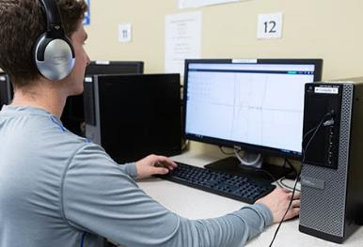
Why the Final Weeks Matter
Notes:
As the semester approaches its final weeks, your role becomes even more influential in shaping student outcomes. This is a critical period where small, intentional actions can make a significant difference in whether students persist, complete the course, and feel successful in their learning. Many students experience increased pressure, competing priorities, and uncertainty about their progress, which can impact both performance and motivation.
Finishing the semester strong is not about adding more content or increasing workload—it is about being purposeful with the time that remains. Clear communication, timely feedback, structured opportunities for improvement, and consistent encouragement help students stay focused and engaged. At this stage, your guidance provides the clarity and direction students need to prioritize effectively and maintain momentum.
This section focuses on practical strategies that support student persistence and completion. By reinforcing progress, addressing gaps, and helping students see a clear path forward, you create the conditions for a strong finish. These final weeks are an opportunity to solidify learning, build confidence, and ensure that students leave your course with a sense of accomplishment and readiness for what comes next.

Slide 3
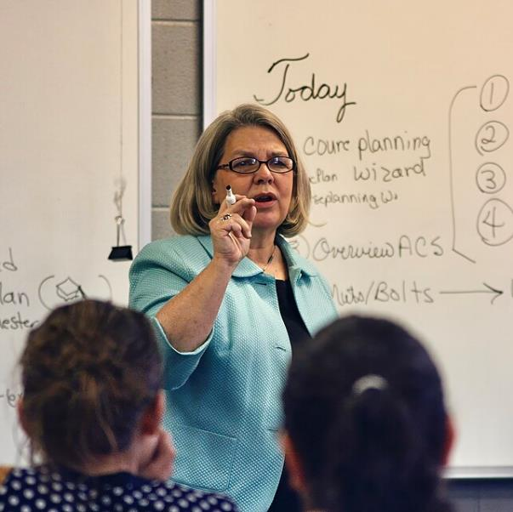
Start with Clarity
Clearly outline final requirements.
Break down major assignments.
Provide timelines and checkpoints.
Reinforce what success looks like.
Notes:
Clarity becomes even more important at the end of the semester. Students need a clear understanding of what remains, what is expected, and how to prioritize their work across multiple responsibilities. At this stage, uncertainty can quickly lead to inaction or misplaced effort. You can reduce this uncertainty by outlining final requirements in a simple, organized way—summarizing remaining assignments, due dates, and grading priorities in one place.
Breaking down final assignments into manageable steps helps students see a path forward rather than a single overwhelming task. Providing timelines, interim checkpoints, or suggested pacing allows students to plan their time more effectively. Even small adjustments—such as highlighting the most critical components of an assignment or clarifying common areas of confusion—can significantly improve student focus.
Reinforcing what success looks like is equally important. Sharing examples, revisiting rubrics, or briefly modeling expectations helps students understand the level of quality required. This guidance allows them to direct their effort toward the most important aspects of their work rather than guessing what matters. When expectations are visible, structured, and reinforced, students are better able to work efficiently, make informed decisions, and complete their assignments with greater accuracy and confidence.

Slide 4

Keep Students Engaged
Use structured review activities.
Ask focused, purposeful questions.
Encourage participation and interaction.
Maintain energy and connection.
Notes:
Engagement can decline toward the end of the semester, but it remains essential for both learning and completion. As students begin to focus on deadlines and final submissions, they may shift into a more passive mode, attending class but not fully participating. This can limit their ability to consolidate understanding at a time when it matters most. Your role is to keep students actively involved by designing review experiences that are structured, focused, and directly tied to key learning outcomes.
Rather than relying on open-ended review sessions, targeted questions and guided discussions help direct attention to the most important concepts. For example, you might organize review around common challenges, core themes, or likely areas of difficulty, asking students to explain their reasoning, compare approaches, or apply concepts to specific scenarios. Structured formats such as small-group problem-solving, case analysis, or concept mapping can help ensure that all students participate and remain engaged.
Encouraging participation is critical at this stage. When students actively contribute—by explaining ideas, asking questions, or working through problems—they reinforce their own understanding and identify gaps that still need attention. This interaction also builds confidence, as students see what they know and where they are improving.
Maintaining engagement in the final weeks helps students stay connected to the course and to each other. It transforms review from a passive recap into an active learning process, ensuring that students are better prepared, more confident, and more likely to complete the course successfully.

Slide 5

Provide Targeted Feedback
Focus on what matters most.
Highlight key areas for improvement.
Be specific and actionable.
Help students make final adjustments.
Notes:
Feedback in the final weeks should be focused and actionable. At this stage, students do not need extensive commentary on every aspect of their work—they need clear direction on what will make the greatest difference before final submission. Your feedback should prioritize the most important areas, such as clarity of ideas, alignment to key criteria, or accuracy of core concepts. This helps students understand where to focus their time and effort.
Being specific is critical. Rather than general comments, highlight exactly what needs attention and how to improve it. For example, pointing out where an argument lacks clarity, where evidence needs to be strengthened, or where a process step is incorrect gives students a clear path forward. When possible, connect feedback directly to the rubric or expectations so students can see how revisions will impact their performance.
Timing also matters. Feedback that is provided while there is still an opportunity to revise is far more effective than feedback given after final submission. Even brief, targeted comments delivered at the right moment can lead to meaningful improvements.
Targeted feedback allows students to concentrate their effort effectively rather than trying to fix everything at once. This not only improves the quality of their work but also increases their confidence as they see progress. In the final weeks, this clarity and focus can make the difference between incomplete work and successful course completion.

Slide 6

Support Improvement
Allow opportunities for revision.
Provide focused practice.
Reinforce progress over perfection.
Encourage continued effort.
Notes:
Support continued improvement, especially in the final weeks when students are working to complete major assignments. Providing opportunities for revision or additional practice reinforces that learning is a process rather than a single performance. When students know they have a chance to apply feedback, correct mistakes, and strengthen their work, they are more likely to stay engaged and put forth effort.
This support can take different forms—allowing revisions on key assignments, offering targeted practice on challenging concepts, or guiding students to revisit specific areas for improvement. Even small opportunities to refine work can make a meaningful difference. These structures signal that improvement is expected and achievable, helping students focus on growth rather than just grades.
Encouraging progress over perfection is especially important at this stage. Many students experience increased pressure as deadlines approach, which can lead to frustration or avoidance. By emphasizing improvement and effort, you help reduce anxiety and keep students moving forward. When students see that their effort leads to measurable gains, their confidence increases and they become more willing to persist.
This ongoing support creates momentum. Students are not defined by earlier performance, but by how they continue to improve. As a result, they are more likely to stay engaged, complete their work, and finish the semester successfully.

Slide 7

Encourage and Motivate
Recognize student progress.
Offer encouragement and support .
Reinforce confidence.
Help students stay focused.
Notes:
Your role becomes especially important at the end of the semester, when students are often managing stress, uncertainty, and competing priorities. Even students who have been performing well may question their progress or feel unsure about their ability to finish strong. At this point, small, intentional interactions can make a meaningful difference. A brief message acknowledging effort, a comment recognizing improvement, or a quick check-in can help students feel seen and supported.
Mentoring in these final weeks does not require extensive time—it is about being purposeful in how you communicate encouragement and direction. Reinforcing what students are doing well, while also reminding them of what they need to complete, helps maintain focus without adding pressure. These moments of support can reestablish confidence and help students regain momentum.
When students feel supported and believe they can succeed, they are more likely to stay engaged and follow through on their work. Confidence and motivation become critical drivers of persistence, especially when challenges increase. By maintaining a visible and supportive presence, you help students continue moving forward and complete the course successfully.

Slide 8

Supporting Stressed-Out Students
Listen actively and acknowledge concerns.
Break tasks into manageable steps.
Share time management tools and strategies.
Offer flexibility and connect to resources.
Encourage self-care and peer support.
Impact: Reduces stress and helps students stay on track for completion
Notes:
One of the first steps in supporting stressed-out students is to listen actively. When students express their stress or anxiety, offer a safe space for them to share their feelings. Acknowledge their emotions without judgment and let them know you understand how overwhelming the end of the semester can be. Sometimes, just having someone to listen can alleviate a significant amount of stress.
After understanding the student's concerns, help them identify practical solutions to manage their workload. Encourage students to break down large tasks into smaller, more manageable chunks, setting realistic goals for each day or week. You can also suggest time management techniques or recommend they use digital tools, like calendars or to-do lists, to organize and prioritize their tasks. Additionally, providing some flexibility on deadlines when possible, or directing them to campus resources (like tutoring or counseling services), can offer students much-needed support.
Remind students of the importance of self-care during stressful times. Encourage them to take breaks, get enough rest, and engage in physical activities like walking or stretching. Mindfulness exercises, like deep breathing or short meditation sessions, can also help reduce stress. If your course includes group work or collaborative learning, create opportunities for peer support so students can lean on each other as well.
By showing understanding and offering practical advice, you help students manage their stress and succeed in the final stretch of the semester. Providing them with both emotional support and tangible solutions can empower them to handle their responsibilities more effectively, helping them to navigate stress in a healthy way.

Slide 9

Manage Late Work and Grade Conversations
Communicate clear, consistent late work policies.
Balance fairness with flexibility for extenuating circumstances.
Listen to student concerns without judgment.
Explain grades transparently using course criteria.
Focus conversations on solutions and next steps.
Impact: Builds trust, maintains fairness, and keeps students engaged toward completion
Notes:
As the semester nears its end, managing late work and handling grade-related conversations effectively is essential to maintaining a positive and productive learning environment. Many students may find themselves struggling to meet deadlines due to personal challenges, increased workload, or a variety of other reasons. As an instructor, it's important to approach these situations with empathy and consistency, while also upholding your course policies.
Managing late work begins with clear communication of your expectations from the start of the semester. Establishing a firm but fair late work policy ensures that students understand the consequences of missing deadlines and the process for submitting late assignments. However, flexibility should be built into the system to account for extenuating circumstances. When students approach you with requests for extensions or to submit late work, evaluate their situations thoughtfully and consistently, considering both the policy and individual needs. It’s helpful to allow students to explain their challenges in a non-judgmental way, making sure they know you're willing to listen but also that you’re adhering to established guidelines.
Grade conversations can be sensitive, especially as students begin to review their performance toward the end of the term. To handle these discussions constructively, encourage open communication and provide clear feedback. When students express concerns about their grades, listen actively and be prepared to explain how their grade was determined based on course criteria. It's helpful to guide the conversation with a positive, solution-oriented mindset. For instance, if a student is concerned about missing assignments or low scores, provide them with specific feedback on what can be done to improve or how they can better demonstrate their learning moving forward. Being transparent about grading criteria and offering opportunities for students to reflect on their work helps to create an environment of trust and mutual respect. By approaching late work and grade conversations with empathy, consistency, and clarity, you not only support student success but also foster a positive classroom culture where students feel empowered to take ownership of their learning and academic progress.

Slide 10
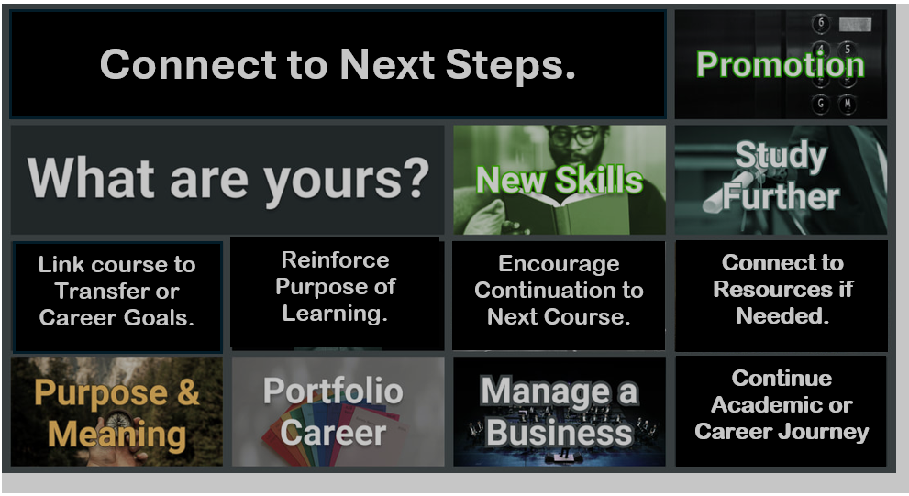
Notes:
Helping students see what comes next is critical for persistence and completion, especially as the semester comes to a close. At this stage, students may be focused only on finishing current requirements without fully considering how this course connects to their broader academic or career goals. You can make these connections explicit by linking course outcomes to future coursework, transfer pathways, or career applications.
This might include briefly discussing how the skills they have developed will be used in the next course, how the course fits into their degree plan, or how specific assignments mirror real-world expectations. Even simple reminders—such as what course comes next or how this course supports a program pathway—can help students see forward movement rather than just an endpoint.
When students understand how their current work fits into a larger goal, their motivation increases. They are more likely to complete final tasks because they see them as part of a meaningful progression rather than isolated requirements. Encouraging continuation—whether it is enrolling in the next course, connecting with advising, or accessing campus resources—helps students maintain momentum beyond the semester.
By connecting learning to next steps and reinforcing available support, you help ensure that students are not only finishing the course but are also prepared and motivated to continue their academic or career journey.

Slide 11

Streamline End-of-Semester Meetings
Use scheduling tools (Calendly, Google Calendar, Doodle).
Share availability with a single booking link.
Eliminate back-and-forth emails.
Set automated reminders to reduce no-shows.
Save time and stay organized.
Impact: Increases efficiency and ensures smooth, consistent student communication
Notes:
Scheduling end-of-semester meetings, such as office hours or final one-on-one conferences with students, can be a logistical challenge. The back-and-forth emails to find a mutually convenient time can be time-consuming and lead to confusion. To streamline this process, using scheduling tools like Calendly, Google Calendar, or Doodle can save you valuable time. These tools allow you to set your availability in advance and share a scheduling link with students, enabling them to book a time that works for both of you. This eliminates the need for multiple emails and ensures that both you and your students are on the same page. Additionally, most scheduling platforms allow you to set up automated reminders, which can be sent to students prior to their appointments. These reminders help reduce no-shows and ensure that meetings run smoothly, allowing you to stay on track without worrying about missed appointments. By automating the scheduling and reminder process, you free up more time for other end-of-semester tasks, making your workflow more efficient and less stressful.

Slide 12

Gather Feedback Efficiently
Use tools (Google Forms, SurveyMonkey).
Create quick, anonymous surveys.
Target specific areas (clarity, engagement, assignments).
Automatically compile and analyze responses.
Identify trends to guide improvements.
Impact: Saves time and provides actionable insights to strengthen future teaching
Notes:
Gathering student feedback at the end of the semester is a valuable opportunity to reflect on your teaching approach and identify areas for improvement. However, manually collecting and reviewing feedback can be time-consuming. To streamline this process, using tools like Google Forms or SurveyMonkey can save you a significant amount of time. These platforms allow you to quickly create anonymous surveys that students can complete at their convenience. With the ability to easily customize feedback questions, you can target specific areas of the course, such as content clarity, engagement strategies, or assignment effectiveness. Once the surveys are submitted, these tools automatically compile the responses, saving you the effort of manually sorting through individual answers. The data is presented in easy-to-read formats, allowing you to quickly analyze trends and insights. By using these tools, you not only make the feedback process more efficient but also gather actionable information that can inform your teaching strategies for future semesters. This process allows you to focus on making improvements based on real-time student input, ultimately enhancing the learning experience for your students.

Slide 13
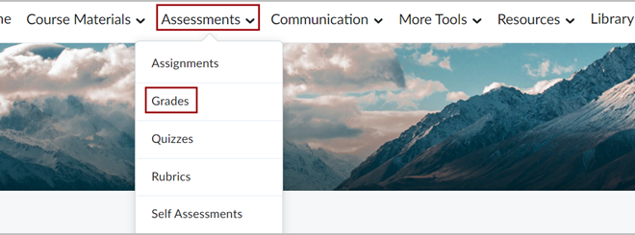
Finalize and Share Grades Efficiently
Use D2L to post grades quickly.
Enable notifications for immediate student updates.
Use Google Sheets for fast, accurate calculations.
Apply formulas (SUM, AVERAGE) to streamline grading.
Collaborate easily for review and accuracy.
Impact: Saves time, ensures accuracy, and delivers timely, consistent communication
Notes:
Finalizing and sharing course grades at the end of the semester can be a time-consuming process, but leveraging the right tools can make it much more efficient. One of the most effective ways to post grades quickly is by using D2L. This platform allows you to input final grades and post them directly to the gradebook, where students can access them immediately. You can also set up automated notifications to alert students when their grades are available, eliminating the need for individual emails or announcements. This not only saves time but ensures that students receive timely and consistent communication about their performance.
If you need to manually calculate or adjust grades, Google Sheets is a great tool to help streamline the process. With built-in functions, such as SUM and AVERAGE, you can quickly total points and compute final grades while maintaining consistency and accuracy. Google Sheets also offers easy collaboration, allowing you to share the document with colleagues or tutors for additional review, further reducing the time spent on manual calculations. By using these tools, you can finalize and distribute grades efficiently, freeing up time for other important end-of-semester tasks.

Slide 14

The Power
of Goodbyes
Ending the Semester
with Connection
Notes:
As the semester comes to a close, it's crucial to provide students with emotional closure and foster a positive final experience. Ending the semester on a meaningful note can leave a lasting impression on students and enhance their overall learning journey. By intentionally creating opportunities for reflection and connection, you help students recognize their growth, feel appreciated, and exit the course with a sense of accomplishment and closure. Here are a few strategies for achieving this.

Slide 15

Use Reflection to Bring Closure
Incorporate brief reflection activities (writing, discussion, presentations).
Ask focused prompts on learning, challenges, and accomplishments.
Encourage students to recognize growth and progress.
Create opportunities for peer sharing and connection.
Gather insights on student experiences and takeaways.
Impact: Reinforces learning, builds confidence, and provides meaningful course closure
Notes:
One powerful way to bring closure to the semester is through structured reflection exercises. Asking students to reflect on their journey throughout the course encourages them to pause and consider how far they’ve come—both academically and personally. These reflections can take many forms, such as brief writing prompts, small-group discussions, or individual presentations. Students might respond to questions like, “What is something you learned that surprised you?” or “What assignment challenged you the most and why?” or “What accomplishment are you most proud of?” These moments of introspection give students a chance to recognize their own growth, solidify key learning experiences, and feel a sense of completion. Additionally, when students are invited to share their thoughts with peers, it fosters a sense of community and validates their efforts. For instructors, these reflections can offer valuable insight into the impact of the course and highlight meaningful student takeaways that might not surface through assessments alone. Overall, reflection exercises are a simple yet impactful way to help students end the course with confidence and a stronger sense of purpose.

Slide 16

Engage Students Through Feedback
Collect feedback (surveys, discussions, exit tickets). Ask what supported learning and engagement. Identify areas for course improvement. | Show that student voices are valued. Promote reflection and continuous improvement. Impact: Builds trust, informs teaching, and strengthens student ownership of learning
Notes:
Collecting student feedback at the end of the semester is a meaningful way to engage students in the learning process while also gaining valuable insights into your teaching practices. This feedback can be gathered in various formats—through anonymous digital surveys using tools like Google Forms or SurveyMonkey, or informally through class discussions or exit tickets. Asking students what aspects of the course helped them learn most effectively, which assignments or activities were most engaging, and what could be improved provides you with practical ideas for course refinement. It also signals to students that their voices are heard and respected. When students see that their opinions are valued, it fosters a sense of mutual respect and encourages them to take more ownership of their learning. Moreover, feedback sessions promote transparency and continuous improvement, reinforcing a growth mindset for both instructor and students. Even brief feedback opportunities at the end of class can have a lasting impact, shaping how students view the course and enhancing your ability to adapt and grow as an educator.

Slide 17

End with Gratitude and Recognition
Acknowledge effort, growth, and contributions.
Highlight individual and class achievements.
Reinforce the connection between effort and success.
Celebrate progress in a supportive, shared setting.
Foster a sense of community and respect.
Impact: Builds confidence, strengthens motivation, and leaves students with a positive final experience
Notes:
Taking time to express gratitude and recognize students' hard work and contributions throughout the semester is a powerful way to end on a positive note. Acknowledging both individual and collective achievements helps students feel valued and appreciated for their efforts. Whether it's praising someone for their perseverance, highlighting significant improvements, or noting specific contributions to class discussions, these moments of recognition reinforce the connection between effort and success. Even small gestures of acknowledgment can have a profound impact on a student's confidence and motivation. Additionally, recognizing achievements in a group setting allows students to reflect on their collective progress and fosters a sense of community. It encourages students to celebrate not only their personal accomplishments but also the achievements of their peers. By ending the semester with gratitude and recognition, you create a positive emotional atmosphere that encourages students to feel proud of their growth and sets a tone of mutual respect as they move on from the course.

Slide 18

Facilitate sharing of highlights and key moments.
Encourage reflection on growth and milestones.
Discuss future goals and next steps.
Promote peer connection and support.
Create space for gratitude and celebration.
Impact: Strengthens community, reinforces learning, and ends the semester on a positive, connected note.
Use Group Activities for Closure
Notes:
Group closure activities are a meaningful way to wrap up the semester by fostering positive interactions among students and helping them reflect on their collective experiences. These activities encourage students to share highlights from the course, such as memorable lessons, breakthroughs, or personal milestones. Sharing these moments allows students to see the value in what they’ve learned and reinforces the connections they've made with their peers. Additionally, discussing future plans—whether it's academic goals, career aspirations, or next steps in their educational journey—gives students a chance to bond over shared experiences and motivate each other for what lies ahead. Such activities help cultivate a sense of camaraderie and community within the class, ensuring that students leave with a feeling of belonging and connection, rather than just a sense of closure. Group closure activities also create an environment where students can express gratitude, celebrate each other’s progress, and reflect on the positive impact of the course. This sense of shared reflection and future-oriented optimism can be a powerful way to end the semester on a high note, leaving students feeling more engaged and connected with their learning and peers.

Slide 19

End with a
Personal Touch
Share personal insights and growth from the course.
Use stories to humanize the learning experience.
Model vulnerability and continuous learning.
Reinforce learning as a shared journey.
Strengthen connection and mutual respect.
Impact: Builds trust, deepens connection, and creates meaningful, lasting closure
Notes:
Ending the semester by sharing your own reflections can create a powerful and meaningful connection between you and your students. Offering personal anecdotes or stories about your own moments of growth throughout the course helps humanize the teaching experience and reminds students that learning is a shared journey. By opening up about your own challenges, successes, and even moments of vulnerability, you invite students to see you as a fellow learner, not just as an instructor. This vulnerability fosters an environment of mutual respect and trust. It also reinforces the idea that growth is a lifelong process, not just something that happens in the classroom. When you share how you’ve learned alongside them, it validates their own experiences and helps them feel more connected to you as a person, not just as an authority figure. Ending on this personal note can create a lasting emotional connection, leaving students with a sense of closure that’s not only academic but also relational. This sense of connection helps students feel appreciated and valued, encouraging them to carry the positive energy from the class forward into their next endeavors.

Slide 20

Finish Strong
Create a Lasting Final Experience
Use final activities to promote reflection, connection, and closure.
Recognize student effort and celebrate achievements.
Reinforce a supportive and inclusive learning environment.
Help students process learning and identify key takeaways.
Encourage confidence and readiness for next steps.
Impact: Leaves students feeling valued, connected, and prepared for continued success
Notes:
In conclusion, it's important to recognize that the last day of class offers a unique opportunity to leave a lasting impression on your students. The activities and strategies discussed are designed not only to provide closure for the semester but also to foster a sense of connection, reflection, and appreciation. Whether it's through group discussions, personal reflections, or gratitude exercises, these activities help students feel acknowledged for their efforts and ensure they leave the course with a positive, reflective mindset.
Incorporating these end-of-semester activities helps create an environment where students feel valued, connected, and confident about the progress they’ve made. Reflecting on what worked well in the course, recognizing individual and group achievements, and offering opportunities for personal reflection all contribute to building a strong, supportive learning community. These moments of connection are essential for helping students process their learning and take away meaningful insights that will stay with them long after the semester ends.
Ultimately, by creating a positive, reflective, and inclusive final experience, you not only support your students' emotional closure but also lay the groundwork for their continued growth and success. As educators, we play a vital role in shaping the end of the semester and, by extension, the overall learning experience. By implementing these strategies, you can ensure that your students leave your class feeling respected, appreciated, and ready to take on the next chapter of their academic journey.

Slide 21

Eggleston, T., and Smith, G. Parting Ways: Ending Your Course. Teaching Tips. Association for Psychological Science.
Ending the Semester. Center for New Designs in Learning and Scholarship. Georgetown University.
Fournier, E. How to End a Course: Teaching Tips. Center for Teaching and Learning. Washington University in St. Louis.
Hardy, J. End-of-the-year reflection: Tools for validation, celebration, gratitude and planning ahead. Office of Student Care Coordination. Vanderbilt University.
Himelein, M. Activities for the Last Day of Class. Teaching Tips. Brigham Young University.
Korgeski, M. Closing the Semester Strong: Essential Tips for Online Instructors. Digital Learning Hub. College of Applied Human Sciences. West Virginia University.
Last Day of Class. Center for Teaching and Learning. University of California Berkeley.
Preparing for the End of the Semester. Center for Teaching Innovation. Cornell University.
Richter, S. Looking back, moving forward, and saying good-bye: Strategies for ending the semester. Center for Innovative Teaching and Learning, Northern Illinois University.
Van Leusen, P. 5 Things Successful Instructors Do When the Semester is Over. Design for Online Learning Toolkit. Arizona State University.
References

