Slide 1

From Intentions to Impact
Making Your Teaching Visible
Faculty Focus: Innovative Teaching Techniques for College Success Series
Notes:
Great teaching is not defined by what you believe about learning—it is defined by what students can actually see, experience, and respond to in your classroom. While beliefs and intentions shape your approach, they only matter when they are translated into clear, observable actions. Students cannot engage with a philosophy; they engage with how you explain concepts, how you design assignments, how you respond to their work, and how you support them when they struggle.
Making teaching visible means turning your intentions into practices that students can recognize and benefit from. If you value clarity, it shows in how you structure your course and communicate expectations. If you value engagement, it appears in the opportunities you create for participation and interaction. If you believe in student growth, it is evident in the feedback you provide and the chances you give students to improve. In each case, what students experience is not the belief itself, but the action that brings that belief to life.
When teaching is visible, students are better able to understand what is expected of them, how to succeed, and how to improve. This clarity reduces confusion, builds confidence, and increases motivation. More importantly, it leads to measurable outcomes—students are more likely to stay engaged, perform successfully in key assignments, and persist from one term to the next. The shift from intention to visible action is what transforms teaching from something you believe into something that produces real, lasting impact.

Slide 2

From Talking About Teaching to Showing Teaching
Teaching identity is often framed as beliefs, philosophies, and intentions.
Students experience actions—not abstract ideas.
Identity becomes meaningful when it is visible in practice.
Effective development comes from clear examples of what teaching looks like.
Shift in Focus:
👉 “What do you believe?” → “What do you do?”
Notes:
Teaching identity is often framed in abstract terms—beliefs about learning, personal philosophies, or intentions for student success. While these elements are important, they are not what students actually experience. Students do not interact with what you believe; they interact with what you do. The way you structure a lesson, communicate expectations, respond to questions, and design assignments are the moments where teaching becomes real and impactful.
For this reason, identity becomes meaningful only when it is visible in practice. Observable actions—such as providing clear instructions, offering timely feedback, or creating opportunities for participation—translate beliefs into experiences that students can understand and benefit from. When teaching is visible, students are better able to navigate the course, recognize how to succeed, and engage more confidently in the learning process.
This shift also reframes how faculty development can occur. Rather than relying on conversation or discussion alone, growth can be supported through clear, concrete examples of effective teaching behaviors. Seeing what works—through short scenarios, modeled practices, or visible strategies—provides immediate clarity and direction. It removes ambiguity and allows instructors to adopt and adapt practices quickly.
Ultimately, this approach represents a shift in focus: from asking “What do you believe?” to examining “What do you do?” It is through consistent, intentional actions that teaching identity is expressed, strengthened, and connected to student outcomes. When those actions are visible, they not only define your teaching—they drive student success.

Slide 3
Communication with Students
Daily Instructional Decisions
Design of Learning Experiences
Concrete Examples
Core Principles of Visible Teaching
Notes:
To make your teaching visible, it is not enough to rely on isolated strategies or one-time actions. What matters most are the consistent principles that guide what you do in your classroom every day. Core principles provide a foundation for your teaching—ensuring that your actions are intentional, aligned, and focused on student success.
These principles help you move beyond reacting in the moment to teaching with purpose. They shape how you design learning experiences, communicate with students, and respond to their needs. When your teaching is grounded in clear principles, your actions become more consistent and more meaningful, making it easier for students to understand expectations and engage in the learning process.
Focusing on core principles also simplifies improvement. Rather than trying to adopt multiple disconnected strategies, you can strengthen a few key practices that have the greatest impact. This approach keeps your teaching manageable while still producing measurable results in areas such as engagement, success, and persistence.
The following principles highlight what effective teaching looks like in action. Each one connects directly to what students experience and demonstrates how small, intentional choices can lead to meaningful outcomes.

Slide 4
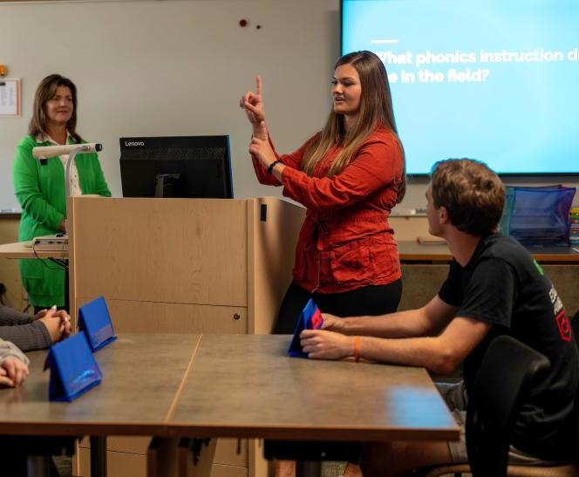
Daily Instructional Decisions
Examples:
How you start a lesson
How you explain key concepts
How you check for understanding
How you respond to questions
Consistent decisions:
Reduce confusion
Build confidence
Support engagement
Key Idea:
👉 What you do every day defines what students experience.
Notes:
Your teaching identity is revealed through the small decisions you make every day in the classroom. These choices—how you begin a lesson, how you explain a concept, when you pause to check for understanding, and how you respond to student questions—shape what students experience in real time. While these decisions may seem routine, they are where your teaching becomes visible and impactful. Each moment presents an opportunity to reinforce clarity, encourage engagement, and support learning.
Intentional daily decisions create consistency for students. When you consistently provide clear explanations, connect ideas, and check for understanding, students are better able to follow the course and stay engaged. These actions reduce confusion, build confidence, and help students see how each part of the lesson contributes to their overall learning. Over time, these consistent practices establish a predictable and supportive learning environment.
Focusing on daily instructional decisions also makes improvement manageable. Instead of overhauling your entire course, you can refine what you already do—adjusting how you present material, how you ask questions, or how you respond in the moment. These small adjustments accumulate, leading to stronger engagement, improved understanding, and better outcomes. What you do each day is not just routine—it is the foundation of your teaching impact.

Slide 5

Communication with Students
Communication signals:
Expectations
Support
Your commitment to their success
Effective communication includes:
Clear instructions and expectations
Timely updates and reminders
Responsive answers to questions
Encouraging and respectful tone
Strong communication:
Reduces uncertainty
Builds trust and connection
Keeps students on track
Key Idea:
👉 How you communicate shows students how to succeed—and that you are invested in their success.
Notes:
Your teaching identity is also made visible through how you communicate with students—both inside and outside the classroom. Every message you send, every announcement you post, and every response you provide shapes how students perceive the course and their place in it. Communication is not just about sharing information; it signals your expectations, your level of support, and your commitment to student success.
Clear and consistent communication helps students navigate the course with confidence. When you provide timely updates, clarify expectations, and explain how assignments connect to learning, students are better able to stay on track and engage with the material. Communication also reduces uncertainty, which is one of the most common barriers to persistence. When students know what to do and how to do it, they are more likely to follow through.
Equally important is the tone of your communication. Encouraging, respectful, and supportive language helps build trust and creates a sense of belonging. A brief message before an exam, a thoughtful response to a question, or feedback that guides improvement can make a significant difference in how students experience your course. These moments communicate that you are invested in their success.
When your communication is intentional, visible, and aligned with your teaching goals, it becomes a powerful tool for engagement and retention. It connects students to the course, supports their progress, and reinforces the learning environment you are working to create.

Slide 6

Learning experiences should be:
Aligned to outcomes
Purposeful and meaningful
Focused on application and skill development
Effective design includes:
Assignments that require thinking and application
Activities that build skills over time
Clear connections between tasks and learning goals
Strong design:
Increases engagement and ownership
Makes expectations clear
Improves student success at scale
Key Idea:
👉 What you design is what students experience—and where learning happens.
Design of Learning Experiences
Notes:
Your teaching identity is most clearly expressed through how you design learning experiences. The structure of your assignments, activities, and assessments determines not only what students learn, but how they learn it. Design is where your intentions become tangible—where your values about learning are translated into the actual tasks students engage with.
Intentional design ensures that learning experiences are aligned, meaningful, and purposeful. When assignments require students to apply concepts, analyze information, or solve problems, you are signaling that learning goes beyond memorization. When activities are structured to build skills over time, students can see their progress and understand how each part of the course contributes to their development. Clear alignment between outcomes, activities, and assessments makes expectations visible and supports student success.
Well-designed learning experiences also promote engagement and ownership. When students are asked to connect ideas to real-world contexts, collaborate with peers, or reflect on their learning, they become active participants rather than passive recipients. This level of engagement deepens understanding and increases motivation, making learning more relevant and lasting.
Focusing on design allows you to create impact at scale. A well-designed assignment or activity can influence every student in your course, reinforcing key skills and improving outcomes. Rather than relying on one-time interventions, strong design builds success into the course itself. What you design is what students experience—and that is where your teaching has its greatest impact.

Slide 7

Concrete Examples
Make expectations visible:
Clear instructions
Models and examples
Defined criteria for success
Show how small actions connect to outcomes:
Early feedback → improved performance
Clear communication → increased retention
Applied assignments → deeper learning
Key Idea:
👉 Behavior is the most reliable evidence of your teaching identity.
Notes:
To make your teaching visible, you need more than general ideas—you need concrete examples that show what effective teaching looks like in action. Examples make abstract concepts clear and actionable. Instead of describing what good teaching is, you demonstrate it through specific, observable practices that you can apply in your own classroom.
One of the most important ways to do this is by making expectations visible. When you clearly communicate what success looks like—through instructions, models, rubrics, or examples—students are better able to understand what is required and how to meet those expectations. This clarity reduces confusion and allows students to focus their effort on learning rather than guessing what to do.
Equally important is showing how small actions connect to student outcomes. Simple practices—such as sending a reminder before an exam, providing early feedback, or redesigning an assignment to require application—can have a measurable impact on retention, engagement, and success. When these connections are made explicit, it becomes clear that teaching is not defined by large, sweeping changes, but by consistent, intentional actions.
Ultimately, behavior is the most reliable evidence of your teaching identity. What you consistently do—how you communicate, design, and respond—demonstrates what you value. When those behaviors are clear and visible, they not only define your teaching, but also create the conditions for student success.

Slide 8

Example Scenarios
(Identity in Action)
Notes:
Understanding effective teaching is important—but seeing it in action is what makes it usable. Example scenarios bring teaching to life by showing how specific behaviors play out in real classroom situations. Rather than describing general principles, scenarios illustrate what those principles look like when you apply them in your daily practice.
These short, focused examples highlight the connection between what you do and how students respond. Each scenario captures a single, intentional action and its impact—whether it is improving clarity, increasing engagement, or supporting persistence. This makes it easier to see how small adjustments in your approach can lead to meaningful differences in student outcomes.
By focusing on concrete moments, scenarios remove ambiguity and provide clear direction. You can quickly recognize practices you already use, identify opportunities for refinement, and adopt new strategies without needing extensive explanation. In this way, scenarios serve as practical models—helping you translate intention into action and action into impact.

Slide 9

Proactive Communication Making Support Visible
(Student-Invested)
Scenario:
You email students one week before the first exam
Include study tips, key concepts, and encouragement.
Visible Identity:
Demonstrates care, clarity, and support
Shows you are invested in student success
Impact:
Reduces anxiety
Increases preparation
Supports Retention (G2-KPI1)
Key Idea:
👉 Anticipating student needs strengthens confidence and persistence.
Notes:
Proactive communication is one of the simplest and most effective ways to make your teaching visible. When you reach out to students before a key moment—such as the first exam—you are not just sharing information; you are signaling that you are invested in their success. A brief email that includes study tips, key concepts to review, and words of encouragement helps students focus their efforts and approach the assessment with greater confidence.
This action demonstrates a visible teaching identity grounded in care, clarity, and support. Instead of waiting for students to struggle or ask for help, you anticipate their needs and provide guidance at the moment it matters most. This reduces uncertainty and helps students understand how to prepare effectively, especially in the early weeks of the course when they are still adjusting expectations.
The impact of this small action is significant. Students experience reduced anxiety because they feel supported and informed. They are more likely to prepare intentionally, leading to stronger performance. Over time, these moments of proactive support contribute to persistence, as students feel connected to the course and confident in their ability to succeed. What may seem like a simple email becomes a clear example of how visible teaching practices support Retention (G2-KPI1/2).

Slide 10

Intentional Assignment Design Making Learning Visible
(Pedagogically Excellent)
Scenario:
You redesign a prompt from recall-based to application-based.
Students apply concepts to real-world cases.
Visible Identity:
Focus on deeper learning and skill development
Emphasis on thinking, application, and problem-solving
Impact:
Improves understanding and transfer
Increases Gateway Course Success (G2-KPI3)
Key Idea: 👉 What you ask students to do shapes how deeply they learn.
Notes:
Intentional assignment design is a powerful way to make your teaching visible and elevate the level of student learning. When you redesign a prompt from recall-based to application-based, you shift the focus from memorizing information to using knowledge in meaningful ways. For example, asking students to apply a concept to a real-world case requires them to analyze, interpret, and make connections—skills that deepen understanding and promote long-term retention.
This design choice reflects a teaching identity grounded in pedagogical excellence. It demonstrates that you value not just what students know, but what they can do with that knowledge. By intentionally designing assignments that require thinking, problem-solving, and application, you make your expectations for learning clear and visible. Students begin to recognize that success in your course depends on their ability to engage with content at a deeper level.
The impact of this shift is significant. Students develop stronger conceptual understanding and are better able to transfer their learning to new contexts. This not only improves performance on assignments and assessments but also supports their progression through key courses. When students can apply what they have learned, they are more likely to succeed in gateway courses, directly contributing to Gateway Course Success (G2-KPI3). A single redesign can transform an assignment into a meaningful learning experience that drives measurable outcomes.

Slide 11

Early Feedback Loop: Making Growth Visible
(Student-Invested / Pedagogically Excellent)
Early Feedback Loop Scenario:
You provide feedback on a low-stakes assignment within the first two weeks.
Visible Identity:
Commitment to student growth and timely guidance
Focus on improvement, not just evaluation
Impact:
Helps students adjust early
Improves persistence and performance
Key Idea:
👉 Early feedback creates momentum for student success.
Notes:
An early feedback loop is one of the most effective ways to make your teaching visible and support student success from the start. When you provide feedback on a low-stakes assignment within the first two weeks, you create an early opportunity for students to understand expectations, identify gaps, and make adjustments before high-stakes assessments occur. This early intervention helps set the tone for the course and establishes a clear pathway for improvement.
This practice reflects a teaching identity grounded in both student investment and pedagogical excellence. It demonstrates that you are committed to student growth, not just evaluation. By offering timely, actionable feedback, you show students how to improve and reinforce that learning is a process. Students experience your teaching as supportive, responsive, and focused on their development.
The impact of early feedback is significant. Students are able to adjust their approach while there is still time to improve, which leads to stronger performance on future assignments. Early success builds confidence and momentum, increasing the likelihood that students will stay engaged and persist in the course. What begins as a small, intentional action becomes a critical factor in improving both persistence and overall performance.

Slide 12
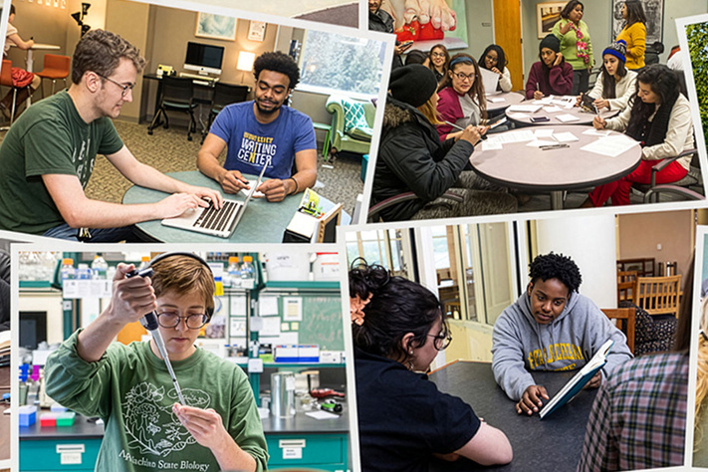
Connecting to Support Services
(Institutionally Dedicated)
Scenario:
You refer struggling students to tutoring.
You explain how and when to use the service.
Visible Identity:
Alignment with institutional resources
Commitment to student success beyond the classroom
Impact:
Increases Wraparound Utilization (G2-KPI5)
Supports course success
Key Idea:
👉 Connecting students to support strengthens learning and persistence.
Notes:
Connecting students to support services is a visible way to extend your teaching beyond the classroom and align your practice with institutional resources. When you identify a struggling student and intentionally refer them to tutoring—while also explaining how to use the service—you remove a common barrier: uncertainty about where to go and what to do. This step transforms support from something optional and unclear into something accessible and actionable.
This practice reflects an institutionally dedicated teaching identity. It shows that you see student success as a shared responsibility and that you actively connect your course to the broader support network available to students. Rather than working in isolation, you leverage tutoring, learning centers, and other services as part of the learning process. Students experience your teaching as connected, resource-aware, and focused on their success both inside and outside the classroom.
The impact is immediate and measurable. Students who are guided to support services are more likely to use them effectively, leading to improved understanding and stronger performance. This increases Wraparound Utilization (G2-KPI5) and directly supports course success. More importantly, it helps students build habits of seeking support, which contributes to long-term persistence. A simple referral—when made visible and intentional—becomes a powerful strategy for improving outcomes.

Slide 13
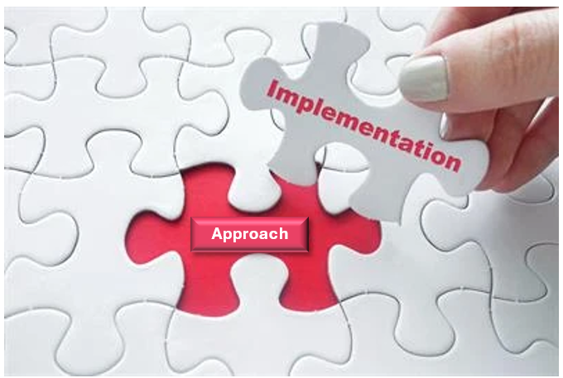
Implementation
How to Use This Approach
Notes:
Understanding what effective teaching looks like is only the first step; the impact comes from how you apply it in your daily practice. This section focuses on turning visible teaching into consistent action by identifying practical, manageable ways to incorporate these strategies into your course. The goal is not to add more to your workload, but to be more intentional with what you already do.
Implementation begins with focus. Rather than trying to adopt multiple new strategies at once, you can start by selecting one or two practices that align with your current teaching and strengthening them. This might mean making your communication more proactive, refining how you design an assignment, or building in an early feedback opportunity. Small, targeted adjustments are more sustainable and more likely to produce meaningful results.
This approach also emphasizes consistency over complexity. When a practice is applied regularly—such as clear communication, timely feedback, or intentional design—it becomes part of the student experience. Over time, these consistent actions shape how students engage, perform, and persist. By focusing on what is visible, repeatable, and aligned with your goals, you can translate intention into action and action into measurable impact.

Slide 14

Integrating Scenarios
Making Teaching Visible Across Materials
Embed scenarios into:
Slides → Show what strategies look like in action
Emails → Reinforce expectations and guide students
Faculty resources → Provide clear, usable examples
Keep scenarios:
Brief and specific
Action-focused
Connected to outcomes
Key Idea:
👉 A few clear examples can make teaching practices visible, consistent, and easy to apply.
Notes:
To make this approach practical and sustainable, focus on integrating just two to three scenarios into the materials you already use. Rather than creating something entirely new, you can embed short, high-impact examples into your slides, emails, and faculty resources. These scenarios serve as quick, concrete illustrations of what effective teaching looks like in action, making your approach both visible and immediately usable.
In your slides, scenarios can be used to model effective practices and connect strategies to outcomes. In emails, scenarios can reinforce expectations and provide guidance in a concise, relatable way—helping students understand not just what to do, but how to approach their work. In faculty resources, scenarios offer clear, actionable models that can be easily adopted or adapted across disciplines.
Keeping the number of scenarios small ensures clarity and focus. Two to three well-chosen examples are enough to demonstrate impact without overwhelming your audience. When consistently used across different formats, these scenarios reinforce key practices, making your teaching more visible and your message more cohesive. This approach allows you to turn everyday materials into powerful tools for modeling effective teaching.

Slide 15

Integrating Scenarios (Example)
Scenario: Early feedback on a low-stakes assignment (Week 2)
Slides: Model effective practice by showing what quality looks like
Emails: Reinforce what to do and how to approach the task
Faculty Resources: Provide a replicable strategy (sample + checklist + self-assessment)
Across Materials: Same scenario, different purpose → consistent and reinforced learning
Key Idea: 👉 One scenario can reinforce effective teaching across all materials.
Notes:
This example illustrates how a single teaching practice can be integrated across multiple materials to make your approach both visible and consistent. Rather than creating new content, you take one high-impact scenario—providing early feedback—and embed it into your slides, emails, and faculty resources. This allows you to reinforce the same message in different contexts, helping students understand both what to do and how to improve.
In your slides, this scenario models effective practice by showing students how to recognize quality. In your emails, it reinforces what to do and how to approach the task in a clear, concise way. In your faculty resources, it becomes a replicable strategy—providing a sample, a checklist, and a structured opportunity for self-assessment. The same scenario appears in each space, but with a slightly different purpose.
By using one scenario across multiple touchpoints, you create consistency in the student experience while also making your teaching more efficient. Students receive the same message in different ways, increasing clarity and reinforcing expectations. At the same time, you reduce the need to create additional materials, making this approach both practical and sustainable.

Slide 16
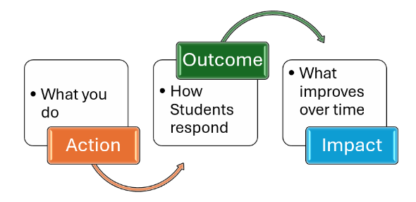
Action → Outcome → Impact
Connecting Teaching to Results
Action: (e.g., early feedback, clear instructions, applied assignments)
Outcome: (e.g., better understanding, increased engagement)
Impact: (e.g., success, persistence, retention)
Makes teaching:
Intentional
Measurable
Aligned to student success
Key Idea: 👉 Small actions lead to meaningful outcomes—and lasting impact.
Notes:
To make your teaching visible and meaningful, it is important to consistently connect what you do to what students experience and achieve. Focusing on Action → Outcome → Impact provides a clear structure for understanding how everyday teaching practices lead to measurable results. This approach helps you move beyond simply using strategies to intentionally examining their effect on student learning.
The first step is the action—a specific, observable teaching practice such as providing early feedback, clarifying expectations, or redesigning an assignment. The next step is the outcome—how students respond in the moment, such as increased understanding, improved preparation, or greater engagement. The final step is the impact—the broader result over time, including improved performance, persistence, or success in key courses.
Using this framework brings clarity and purpose to your teaching. It allows you to see the direct connection between small, intentional actions and larger institutional goals. When you consistently apply this thinking, your teaching becomes more focused, your decisions more strategic, and your impact more measurable. This is how visible teaching translates into student success.

Slide 17
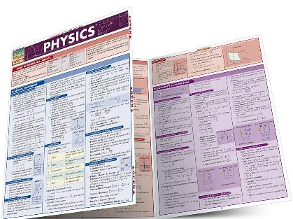
Action:
You provide a study guide one week before the exam.
Includes key concepts, examples, and practice questions
Outcome:
Students focus their studying on what matters most.
Increased preparation and more targeted review
Impact:
Higher exam performance
Increased confidence
Improved course success and persistence
Key Idea: 👉 What you do → shapes what students experience → drives what they achieve.
Action → Outcome → Impact
Example
Notes:
This example illustrates how a single, intentional teaching action can lead to meaningful and measurable results when viewed through the lens of Action → Outcome → Impact. By providing a study guide one week before the exam, you are taking a clear, observable action that supports student preparation. This is not simply an added resource—it is a targeted strategy designed to guide student effort and reduce uncertainty.
The immediate outcome of this action is seen in how students respond. With a clear study guide, students are able to focus on the most important concepts, organize their preparation, and approach the exam with greater confidence. Instead of guessing what to study, they engage more intentionally with the material, leading to more effective and efficient learning.
Over time, these outcomes translate into broader impact. Students perform better on the exam, feel more confident in their abilities, and are more likely to stay engaged in the course. This contributes to improved course success and persistence. By connecting the action to both immediate outcomes and long-term impact, this example demonstrates how small, intentional practices can directly influence student achievement and overall success.

Slide 18

Keep Teaching Clear and Focused
Avoid:
Lengthy explanations that overwhelm or distract
Open-ended discussions without clear direction
Instead:
Use concise, focused explanations.
Structure discussions with clear prompts and outcomes.
Result:
Greater clarity
Stronger engagement
More effective learning
Key Idea:
👉 Clarity and structure make teaching more visible and impactful.
Notes:
To keep your teaching clear and effective, it is important to avoid over-explaining or relying too heavily on open-ended discussions without structure. While explanation and discussion have their place, too much of either can reduce clarity and make it harder for students to identify what matters most. When information becomes overly detailed or unfocused, students may struggle to determine expectations or apply what they are learning.
Instead, prioritize clarity and precision. Concise explanations that highlight key ideas help students focus their attention and process information more effectively. Similarly, structured discussions—guided by clear prompts, expectations, or outcomes—ensure that participation leads to meaningful learning rather than confusion or disengagement. The goal is not to eliminate explanation or discussion, but to make both purposeful and aligned with your learning objectives.
By reducing unnecessary complexity, you create a more accessible learning environment. Students are better able to understand expectations, stay engaged, and apply what they have learned. This approach keeps your teaching focused, visible, and effective—ensuring that your actions lead directly to meaningful outcomes.

Slide 19

Clarity Over
Over-Explanation
(Example)
Before: Long explanation + broad question (“Any examples?”)
Issue: Unclear expectations → uneven participation
After: Concise definition + structured prompt
Example Task: Identify stimulus, response, and explain reasoning.
Result:
Clear expectations
More focused discussion
Higher-quality responses
Key Idea:
👉 Clarity and structure lead to more effective learning.
Notes:
This example illustrates how shifting from over-explanation to clarity and structure improves student learning. In an introductory psychology course, rather than spending 15–20 minutes explaining classical conditioning in multiple ways and then asking a broad question such as “Can anyone think of an example?”, the approach is streamlined and focused. The instructor presents a concise definition—classical conditioning occurs when a neutral stimulus becomes associated with a response through repeated pairing—eliminating unnecessary detail and highlighting the key idea.
This explanation is immediately followed by a structured prompt: a student feels anxious when entering a testing center due to past exam experiences. Students are asked to identify the neutral stimulus, conditioned stimulus, and conditioned response, and to explain their reasoning. This shift replaces vague discussion with a clear, guided task that directs student thinking and participation.
As a result, students are more focused and confident in their responses because expectations are explicit. Participation increases, responses are more accurate, and the discussion becomes purposeful rather than scattered. By prioritizing clarity and structure over extended explanation, the instructor creates a learning environment where students can more effectively understand and apply the concept.

Slide 20

Teaching Across
Disciplines
Making Effective
Practice Visible
Notes:
Effective teaching practices are not limited to one subject—they are adaptable across disciplines. While the content you teach may differ, the principles that make teaching visible—clear communication, intentional design, timely feedback, and meaningful engagement—apply in every field. What changes is how those principles are expressed within the context of your discipline.
Examples from various disciplines help illustrate this adaptability. They show how the same core practice can look different depending on the subject, while still producing similar outcomes. A strategy used in a history course may appear different in a math or biology class, but the underlying purpose remains the same: to support understanding, engagement, and student success.
By exploring cross-disciplinary examples, you can see how to translate these practices into your own teaching context. These examples are not meant to be copied exactly, but to serve as models that you can adapt based on your content, students, and goals. This approach reinforces that effective teaching is not about following a single method—it is about applying shared principles in ways that make your teaching visible and impactful in your specific discipline.

Slide 21

Sociology
Making Concepts Visible
Scenario:
You ask students to apply a concept (e.g., social stratification) to a real-world issue.
Students analyze current events, social trends, or community examples.
Visible Identity:
Focus on real-world relevance and critical thinking.
Emphasis on applying concepts, not just defining them.
Impact:
Increases engagement and participation
Improves understanding and application
Strengthens ability to think sociologically
Key Idea:
👉 Connecting concepts to real life makes learning meaningful and visible.
Notes:
In sociology, making your teaching visible means helping students connect abstract concepts to real-world social dynamics. Sociological ideas—such as social norms, inequality, or group behavior—can feel distant unless students see how they operate in everyday life. When you design learning experiences that ask students to analyze current events, social media trends, or community issues, you make these concepts tangible and relevant.
For example, you might ask students to apply a concept like social stratification to a real-world case, such as access to education or healthcare. Instead of defining the concept, students examine how it appears in society, identify patterns, and explain its impact. This approach makes your expectations clear: students are not just learning terminology—they are learning how to think sociologically.
This visible practice reflects a commitment to deeper learning and application. Students engage more actively because they can see the relevance of what they are learning. As a result, understanding improves, discussions become more meaningful, and students are better able to transfer their knowledge beyond the classroom. By making learning visible through real-world application, you strengthen both engagement and long-term comprehension.

Slide 22
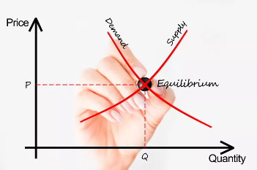
Scenario:
You ask students to apply supply and demand to a real-world market (e.g., housing, gas prices).
Students analyze trends and explain price changes.
Visible Identity:
Focus on application and analytical reasoning
Emphasis on real-world decision-making
Impact:
Improves understanding of economic concepts
Increases ability to analyze real-world situations
Strengthens transfer of learning
Key Idea: 👉 Applying concepts to real situations makes economic thinking visible.
Economics
Making Thinking Visible
Notes:
In economics, making your teaching visible means helping students see how abstract models and theories operate in real-world decision-making. Concepts such as supply and demand, opportunity cost, or inflation can remain theoretical unless students are asked to apply them to situations they recognize. When you design learning experiences that connect economic principles to current events, personal choices, or market behaviors, you make these ideas concrete and meaningful.
For example, you might ask students to analyze how changes in supply and demand affect the price of a common product, such as housing or gasoline. Rather than simply defining the concept, students examine real data, identify trends, and explain the underlying economic forces at work. This makes your expectations visible—students are not just learning definitions; they are learning how to think like economists.
This approach reflects a teaching identity grounded in application and analytical reasoning. Students become more engaged because they can see how economics influences everyday life. As a result, they develop a deeper understanding of key concepts and are better able to transfer their knowledge to new contexts. By making economic thinking visible, you strengthen both comprehension and the ability to apply concepts, leading to improved performance and success.

Slide 23
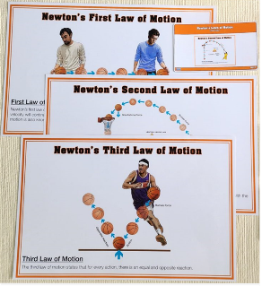
Physics
Making Concepts and Thinking Visible
Scenario:
You ask students to apply a concept (e.g., Newton’s laws) to a real-world situation.
Students explain motion, forces, or energy in context.
Visible Identity:
Focus on conceptual understanding and application.
Emphasis on explaining, not just calculating.
Impact:
Improves understanding of physical principles
Strengthens problem-solving and reasoning
Increases accuracy in applying formulas
Key Idea:
👉 Explaining real-world phenomena makes physics concepts visible and meaningful.
Notes:
In physics, making your teaching visible means helping students connect mathematical formulas and abstract principles to observable physical phenomena. Concepts such as force, motion, energy, or electricity can feel disconnected unless students see how they operate in the real world. When you design learning experiences that require students to predict, test, and explain physical behavior, you make these concepts concrete and understandable.
For example, you might ask students to apply Newton’s laws to analyze the motion of a car, a falling object, or a real-life scenario such as braking distance. Instead of only solving equations, students explain what is happening, why it happens, and how the variables interact. This makes your expectations visible—students are not just performing calculations; they are developing conceptual understanding and scientific reasoning.
This approach reflects a teaching identity grounded in inquiry, application, and problem-solving. Students engage more deeply because they can see how physics explains the world around them. As a result, they improve both their conceptual understanding and their ability to apply formulas appropriately. By making thinking visible through real-world application and explanation, you strengthen comprehension, accuracy, and overall success in the course.

Slide 24

Pharmacy Technology
Making Clinical Thinking Visible
Scenario:
You present a patient case requiring medication selection or dosage decisions.
Students analyze patient data and justify their recommendations.
Visible Identity:
Focus on clinical reasoning and patient-centered care
Emphasis on application, accuracy, and decision-making
Impact:
Improves ability to apply knowledge in clinical contexts
Strengthens critical thinking and precision
Builds confidence for real-world practice
Key Idea: 👉 Applying knowledge to patient care makes learning relevant and visible.
Notes:
In pharmacy technology, making your teaching visible means helping students connect scientific knowledge to real patient care decisions. Concepts such as pharmacokinetics, drug interactions, and dosage calculations can remain abstract unless students apply them in clinical contexts. When you design learning experiences that require students to evaluate patient cases, interpret data, and make recommendations, you make learning directly relevant to professional practice.
For example, you might present a patient scenario and ask students to determine the appropriate medication, dosage, or potential drug interactions. Instead of recalling information in isolation, students analyze patient history, consider variables such as age or comorbidities, and justify their decisions. This makes your expectations visible—students are not just learning facts; they are learning how to think like pharmacists.
This approach reflects a teaching identity grounded in clinical reasoning, precision, and patient-centered care. Students become more engaged because they can see the direct connection between coursework and their future roles. As a result, they develop stronger decision-making skills, improve accuracy, and gain confidence in applying their knowledge. By making learning visible through authentic scenarios, you prepare students for real-world practice and improve overall success.

Slide 25

Art History
Making Interpretation Visible
Scenario:
You ask students to analyze a work of art using visual elements and historical context.
Students interpret meaning rather than recall facts.
Visible Identity:
Focus on analysis, interpretation, and visual literacy
Emphasis on context and meaning-making
Impact:
Improves analytical and critical thinking skills
Deepens understanding of art and context
Increases engagement with visual material
Key Idea: 👉 Guided analysis makes interpretation visible and meaningful.
Notes:
In art history, making your teaching visible means helping students move beyond description to interpretation and analysis. Works of art are rich with meaning, context, and perspective, but students often need guidance in how to “read” them. When you design learning experiences that require students to analyze visual elements, consider historical context, and construct interpretations, you make disciplinary thinking clear and accessible.
For example, you might present a work of art and ask students to analyze how composition, symbolism, and historical context contribute to its meaning. Instead of simply identifying the artist or time period, students examine how the artwork communicates ideas and reflects its cultural moment. This makes your expectations visible—students are not just learning about art; they are learning how to interpret it.
This approach reflects a teaching identity grounded in critical analysis, visual literacy, and contextual understanding. Students engage more deeply because they are actively making meaning rather than passively receiving information. As a result, they develop stronger analytical skills and a greater appreciation for the complexity of artistic expression. By making interpretation visible, you strengthen both understanding and the ability to think critically about visual culture.

Slide 26

Better for Students, Better for You
The Power of Visible Teaching
Notes:
Making your teaching visible creates shared benefits for both students and you. When expectations are clear, practices are consistent, and learning experiences are intentionally designed, students gain clarity and confidence while you gain efficiency and control. This alignment strengthens the overall learning environment, making it more effective and more manageable.
For students, visible teaching provides structure, guidance, and meaningful opportunities to engage and succeed. For you, it reduces ambiguity, streamlines communication, and makes it easier to see what is working and where to make adjustments. The same practices that support student success also simplify your teaching, creating a more focused and purposeful approach.
This shared impact is what makes visible teaching so powerful. It is not an added task—it is a more effective way of doing what you already do. When your teaching is clear, consistent, and intentional, it improves outcomes for students while enhancing your effectiveness. The result is a learning experience that works better for everyone involved.

Slide 27

Benefits for Students Clear, Supported, Successful
Clear expectations:
Know what to do and how to succeed
Reduce confusion and uncertainty
Visible support:
Timely communication and feedback
Increased confidence and motivation
Meaningful learning:
Apply concepts to real situations
Deeper understanding and engagement
Consistent practices:
Stronger performance
Increased persistence and success
Key Idea: 👉 When teaching is visible, students are more confident, engaged, and successful.
Notes:
When your teaching is visible, students experience greater clarity, confidence, and connection to their learning. Clear expectations, structured activities, and timely communication help students understand what is required and how to succeed. Instead of navigating uncertainty, they are able to focus their effort on learning, which leads to stronger engagement and more consistent performance.
Visible teaching also supports student confidence and motivation. When students receive early feedback, see examples of successful work, and understand how concepts apply to real situations, they begin to recognize their progress and capability. This reduces anxiety and builds momentum, especially in the early weeks of the course. As a result, students are more likely to participate, complete assignments, and remain engaged.
Over time, these experiences lead to measurable outcomes. Students who understand expectations and feel supported are more likely to succeed in their coursework and persist from one term to the next. Visible teaching creates a learning environment where students can navigate challenges, apply their knowledge, and make steady progress. The result is not only improved performance, but a stronger, more sustainable path to success.

Slide 28

Greater Clarity:
Clear expectations and structured practices
Strong alignment between what you do and student outcomes
Increased Efficiency:
Fewer repeated questions
More streamlined communication and course management
Improved Effectiveness:
Easier to identify what works and refine your approach
More consistent student performance
Stronger Impact:
Direct connection to retention, success, and persistence (G2)
Alignment with institutional goals (G1–G4)
Key Idea: 👉 Making your teaching visible makes your work more effective, efficient, and impactful.
Benefits for Faculty
Clear, Efficient, Impactful Teaching
Notes:
Making your teaching visible does not only benefit students—it also makes your work more effective, efficient, and manageable. When your practices are clear and intentional, you spend less time addressing confusion and more time supporting learning. Clear expectations, structured assignments, and consistent communication reduce repeated questions, streamline your workflow, and create a more organized teaching experience.
Visible teaching also strengthens your sense of control and alignment. When your actions are intentionally connected to outcomes, it becomes easier to see what is working and where adjustments are needed. This clarity allows you to refine your approach over time without overhauling your course. Instead of reacting to challenges, you are able to anticipate and address them through consistent practices.
In addition, making your teaching visible connects your daily work to a larger purpose. The strategies you use in your classroom directly contribute to student success and institutional goals. This alignment reinforces the impact of your role and highlights how your everyday decisions support retention, course success, and long-term student achievement. Visible teaching not only improves the student experience—it enhances your effectiveness and impact as an instructor.

Slide 29

Why This Matters
Replacing Conversation with Clarity
Notes:
In faculty development, conversations about teaching are common—but they do not always lead to clear or consistent change. While discussion can generate ideas, it often leaves room for interpretation, making it difficult to translate concepts into action. Without clear examples, what effective teaching looks like can remain ambiguous, varying from one person to another.
Replacing conversation with clarity shifts the focus from talking about teaching to showing it. When expectations are visible and grounded in concrete practices, it becomes easier to understand, apply, and refine effective strategies. Clear examples eliminate guesswork, allowing you to see exactly how a practice works and how it can be implemented in your own classroom.
This clarity is what drives improvement. When teaching is defined through observable actions, it becomes more consistent, more intentional, and more aligned with student outcomes. Instead of relying on interpretation, you have a clear model to follow—one that connects directly to engagement, success, and persistence. In this way, clarity does not replace professional dialogue; it strengthens it by ensuring that what is discussed can be seen, understood, and applied.

Slide 30

Examples
A Clear Alternative to Discussion
Examples show exactly what teaching looks like in action.
Reduce ambiguity and eliminate guesswork
Provide a shared reference point for understanding
Unlike discussion, examples:
Do not rely on interpretation
Are immediately usable
Can be applied quickly
Make professional learning:
More efficient
More accessible
More consistent
Key Idea:
👉 Clear examples can replace conversation by making teaching practices visible and actionable.
Notes:
Examples can serve the same function as peer discussion by making effective teaching practices immediately visible and understandable. While conversations allow for the exchange of ideas, they often rely on interpretation and prior experience. In contrast, well-designed examples show exactly what a strategy looks like in action, removing ambiguity and making it easier to translate ideas into practice.
When you use clear scenarios, you provide a shared reference point. Instead of imagining how a strategy might work, you can see a specific action, understand the context, and recognize the outcome. This creates a more efficient form of professional learning—one that does not depend on extended dialogue but still supports reflection and improvement.
Examples also make learning more accessible and scalable. Not everyone has access to the same conversations or collaborative opportunities, but everyone can benefit from concrete models of effective teaching. By using examples as stand-ins for peer discussion, you create clarity, consistency, and immediate applicability. This ensures that effective practices are not just discussed but understood and implemented.

Slide 31

Immediate Clarity
What Good Teaching Looks Like
Examples show specific, observable teaching practices.
Help you:
Recognize effective strategies quickly
Apply practices with confidence
Align actions with student outcomes
Support:
Consistency in teaching
Faster improvement
More effective practice
Key Idea:
👉 Clear examples show exactly what good teaching looks like—and how to do it.
Notes:
One of the most significant benefits of using examples is that they provide immediate clarity on what good teaching looks like in practice. Instead of relying on abstract descriptions or general advice, examples show specific actions that define effective teaching. This removes uncertainty and helps you quickly recognize what to do and how to do it.
When expectations are clear, it becomes easier to align your teaching with desired outcomes. You can see how a strategy is implemented, understand its purpose, and apply it directly to your own context. This clarity reduces the time spent interpreting ideas and increases the time spent improving practice. It also helps ensure consistency, as effective teaching is defined by observable actions rather than individual interpretation.
Immediate clarity is especially important in fast-paced teaching environments where time is limited. Clear examples allow you to make quick, informed adjustments that enhance student learning. By showing what effective teaching looks like, rather than simply describing it, examples make improvement more accessible, practical, and impactful.

Slide 32
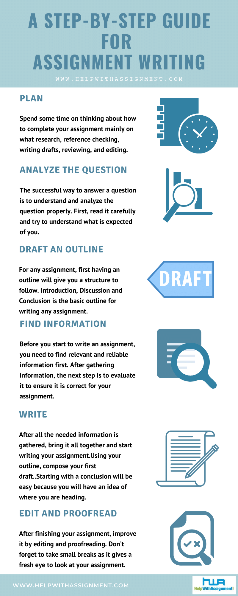
Reducing Ambiguity
Making Expectations Clear
Examples make expectations explicit and visible.
Eliminate confusion about what success looks like
Help students:
Understand how to approach tasks
Focus on learning—not guessing
Perform more consistently
Help you:
Align intentions with student experience
Communicate more clearly
Reduce misunderstandings
Key Idea:
👉 Clear expectations reduce confusion and support student success.
Notes:
Another key benefit of using clear examples is that they reduce ambiguity in expectations—both for you and for your students. When expectations are vague or implied, students are left to interpret what success looks like, often leading to confusion, inconsistency, and uneven performance. Similarly, without clear models of effective teaching, it can be difficult to determine how to translate general ideas into specific actions.
Examples remove this uncertainty by making expectations explicit and visible. When students can see what a strong response looks like, understand how an assignment should be approached, or recognize how concepts are applied, they are better equipped to meet expectations. This clarity shifts their focus from figuring out what to do to actually engaging in the learning process.
For you, reduced ambiguity means greater alignment between what you intend and what students experience. Your instructions, assignments, and feedback become more precise and consistent, leading to fewer misunderstandings and more meaningful engagement. When expectations are clear, students are more confident, more prepared, and more likely to succeed. Clarity does not simplify learning—it makes success achievable.

Slide 33

Adopt and Adapt
Making Improvement Practical
Examples provide ready-to-use models of effective teaching.
Reduce time spent interpreting or designing from scratch
Allow you to:
Apply strategies immediately
Adjust practices to fit your course
Build on what you already do well
Support:
Efficient implementation
Continuous improvement
Greater teaching impact
Key Idea: 👉 Clear examples make it easy to adopt, adapt, and improve your teaching.
Notes:
A key advantage of using clear examples is that they allow you to quickly adopt and adapt effective teaching practices. Instead of starting from scratch or trying to interpret broad recommendations, you can see a concrete model and immediately consider how it fits within your own course. This reduces the time and effort required to implement new strategies while increasing the likelihood that they will be used effectively.
Examples provide a starting point, not a script. You can adjust them based on your discipline, course structure, and student needs while maintaining the core principle behind the practice. This flexibility makes improvement both practical and sustainable. Rather than overhauling your teaching, you can make targeted adjustments that build on what you already do well.
This approach also supports continuous improvement. As you adopt and refine practices, you begin to see what works best in your context. Over time, these adaptations become part of your teaching routine, strengthening both consistency and impact. When practices are clear and adaptable, you are better equipped to respond to student needs and improve outcomes efficiently.

Slide 34

Small Actions, Measurable Impact
Teaching impact comes from small, intentional actions.
Daily practices shape student experience and outcomes.
Examples:
Clear expectations → reduced confusion
Early feedback → improved performance
Timely communication → increased preparation
Over time, these actions lead to:
Higher success rates
Increased retention
Greater student confidence
Key Idea: 👉 Small, consistent actions lead to meaningful and measurable results.
Notes:
One of the most important messages reinforced by this approach is that small, intentional actions lead to measurable outcomes. Teaching impact is not driven only by large changes or complete course redesigns—it is built through consistent, purposeful decisions made every day. Actions such as providing early feedback, clarifying expectations, or sending a timely reminder may seem minor, but they directly influence how students engage, prepare, and perform.
When these actions are intentional and aligned with your goals, their effects become visible in student outcomes. Increased preparation leads to stronger performance, clear expectations reduce confusion, and timely support improves persistence. Over time, these small actions accumulate, producing measurable improvements in areas such as retention, course success, and student confidence.
This perspective shifts the focus from complexity to consistency. You do not need to do more—you need to be more intentional with what you already do. By recognizing the connection between everyday actions and measurable results, you can make targeted adjustments that lead to meaningful impact. Small actions, when applied consistently, are what drive student success.

Slide 35
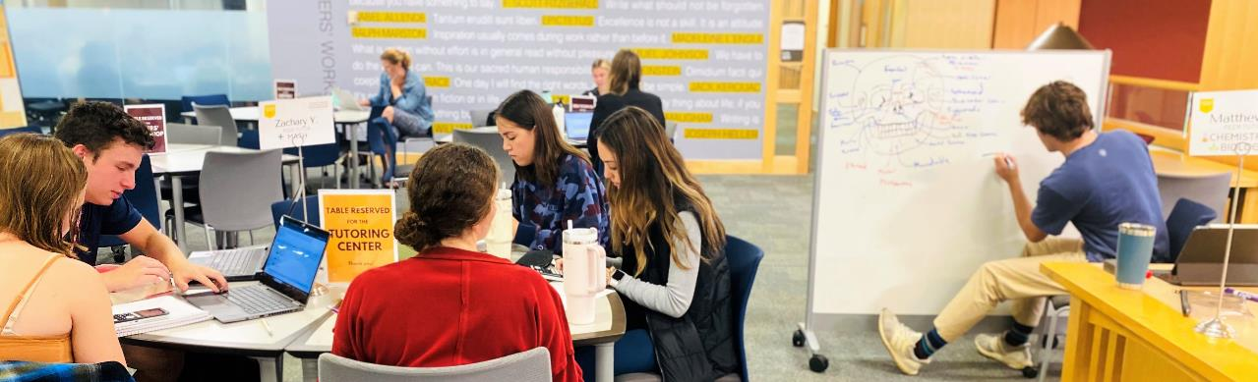
Teaching Practices and Institutional Goals
Daily Teaching Practices Drive Institutional Success.
Completion and Pathways (G4) → Sustained student progress
Leads to:
Student success and persistence
Enrollment stability
Financial resilience (G1)
Key Idea: 👉 What you do every day in the classroom drives institutional success.
Your daily actions directly impact student and institutional outcomes.
Aligned to Key Goals (G1–G4):
Retention (G2-KPI1/2) → Early engagement and clear expectations
Gateway Success (G2-KPI3) → Effective teaching and assignment design
Wraparound Utilization (G2-KPI5) → Referrals to support services
Notes:
Daily teaching practices are not separate from institutional goals—they are how those goals are achieved. Every interaction, assignment, and instructional decision contributes to broader outcomes such as retention, course success, persistence, and completion. When your teaching is intentional and visible, it directly supports the metrics that define institutional success.
For example, clear expectations and early engagement support Retention (G2-KPI1) by helping students stay connected and on track. Thoughtfully designed assignments that promote application and understanding improve Gateway Course Success (G2-KPI3). Referring students to support services increases Wraparound Utilization (G2-KPI5) and strengthens persistence. Over time, these outcomes contribute to completion, transfer, and workforce readiness (G4), while also supporting enrollment stability and financial resilience (G1).
This alignment reinforces an important idea: institutional success is built through everyday teaching. When your daily practices are intentional and connected to student outcomes, they extend beyond the classroom and contribute to the college’s mission and strategic goals. What you do each day is not just teaching—it is a direct driver of student success and institutional effectiveness.

Slide 36
From Intentions to Impact: Making Your Teaching Visible
Teaching is defined by what you do—not just what you intend
Visible practices create:
Clarity
Engagement
Student success
Focus on:
Small, intentional actions
Consistent, clear practices
Observable impact on students
Your daily teaching supports:
Retention
Course success
Institutional goals (G1–G4)
Key Idea: 👉 What you make visible is what makes the difference
Notes:
In conclusion, effective teaching is not defined by intention alone—it is defined by what you consistently make visible in your practice. Throughout this resource, the focus has been on translating beliefs into action, using clear examples, and emphasizing small, intentional decisions that shape the student experience. When your teaching is visible, students understand expectations, engage more fully, and are better equipped to succeed. What you do each day becomes the foundation for meaningful learning.
This approach also reinforces that improvement does not require major changes. By focusing on a few high-impact practices—proactive communication, intentional design, timely feedback, and connection to support—you create consistent experiences that lead to measurable outcomes. These actions build momentum over time, strengthening confidence, performance, and persistence. Clear, visible teaching practices make success more accessible for students and more achievable for you.
Ultimately, making your teaching visible connects your daily work to something larger. Your actions influence not only individual student outcomes, but also broader goals such as retention, course success, and completion. This is where intention becomes impact. When your teaching is clear, consistent, and purposeful, it drives both student success and institutional effectiveness. What you make visible is what makes the difference.

Slide 37

Almarode, J. Building and Sustaining a Visible Learning Classroom. YouTube.
Almarode, J. Making Sense of Visible Learning, Corwin Connect.
Bennett, C. Visible Learning Ranks Teacher Estimate as #1 Factor in Learning. Issues in Education, ThoughtCo.
Hattie, J. Visible Learning: A Synthesis of Over 800 Meta-Analyses Relating to Achievement. Routledge, Taylor and Francis Group.
Hattie, J. Visible Learning for Teachers: Maximizing Impact in Learning. Routledge, Taylor and Francis Group.
Hattie’s Concept of Visible Teaching and Learning, Research for Teachers, General Teaching Council for England.
High Impact Teaching Strategies, Excellence in Teaching and Learning. Victoria State Government.
Hutchings, P. Editor. The Course Portfolio: How Faculty Can Examine Their Teaching to Advance Practice and Improve Student Learning. American Association for Higher Education.
Kuh, G. D., Ikenberry, S. O., Jankowski, N. A., Cain, T. R., Ewell, P. T., Hutchings, P., & Kinzie, J. (2015). Using evidence of student learning to improve higher education. American Association of Colleges and Universities & National Institute for Learning Outcomes Assessment.
Visible Learning, Mary MacKillop College, Brisbane Catholic Education.
References

