Slide 1

Inclusive
Teaching:
Supporting Students with Disabilities
Faculty Focus: Innovative Teaching Techniques for College Success Series
Notes:
Imagine stepping into a classroom where the material is engaging, the instructor is passionate, and your peers are eager to learn—yet you can’t follow the lecture because the slides have too much text, the videos have no captions, or your disability makes it hard to take notes fast enough. For many students with disabilities, this is not just an occasional challenge—it’s a daily experience. While most faculty care deeply about student success, we often overlook the hidden barriers that prevent some students from fully participating and thriving. In this resource, we’ll explore how we can make our classrooms more inclusive—not by lowering standards, but by recognizing the diversity of learners and designing with accessibility in mind. Because when we teach with inclusion at the forefront, we don’t just support students with disabilities—we create better learning environments for everyone.

Slide 2
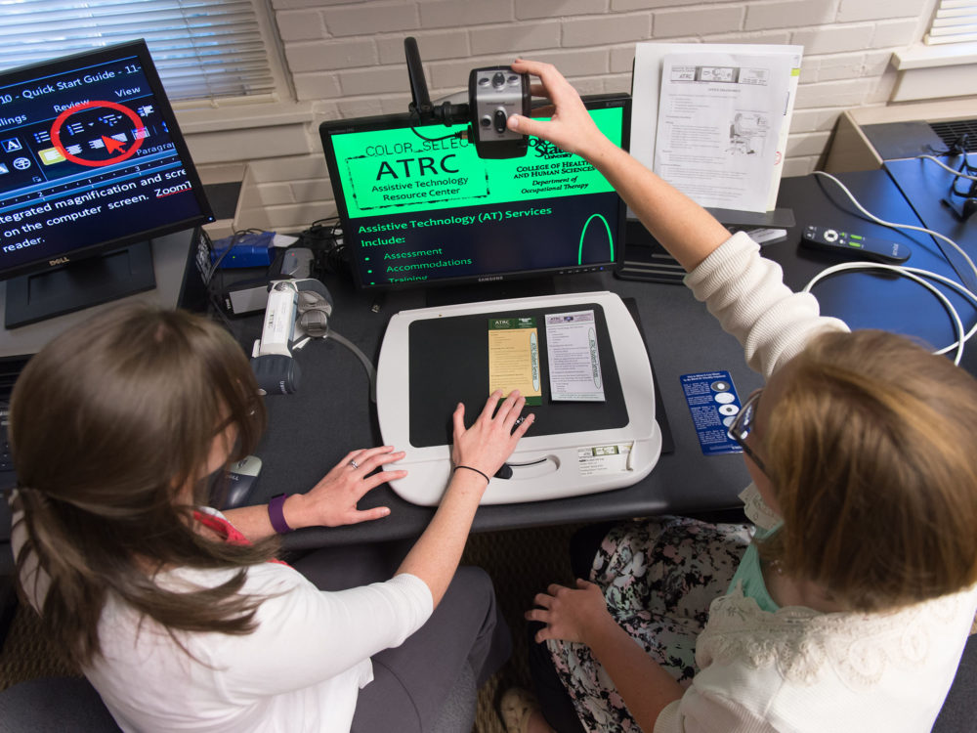
Why This
Matters
“1 in 5 college students reports having a disability.”
– National Center for Education Statistics
Disabilities may be physical, sensory, cognitive, psychological, or invisible.
Many students face unintentional barriers in learning environments not designed with their needs in mind.
Inclusive teaching helps remove these barriers and benefits all learners.
Notes:
"One in five college students reports having a disability." This powerful statistic from the National Center for Education Statistics reminds us that students with disabilities are not a small minority—they are a significant part of our campus communities. Yet many of these students continue to face barriers in classrooms not designed with their needs in mind. Disabilities may be physical, sensory, cognitive, psychological, or invisible—but all can impact learning when instructional practices are not inclusive. This presentation offers strategies to help faculty better support students with disabilities by creating learning environments that are accessible, flexible, and equitable for all.

Slide 3

Types of Disabilities
and Barriers to Learning
Disabilities vary widely and may be:
  Physical (e.g., mobility or chronic health conditions)
  Sensory (e.g., hearing or vision impairments)
  Cognitive (e.g., learning disabilities, brain injuries)
  Psychological (e.g., anxiety, depression, PTSD)
  Neurodivergent (e.g., ADHD, autism spectrum)
Disabilities may be visible or invisible
Common learning barriers include:
  Inaccessible course materials
  Rigid assessments or deadlines
  Fast-paced or unclear lectures
  Assumptions about ability
  Lack of flexibility in teaching
Awareness is the first step toward creating inclusive, supportive learning environments.
Notes:
Students with disabilities represent a broad and diverse group, each with unique needs and strengths. Disabilities may be physical, such as mobility or chronic health conditions; sensory, such as hearing or vision impairments; cognitive, such as learning disabilities or traumatic brain injuries; or psychological, including anxiety, depression, or PTSD. Some students are neurodivergent, including those with ADHD or autism spectrum disorders. These conditions may be visible or invisible, and each can present barriers in the learning environment. Common challenges include inaccessible course materials, rigid assessments, unclear expectations, fast-paced lectures, or assumptions about student ability. Recognizing these barriers is the first step toward creating more inclusive classrooms where all students can thrive.

Slide 4

Understanding
Disabilities
Notes:
Understanding disabilities is essential to creating inclusive learning environments. Disabilities are not one-size-fits-all—they vary in type, visibility, and impact. Some students may use wheelchairs or assistive devices, while others may have conditions like dyslexia, anxiety, or autism that are not immediately apparent. Each student’s experience is unique, and the challenges they face in college classrooms can differ widely depending on course design, teaching style, and available support. In this section, we’ll explore the broad categories of disability and how they can affect a student’s ability to access, process, and demonstrate learning. By building our awareness, we take the first step toward removing barriers and supporting academic success for all.

Slide 5

Learning disabilities affect how students process, retain, or express information.
Dyslexia:
  Difficulty with reading fluency, decoding, spelling, and comprehension
  Reading-heavy or timed tasks can be especially challenging
ADHD:
  Challenges with focus, organization, time management, and impulse control
  May struggle with long lectures, instructions, or sustained tasks
Key point: These difficulties are not related to intelligence or effort.
Support matters: With the right strategies and accommodations, students can thrive.
Learning Disabilities: Dyslexia and ADHD
Notes:
Learning disabilities are neurological conditions that affect how individuals acquire, process, retain, or express information. Two of the most common learning disabilities in college settings are dyslexia and Attention-Deficit/Hyperactivity Disorder (ADHD). Students with dyslexia may have difficulty reading accurately and fluently, often struggling with decoding words, spelling, and understanding written text. This can make reading-heavy assignments or timed reading tasks especially challenging.
On the other hand, students with ADHD may experience difficulties with focus, organization, time management, and impulse control. They might find it hard to concentrate during lectures, follow multistep instructions, or stay on task during exams or long assignments. Importantly, these challenges are not related to intelligence or motivation—students with learning disabilities are capable of high academic achievement when given appropriate support and accommodations. Understanding the nature of these disabilities helps you design more accessible materials and classroom strategies that foster success for all learners.

Slide 6
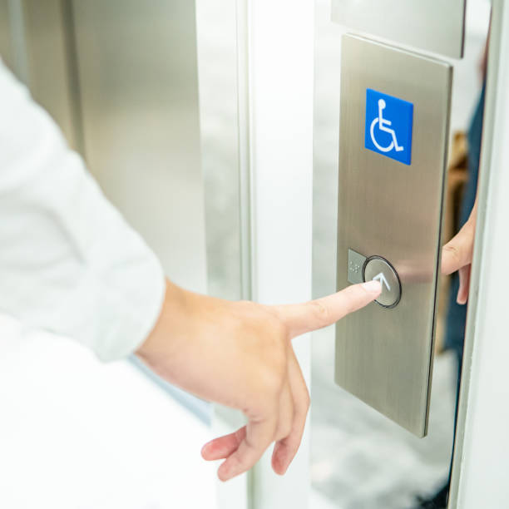
Physical
Disabilities
Include conditions affecting mobility, stamina, or physical functioning (e.g., cerebral palsy, muscular dystrophy, spinal cord injuries)
Students may use wheelchairs, scooters, braces, or other mobility aids
Common barriers:
  Inaccessible buildings or classrooms
  Heavy doors, distant parking, tight seating spaces
  Limited participation in physical activities or labs
Accessibility goes beyond building codes—flexibility in teaching matters
Inclusive practices help ensure full participation and support student success
Notes:
Physical disabilities include a wide range of conditions that affect a person’s mobility, stamina, or physical functioning. These can result from congenital conditions, injuries, or chronic illnesses such as cerebral palsy, muscular dystrophy, multiple sclerosis, or spinal cord injuries. In a college setting, students with physical disabilities may use wheelchairs, scooters, braces, or other mobility aids. Their challenges can include navigating inaccessible buildings, reaching classroom materials, or participating in activities that require physical movement. Even when buildings are technically compliant with accessibility standards, barriers like heavy doors, distant parking, or cramped seating arrangements can create daily obstacles. It's important for instructors to consider not just physical access, but also flexibility in participation—offering alternative ways to engage in lab work, group activities, or presentations, for example. Recognizing and addressing these barriers promotes greater equity and helps all students feel welcome and supported in the learning environment.

Slide 7
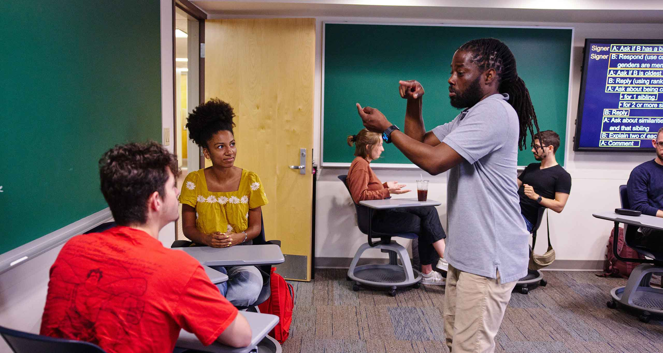
Sensory
Disabilities
Involve impairments in vision, hearing, or both
Vision impairments:
  May require large print, Braille, or screen reader–friendly materials
  Visuals and handouts need accessible formats or descriptions
Hearing loss:
  Students may use hearing aids, captioning, or sign language interpreters
  Spoken content without visual support can be a barrier
Common challenges:
  Uncaptioned videos
  Instructors not facing students when speaking
  Heavy reliance on verbal-only instruction
Inclusive tip: Use multimodal communication (text, visuals, captions, etc.) to support access.
Notes:
Sensory disabilities involve impairments related to sight, hearing, or both, and can significantly affect how students access and engage with course materials. Students with vision impairments may be blind or have low vision, requiring materials in accessible formats such as large print, Braille, or screen reader–compatible digital documents. Visual presentations, handouts, and diagrams can become barriers if not described or made accessible.
Students with hearing loss may be hard of hearing or Deaf and often rely on assistive technologies such as hearing aids, captioning services, or sign language interpreters to access spoken content. Instructors who speak while facing the board, play uncaptioned videos, or rely heavily on verbal discussion without visual cues may unintentionally exclude these learners. Creating a sensory-accessible classroom involves using clear, multimodal communication strategies and being mindful of how content is delivered to ensure all students can fully participate and understand.

Slide 8

Mental Health Conditions
Include anxiety, depression, and other mood or emotional disorders
Often invisible and may fluctuate in severity over time
Anxiety:
  Can affect participation, presentations, test-taking, and attendance
Depression:
  May impact energy, focus, motivation, and assignment completion
Common challenges:
  Meeting deadlines
  Concentrating in class
  Managing academic stress
Supportive strategies:
  Normalize mental health discussions
  Offer flexibility and clarity
  Create an empathetic, low-pressure learning environment
Notes:
Mental health conditions such as anxiety and depression are increasingly common among college students and can significantly impact learning and classroom engagement. Students with anxiety may struggle with participation, presentations, timed tests, or even attending class regularly due to overwhelming stress or fear of judgment. Depression can affect energy levels, concentration, motivation, and the ability to complete assignments or meet deadlines. These conditions are often invisible and can fluctuate over time, making them difficult to recognize. Without understanding and support, students may fall behind academically or withdraw from the learning environment altogether. Creating a classroom culture that normalizes mental health support, offers flexibility when possible, and emphasizes empathy can make a meaningful difference. Small changes—like offering alternative participation options or clearly outlining expectations—can help students with mental health conditions feel more secure, included, and capable of succeeding.

Slide 9

Neurodiversity
Refers to natural differences in how people think and learn
Includes autism, ADHD, dyslexia, and other cognitive variations
Autism spectrum:
  May affect communication, sensory processing, and flexibility with change
  Group work and vague instructions can be challenging
Strengths often include:
  Deep focus, attention to detail, creativity, and strong memory
Inclusive strategies:
  Use clear expectations and consistent routines
  Provide visual aids and multiple ways to participate
  Embrace neurodiversity as a difference, not a deficit
Notes:
Neurodiversity refers to the natural variation in how people think, learn, and process information. It includes conditions such as autism spectrum disorder (ASD), ADHD, dyslexia, and others. Students on the autism spectrum may experience differences in social communication, sensory processing, or behavior regulation. In a college classroom, they might find group work, sudden schedule changes, or vague instructions particularly challenging. At the same time, neurodivergent students often bring strengths such as deep focus, creative thinking, attention to detail, and strong memory skills. It’s important to recognize that neurodiversity is not a deficit but a difference, and students benefit when instructors design environments that offer structure, clarity, and multiple ways to engage. Simple practices—like providing clear expectations, using consistent routines, and offering visual aids—can help neurodivergent students feel more supported, understood, and capable of academic success.

Slide 10

Invisible vs. Visible Disabilities
Visible disabilities are easily noticeable.
  Examples: wheelchair use, limb differences, mobility aids
  Often more readily acknowledged and accommodated
Invisible disabilities are not immediately apparent.
  Examples: learning disabilities, mental health conditions, chronic pain, hearing loss
  Can be misunderstood or overlooked
Key challenges:
  Invisible disabilities may lead to stigma or disbelief.
  Students may hesitate to disclose or seek help.
Inclusive mindset:
  Avoid assumptions—not all disabilities are visible.
  Foster empathy and provide support for all students.
Notes:
Disabilities can be broadly categorized as either visible or invisible, and understanding this distinction is crucial for fostering empathy and inclusion. Visible disabilities are those that are apparent to others, such as mobility impairments that require the use of a wheelchair or crutches. Because these disabilities are outwardly noticeable, they are often more readily acknowledged and accommodated.
In contrast, invisible disabilities are not immediately apparent and may include conditions such as learning disabilities, mental health disorders, chronic pain, or sensory impairments like hearing loss. These can be just as impactful on a student’s academic experience but may go unrecognized or misunderstood by instructors and peers. As a result, students with invisible disabilities may face skepticism or be reluctant to seek accommodations for fear of stigma. Recognizing that many disabilities are not visible reminds you to approach each student with openness, avoid assumptions, and prioritize accessibility and support for all learners, regardless of what we can see.

Slide 11

Equal Access to Education
Notes:
Creating an inclusive learning environment for students with disabilities isn’t just a best practice—it’s a legal responsibility. Colleges and universities are required by federal law to provide equal access to education for all students, regardless of disability. Understanding the legal and institutional framework behind disability services helps you know your role in supporting students and ensuring compliance. This section explores two key pieces of legislation—the Americans with Disabilities Act (ADA) and Section 504 of the Rehabilitation Act—that shape how institutions accommodate students and remove barriers to learning.

Slide 12

Legal and
Institutional Context
Americans with Disabilities Act (ADA)
  Enacted in 1990
  Requires public institutions to provide equal access and reasonable accommodations
  Applies to facilities, programs, and services
Section 504 of the Rehabilitation Act (1973)
  Applies to institutions receiving federal funding
  Prohibits discrimination against students with disabilities
  Ensures access to all programs and activities
Impact on colleges:
  Must remove barriers to learning
  Support includes accommodations (e.g., extended time, accessible materials).
Key takeaway:
  These laws protect student rights and support inclusive teaching.
Notes:
In higher education, laws like the Americans with Disabilities Act (ADA) and Section 504 of the Rehabilitation Act provide critical legal protections for students with disabilities. These laws require colleges and universities to ensure equal access to education and prohibit discrimination based on disability. The ADA, enacted in 1990, mandates that public institutions—including colleges—provide reasonable accommodations and make facilities, programs, and services accessible to individuals with disabilities. Section 504, part of the Rehabilitation Act of 1973, specifically applies to institutions receiving federal funding. It states that no qualified individual with a disability can be excluded from participation in, denied the benefits of, or subjected to discrimination under any program or activity. Together, these laws form the foundation for disability services in higher education, ensuring that students are not only granted physical access but also academic access through accommodations like extended testing time, note-taking support, or accessible course materials. Understanding these legal frameworks helps you recognize your responsibilities and contribute to an inclusive learning environment

Slide 13
Lone Star College Accessibility
Services and Resources
Creating Inclusive Environments at Lone Star College
Mission: Collaborates across the College to proactively create usable, equitable, and inclusive working and learning environments.
Compliance: Ensures adherence to
  Section 504 of the Rehabilitation Act (1973)
  Americans with Disabilities Act (1990 & Amendments)
Services: Provides strategies, programs, and initiatives to support accessibility
Policy VI.D.11.01 – Student Disability Rights
Commitment: Equal access to educational opportunities for qualified individuals with disabilities.
Accommodations: Provides reasonable accommodations and auxiliary aids/services as required by law.
Procedures: Ensures prompt and equitable implementation of accommodation requests.
Full Policy: VI.D.11 – Students with Disability Rights
Notes:
Accessibility Services and Resources is responsible for collaborating with members of Lone Star College to proactively create usable, equitable, and inclusive working and learning environments for the College’s community. The department provides strategy, initiatives, and programs for ensuring compliance with Section 504 of the Rehabilitation Act of 1973 and the Americans with Disabilities Act (1990) and the revisions under the Americans with Disabilities Act.
VI.D.11.01. Policy
The College recognizes and supports the principles set forth in federal and state laws designed to eliminate discrimination against qualified individuals with disabilities. The College believes in equal access to educational opportunities for all individuals. The College is committed to making reasonable accommodations, including furnishing auxiliary aids and services, for qualified individuals with disabilities as required by law. For purposes of this policy section, accommodation requests also mean requests for auxiliary aids and services.
The College shall communicate and make available the procedures for the prompt and equitable implementation of reasonable accommodations for qualified individuals.
The Lone Star College Complete Policy on Student Disabilities can be found at VI.D.11. Students with Disability Rights.

Slide 14
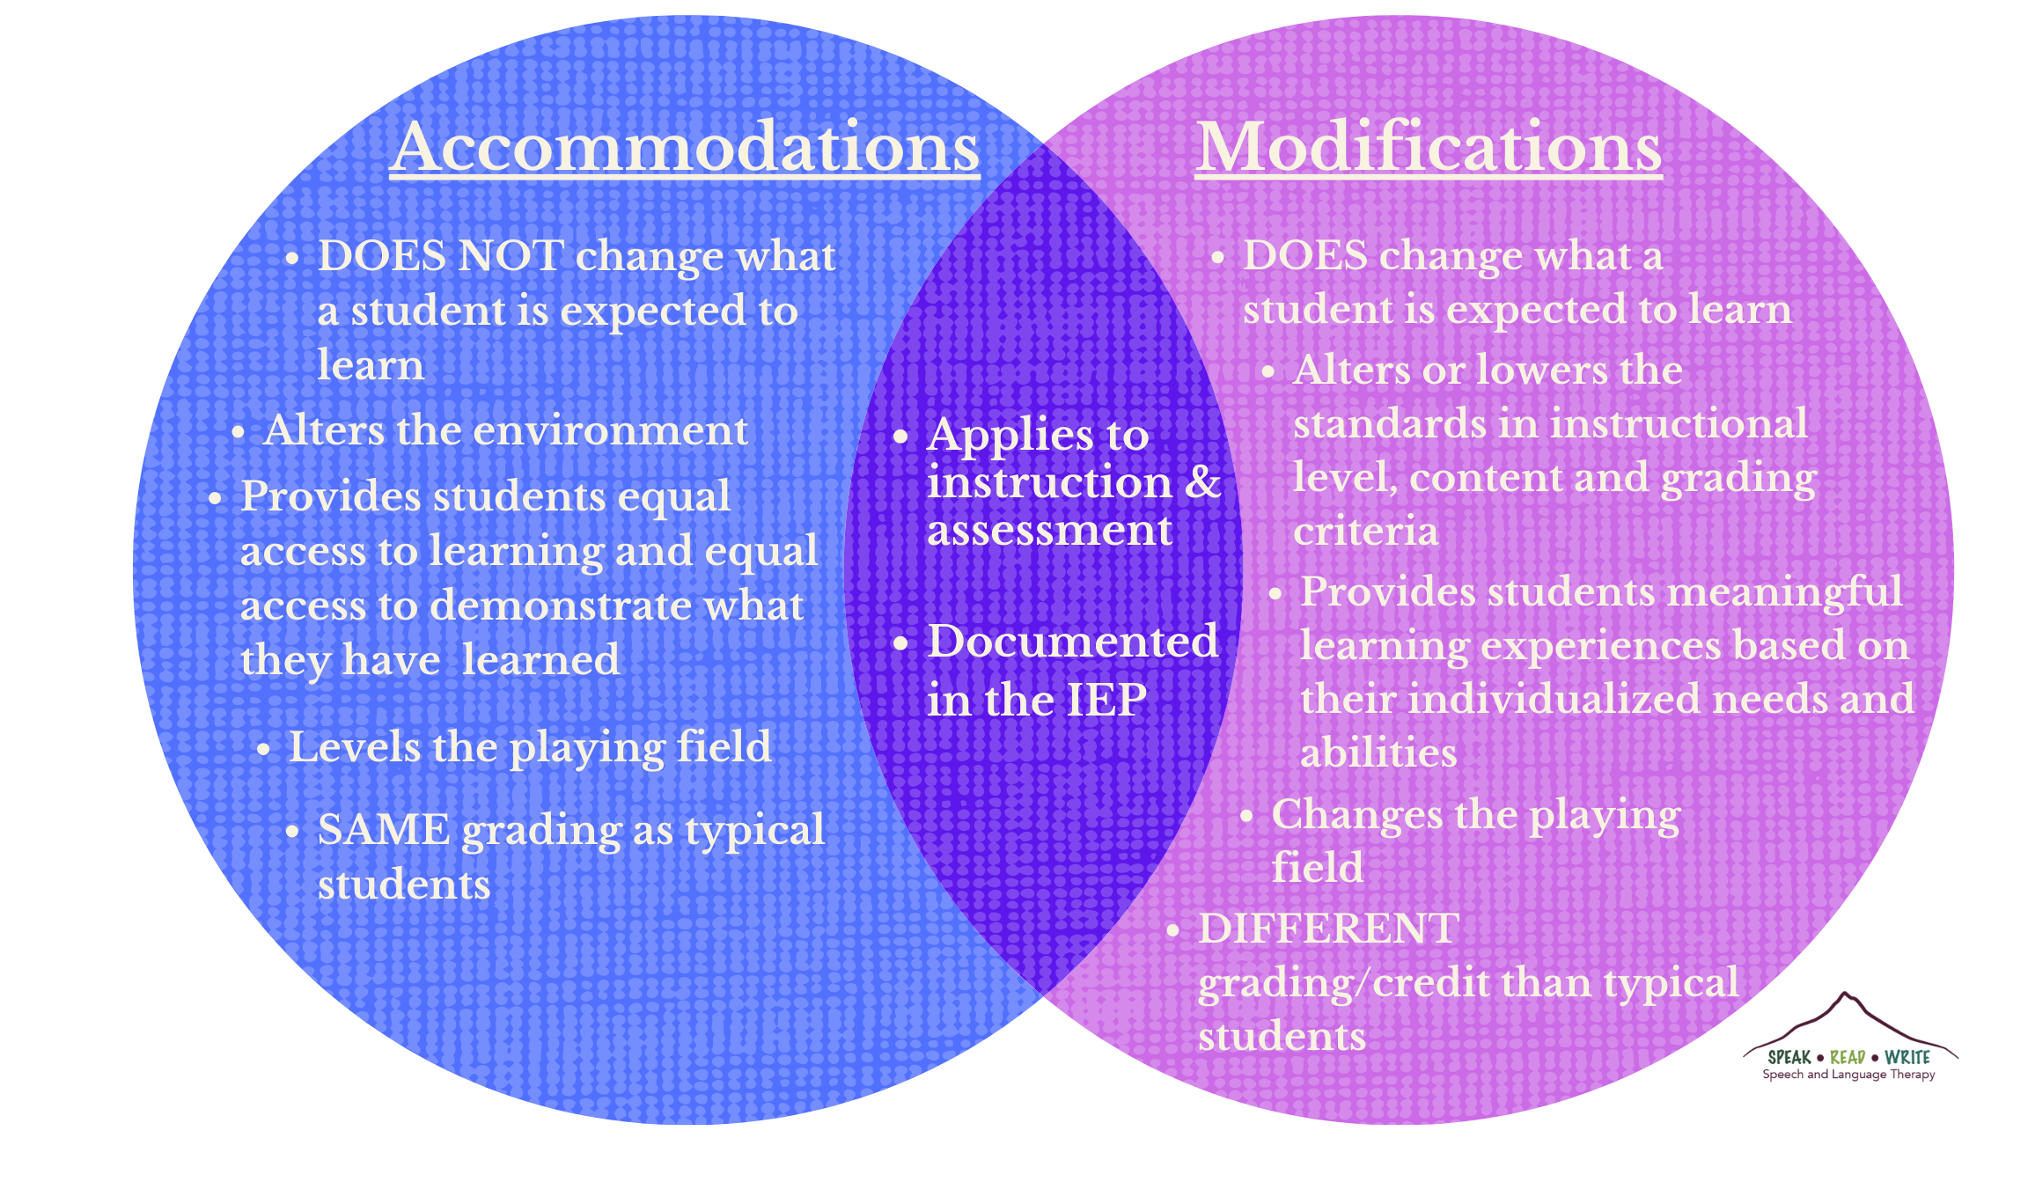
Accommodations vs. Modifications
Aspect | Accommodations | Modifications
Definition | Changes how a student learns | Changes what a student is expected to learn
Course Content | Remains the same | Is altered or simplified
Academic Standards | Not lowered | May be lowered or adjusted
Examples | Extended time, note-taking help, accessible formats | Fewer test questions, simplified assignments
Common in College? | Yes | Rarely
Purpose | Ensures equal access | Changes learning expectations
Notes:
Understanding the difference between accommodations and modifications is essential when supporting students with disabilities in higher education. Accommodations are adjustments that help students access the same curriculum as their peers without changing the learning expectations or course content. Examples include extended time on exams, note-taking assistance, accessible digital formats, or permission to record lectures. These supports level the playing field by removing barriers to learning.
In contrast, modifications involve altering what a student is expected to learn or demonstrate. While common in K–12 settings, modifications are rarely used in college because they can change the essential requirements of a course or program. For instance, reducing the number of exam questions or simplifying assignments would be considered a modification. In higher education, the focus is almost always on accommodations, which preserve academic standards while ensuring equal opportunity for success. Understanding this distinction helps you uphold both fairness and academic integrity.

Slide 15
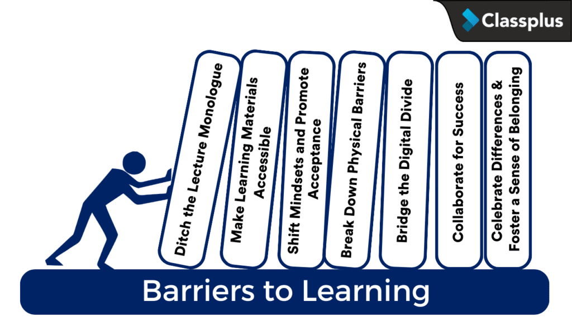
Notes:
Even with legal protections and support systems in place, students with disabilities often face significant barriers that can impact their academic success. These barriers may be physical, technological, instructional, or attitudinal, and they can make it harder for students to fully engage in learning. By understanding the types of obstacles students encounter—both seen and unseen—you can take proactive steps to reduce or eliminate them. This section explores common barriers to learning and highlights ways you can create a more inclusive and accessible classroom environment.

Slide 16
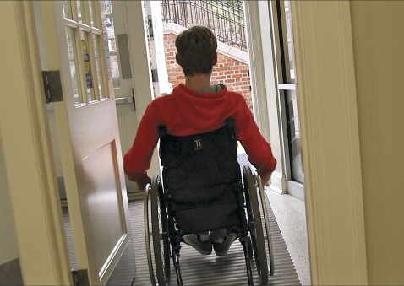
Physical Barriers to Learning
Inaccessible classrooms or buildings
  No ramps, elevators, or automatic doors
Furniture that doesn’t accommodate mobility aids
  Narrow aisles or fixed desks
Poorly designed layouts
  Limited space to navigate with a wheelchair or walker
Restrooms and entrances that are not ADA-compliant.
Impact: Limits independence, access to learning, and sense of belonging
Solution: Ensure all learning spaces are physically accessible and inclusive by design.
Notes:
Physical barriers are among the most visible challenges faced by students with disabilities, and they can significantly hinder access to learning spaces and resources. These barriers include things like classrooms that are located up stairs with no elevator access, desks that do not accommodate wheelchairs, narrow doorways, or restrooms that are not accessible. Even small obstacles, such as heavy doors or poorly placed furniture, can make it difficult for students with mobility impairments to navigate a campus or classroom independently. When physical spaces are not designed with accessibility in mind, they send an unintentional message that some students do not fully belong. Ensuring that learning environments are physically accessible is not just a legal requirement—it’s a foundational step toward creating an inclusive and welcoming educational experience for all students.

Slide 17

Instructional Barriers to Learning
Fast-paced lectures without captions or transcripts
Heavy reliance on spoken or written text only
Inaccessible materials (e.g., scanned PDFs, untagged PowerPoints)
Lack of clarity in directions or assignment expectations
Limited flexibility in pacing or participation
Impact: Excludes students with hearing loss, learning disabilities, or attention difficulties
Solution: Apply Universal Design for Learning (UDL) principles
  Use captions, transcripts, visual aids, and flexible formats
Notes:
Instructional barriers occur when teaching methods or materials are not designed to accommodate diverse learning needs, making it difficult for some students with disabilities to access or engage with course content. For example, fast-paced lectures that rely heavily on spoken information without captions or transcripts can be challenging for students with hearing impairments, processing disorders, or attention difficulties. Similarly, dense reading materials without alternative formats, inaccessible slide presentations, or unclear instructions can pose significant obstacles. These barriers are often unintentional but can create unequal learning conditions. You can reduce instructional barriers by incorporating universal design principles, such as providing multiple means of representation (e.g., captions, transcripts, visuals), offering flexible pacing, and using clear, structured communication. By anticipating varied learning needs, you create more inclusive and effective instruction for all students.

Slide 18

Attitudinal Barriers to Learning
Low expectations for students with disabilities
Assumptions about ability or motivation
Lack of awareness about different types of disabilities
Resistance to accommodations or inclusive teaching strategies
Insensitive language or dismissive behavior
Impact: Creates an unwelcoming or discouraging environment
Solution:
  Foster empathy and respect.
  Raise disability awareness.
  Maintain high expectations for all students.
Notes:
Attitudinal barriers stem from beliefs, assumptions, and perceptions that instructors or peers may hold—often unconsciously—about students with disabilities. These barriers can be especially damaging because they affect the learning environment in subtle but powerful ways. For example, a professor who assumes that a student with a disability cannot meet the same academic standards as their peers may set lower expectations, which can undermine the student’s confidence and limit their opportunities.
Similarly, a lack of awareness or understanding about different types of disabilities may lead to insensitive comments, resistance to accommodations, or a reluctance to adapt teaching practices. These attitudes can create a classroom culture that feels unwelcoming or even hostile. Addressing attitudinal barriers involves cultivating empathy, increasing disability awareness, and embracing inclusive teaching practices. When you foster a mindset of equity and high expectations for all students, you contribute to a more respectful and supportive learning environment.

Slide 19

Principles of
Inclusive Teaching
Notes:
Inclusive teaching is about creating a learning environment where all students—regardless of ability, background, or identity—feel respected, valued, and supported. For students with disabilities, this means going beyond basic compliance to intentionally designing instruction that is flexible, accessible, and responsive to diverse needs. By applying inclusive teaching principles, you can reduce barriers to learning, promote equity, and help all students reach their full potential. This section introduces key strategies that support inclusive instruction and foster a culture of belonging in the classroom.

Slide 20
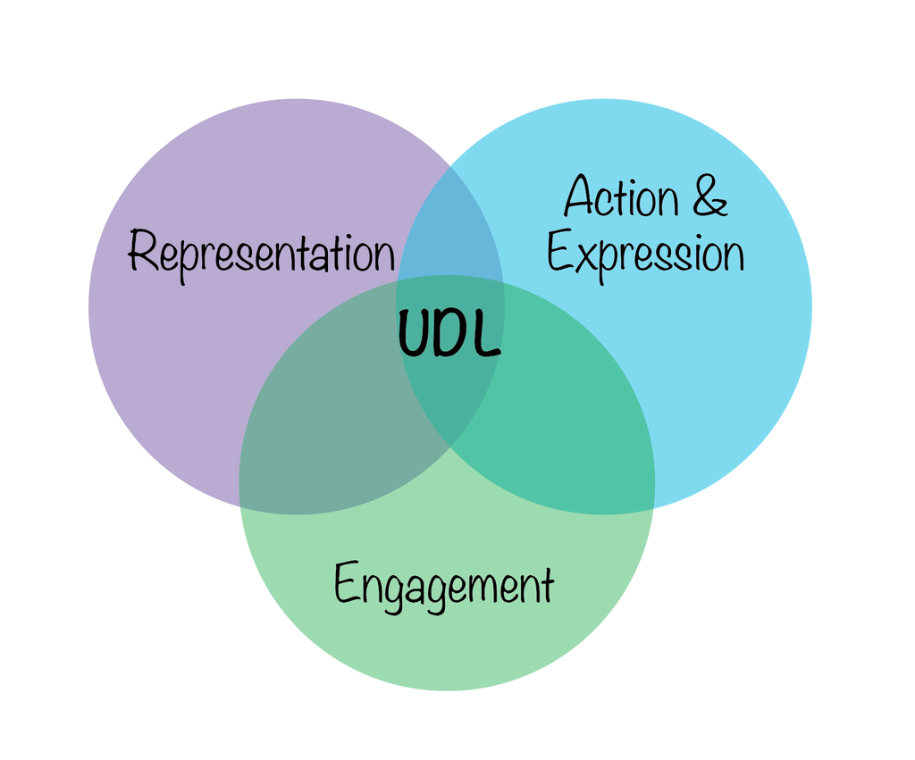
Universal Design
for Learning (UDL)
Purpose: Make learning accessible to all students, regardless of ability
Key Principles:
  Provide multiple means of representation (e.g., text, audio, visuals)
  Offer multiple means of engagement (e.g., discussions, projects, reflection)
  Allow multiple means of expression (e.g., essays, presentations, portfolios)
Benefits:
  Proactively supports students with disabilities
  Increases engagement and participation for all learners
  Reduces the need for retrofitting accommodations
Goal: Foster an inclusive learning environment from the start
Notes:
Universal Design for Learning (UDL) is a proactive approach to teaching that aims to make learning accessible to all students by offering flexibility in how content is presented, how students engage with material, and how they demonstrate their learning. Rather than retrofitting accommodations after a barrier is identified, UDL encourages instructors to design courses from the start with diverse learners in mind—including those with disabilities. This might include providing multiple formats for course materials (e.g., text, audio, video), allowing for different ways to participate (e.g., discussion boards, group work, individual reflection), and offering various assessment options. UDL is grounded in the understanding that no two students learn the same way, and by embedding choice and accessibility into instruction, you can create a more inclusive and effective learning environment for everyone.

Slide 21
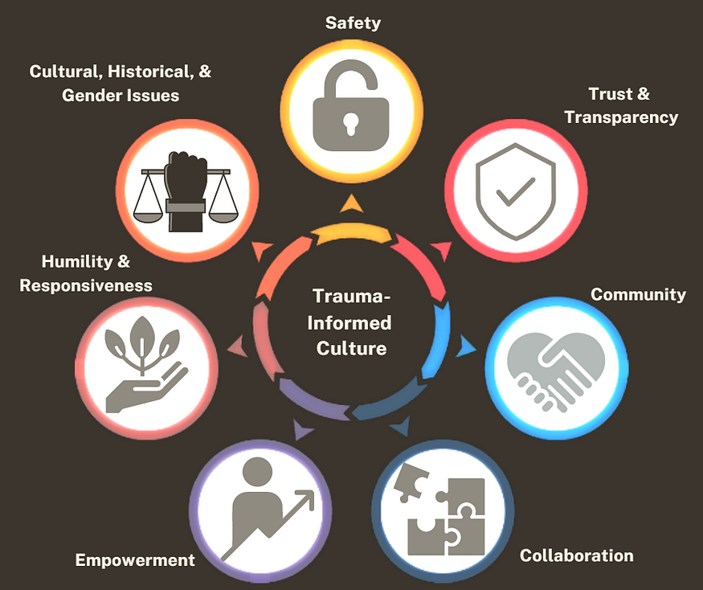
Trauma-Informed and Culturally Responsive Approaches
Trauma-Informed Approach:
  Recognizes the impact of trauma on learning
  Creates a safe, predictable, and supportive environment
  Focuses on building trust and sensitivity to emotional needs
Culturally Responsive Approach:
  Values and incorporates students' cultural backgrounds
  Acknowledges diverse perspectives and experiences
  Adapts teaching to be inclusive and respectful
Combined Impact:
  Supports students with trauma
  Empowers students from diverse cultures
  Creates an inclusive, supportive learning environment
Notes:
Trauma-informed and culturally responsive approaches are key strategies for fostering an inclusive and supportive learning environment. A trauma-informed approach recognizes that students may have experienced various forms of trauma that can impact their ability to learn, engage, and succeed. This approach involves creating a safe and predictable classroom environment, establishing trust, and being sensitive to students' emotional and psychological needs.
On the other hand, a culturally responsive approach acknowledges and values the diverse backgrounds, experiences, and perspectives that students bring to the classroom. It emphasizes understanding and incorporating students' cultural contexts into teaching practices and curriculum design. When combined, these approaches create a classroom that not only supports students who have experienced trauma but also respects and nurtures their cultural identities, ensuring that all students feel understood, valued, and empowered to succeed.

Slide 22

Inclusive Teaching Strategies
Notes:
Incorporating inclusive teaching strategies into the classroom requires more than just an awareness of student needs—it also involves practical, actionable steps that can be integrated into daily teaching practices. This section focuses on specific strategies that can help create a more accessible and equitable learning environment for all students, including those with disabilities. These strategies are designed to be flexible, proactive, and applicable across various teaching contexts, ensuring that students have the support they need to engage with the material, participate in discussions, and demonstrate their learning effectively. By implementing these strategies, you can foster a classroom culture where all students have an equal opportunity to succeed.

Slide 23
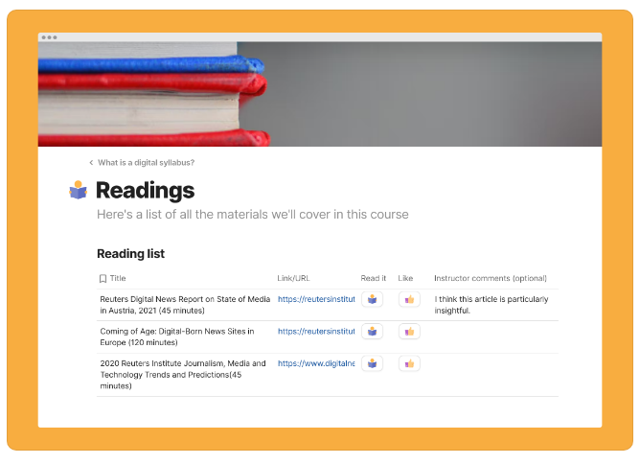
Course
Design
Accessible Syllabus
  Digital format compatible with screen readers
  Clear headings, plain language, readable layout
  Transparent grading and expectations
Predictable Structure
  Consistent weekly routines and deadlines
  Stable format for materials and assignments
  Reduces anxiety and supports executive function
Benefit: Enhances clarity, accessibility, and student confidence
Notes:
Inclusive course design begins with creating materials and structures that are accessible, clear, and consistent. An accessible syllabus, for instance, should be provided in a digital format that works with screen readers and other assistive technologies, using plain language, clear headings, and a readable layout. Beyond accessibility, the syllabus should clearly communicate course objectives, grading policies, and expectations so that all students understand what is required of them. Equally important is maintaining a predictable course structure—such as consistent weekly routines, clear deadlines, and a stable format for assignments and materials. This helps all students, especially those with disabilities such as ADHD, anxiety, or learning disorders, to plan effectively and reduce cognitive overload. A well-designed course acts as a roadmap, supporting student confidence and success from the start.

Slide 24
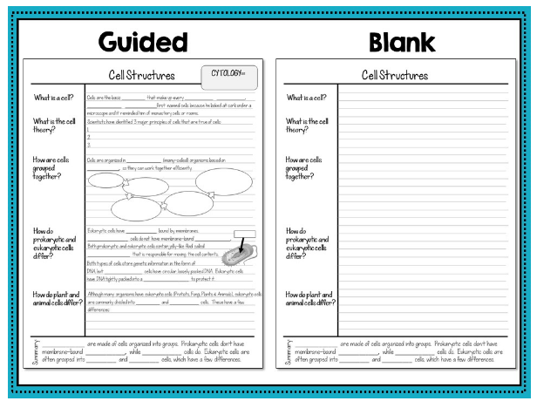
Instructional
Practices
Use captions for videos and transcripts for audio
  Supports students with hearing impairments and others
Provide slides or notes in advance
  Helps students prepare and follow along more effectively
Use plain language
  Make content more accessible to all learners
Explain new or complex terms clearly
  Aids comprehension, especially for students with learning disabilities or English language learners
Benefit: Improves access, understanding, and engagement for all students
Notes:
Inclusive instructional practices are essential for ensuring that all students can access and engage with course content. One key practice is providing captions for videos and transcripts for audio recordings, which support not only students who are deaf or hard of hearing but also those who process information better visually or need to review content at their own pace. Sharing slides or lecture notes ahead of time gives students the opportunity to prepare, follow along more easily, and focus on comprehension rather than scrambling to take notes during class. Additionally, using plain language and clearly explaining new or complex terms helps all students—especially those with learning disabilities or for whom English is not a first language—understand the material without unnecessary confusion. These simple yet powerful strategies foster an inclusive environment where students feel supported and capable of succeeding.

Slide 25
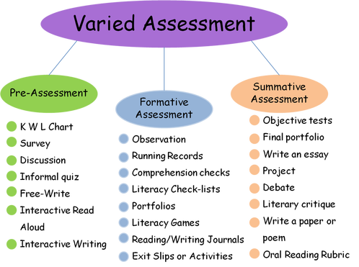
Assessment
Practices
Flexible Deadlines (when appropriate)
  Supports students with health or disability-related challenges
  Promotes equity without lowering academic standards
Varied Assessment Formats
  Examples: Oral presentations, projects, visual work, written assignments
  Accommodates different learning styles and strengths
Benefit:
  Encourages deeper engagement
  Allows students to demonstrate learning in meaningful ways
Notes:
Inclusive assessment practices recognize that students demonstrate their learning in different ways and that flexibility can help remove unnecessary barriers. Offering flexible deadlines, when appropriate, can support students managing chronic health conditions, mental health challenges, or other disability-related concerns without compromising academic standards. This flexibility promotes equity by acknowledging that some students may need more time due to factors beyond their control. Additionally, using varied assessment formats—such as oral presentations, projects, visual displays, or traditional written assignments—allows students to choose how they best express their understanding. This not only accommodates diverse learning styles and abilities but also encourages creativity and deeper engagement with the material. By incorporating both flexibility and variety in assessments, you can create a more inclusive and supportive learning environment that values student strengths.

Slide 26
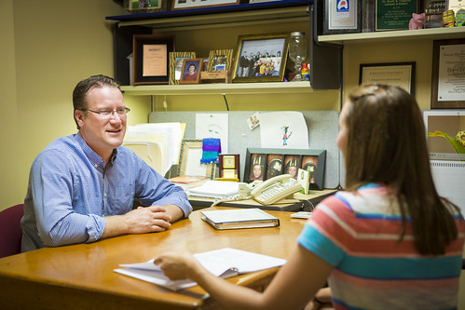
Communication
Strategies
Encourage Self-Advocacy
  Empower students to voice needs and request support
  Foster confidence and independence
Be Approachable
  Create a welcoming, nonjudgmental environment
  Show empathy and active listening
Maintain Confidentiality
  Respect student privacy
  Handle disability-related conversations with discretion
Benefit: Builds trust and supports student success
Notes:
Effective and inclusive communication is vital for supporting students with disabilities. One important aspect is encouraging self-advocacy, which empowers students to express their needs, ask for accommodations, and take an active role in their own learning process. You can foster self-advocacy by creating a welcoming environment where students feel comfortable initiating conversations about their challenges and needs. Equally important is being approachable and maintaining confidentiality. Students are more likely to seek help when they know their concerns will be heard without judgment and handled with discretion. Demonstrating empathy, active listening, and a respectful tone helps build trust and signals to students that their well-being and success matter. Together, these communication practices create a supportive classroom culture where students with disabilities feel safe, valued, and empowered.

Slide 27
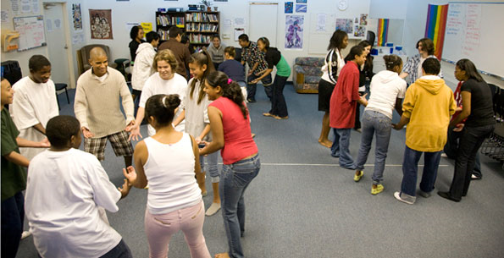
Real-World Scenarios
Notes:
Understanding best practices in inclusive teaching is important but seeing how they play out in real classroom situations brings these ideas to life. This section presents real-world scenarios that illustrate common challenges faced by students with disabilities and the practical responses you can take to support them. These examples highlight the impact of thoughtful course design, inclusive communication, and flexible teaching strategies. By examining these scenarios, you can better prepare to recognize barriers, respond with empathy, and create learning environments where all students can thrive.

Slide 28

Student with
ADHD
Challenge:
Jasmine struggles to stay focused during long, uninterrupted lectures.
Impact:
Misses key information, leading to lower performance on assessments.
Support Strategies:
  Break lectures into shorter segments
  Incorporate interactive activities (e.g., polls, think-pair-share)
  Provide slides/notes in advance
  Allow use of note-taking tools
Benefit:
Enhances focus and retention for Jasmine—and improves engagement for the entire class.
Notes:
Scenario: Supporting a Student with ADHD
Jasmine is a bright, engaged student diagnosed with ADHD. She participates actively in class discussions but struggles to maintain focus during long, uninterrupted lectures. By the 30-minute mark, she often becomes restless, distracted, and misses key information, which affects her performance on assessments tied to lecture content.
Support Strategy:
To support Jasmine, the instructor breaks the lecture into shorter segments interspersed with interactive elements like polls, think-pair-share activities, or quick reflection prompts. The instructor also provides lecture slides ahead of time and allows Jasmine to use a note-taking app that helps her organize and review information. These adjustments benefit not only Jasmine but also other students by making the lecture more engaging and digestible.

Slide 29
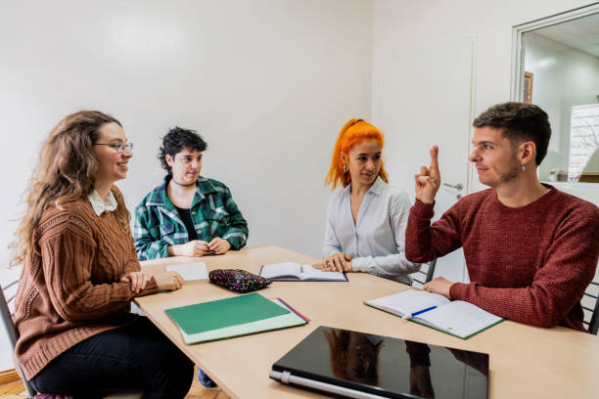
Student with a Hearing Impairment
Challenge:
Daniel has difficulty following spoken content during class discussions.
Impact:
Misses key points; feels excluded from classroom conversations.
Support Strategies:
  Use captioned videos and provide transcripts
  Face students while speaking
  Repeat student questions and comments aloud
  Share lecture notes in advance
  Ensure clear sightlines for lip reading
Benefit:
Improves access and inclusion for Daniel and others with diverse learning needs.
Notes:
Scenario: Supporting a Student with a Hearing Impairment
Daniel is a student with moderate hearing loss who uses hearing aids. He finds it difficult to follow class discussions, especially when multiple students speak or when instructors face away from the class while talking. As a result, he misses important content and feels left out of conversations.
Support Strategy:
The instructor ensures all videos have accurate captions and provides transcripts when needed. During class, they face the students while speaking and repeat student comments or questions before responding. The instructor also shares lecture notes and encourages Daniel to sit in a spot with good visibility. These inclusive practices improve access for Daniel while benefiting students who process information visually or speak English as an additional language.

Slide 30

Scenario: Student with Anxiety
Challenge:
Maria struggles with class participation and timed assessments due to anxiety.
Impact:
Avoids class, freezes during presentations, and underperforms on timed tests.
Support Strategies:
  Offer alternative participation methods (e.g., online discussions)
  Allow untimed testing in a reduced-distraction setting
  Maintain open, confidential communication
  Encourage use of campus support services
Benefit:
Creates a safe, supportive learning environment without compromising standards.
Notes:
Scenario: Supporting a Student with Anxiety
Maria is a student who experiences generalized anxiety disorder. While she does well on written assignments, she finds class participation and timed exams overwhelming. Her anxiety often peaks during group activities and oral presentations, which sometimes causes her to miss class or freeze under pressure.
Support Strategy:
The instructor works with Maria to create a supportive plan that includes flexible participation options—such as contributing to discussions via an online forum—and untimed testing in a quiet environment through the college’s accessibility office. By checking in privately, the instructor builds trust and encourages Maria to communicate when she’s feeling overwhelmed. These strategies reduce barriers while preserving academic expectations.

Slide 31
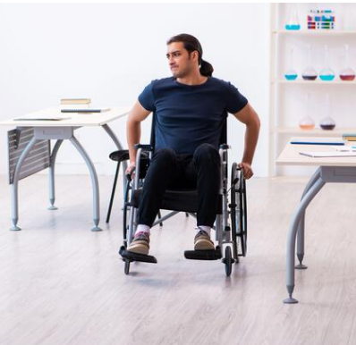
Supporting a Student with a Physical Disability
Challenge:
Chris uses a wheelchair and encounters physical access issues in and around class.
Impact:
Struggles with classroom mobility and group participation.
Support Strategies:
Ensure classroom is wheelchair-accessible
Rearrange furniture for clear movement paths
Adapt group activities to include all students
Advocate for accessible campus facilities if needed
Benefit:
Removes physical barriers and promotes full participation.
Notes:
Chris uses a wheelchair due to a spinal cord injury. While he is highly engaged academically, he faces challenges navigating the campus and accessing classrooms located in older buildings with heavy doors or limited elevator access. Once in class, cramped desk spacing makes movement difficult, and some group work activities are not designed with mobility in mind.
Support Strategy:
The instructor proactively checks that classroom spaces are physically accessible, and requests room changes if needed. Furniture is rearranged to allow clear pathways, and group activities are adapted so that all students can participate without physical barriers. These steps ensure that Chris can engage fully with his peers and the course content.

Slide 32

Student on the Autism Spectrum
Challenge:
Leila finds ambiguity, schedule changes, and noisy environments overwhelming.
Impact:
Difficulty with focus, group work, and adapting to unexpected changes.
Support Strategies:
  Provide predictable schedules and clear instructions
  Offer structured group roles or solo options
  Reduce sensory overload (quiet testing spaces)
  Encourage respectful peer communication
Benefit:
Fosters a calm, structured environment where neurodiverse students thrive.
Notes:
Leila is a student on the autism spectrum who excels at written analysis but struggles with sudden schedule changes, ambiguous instructions, and unstructured group work. She often becomes overwhelmed by sensory stimuli in large, noisy classrooms, which affects her ability to focus and participate.
Support Strategy:
The instructor provides a clear, consistent schedule and detailed assignment instructions with examples. Group activities are structured with defined roles, and Leila is given the option to work independently when appropriate. The instructor also offers quiet spaces for testing and encourages all students to communicate respectfully. These inclusive approaches help Leila navigate the course with confidence.

Slide 33

Resources
Notes:
Supporting students with disabilities goes beyond classroom strategies—it also involves connecting them with the right tools, services, and support networks. Fortunately, there are many campus and community resources available to help both instructors and students navigate accommodations, accessibility, and inclusive learning. In this section, we’ll highlight key offices, tools, and materials that can empower faculty to create more inclusive classrooms and help students advocate for their needs effectively.

Slide 34

The LSC-North Harris Disability Services is located in Winship 120. This office:
Reviews documentation and determines accommodations
Provides support like:
Assistive technology
Note-taking help
Extended test time
Accessible furniture
Offers guidance to faculty on implementing accommodations
Acts as a bridge between students and instructors
Promotes legal compliance and inclusive learning environments
A complete list of services can be found at Disability Services.
Notes:
The LSC-North Harris Campus disability services play a central role in ensuring equal access to education for students with disabilities. This office is responsible for reviewing documentation, determining reasonable accommodations, and serving as a bridge between students and faculty. They offer a range of supports, such as assistive technology, note-taking assistance, extended test time, and accessible furniture. Disability services also provide faculty with guidance on how to implement accommodations while maintaining academic standards. Building a strong partnership with this office helps create a more supportive and legally compliant learning environment for all students.

Slide 35

Accessibility Tools
Screen Readers
  Examples: NVDA, VoiceOver
  Reads on-screen text aloud
  Navigates documents and websites
Microsoft Immersive Reader
  Text-to-speech
  Line focus
  Translation
  Grammar support
Free Benefits
  Supports diverse learning needs
  Freely available and easy to integrate
  Promotes equity and independence
Notes:
Free accessibility tools are valuable resources that help make learning more inclusive and personalized for students with disabilities. Tools like Microsoft Immersive Reader support students with reading challenges by providing text-to-speech, translation, and visual formatting options that enhance comprehension. Screen readers, such as NVDA or VoiceOver, allow students with visual impairments to access digital content by reading aloud on-screen text and navigating through websites or documents. These tools are often built into common software platforms or available for free download, making them widely accessible. By incorporating and encouraging the use of these tools, you can help reduce barriers and promote more equitable learning experiences for all students.

Slide 36
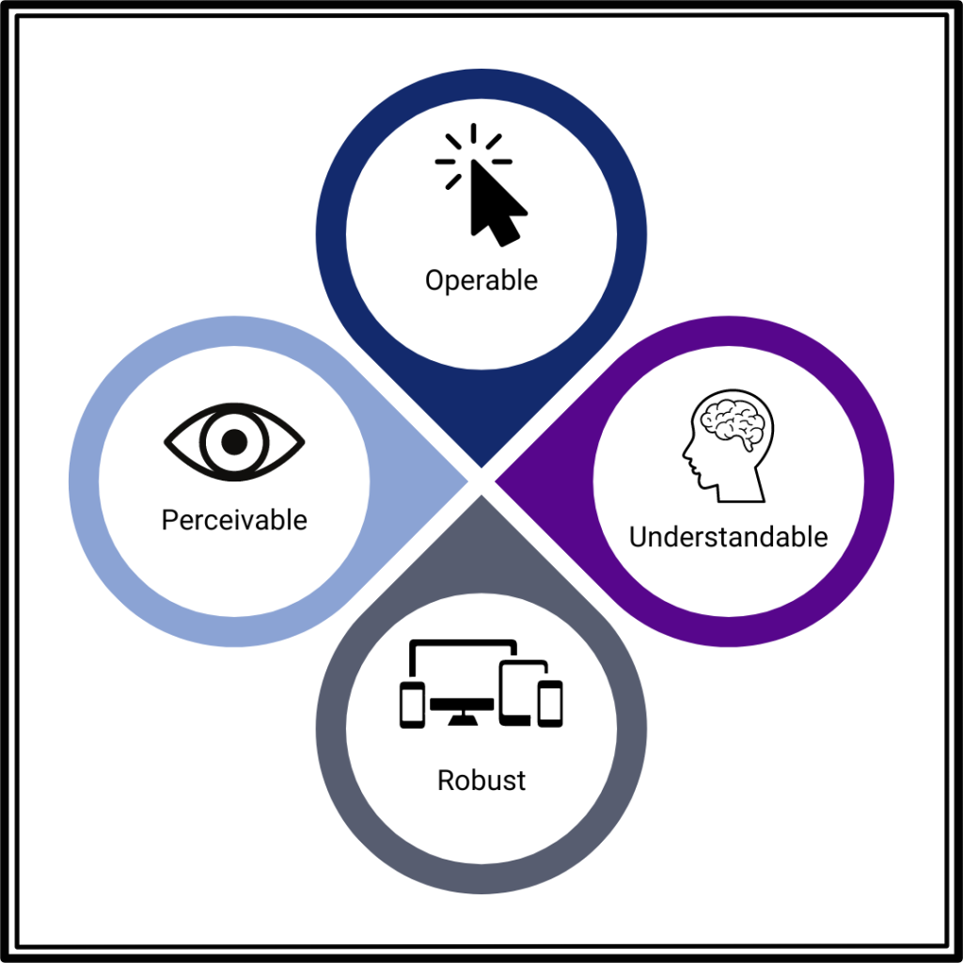
Web-Based Accessibility Resources
WAVE Tool
  Checks website accessibility
  Ensures WCAG compliance
CAST (Center for Applied Special Technology)
  Offers UDL guidelines and resources
  Supports diverse learning needs
YouTube and Online Captioning
  Auto-captions videos
  Improves access to audio/video content
Benefits
  Easy to use and widely available
  Helps create inclusive digital materials
Notes:
Web-based accessibility resources offer a wide range of tools, guides, and platforms that help educators and students create and engage with inclusive content. Websites like the WAVE Web Accessibility Evaluation Tool allow users to check the accessibility of online materials, ensuring they meet standards such as the Web Content Accessibility Guidelines (WCAG). Other platforms, such as CAST (Center for Applied Special Technology), provide Universal Design for Learning (UDL) frameworks and teaching materials to support diverse learners. Additionally, YouTube’s auto-captioning feature and online transcription services make video and audio content more accessible. These resources empower you to design more inclusive courses and help students access learning in formats that suit their needs.

Slide 37
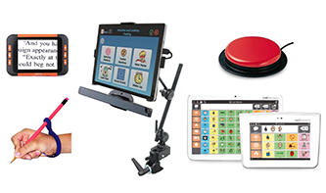
Assistive
Technology
What it is
  Tools that support students with disabilities
  Enhances learning and independence
Examples
  Speech-to-text software
  Screen magnifiers
  Alternative input devices
Benefits
  Increases accessibility
  Supports diverse learning styles
  Promotes equity and academic success
Notes:
Assistive technology refers to devices, software, or equipment designed to support individuals with disabilities in performing functions that might otherwise be difficult or impossible. In educational settings, this includes tools such as speech-to-text software for students with writing challenges, screen magnifiers for those with low vision, and alternative input devices for individuals with limited mobility. These technologies enhance access to learning by adapting the environment to meet the student’s needs, rather than requiring the student to conform to traditional methods. When integrated thoughtfully into the classroom, assistive technology not only fosters independence and engagement but also promotes equity and academic success for all learners.

Slide 38

Best Practices for Integrating Accessibility Tools
Notes:
Creating an inclusive learning environment begins with ensuring that all students—regardless of ability—can access and engage with course materials. Accessibility tools are powerful resources that help bridge gaps, support diverse learning needs, and remove barriers to success. Whether you're teaching in-person, online, or in a hybrid format, integrating these tools effectively not only enhances learning outcomes but also aligns with principles of Universal Design for Learning (UDL) and legal accessibility standards.
This section explores best practices for integrating accessibility tools into your teaching. From selecting the right tools to training students on their use, these strategies will help you create a classroom where all learners can thrive.

Slide 39

Start Early: Set the Stage for Accessibility
Key Strategies:
Introduce tools at the beginning of the course
→ Highlight in syllabus and first-class session
Normalize their use for all students
→ Present as helpful for everyone, not just for accommodations
Provide tutorials or demonstrations
→ Use videos, guides, or in-class demos
→ Embed instructions in your LMS
Why It Matters:
Early exposure reduces barriers and builds student confidence using accessibility tools.
Notes:
Integrating accessibility tools effectively begins with early and intentional planning. Introducing these tools at the start of the course helps normalize their use and ensures that all students are aware of the supports available to them. Rather than waiting until a student requests assistance or encounters a barrier, proactively sharing accessibility resources signals a commitment to inclusive teaching. This early introduction can include highlighting tools in the syllabus, demonstrating them during the first-class session, or embedding short tutorials within the learning management system. Providing students with guided walkthroughs or hands-on practice—whether through video demonstrations, written guides, or live instruction—empowers them to use the tools confidently and consistently throughout the course. By starting early, you not only reduce potential frustration but also create a learning environment where every student feels supported from day one.

Slide 40
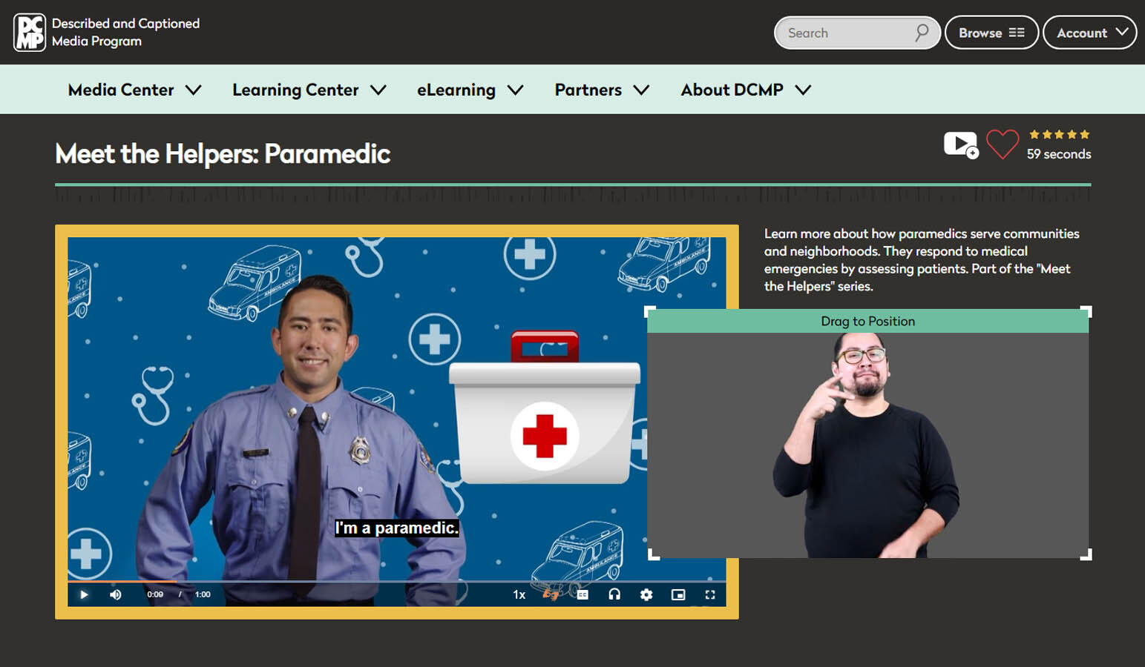
Embed Accessibility:
Make Inclusion the Default
Key Practices
Use captioned videos
→ Supports all learners, including those with hearing loss or language barriers
Create accessible documents
→ Use clear headings, alt text, readable fonts, and accessible PDFs
Design for screen reader compatibility
→ Ensure navigation and structure work for assistive technology users
Normalize Tool Use
Present tools as helpful for everyone
Encourage exploration without requiring disclosure
Include accessibility supports in general course instructions
Goal
Make accessibility tools and practices a seamless part of the learning experience—for every student.
Notes:
To create a truly inclusive learning environment, accessibility must be woven into the fabric of your course—not added as an afterthought. Embedding accessibility involves using captioned videos, screen reader–friendly documents, and other universally accessible formats as the default. For example, ensuring that all videos have accurate captions benefits not only students who are deaf or hard of hearing but also those learning in noisy environments or processing information better through text. Similarly, using properly structured documents with clear headings, alt text for images, and accessible PDFs ensures that all students—especially those using assistive technologies—can navigate course materials with ease. Equally important is normalizing the use of accessibility tools for all students. By presenting these tools as standard supports available to everyone, you help remove any stigma that might be associated with accommodations. This inclusive approach encourages all learners to explore and adopt tools that enhance their learning, regardless of whether they have a documented disability. Embedding accessibility and normalizing tool use not only improves access—it also promotes equity and academic success for every student.

Slide 41
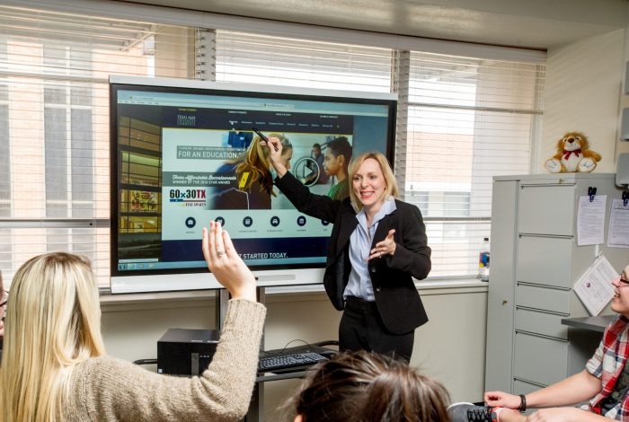
Stay Informed and Flexible
Key Practices
Learn which tools match student needs
→ Stay current with accessibility trends and institutional resources
Solicit and value student feedback
→ Ask what’s working—and what’s not
Adjust as needed
→ Be open to revising materials and tool use to better support learning
Why It Matters
A responsive and flexible approach ensures accessibility remains relevant and effective for all students.
Notes:
Effective integration of accessibility tools requires ongoing learning and adaptability. Instructors should take the time to explore which tools best align with the diverse needs of their students, recognizing that no single solution fits all learners. Staying informed about new accessibility features, updates to existing tools, and institutional support services can help instructors make informed decisions that enhance student success. Just as important is maintaining a flexible mindset. What works well for one group of students or in one semester may need to be adjusted for another. Encouraging students to share feedback about the accessibility of course materials and the usefulness of available tools creates a collaborative, student-centered environment. By listening to their experiences and being willing to make adjustments, instructors demonstrate a commitment to continuous improvement and inclusive teaching. Staying informed and flexible ensures that accessibility efforts remain effective, relevant, and responsive to the evolving needs of today’s learners.

Slide 42

Work with Disability Services
Why It Matters
Ensures accommodations are implemented correctly
Provides expert support for accessibility challenges
Reinforces commitment to equity and inclusion
How to Collaborate
Consult on accessible materials and tools
Clarify accommodation requirements
Seek training and support as needed
Maintain open communication throughout the semester
Key Message
You don’t have to do it alone—partner with disability services to support every student’s success.
Notes:
One of the most effective ways to ensure accessibility in your course is to actively collaborate with the college’s Disability Services Office. These professionals offer valuable expertise in accommodating diverse student needs and can provide guidance on selecting and implementing appropriate accessibility tools. Whether you’re unsure about how to make a particular resource accessible or need help interpreting a student’s accommodation letter, disability services can serve as a crucial partner. They can also assist in training faculty on inclusive practices and help troubleshoot challenges that arise during the semester. By working together, instructors and disability services staff can create a more cohesive and supportive learning environment. This partnership not only helps ensure legal compliance but also reinforces a shared commitment to equity and student success.

Slide 43

Conclusion:
Inclusive Teaching for All
Inclusion Starts with Intention
Embed accessibility from the start.
Use tools and strategies that support all learners.
Apply Universal Design for Learning principles.
Collaboration and Flexibility Matter
Introduce tools early and normalize their use.
Partner with disability services for support.
Stay open to feedback and adjust as needed.
Empower Every Student
Inclusive teaching is about equity, not just compliance.
Small changes make a big impact.
Every student deserves a chance to thrive.
Notes:
In conclusion, inclusive teaching is more than a checklist—it is a commitment to creating an environment where all students, including those with disabilities, feel valued, supported, and empowered to succeed. By integrating accessibility tools, designing flexible learning experiences, and embracing Universal Design for Learning principles, you can ensure that barriers to participation are minimized. When accessibility is embedded in course planning from the beginning, it benefits not just students with documented disabilities, but the entire class.
The key to inclusive instruction lies in being proactive, informed, and collaborative. Early introduction of accessibility tools, regular feedback from students, and intentional partnerships with disability services can transform the learning experience. These efforts signal to students that their needs matter and that their success is a shared priority. Flexibility and openness to change are essential, especially as student needs evolve and new tools become available.
Ultimately, inclusive teaching fosters a culture of respect, equity, and academic excellence. Supporting students with disabilities is not just a legal or procedural obligation—it is a fundamental aspect of good teaching. By adopting inclusive practices, you help ensure that every student has the opportunity to engage fully, learn meaningfully, and thrive in their academic journey.

Slide 44

Accessible Teaching Practices for Students with Disabilities, Center for Teaching, Learning and Innovation, University of Pennsylvania.
Allarakhia, H. (2022) Strategies for Accommodating Students with Disabilities in Higher Education, Faculty Focus.
Association on Higher Education and Disability (AHEAD). (n.d.). AHEAD: Equity & excellence in higher education.
Burgstahler, S. (2015). Universal design in higher education: From principles to practice (2nd ed.). Harvard Education Press.
CAST. (2018). Universal Design for Learning guidelines version 2.2.
Faculty Focused Tools and Resources. Digital Accessibility Solutions, University of Mississippi,
Faculty Guide: Teaching and Interacting with Students with Disabilities, Disability Resources, Texas A&M University,
Higbee, J. L., & Goff, E. (2008). Pedagogy and student services for institutional transformation: Implementing universal design in higher education. Center for Research on Developmental Education and Urban Literacy, University of Minnesota.
Higher Education Resource Guide for Students with Disabilities. Texas Council for Developmental Disabilities.
Strategies for Working with Students with a Disability, Walters State Community College.
The National Center on Accessible Educational Materials (AEM Center). (n.d.). AEM Center at CAST: Accessible educational materials.
Scott, S. S., McGuire, J. M., & Shaw, S. F. Teaching College Students with Learning Disabilities.
Scott, S. S., McGuire, J. M., & Shaw, S. F. (2003). Universal Design for Instruction: A new paradigm for adult instruction in postsecondary education. Remedial and Special Education, 24(6), 369–379.
U.S. Department of Education, Office for Civil Rights. (2020). Students with disabilities preparing for postsecondary education: Know your rights and responsibilities.
References

