Slide 1

Rewriting Assignments in the AI Era
Authentic Work Students Can’t Outsource
Faculty Focus: Innovative Teaching Techniques for College Success Series
Notes:
Artificial intelligence is changing how students approach coursework—but it does not have to diminish learning. In fact, this moment presents an opportunity to rethink assignments in ways that strengthen engagement, deepen thinking, and make learning more meaningful. Rather than focusing on how to prevent AI use, you can design assignments that require judgment, reflection, and context—things students must do themselves. This presentation explores practical ways to rewrite assignments so they emphasize authentic learning that AI cannot easily replace.

Slide 2

Why Assignment Design Matters
AI tools are already part of students’ learning environment.
Traditional assignments are easy to outsource.
Detection and policing have limited impact.
Design tasks that require application, explanation, and context.
Authentic assignments make learning—and thinking—visible.
Notes:
Students already have access to AI tools, whether or not they are explicitly discussed in your course. Many traditional assignments—generic essays, summaries, or problem sets—can now be completed quickly using AI with little evidence of learning. Rather than relying on detection tools or policing behavior, the most effective response is assignment design. When assignments ask students to apply ideas, explain their thinking, and connect learning to real contexts, outsourcing becomes difficult and unnecessary.

Slide 3

What AI Does Well
Summarizes and reorganizes existing information
Produces polished, academic-sounding responses
Follows predictable structures and prompts
Excels at recall, restatement, and formulaic writing
Key Implication: Assignments that emphasize recall or structure are increasingly easy to outsource.
Notes:
AI systems are highly effective at working with existing information. They can quickly summarize readings, synthesize multiple sources, generate well-structured responses, and replicate the conventions of academic language with impressive fluency. For tasks that rely on recall, paraphrasing, or predictable formats—such as standard essays, discussion posts, or short-answer explanations—AI can often produce work that appears polished and complete with minimal student effort.
As a result, assignments that emphasize restatement of content or formulaic writing are increasingly easy for students to outsource. When success is measured primarily by completeness, structure, or surface accuracy, students may be rewarded for submission rather than for thinking. This can obscure whether learning has actually occurred and limit opportunities for students to engage deeply with ideas, apply concepts in meaningful ways, or develop transferable skills.
Understanding what AI does well allows you to be more intentional in your assignment design. By recognizing AI’s strengths, you can avoid tasks that unintentionally privilege surface-level completion and instead design learning experiences that require interpretation, judgment, context, and reflection—elements that depend on students’ lived experiences, disciplinary reasoning, and decision-making processes. When assignments ask students to explain why they made certain choices, connect learning to specific contexts, or document their thinking over time, the focus shifts from producing an answer to demonstrating understanding.

Slide 4

Lived experience and personal perspective
Original data collection and observation
Contextual judgment and decision-making
Reflection on learning over time
Key Takeaway: Assignments that emphasize experience, context, and reflection make learning visible—and difficult to outsource.
What AI Struggles to Do
Notes:
While AI can generate fluent and well-organized text, it cannot replicate a student’s lived experience, personal perspective, or individual learning journey. AI has no access to classroom discussions, local contexts, personal observations, or the intellectual and emotional processes students go through as they grapple with new ideas. It can imitate reflection, but it cannot authentically describe how understanding changed, what misconceptions were challenged, or why certain decisions were made during learning.
AI also struggles with tasks that require original data collection and contextual judgment. When students gather data through observation, interviews, experiments, fieldwork, or workplace simulations, the learning is grounded in real-world experience that cannot be meaningfully outsourced. Similarly, assignments that require students to make discipline-specific judgments—choosing methods, justifying approaches, or responding to unique constraints—demand human reasoning rather than automated text generation.
Most importantly, AI cannot document learning over time. Growth, revision, uncertainty, and insight emerge through drafts, feedback, reflection, and iteration. Assignments that ask students to explain how their thinking evolved, what strategies they adjusted, or how feedback influenced their work shift the focus from producing a polished final product to demonstrating learning in progress. By emphasizing experience, context, and reflection, you make student thinking visible and meaningful—while designing assignments that naturally resist outsourcing and reinforce deep learning.

Slide 5

The Limits of Traditional Assignments
Designed for a pre-AI learning environment
Broad prompts encourage generic responses
Product-only grading masks learning
Rewards what “looks right,” not how students think
Invites outsourcing rather than understanding
Notes:
Many of the assignments commonly used in higher education were created before AI tools were widely available to students. These tasks often rely on broad prompts—such as open-ended essays or standard problem sets—that emphasize a polished final product rather than the learning process behind it. As a result, students can meet assignment requirements by producing work that appears correct or well written, without necessarily engaging deeply with the material.
When grading focuses primarily on the end product, it becomes difficult to distinguish between genuine understanding and surface-level completion. Students are rarely asked to explain their reasoning, justify their choices, or reflect on how their thinking developed. This gap unintentionally encourages AI use, because the assignment does not require evidence of learning—only evidence of completion.
By recognizing the limits of traditional assignments, you can begin to rethink how tasks are structured and assessed. When assignments ask students to document their process, apply ideas in context, and explain why their work matters, learning becomes visible. These shifts not only reduce the incentive to outsource work but also create more meaningful, engaging learning experiences that reflect how students actually learn and grow.

Slide 6
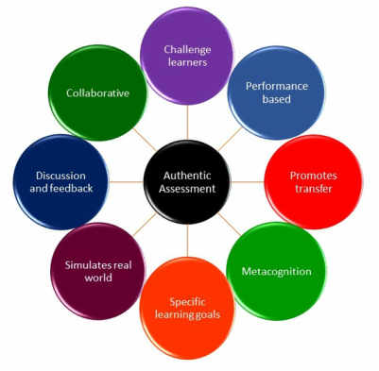
What Makes an Assignment Authentic
Grounded in real-world or course-specific context
Emphasizes process, not just product
Requires reflection and justification
Focuses on how and why—not just what
Encourages growth and deeper engagement
Notes:
Authentic assignments are designed to mirror how learning is used beyond the classroom. They are grounded in real contexts—personal, professional, disciplinary, or local—so students must apply concepts rather than simply repeat information. These assignments move away from abstract or generic tasks and instead ask students to engage with situations that feel relevant and meaningful.
A key feature of authentic assessment is its focus on process. Instead of asking only what students produced, authentic assignments ask how they approached the task and why they made certain choices. Students may be asked to explain their reasoning, document decision points, reflect on challenges, or revise their work based on feedback. This makes learning visible and provides a clearer picture of student understanding.
When assessments value reasoning, application, and growth, student engagement increases. Learners are more invested because the work feels purposeful and connected to real thinking. In this environment, AI shifts from being a shortcut to being a support tool—something that can assist with brainstorming or organization, but not replace judgment, reflection, or learning. Authentic assignment design ultimately reinforces the value of human thinking and creates richer learning experiences for you and your students.

Slide 7

Designing Authentic Assignments
Notes:
Designing authentic assignments does not require a complete overhaul of your course. In many cases, small, intentional shifts in how assignments are framed, structured, or assessed can significantly improve learning and reduce the temptation to outsource work. The goal is not to eliminate technology, but to design tasks that make student thinking visible and meaningful.
Authentic assignments prioritize learning over completion. They ask students to apply ideas in context, explain their reasoning, and reflect on their learning process. These elements help you see how students are engaging with the material, not just whether they can produce a finished product. When assignments are designed this way, students are encouraged to take ownership of their learning.
The strategies that follow are practical and adaptable across disciplines. Whether you teach in the humanities, sciences, technical fields, or professional programs, these approaches can be applied to assignments you already use. Each strategy is designed to strengthen authenticity, deepen engagement, and reinforce the value of human thinking in the AI era.

Slide 8

Anchor Assignments in Context
Ground assignments in local, personal, or course-specific situations.
Ask students to apply concepts to campus, workplace, or community issues.
Shift tasks from information retrieval to interpretation and judgment.
Require students to justify choices and explain relevance.
Increase engagement by connecting learning to students’ real experiences.
Notes:
Assignments that are grounded in local, personal, or course-specific contexts are inherently more authentic and significantly harder to outsource. When students are asked to apply concepts to a campus issue, a workplace scenario, a community challenge, or a personal observation, they must draw on experiences and environments that are unique to them. This shifts the task from information retrieval to interpretation and judgment.
Context-based assignments require students to think critically about how course concepts function in real situations. For example, students might analyze a policy as it affects their community, apply a theory to a workplace experience, or reflect on how a concept appears in their daily lives. These tasks ask students to make connections, justify choices, and explain relevance—elements that cannot be accurately generated by AI without direct student input.
By anchoring assignments in meaningful contexts, you also increase student engagement. Learners are more invested when they see how course content connects to their world. This approach reinforces learning transfer, strengthens critical thinking, and ensures that assignments reflect genuine understanding rather than polished but disconnected responses.

Slide 9

Document the Learning Journey
Require students to document how they approach an assignment.
Build in drafts, checkpoints, or progress submissions.
Include short reflections on decisions, challenges, and revisions.
Shift emphasis from a polished final product to learning over time.
Gain clearer insight into student understanding and growth.
Notes:
When students are required to document their process, learning becomes visible and measurable. Instead of submitting only a final product, students share how they approached the task, the decisions they made, and the challenges they encountered along the way. Drafts, checkpoints, and brief reflections provide natural opportunities for students to explain their thinking and demonstrate growth.
Process-focused assignments shift attention away from producing a flawless end result and toward engaging in meaningful learning over time. Students begin to see learning as iterative—something that develops through feedback, revision, and reflection. This not only reduces the temptation to rely on AI-generated work but also encourages persistence and deeper engagement with course content.
For you, requiring process documentation offers clearer insight into student understanding. You can see where misconceptions arise, how students apply feedback, and how their thinking evolves. This makes assessment more accurate, supports targeted feedback, and reinforces the value of effort, reasoning, and growth in the learning process.

Slide 10

Integrate Original Data or Creation
Require students to collect, observe, or generate original material.
Use interviews, surveys, experiments, or observations.
Ask students to create models, visuals, or artifacts.
Emphasize interpretation and explanation of findings.
Allow AI to support organization—but not replace thinking.
Notes:
Assignments that require students to generate original data or create something new are among the most authentic forms of assessment. When students conduct interviews, gather survey data, observe behaviors, run experiments, or create models and visuals, they are producing work that cannot be easily outsourced. These tasks require students to engage directly with the subject matter and take ownership of their learning.
The key to these assignments is interpretation. Rather than simply collecting data or producing an artifact, students must explain what their findings mean, how they made sense of the information, and why their conclusions are reasonable. This moves the assignment beyond completion and into analysis and judgment—skills that are central to learning across disciplines.
AI can still play a limited, transparent role in these tasks by helping students organize notes, format data, or brainstorm presentation structures. However, the core intellectual work—deciding what to collect, how to interpret results, and what conclusions to draw—remains firmly in the student’s hands. This balance reinforces ethical AI use while preserving the integrity and value of student learning.

Slide 11

Break assignments into clear, manageable stages.
Use proposals, drafts, and revision checkpoints.
Provide feedback throughout the process.
Emphasize reflection and improvement over time.
Reduce outsourcing by monitoring progress.
Build Iteration Into Assignments
Notes:
Breaking assignments into stages reinforces the idea that learning is a process, not a one-time event. When students move through phases such as proposals, drafts, feedback cycles, and revisions, they engage more intentionally with the content and have multiple opportunities to clarify understanding. This structure supports sustained effort and deeper learning rather than last-minute completion.
Iterative assignment design allows you to provide targeted feedback at key points, helping students refine their ideas and improve their work. Reflection prompts—such as asking students to explain what they changed and why—encourage metacognition and reinforce the value of growth. Students learn to see revision as part of learning rather than as a penalty.
This approach also reduces the incentive to outsource work. When progress is monitored across multiple stages, students must demonstrate ownership of their ideas and thinking over time. Iterative design promotes accountability, supports authentic learning, and creates richer evidence of student understanding.

Slide 12

Design for a Real Audience
Identify an audience beyond the instructor.
Use peers, community members, or professional roles.
Require appropriate tone and purpose.
Emphasize judgment and contextual awareness.
Increase motivation through meaningful communication.
Notes:
When students create work for an audience beyond the instructor, the assignment immediately becomes more meaningful. Writing or designing for peers, community members, clients, or simulated professional roles gives students a clear purpose and encourages them to think carefully about how their message will be received. This shift transforms assignments from academic exercises into authentic acts of communication.
Assignments with real or realistic audiences require students to make decisions about tone, format, and level of detail. Students must consider what their audience needs to know, how to present information clearly, and why their work matters. These judgment calls cannot be easily outsourced to AI, as they depend on context, intent, and human understanding.
Designing for an authentic audience also increases student motivation and accountability. When students know their work will be read, viewed, or used by others, they tend to invest more effort and take greater ownership of the learning process. This approach reinforces communication skills, deepens engagement, and highlights the value of human thinking in an AI-enabled world.

Slide 13
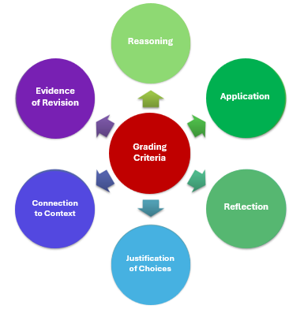
Grade What Matters Most
Align rubrics with learning priorities.
Emphasize reasoning and application.
Value reflection and revision.
De-emphasize polish over thinking.
Encourage authentic student engagement.
Notes:
Rubrics communicate what you value in student work. When grading criteria focus primarily on surface features—such as formatting or polished language—students may prioritize appearance over understanding. By intentionally aligning rubrics with learning goals, you signal that reasoning, application, and reflection are central to success.
Emphasizing how students think, apply concepts, and explain their decisions encourages deeper engagement. Criteria such as justification of choices, connection to context, and evidence of revision highlight learning as an ongoing process rather than a one-time performance. This approach also provides clearer guidance to students about expectations and supports more meaningful feedback.
When grading focuses on thinking and growth, students are more likely to engage authentically with assignments. They understand that effort, reflection, and improvement are valued, which reduces the incentive to outsource work and reinforces the importance of human judgment. Thoughtfully designed rubrics ultimately support integrity, learning, and student confidence.
The appendix of this presentation includes a rubric designed to evaluate student thinking, process, and reflection.

Slide 14
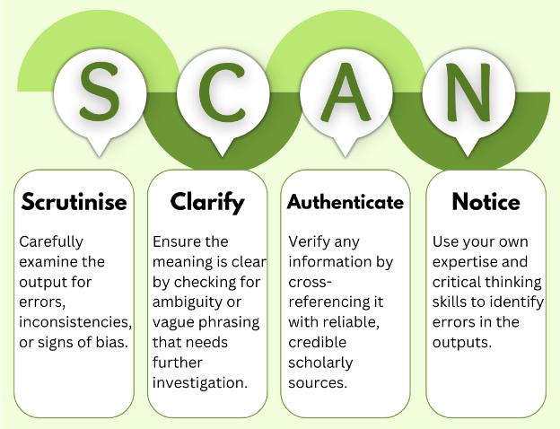
Clarify AI’s Role in Learning
Move from prohibition to guidance.
Define when and how AI may be used.
Teach students to critique AI output.
Address limitations, bias, and accuracy.
Promote ethical and transparent use.
Notes:
Rather than banning AI outright, you can take a more effective and realistic approach by clearly defining when and how its use is appropriate. Students are already encountering AI tools in academic and professional settings and ignoring this reality can create confusion or misuse. Clear guidance helps students understand expectations and reduces uncertainty around acceptable use.
Teaching students to critique AI output is an essential component of digital literacy. Students can learn to question accuracy, identify bias, and evaluate whether AI-generated content truly meets the goals of an assignment. Reflection prompts that ask students how AI was used—and why—encourage transparency and reinforce ethical reasoning.
When expectations around AI use are explicit, students are more likely to engage thoughtfully rather than rely on shortcuts. This approach reframes AI as a support tool that can assist with brainstorming or organization, while preserving the integrity of student thinking. Ultimately, clear and intentional guidance promotes responsible technology use and strengthens learning outcomes.

Slide 15

Designing for Learning, Not Detection
Focus on learning, not AI avoidance.
Prioritize context, process, and reflection.
Design work that requires human judgment.
Reinforce the value of thinking and growth.
Create learning experiences that endure.
Notes:
The goal in the AI era is not to create assignments that are completely AI-proof, but to design learning experiences that center on how students think, learn, and grow. When the primary focus is avoidance or detection, the emphasis shifts away from learning. Instead, learning-centered assignments invite students to engage deeply with ideas, apply concepts in meaningful ways, and reflect on their understanding.
Assignments that prioritize context, process, and reflection naturally require human judgment. Students must interpret information through their own experiences, explain their reasoning, and document how their thinking evolves. These elements cannot be replicated by AI alone, and they make learning visible and authentic.
By rewriting assignments with intention, you reinforce the value of human thinking in an increasingly automated world. You create learning experiences that are purposeful, engaging, and meaningful—experiences that support academic integrity while preparing students to think critically and ethically long after the tools change.

Slide 16

Start Small, Make an Impact
No full course redesign required.
Revise one existing assignment.
Add a reflection or process step.
Increase authenticity and engagement.
Reduce reliance on AI-generated work.
Notes:
You do not need to redesign your entire course to respond effectively to AI. Meaningful change can begin with a single assignment. By revising one prompt, adding a short reflection, or requiring students to document part of their process, you can significantly strengthen the authenticity of student work.
Small changes often have a large impact. Adding a checkpoint, asking students to explain their reasoning, or requiring a brief reflection on learning encourages deeper engagement and makes student thinking visible. These adjustments help shift assignments from product-focused to learning-focused without increasing workload or complexity.
Starting small also allows you to experiment and refine your approach over time. As you see how students respond, you can build additional strategies into future assignments. Incremental changes reduce reliance on AI-generated work while creating richer, more meaningful learning experiences that align with your goals.

Slide 17
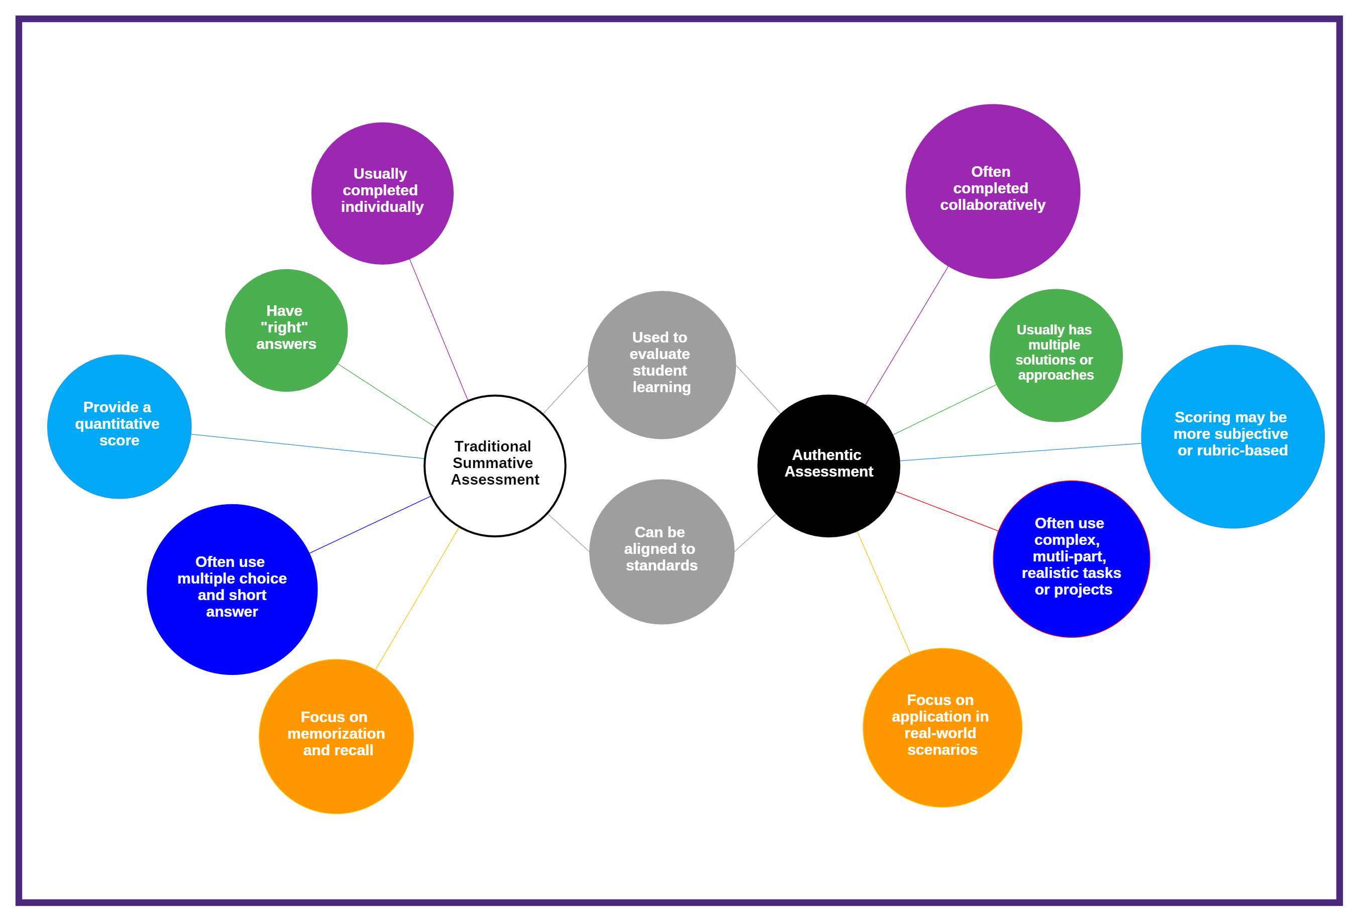
Authentic, AI-Resistant Assignments Across Disciplines
Notes:
Authentic, AI-resistant assignments do not look the same in every discipline. Critical thinking in English differs from critical thinking in Chemistry; communication in Mathematics differs from communication in Nursing. What remains consistent are the underlying principles: context, process, reflection, and application. The following examples show how you can apply these principles within your discipline—often by slightly reframing assignments you already use.

Slide 18

English and Humanities
Move beyond traditional literary analysis.
Connect themes to personal or contemporary contexts.
Emphasize interpretation and reflection.
Make meaning visible and personal.
Notes:
Instead of assigning a traditional literary analysis focused solely on theme and textual evidence, you can invite students to make meaningful connections between the text and their own lives or the world around them. For example, students might explore how a novel’s theme of identity, power, or belonging appears in their educational journey, family history, cultural background, or a current social issue they observe in their community.
This approach shifts the assignment from summarizing or analyzing a text in a generic way to interpreting literature through lived experience. Students must select a connection that matters to them, explain why it is relevant, and use course concepts to support their interpretation. These decisions require judgment and personal insight—elements that cannot be accurately generated by AI.
Requiring a short reflection further strengthens authenticity. When students explain why they chose a particular connection and how their thinking evolved during the assignment, they reveal the learning process behind the work. This not only makes the assignment difficult to outsource but also deepens engagement and helps you better understand how students are connecting course content to their own lives.

Slide 19

History
Shift from broad research to localized analysis.
Focus on communities, regions, or institutions.
Emphasize primary sources and interpretation.
Prioritize historical reasoning over summary.
Notes:
Instead of assigning a broad research paper on a major historical event, you can ask students to investigate how that event affected a specific community, region, or institution. Narrowing the focus encourages deeper analysis and helps students see history as something that shaped real people and places, rather than as a collection of distant facts.
For example, students might examine how a national policy influenced their city, state, or local institution by analyzing primary sources such as newspapers, government records, letters, or photographs. Asking students to explain why they selected certain sources and how those sources shape their understanding of the past emphasizes historical thinking rather than information gathering.
By requiring students to justify source choices and explain historical significance, you shift the assignment from summary to interpretation and reasoning. Students must make judgments, weigh evidence, and articulate meaning—skills that are central to historical inquiry and difficult to outsource to AI. This approach results in more authentic work and deeper engagement with historical content.

Slide 20

Social Sciences
Center assignments on real-world observation.
Apply theory to local or lived context.
Address ethics, limitations, and perspective.
Emphasize analysis over description.
Notes:
In the social sciences, assignments can be redesigned to focus on real-world observation and application rather than abstract description. In psychology, for example, students might observe a behavior connected to course concepts—such as attention, conformity, or stress—and reflect on what they observed, the ethical considerations involved, and the limitations of their interpretation. This requires students to think critically about both the behavior and the research process itself.
In sociology or political science, students could analyze a local policy, community trend, or campus issue using theoretical frameworks discussed in class. Rather than summarizing theory, students must apply it to a specific context, explain how it helps them understand the issue, and consider where the theory falls short. These tasks require judgment, interpretation, and contextual awareness.
By grounding assignments in lived contexts, you move students beyond surface-level understanding. Students must connect theory to observation, justify their reasoning, and reflect on complexity. Because the analysis is rooted in personal observation and local context, the work is difficult to outsource and results in more authentic, meaningful learning.

Slide 21

Mathematics
Go beyond final answers.
Emphasize reasoning and strategy.
Use error analysis to reveal understanding.
Make problem-solving visible.
Notes:
In mathematics, assignments often focus on whether students arrive at the correct answer. To make learning more authentic, you can shift attention to how students approach problems and why they choose particular methods. Asking students to explain their problem-solving process encourages deeper engagement with underlying concepts rather than reliance on procedures alone.
An effective strategy is error analysis. Instead of correcting their own work, students analyze incorrect solutions—either their own or provided examples—and explain where the reasoning breaks down. This requires students to understand the concept well enough to diagnose mistakes and articulate why an approach is flawed. Error analysis emphasizes conceptual understanding and critical thinking over computation.
Including brief reflections on problem-solving strategies further strengthens learning. When students explain what worked, what didn’t, and how they would approach a similar problem in the future, their thinking becomes visible. This approach reduces reliance on AI-generated solutions by valuing reasoning, explanation, and growth—skills that reflect genuine mathematical understanding.

Slide 22

Natural Sciences
Shift focus from procedures to reasoning.
Emphasize experimental design and decisions.
Analyze sources of error and unexpected results.
Interpret data rather than report outcomes.
Notes:
In lab-based courses, assignments often emphasize following procedures and reporting results. To increase authenticity, you can shift the focus toward reasoning and decision-making. Instead of requiring only a traditional lab report, ask students to reflect on why certain experimental choices were made and how those choices affected outcomes.
Students might analyze sources of error, discuss unexpected results, or compare their findings to initial hypotheses or theoretical expectations. These reflections require students to interpret their own data rather than simply present it. By explaining what the data mean and why results may differ from expectations, students engage in deeper scientific thinking.
When students are asked to justify decisions and interpret findings, the assignment becomes learning-focused rather than procedural. This approach mirrors how scientific work is conducted in real settings and reduces reliance on AI-generated reports by prioritizing judgment, analysis, and reflection—key components of authentic scientific learning.

Slide 23

Health Sciences and Nursing
Use realistic patient or clinical scenarios.
Focus on decision-making, not just correct answers.
Justify care priorities and communication choices.
Reflect on growth after feedback.
Notes:
In health sciences and nursing, assignments are most authentic when they reflect the complexity of real clinical practice. Instead of asking students to identify a single “correct” response, you can design assignments around realistic patient scenarios that require judgment, prioritization, and ethical reasoning. Students might explain why they chose certain interventions, how they communicated with patients or families, or how they navigated competing priorities.
Case-based assignments encourage students to think like practitioners rather than test-takers. By asking students to justify care decisions and consider ethical implications, you emphasize clinical reasoning over memorization. These explanations reveal how students are applying knowledge in context and making informed decisions.
Including a reflection after feedback further strengthens learning. When students explain how their thinking changed or what they would do differently in a similar situation, they engage in professional self-reflection. This mirrors real clinical practice, supports the development of sound judgment, and makes the work difficult to outsource while reinforcing meaningful, practice-based learning.

Slide 24

Business
Move beyond generic business plans.
Analyze local or simulated organizations.
Explain strategy, risks, and trade-offs.
Write for a specific professional audience.
Notes:
In business courses, traditional assignments such as generic business plans often emphasize format over thinking. To increase authenticity, you can ask students to analyze a local business, a workplace scenario, or a simulated organization that includes specific constraints such as limited budgets, staffing challenges, or market conditions. These constraints require students to think strategically rather than rely on templates.
Students might propose a course of action and explain the reasoning behind their decisions, including potential risks and trade-offs. Asking students to justify why one strategy was chosen over another emphasizes critical thinking and real-world decision-making. These explanations make student thinking visible and difficult to outsource.
Writing for a specific audience—such as a manager, client, or stakeholder—adds another layer of authenticity. Students must consider tone, clarity, and purpose while communicating recommendations. This approach mirrors professional practice, increases student engagement, and reinforces the value of judgment and context in business decision-making.

Slide 25

Career and Technical Programs
Mirror real workplace tasks and expectations.
Document steps, decisions, and adjustments.
Use photos, logs, or brief reflections.
Emphasize skill application over final output.
Notes:
In career and technical programs, assignments are most effective when they closely resemble real workplace tasks. Instead of focusing only on the final product, you can ask students to complete a project and document each step they take along the way. This may include planning decisions, adjustments made during the process, and problem-solving strategies used when challenges arise.
Requiring documentation—such as photos of work in progress, process logs, or brief written reflections—reinforces accountability and ownership. Students must demonstrate not only what they produced, but how they applied technical skills, followed procedures, and adapted to real-world conditions. These elements reflect how work is evaluated in professional settings.
By emphasizing process and application rather than output alone, you highlight the development of practical skills and professional judgment. This approach reduces reliance on AI-generated work, strengthens authenticity, and ensures that assessments accurately reflect student learning and readiness for the workplace.

Slide 26
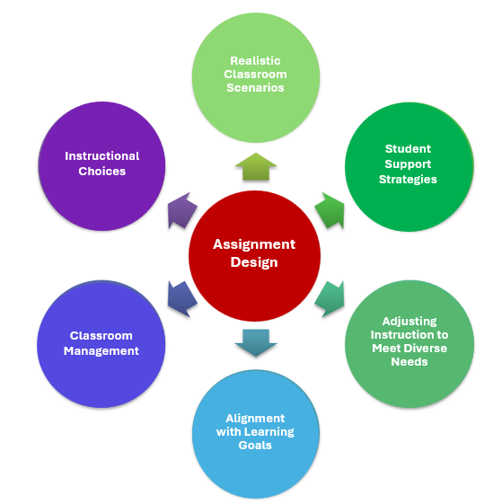
Education
Focus on lesson planning and classroom scenarios.
Emphasize instructional decision-making.
Anticipate challenges and student needs.
Reflect on alignment with learning goals.
Notes:
In education courses, assignments are most meaningful when they reflect the realities of teaching and learning. Instead of focusing solely on theory or generic lesson plans, you can design assignments around realistic classroom scenarios, instructional challenges, or student support strategies. These tasks invite students to think like practitioners and apply pedagogical concepts in context.
Asking students to explain their instructional choices strengthens pedagogical thinking. Students can describe why they selected specific strategies, how those choices align with learning objectives, and how they would adjust instruction to meet diverse student needs. Anticipating potential challenges—such as classroom management issues or varying levels of readiness—further reinforces professional judgment.
Reflective components ensure that learning goes beyond planning to purposeful decision-making. When students reflect on feedback and alignment with learning goals, they demonstrate growth and adaptability. These elements ground learning in professional practice, make student thinking visible, and create authentic assessments that are difficult to outsource.

Slide 27

The Common Thread Across Disciplines
Apply learning in meaningful contexts.
Make thinking and decision-making visible.
Build in reflection and growth.
Strengthen learning and assessment.
Reduce reliance on AI outsourcing.
Notes:
Across all disciplines, the most effective and authentic assignments share a common foundation. They require students to apply what they are learning in meaningful contexts rather than simply recall or repeat information. Whether the context is personal, local, professional, or disciplinary, these assignments ask students to interpret ideas and make informed decisions.
Another defining feature is transparency of thinking. By requiring students to document their process, explain their reasoning, and justify choices, assignments make learning visible. This allows you to assess understanding more accurately and provide targeted feedback while discouraging the use of AI as a shortcut.
Reflection and growth tie these elements together. When students reflect on feedback, challenges, and progress, they engage in deeper learning and metacognition. These shared features not only reduce the likelihood of outsourcing work but also lead to richer learning experiences and more meaningful assessment across disciplines.

Slide 28

Rewriting Assignments in the AI Era
Shift the focus from detection to design.
Emphasize context, process, and reflection.
Make student thinking visible across disciplines.
Start small—revise one assignment.
Design learning that values human judgment and growth.
Notes:
In conclusion. artificial intelligence has fundamentally changed the landscape of student work, making it easy to generate polished responses to traditional assignments. Rather than focusing on restriction or detection, you can respond by rethinking how assignments are designed. When tasks emphasize generic prompts and product-only grading, they unintentionally invite outsourcing.
By shifting your focus to learning-centered design—where students must apply concepts, explain reasoning, and engage with real contexts—you reinforce academic integrity while strengthening student learning.
Across disciplines, authentic assignments share common characteristics. They are grounded in personal, local, or disciplinary contexts; they require students to document their process and decision-making; and they include opportunities for reflection and revision. Whether students are analyzing a literary theme through lived experience, explaining mathematical reasoning, interpreting original data in a lab, or justifying decisions in a clinical or business scenario, the emphasis moves from producing an answer to demonstrating understanding. These small but intentional changes make student thinking visible and difficult to outsource.
You do not need to redesign your entire course to teach effectively in the AI era. Revising a single assignment, adding a reflective component, or building in a checkpoint can have a significant impact. When assignments prioritize human judgment, growth, and application, AI becomes a tool rather than a shortcut. Ultimately, designing authentic work helps you create learning experiences that are meaningful, engaging, and enduring—long after the technology changes.

Slide 29

A Framework for Designing Assignments in the Age of AI. Harvard College Writing Program.
Akbar, M. S. (2025). Beyond detection: Designing AI-resilient assessments with automated feedback tools to foster critical thinking. arXiv.
Carleton College. (n.d.). AI-resistant assignments. Writing Across the Curriculum.
Faculty Guide to Generative AI. Niagara University.
Khlaif, Z. N., Alkouk, W. A., Salama, N., & Abu Eideh, B. (2025). Redesigning assessments for AI-enhanced learning: A framework for educators in the generative AI era. Education Sciences, 15(2), 174.
Kofinas, A. K. (2025). The impact of generative AI on academic integrity and authentic assessments. British Journal of Educational Technology. Advance online publication.
Mintz, S. Teaching Writing in the Age of AI: Challenges and Approaches. Inside Higher Ed.
Northern Michigan University. (n.d.). Creating AI-resistant assignments, activities, and assessments. Center for Teaching and Learning.
Packback. (2025). AI-proof your assignments: Five strategies to prevent cognitive offloading in higher education.
Tucker, C. (2024). Five tips for designing AI-resistant tasks.
University of Chicago. (n.d.). Strategies for designing AI-resistant assignments. Generative AI Teaching Resources.
University of Massachusetts Amherst. (n.d.). Redesigning assignments and assessments in an AI-impacted world. Center for Teaching and Learning.
Using AI ethically in writing assignments. Center for Teaching Excellence. University of Kansas.
Van Niekerk, J. (2025). Addressing the use of generative AI in academic writing. Computers and Education: Artificial Intelligence. Volume 8, June 2025, 100342. Science Direct.
References

Slide 30
Appendix
Authentic Learning and Process Rubric
Purpose:
This rubric evaluates how students think, apply, and reflect, not just what they produce.
Criteria | Exceeds Expectations | Meets Expectations | Needs Development
Experience and Perspective | Integrates specific personal or contextual experiences that clearly inform understanding and decisions. | Includes relevant experience or perspective connected to the task. | Little or no personal or contextual connection.
Original Evidence / Data | Uses well-documented original data, observations, examples, or artifacts and explains their relevance. | Includes original evidence or examples with basic explanation. | Relies on generalized information or lacks original evidence.
Judgment and Decision-Making | Clearly explains why choices were made and how context or constraints shaped decisions. | Describes decisions with some reasoning. | Decisions are unclear or not justified.
Process Documentation | Documents key steps, drafts, revisions, or checkpoints showing intentional effort. | Documents major steps in the process. | Minimal or missing process documentation.
Reflection on Learning | Thoughtful reflection showing how understanding changed over time and what was learned. | Reflection describes learning or challenges. | Reflection is superficial or missing.
Clarity and Communication | Ideas are clearly organized and easy to follow. | Communication is generally clear. | Organization or clarity interferes with understanding.

