Slide 1

Simplify Without Sacrificing
Design Smarter, Not Harder
Faculty Focus: Innovative Teaching Tips for College Success Series
Notes:
We’ve all been there—trying to build the perfect course. We start with good intentions, add rich content, layer in readings, videos, quizzes, discussions… and before we know it, our course has become a maze. What began as thoughtful design can quickly become overwhelming—for us, and for our students. g76Now, imagine being a student logging into that course. You’re managing multiple classes, a job, maybe a family. You click through the course shell and find five folders, ten links, multiple announcements—and no clear path forward. It’s not that the content isn’t valuable—it’s that it’s hard to navigate, hard to prioritize, and sometimes, hard to keep up. That’s where efficient course design comes in. This session is about more than saving time. It’s about making intentional choices that create a better learning experience. We’ll explore simple, research-based strategies to help you streamline your course design—without sacrificing rigor, creativity, or connection. Because when students know what to do, where to find it, and why it matters—they engage more, learn more, and stress less. Let’s look at how we can simplify with purpose.

Slide 2
Why Efficient Design Matters
🔄 Reduces overload for instructors. Less time spent managing content, more time for teaching and feedback.
🧭 Creates clarity and structure for students. Predictable, accessible design helps all learners—especially first-gen, ESL, and nontraditional students.
⚖️ Supports equity and inclusion. Clear navigation, simple instructions, and flexible formats level the playing field.
💡 Improves engagement and persistence Students stay focused when they know what to do, where to go, and why it matters.
🛠️ Makes updates and reuse easier. Streamlined courses are easier to revise, adapt, and scale.
Notes:
Teaching today looks different than it did even a few years ago. Many of us are managing growing class sizes, increasing workloads, and rapidly changing technology. At the same time, our students bring a wide range of backgrounds, learning preferences, and life responsibilities into the classroom. Some are balancing school with full-time jobs, caregiving duties, or learning in a second language. Others are navigating college for the very first time—often without a clear roadmap. In this environment, efficient course design isn’t just a nice-to-have—it’s critical. For faculty, it reduces prep time, cuts down on repetitive tasks, and makes course updates more manageable. For students, it creates clarity, structure, and predictability—three things that lower stress and increase the chances they’ll stay engaged and succeed. When we simplify with intention, we’re not watering down our courses. We’re removing roadblocks. We’re making the learning journey smoother—so that more students can get where they’re going, and faculty can focus more on teaching, feedback, and connection.

Slide 3

Avoid cognitive overload. Too much content or too many tools can confuse and exhaust students.
Enhance focus and clarity. Clear priorities help students understand what matters most.
Support deeper learning. Simpler design allows more time for reflection, practice, and feedback.
Reduce instructor workload. Streamlined courses are easier to manage, update, and troubleshoot.
Simplicity ≠ Easiness It’s about designing with purpose—not lowering the bar.
The Case for Simplicity
Notes:
In course design, more isn’t always better. When we pack our courses with too many readings, activities, discussion boards, or tech tools, we risk overwhelming both our students and ourselves. The intention is usually good—we want to provide options, deepen understanding, and cover all the bases. But the result can be cognitive overload, unclear expectations, and a learning experience that feels disjointed or exhausting. Simplicity in design isn’t about lowering standards—it’s about creating focus. When students can clearly see what’s most important and how it connects to their goals, they’re more likely to engage deeply, complete tasks, and retain what they learn. A simplified course is also easier to teach, easier to update, and easier to troubleshoot when issues arise. In short, simplicity creates space—for learning, connection, and success.

Slide 4

Guiding Principles of Efficient Design
Notes:
So how do we move from good intentions to purposeful simplicity? The key is designing with a set of clear, guiding principles that keep both teaching and learning at the center. Efficient course design isn’t about cutting corners—it’s about aligning your content, activities, and assessments in a way that saves time, reduces confusion, and improves outcomes. Whether you’re building a new course or refining an existing one, these principles can serve as your design compass—helping you create a course that’s not only easier to manage, but more impactful for your students.
This section outlines key guiding principles to help educators simplify their course design thoughtfully and strategically, ensuring that simplification enhances rather than diminishes academic rigor and student learning.

Slide 5
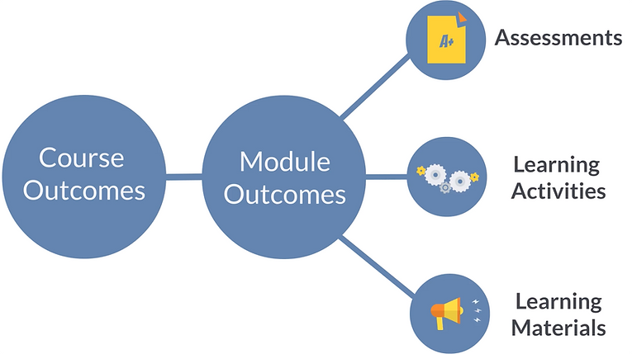
Alignment
What is Alignment? Ensuring course objectives, assessments, and activities are in sync
Why It Matters Creates a cohesive learning experience for students and instructors
Steps to Align
Start with clear objectives Define what students should know or be able to do by the end of the course.
Design assessments Ensure quizzes, papers, or projects directly measure the objectives.
Plan learning activities Use readings, discussions, and group work to build the skills needed for the assessments.
Impact Students understand expectations, how they’ll be evaluated, and how activities contribute to their learning.
Notes:
As we design our courses, it's crucial to keep a few guiding principles in mind to ensure both efficiency and effectiveness. One of the most important of these is alignment—making sure that your course objectives, assessments, and activities are all in sync with each other. Alignment is the foundation of efficient course design. It means ensuring that your course objectives, assessments, and activities are all aligned to create a cohesive learning experience. Start with clear, measurable learning objectives that define what you want students to know or be able to do by the end of the course. Next, design your assessments—whether quizzes, papers, or projects—to directly measure those objectives. If an objective is about analyzing historical trends, then your assessments should give students the chance to demonstrate that skill, such as through a comparative analysis or case study. Finally, ensure that the learning activities—readings, discussions, group work—help students develop the skills they need to meet those objectives. When your course elements are aligned, students know exactly what is expected, how they’ll be evaluated, and how the activities contribute to their learning. This clarity not only increases student confidence but also helps you streamline your teaching, focusing on what matters most and reducing unnecessary content or tasks.

Slide 6

Clarity
What is Clarity? Clear structure, expectations, and instructions throughout the course
Why It Matters Reduces confusion, increases student confidence, and supports smoother learning
Key Elements to Ensure Clarity
Course Structure Organized, consistent layout that’s easy to navigate
Expectations Explicit learning outcomes, participation guidelines, and grading criteria
Instructions Clear, concise directions for assignments, activities, and assessments
Impact Students know what to do, when to do it, and how it will be evaluated.
Notes:
Clarity is another cornerstone of efficient course design. It ensures that both you and your students are on the same page. This principle emphasizes the importance of being explicit in your course structure, expectations, and instructions. A well-structured course should have a clear and consistent layout that guides students step-by-step through each module or week. This includes clear labels for course content, assignments, and assessments, making it easy for students to navigate. Equally important are well-defined expectations: students should know exactly what is expected of them in terms of learning outcomes, participation, deadlines, and grading criteria. In addition, instructions for assignments, discussions, and activities should be concise and unambiguous, leaving no room for confusion. When these elements are clear, students can focus on learning rather than spending time trying to figure out what they need to do or how to do it. Clarity not only reduces frustration but also fosters a sense of confidence, helping students feel more in control of their learning journey.

Slide 7

Consistency
What is Consistency? Using predictable patterns across modules and assignments
Why It Matters Helps students manage time and effort, reducing confusion and cognitive load
Key Elements of Consistency
Module Structure Maintain a similar layout each week (e.g., overview, objectives, content, activities, assignments).
Assignment Format Use consistent rubrics, deadlines, and expectations across tasks.
Assessment Style Keep assessment types and formats similar throughout the course.
Impact Students can focus on learning without being distracted by unpredictable course structures.
Notes:
Consistency is a key principle in course design that ensures students know what to expect from week to week. When modules and assignments follow a predictable pattern, students can focus their energy on learning, not on figuring out how the course works. This means using a consistent structure across all units or modules—whether that’s the way readings, videos, and assignments are presented or how assessments are formatted. For example, you might choose to present each week with a similar layout: an introductory overview, a list of key objectives, followed by the content, activities, and a concluding assignment. In addition, assignments should follow a similar format, with clear rubrics and similar deadlines. Consistency not only helps students manage their time and effort more effectively, but it also reduces cognitive load. When students know exactly how to engage with each module and what to expect from every assignment, they can stay focused on learning rather than constantly adapting to new formats or structures. This reliable pattern leads to greater student success and less frustration.

Slide 8

Reusability
What is Reusability? Leveraging existing materials, templates, and resources to save time and enhance course efficiency
Why It Matters Streamlines course creation, ensures consistency, and reduces workload across semesters
Key Elements of Reusability
Templates Create reusable frameworks for weekly modules, assignments, and rubrics.
Past Materials Repurpose lecture notes, videos, readings, and discussion prompts from previous courses.
Content Banks Use collections of quizzes, discussion questions, and multimedia to quickly adapt materials.
Impact More time to focus on refining student engagement and teaching effectiveness
Notes:
Reusability is a principle that helps you save time and effort by reusing and repurposing existing materials and resources. Rather than reinventing the wheel each semester, you can leverage templates, past course materials, and content banks to streamline your course design process. For instance, creating templates for weekly modules, assignment guidelines, or assessment rubrics can significantly reduce the time spent on course preparation. Additionally, reusing materials such as lecture notes, readings, videos, or even discussion prompts from previous semesters ensures that valuable content is not lost or forgotten, and it can be updated or refined as needed. Content banks—repositories of reusable materials such as quizzes, discussion questions, and multimedia resources—allow you to easily access and integrate pre-vetted resources into your courses. This not only saves time but also helps ensure consistency and alignment across different sections or semesters. By embracing reusability, you can create courses that are more efficient to teach and update, while focusing your time and energy on enhancing the student experience.

Slide 9

Streamline Your Course Map
Notes:
Now that we’ve covered some key principles of efficient course design, let’s dive into one of the most effective ways to simplify your course: streamlining your course map. Think of your course map as a blueprint—it’s the roadmap that guides both you and your students through the semester. A clear, streamlined course map not only makes your course easier to navigate, but it also ensures that your students understand how all the pieces fit together. By organizing your content, activities, and assessments in a logical, predictable flow, you can help students focus on what really matters: learning. This section will walk you through strategies to structure your course so that it feels cohesive, manageable, and aligned with your learning objectives. Whether you're designing a new course or revising an existing one, a streamlined course map is a powerful tool for enhancing both student success and your teaching efficiency.

Slide 10
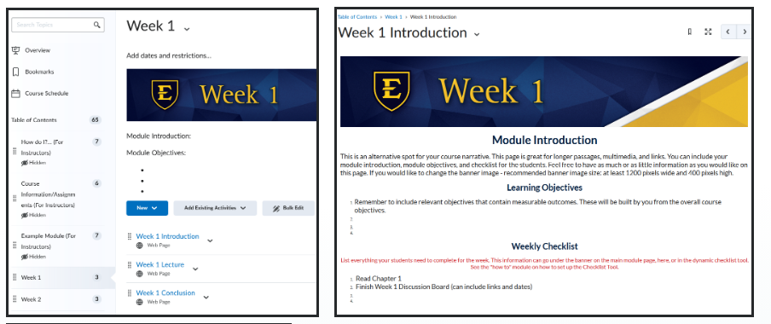
Weekly/Module Structure Template
What is a Weekly/Module Structure Template? A consistent, predictable layout for each week or module in the course
Why It Matters Provides clarity and organization, helping students focus on learning, not navigation
Key Components of a Weekly/Module Template
Overview/Introduction Clearly state the weekly objectives and goals
Content Delivery Include readings, videos, and interactive learning materials
Learning Activities Assignments, discussions, or quizzes that reinforce the content
Summary/Reflection A wrap-up to consolidate learning and prepare for the next week
Impact Reduces student confusion, increases engagement, and simplifies course updates
Notes:
A weekly or module structure template is one of the simplest yet most effective ways to streamline your course design. By creating a consistent template for each week or unit, you establish a clear, predictable flow that helps students understand what they need to do and when. A good template will typically start with an overview or introduction that outlines the key objectives and goals for that week, providing students with a roadmap for what they will learn. This is followed by the main content, which could include readings, lecture videos, or interactive learning materials. Next, include any activities or assignments that reinforce the content—these could be discussions, quizzes, or group projects. Finally, wrap up with a summary or reflection to help students consolidate what they’ve learned. A weekly/module template ensures that all essential elements are present and clearly laid out, reducing the mental load for both students and instructors. The key is to keep it simple, with a consistent structure that repeats throughout the course, making it easier to maintain and update as needed. This level of organization helps students focus on mastering the material rather than deciphering the course layout.

Slide 11
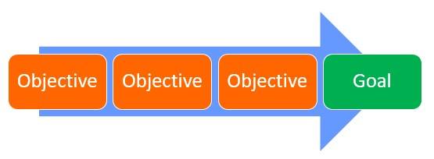
What Does Limiting Goals Mean? Focus on 1-2 key outcomes per module for deeper learning
Why It Matters Helps students master concepts without feeling overwhelmed
How to Limit Learning Goals
Identify 1–2 Major Outcomes Choose clear, measurable goals that can be fully explored in one module.
Align Assessments and Activities Design tasks that directly support the focused outcomes.
Maintain Depth Over Breadth Encourage mastery rather than surface-level coverage of multiple topics.
Impact Increases student engagement, improves retention, and reduces cognitive overload
Limit Major Learning Goals Per Module
Notes:
One of the best ways to maintain focus and clarity in your course design is to limit the number of major learning goals you set for each module. Rather than trying to cover too many concepts or skills in a single week, focus on 1 to 2 key outcomes that you want your students to master. By narrowing the scope, you allow students to engage deeply with the content, ensuring they have time to fully understand and apply what they've learned. For example, in a history module, instead of trying to cover every major event in a century, you might focus on analyzing the causes of one major historical event or understanding the impact of one cultural movement. This approach also makes it easier to design assessments and activities that directly support those specific outcomes. When students have fewer, more focused goals, they can concentrate their efforts and energy on mastering those specific skills, which leads to better retention and understanding. Moreover, this strategy prevents the course from feeling overwhelming, reducing cognitive overload and allowing both students and instructors to stay on track without feeling rushed.

Slide 12
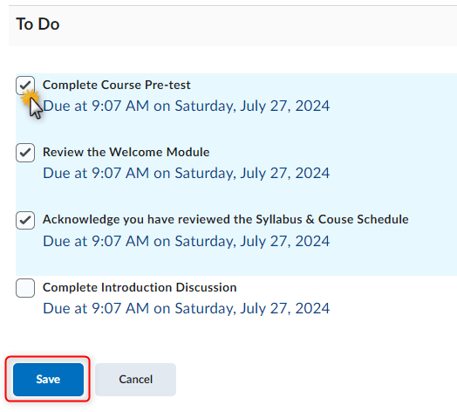
Use a Simple Visual Map for Each Unit
What is a Visual Map? A clear, simple guide showing the sequence of tasks and learning activities
Why It Matters Helps students understand the flow of the module and track progress easily
Types of Visual Maps:
Table: List topics, activities, readings, and due dates
Checklist: Break down the steps for each module or unit
Icon-Based Roadmap: Visual sequence of tasks or milestones
Impact Reduces confusion, increases student organization, and improves time management
Notes:
A simple visual map for each unit or module can be a game-changer in terms of course organization and student understanding. By using a visual tool such as a table, checklist, or icon-based roadmap, you give students a clear, easy-to-follow guide of what’s expected and what to do next. These visual aids not only make the course content more approachable but also help students see how the learning objectives, activities, and assessments are connected. For example, a table could lay out the key topics for the week, the associated readings or videos, and the due dates for assignments, making it easier for students to track their progress. Alternatively, an icon-based roadmap could show a visual sequence of activities, helping students understand the flow of the module and how each task fits into the bigger picture. These maps provide students with a sense of direction and control, reducing anxiety and helping them plan their time effectively. They also serve as a quick reference point, cutting down on the time students spend searching for information. By incorporating visual elements like these, you support not only clarity and efficiency but also student engagement and motivation.

Slide 13
Module/Week | Content | Activities | Assessment | Due Date
Week 1: Introduction to Course | Course Overview, Learning Objectives | Watch Intro Video, Read Syllabus | Participate in Discussion | Sunday, Week 1
Week 2: Understanding History | Chapter 1 Reading, Key Themes | Complete Quiz, Discussion Post | Submit Short Essay | Wednesday, Week 2
Week 3: Analyzing Causes of Events | Case Study, Watch Video | Group Project, Class Discussion | Submit Group Report | Friday, Week 3
Sample Layout for a Visual Map: Table Format
Notes:
There are several ways to visually organize the components of a unit or module, but two of the most effective and student-friendly options are the table format and the icon-based roadmap. The table format is ideal for presenting a structured overview of each week’s content. It typically includes columns for the module title, required content, learning activities, assessments, and due dates. This layout allows students to quickly scan what they need to do, understand the sequence of learning tasks, and keep track of deadlines—all in one place. It’s especially helpful for courses that rely on a combination of readings, videos, assignments, and assessments each week.

Slide 14




Sample Layout for a Visual Map Icon-Based Roadmap
Readings – Read Chapter 1 (due Tuesday)
Videos – Watch introductory video (due Wednesday)
Discussion – Post discussion response (due Friday)
Assessment – Complete and submit quiz (due Sunday)
Notes:
The icon-based roadmap, on the other hand, offers a more visual and engaging representation of the learning path. This format breaks down the week’s tasks into simple steps, each marked by an intuitive icon (e.g., a book for readings, a play button for videos, a chat bubble for discussion, or a pencil for an assignment). Students can follow the flow at a glance, making this format particularly helpful for visual learners or those who benefit from more graphic cues. Both layouts support clarity and time management, and they can be used interchangeably depending on the content and your course design style. Incorporating either of these visual tools at the start of each module helps reduce confusion, enhance motivation, and guide students through the learning process with confidence.

Slide 15

Strategies to Simplify, Strengthen, and Streamline Your Course
Notes:
With your course map in place and guiding principles established, the next step is to fine-tune how your course operates week to week. This section focuses on practical strategies that help you simplify without sacrificing depth, manage your workload without lowering expectations, and create a learning experience that’s clear, consistent, and supportive. We’ll explore ways to streamline content delivery so students can focus on learning rather than navigating disjointed materials. You’ll learn how to minimize content without ‘dumbing it down,’ design smart assessments that are meaningful and manageable, and create intuitive navigation that supports—not distracts from—student success. Finally, we’ll look at how to reuse and repurpose existing materials so you can save time while maintaining quality. These strategies are all about teaching with intention—designing smarter, not harder—to create courses that are efficient, effective, and learner-centered.

Slide 16
Why It Matters Reduces cognitive overload and improves student engagement
Key Strategies
Chunk content into shorter videos, readings, and sections
Embed resources directly into the course shell (LMS pages > attachments)
Focus on “need-to-know” content over “nice-to-know” extras
Use headings, icons, and labels to guide students through content.
Impact Clearer delivery = deeper understanding and better retention
Simplify Content Delivery
Notes:
With your course map streamlined and your modules clearly structured, the next challenge is delivering content in a way that supports—not overwhelms—student learning. In many courses, students face an overload of readings, lengthy lecture videos, and scattered resources that make it hard to know where to begin. But simplifying content delivery isn’t about removing important material—it’s about organizing and presenting it more effectively. By chunking information into manageable parts, embedding content directly into the course shell, and focusing on what students truly need to know, we can help learners stay focused and engaged. Clear, intentional content delivery makes your course easier to navigate and allows students to connect with the material at a deeper level.
Appendix A in the PDF is a sample content layout for a simplified course module that applies the strategies of chunking, embedding, and prioritizing content. This example assumes delivery in an LMS (like D2L, Canvas, or Blackboard), but can be adapted to any platform.

Slide 17
Minimize Without
Dumbing Down
What Does It Mean? Focus on the essential concepts, skills, and materials that directly support your outcomes.
Why It Matters Reduces cognitive overload and allows for deeper engagement with key topics
How to Minimize:
Prioritize core content that aligns with learning goals
Limit the number of readings, assignments, and activities
Replace quantity with quality, ensuring rigor in what is included
Impact Students engage more meaningfully, perform better, and experience less overwhelm.
Notes:
One of the most powerful ways to simplify your course is by minimizing the amount of content students are expected to absorb in each module—but this doesn’t mean lowering the intellectual rigor or expectations. The goal is to be intentional about what you include. Rather than overwhelming students with excessive readings, videos, and assignments, focus on the essential concepts, skills, and materials that directly support your learning outcomes. Carefully selected content allows students to engage more deeply, think more critically, and retain more information. It also gives you the opportunity to design more meaningful activities and discussions, rather than rushing to cover every possible topic. When students are asked to do less—but with greater focus—they often perform better, feel less stressed, and gain a stronger grasp of the material. Minimizing content is not about removing challenge—it’s about removing clutter.
Appendix B in the PDF demonstrates how you can reduce content volume while maintaining academic rigor and depth of engagement.

Slide 18

Smart Assessment Strategies
What Are Smart Assessment Strategies? Efficient assessments that measure learning while saving time for both students and instructors
Why It Matters Provides timely, actionable feedback without overwhelming students or instructors
Key Approaches:
Use formative assessments (quizzes, reflections, peer reviews) for ongoing feedback
Align assessments with course objectives to measure key skills and knowledge
Implement low-stakes assessments to reduce stress and allow multiple opportunities for success
Impact Increases student understanding, supports deeper learning, and provides valuable insights into student progress
Notes:
Assessment is one of the most powerful tools for gauging student learning, but traditional methods like exams and lengthy assignments can be time-consuming for both students and instructors. Smart assessment strategies focus on making assessments more efficient while still maintaining their ability to measure deep learning. This can involve using formative assessments like quizzes, reflections, or peer reviews that provide quick, actionable feedback without overwhelming students or creating grading burdens. Additionally, assessments should be aligned with your course objectives, allowing students to demonstrate their understanding in a way that reflects the key skills and knowledge they need to develop. By integrating assessments throughout the course, such as through weekly check-ins or low-stakes quizzes, students get regular feedback and have multiple opportunities to demonstrate mastery. This approach not only helps students stay on track but also helps you adjust your teaching based on the needs of your class.

Slide 19

Design for Navigation, Not Exploration
What Does It Mean? Create a clear, predictable course structure that guides students through each module
Why It Matters Helps students stay focused on content without wasting time on finding materials or tasks
Key Strategies:
Use consistent layout and structure for all modules
Clearly label content and activities with easy-to-understand titles
Ensure a logical flow from one task to the next, reducing confusion
Impact Improves student engagement, reduces frustration, and supports efficient learning
Notes:
When designing your course, think about how your students will experience it. Rather than leaving them to explore or figure out how to navigate between modules and materials, create a structure that provides clear guidance at every step. A consistent layout with well-labeled content, logical sequencing, and intuitive navigation reduces frustration and allows students to focus on what really matters: learning. By simplifying the structure and making it easy to find readings, assignments, and other resources, students can engage with the course more efficiently. When you design for navigation instead of exploration, you help your students stay on track, save time, and experience a smoother, more productive learning journey.
Examples for Designing for Navigation, Not Exploration are found in Appendix C of the PDF.

Slide 20
Reuse and Repurpose Effectively
What Does It Mean? Adapt and update existing materials to save time while maintaining quality
Why It Matters Saves time, ensures consistency, and builds upon proven content
Key Strategies:
Repurpose Content Formats Convert readings into discussions, videos into quizzes, or lectures into podcasts
Modify Assignments for Different Contexts Adapt group projects, papers, or discussion prompts for various courses
Update Existing Materials Refresh outdated content or improve materials based on feedback
Impact Streamlines course creation, reduces repetitive work, and maintains high-quality learning experiences
Notes:
Reusing and repurposing content is a powerful strategy for making the most of your existing materials while saving time and effort in course design. Instead of creating new content from scratch every semester, you can adapt and update what has already been created. This might mean revisiting your lecture slides, assignments, or reading materials and tweaking them to fit new contexts or learning outcomes. For instance, a group project assignment designed for one course could be modified for another by adjusting the focus or level of difficulty. Similarly, a successful discussion prompt could be reused in future courses with slight modifications to keep it relevant. Repurposing can also involve converting content into different formats to suit diverse learning styles—turning a written article into an interactive activity or a video lecture into a podcast. By strategically reusing and repurposing, you not only streamline your course design process but also maintain consistency and quality across multiple semesters. This approach allows for a more sustainable course design, where valuable materials are preserved and refined, rather than continually reinvented. A breakdown how to reuse content effectively can be found in Appendix D of the PDF.

Slide 21

Tools That
Save Time
Notes:
Even with the most efficient course design, teaching still involves a great deal of behind-the-scenes work—creating materials, grading, communicating with students, and managing updates. Fortunately, there are tools that can significantly lighten the load. In this section, we’ll explore a variety of practical tools and techniques that help save time without sacrificing quality. Whether it’s automating routine tasks, using templates to speed up content creation, or leveraging built-in LMS features more effectively, the goal is to reduce redundancy and make your workflow smoother. These tools aren’t about cutting corners—they’re about working smarter so you can focus more of your time and energy on teaching and connecting with students.

Slide 22
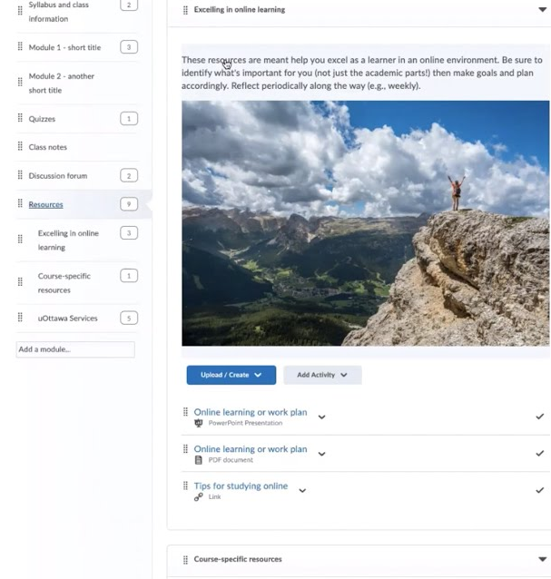
Save Time with a D2L Course Template
What Is It? A pre-built structure in D2L for organizing weekly modules, content, and assessments
Why It Helps Saves setup time, ensures consistency, and aligns with accessibility and design best practices
Key Features: Weekly module structure with placeholders for:
Overview page
Learning materials
Discussions and quizzes
Assignment submissions
Consistent layout across semesters
Easy to duplicate, update, and reuse
Impact Speeds up course building, supports student navigation, and reduces prep workload
Notes:
D2L Brightspace offers course templates that can dramatically reduce the time it takes to build and maintain a well-organized, student-friendly course. These templates provide a consistent structure that includes placeholders for weekly overviews, content modules, discussions, quizzes, and assignments. Instead of starting from a blank course shell, you can use a pre-designed layout aligned with best practices in navigation, accessibility, and instructional flow. Many institutions, including ours, provide D2L templates that follow local guidelines and are customizable to suit your teaching style. For example, a weekly module might already include a spot for a learning objectives page, a space to upload your lecture materials, a discussion forum, and an assignment submission folder. All you need to do is plug in your content. Using a D2L template not only saves you time in setup, but it also ensures a smoother experience for students who benefit from predictable layouts across courses. Once you've customized a template for your course, you can easily copy it from semester to semester, making updates quick and hassle-free. In short, the template gives you more time to focus on teaching and student interaction while ensuring your course remains structured and easy to navigate.
Appendix E in the PDF provides a template you can use as an example. Once you customize this layout for your course, you can copy it into future semesters with one click using "Import/Export/Copy Components" in D2L.

Slide 23
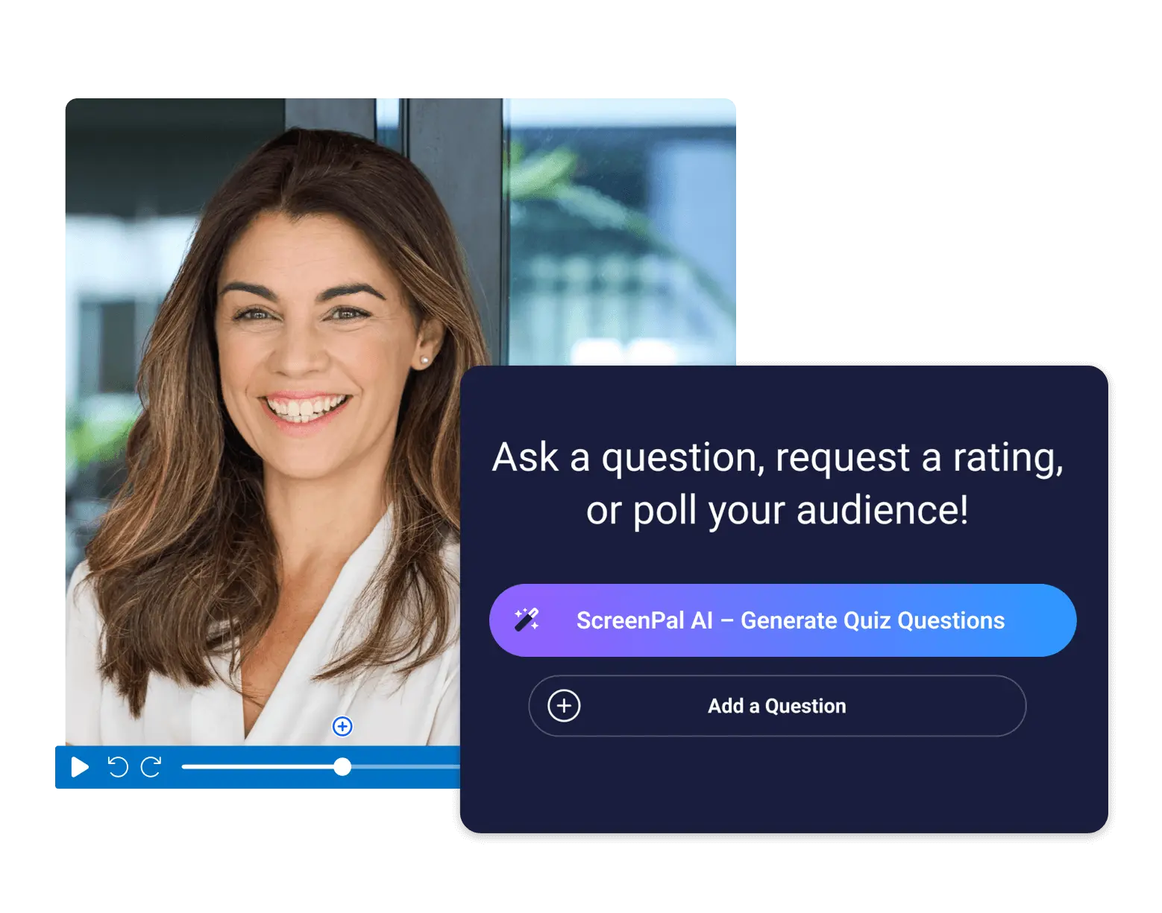
AI for Feedback or Quiz Generation
What It Does Speeds up quiz creation and streamlines formative feedback
Why It Helps Reduces repetitive tasks while maintaining quality and alignment with learning goals
How to Use AI Effectively:
Generate quiz questions from readings, lectures, or key terms
Draft formative feedback on drafts, discussion posts, or journals
Identify common writing or reasoning issues quickly
Best Practice Use AI to supplement—not replace—your expertise and personalize when needed
Impact Saves hours of prep and grading while supporting student success
Notes:
Artificial intelligence tools are becoming increasingly useful for reducing the time instructors spend on repetitive but essential tasks—especially when it comes to giving feedback and creating assessments. One valuable application is using AI to generate quiz questions based on your course content. For example, by inputting a reading passage, lecture transcript, or set of key concepts into an AI tool, you can quickly generate multiple-choice, true/false, short answer, or even scenario-based questions that align with your learning objectives. This is especially helpful when you need to build quizzes quickly but still want to ensure they target the right content. Another powerful use of AI is providing formative feedback to students. Tools can be used to give initial comments on drafts, discussion posts, or short assignments—helping students improve their work before you even grade it. While AI shouldn’t replace personalized instructor feedback, it can supplement your workflow by identifying patterns, offering suggestions, or flagging common issues for students to revise. The key is to use AI as a support, not a substitute—freeing up your time while still maintaining a high-quality, responsive learning experience. Appendix F in the PDF provides an example for using AI for Feedback or Quiz Generation.

Slide 24
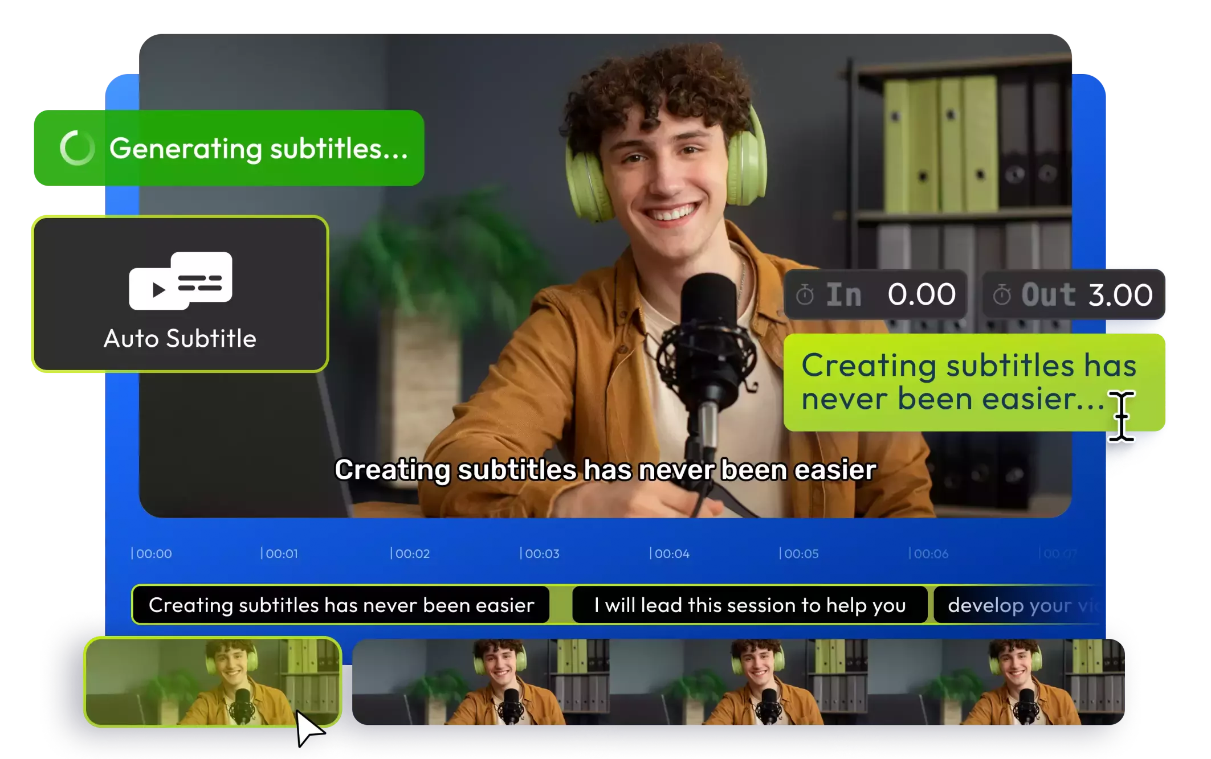
Auto-Captioning Tools
What It Does Automatically generates captions for video/audio content
Why It Helps Saves hours of manual transcription while improving accessibility
Where You Can Use It:
D2L (Brightspace) video notes
YouTube auto-captioning
Zoom live transcripts
Microsoft Stream / Teams
Panopto or Kaltura integrations
Best Practice Always review and edit for accuracy—especially for technical terms or names
Impact Supports all learners, improves comprehension, and ensures ADA compliance with less effort
Notes:
Auto-captioning tools are an essential resource for instructors looking to make their content more accessible while saving time on video production. Whether you're recording a lecture, a walkthrough, or a welcome message, modern captioning tools can automatically generate accurate subtitles with minimal manual editing. Platforms like YouTube, Zoom, and even D2L Brightspace’s integrated video tools often include auto-captioning features that transcribe spoken words into on-screen text. These tools not only support students who are deaf or hard of hearing but also benefit multilingual learners, students in noisy environments, or those who prefer to read along while watching. Auto-captioning also helps you comply with accessibility guidelines without the need to hand-type transcripts. While it’s good practice to quickly review and correct any errors, the bulk of the work is already done for you. By incorporating auto-captioning into your workflow, you make your materials more inclusive and student-friendly—without adding hours of extra labor. Appendix G in the PDF provides examples of auto-captioning tools in action.

Slide 25
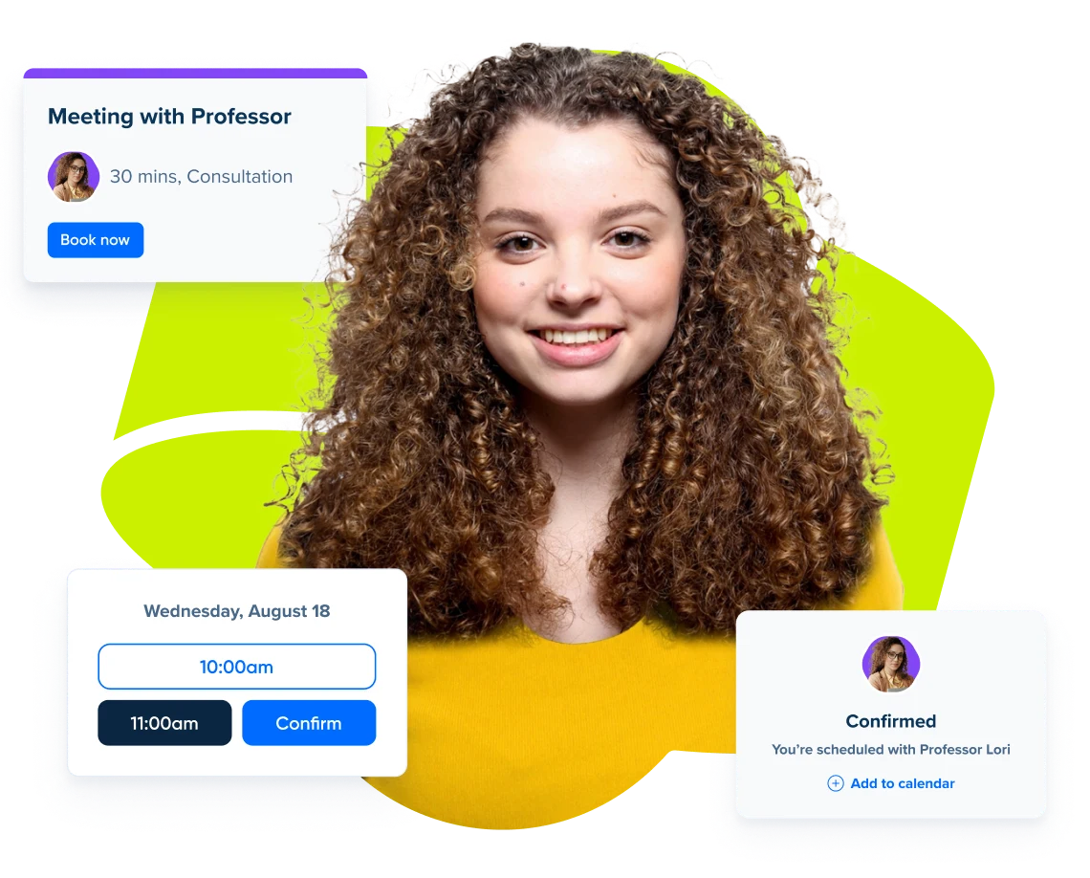
Scheduling Software for Office Hours
What It Does Automates the booking process for office hours or student meetings
Why It Helps Eliminates email back-and-forth, avoids double-bookings, and reduces no-shows
Popular Tools:
Calendly
Microsoft Bookings
Google Calendar Appointment Slots
YouCanBookMe
Key Features:
Syncs with your calendar
Sends auto-confirmations and reminders
Custom booking rules (duration, buffers, limits)
Option to auto-generate Zoom/Teams links
Impact Saves time, increases student access, and makes office hours more organized and professional
Notes:
Scheduling software is a simple but powerful time-saving tool that can streamline the way you manage student meetings and office hours. Instead of juggling back-and-forth emails or last-minute drop-ins, tools like Calendly, Microsoft Bookings, or Google Calendar appointment slots allow students to see your availability and book a time that works for them—all without any effort on your part once it's set up. These platforms automatically sync with your calendar, prevent double-bookings, and send confirmation or reminder emails, reducing no-shows and last-minute confusion. Some tools even allow you to set limits on meeting length, buffer times between appointments, and custom questions students must answer when they book—helping you prepare for each meeting. In a virtual or hybrid teaching environment, many platforms also support automatic generation of Zoom or Teams links for each session. By using scheduling software, you not only save time and reduce logistical friction but also empower students to take initiative in seeking support in a professional and organized way. A sample layout for Scheduling Software for Office Hours can be found in Appendix H of the PDF.

Slide 26

Faculty Favorites
Small Changes, Big Wins
Notes:
Sometimes the most impactful improvements in teaching don’t come from major overhauls, but from small, thoughtful adjustments. Across campuses, experienced faculty have discovered that simple changes—whether in how they communicate expectations, organize materials, or engage students—can lead to significant gains in learning and classroom efficiency. This section highlights faculty favorites: practical, easy-to-implement strategies that require minimal time but deliver big results. These tried-and-true approaches demonstrate that even small shifts in practice can create more clarity, foster stronger connections, and boost student success.

Slide 27

From Multiple Papers to One Reflective Portfolio
Replaced 3 short unit papers with 1 end-of-term reflective portfolio
Benefit to Instructor: Reduced grading workload
Benefit to Students: Encouraged synthesis and deeper connections
Resulted in:
Stronger final submissions
Greater reflection on learning
Improved critical thinking
One thoughtful change = major impact
Notes:
For example, one professor streamlined their course by replacing three separate short papers—each tied to individual units—with a single end-of-term reflective portfolio. This simple change significantly reduced the amount of grading throughout the semester, easing the instructor’s workload without compromising academic rigor. More importantly, it shifted the focus for students from completing isolated assignments to engaging in meaningful synthesis. By revisiting key themes and connecting concepts across the entire course, students were encouraged to reflect on their growth, recognize patterns in the material, and produce final work that demonstrated a deeper level of critical thinking and integration. The result was not only stronger student submissions, but also a clearer sense of purpose in their learning journey.

Slide 28

From Daily Reminders to Weekly Overviews
Switched from daily messages to one “Week-at-a-Glance” email every Monday
Benefit to Instructor: Reduced repetitive communication
Benefit to Students: Clearer structure and expectations
Resulted in:
Better time management
Fewer missed deadlines
Increased student satisfaction
One email, big impact
Notes:
Another instructor found success by replacing daily reminder messages with a single, comprehensive “Week-at-a-Glance” email sent every Monday. This small adjustment not only streamlined the instructor’s communication routine but also gave students a clearer and more organized overview of what to expect for the week. Instead of piecing together fragmented updates, students could quickly reference one message to stay on track with assignments, readings, and deadlines. The change reduced the number of repetitive announcements while promoting student self-management and accountability. It also created a more professional, predictable rhythm to the course that students came to rely on and appreciate.

Slide 29

From Manual Homework to Auto-Graded Quizzes
Replaced weekly graded homework with short, auto-graded online quizzes
Benefit to Instructor: Saved hours of grading time each week
Benefit to Students: Instant feedback for faster learning adjustments
Resulted in:
Continued focus on key STEM skills
Improved student engagement
More time for interactive teaching
Efficient and effective learning
Notes:
In a STEM course, one faculty member simplified their approach by replacing manually graded weekly homework assignments with short, auto-graded online quizzes. These quizzes were designed to assess the same key concepts and problem-solving skills but offered a more efficient and engaging experience for both the students and the instructor. Students benefited from immediate feedback, which helped them quickly identify areas of confusion and adjust their study strategies in real time. At the same time, the instructor regained several hours of grading each week, allowing for more focus on lesson planning, student support, and interactive teaching. This small shift not only maintained academic rigor but also enhanced the overall learning experience through timely reinforcement and greater instructional efficiency.

Slide 30
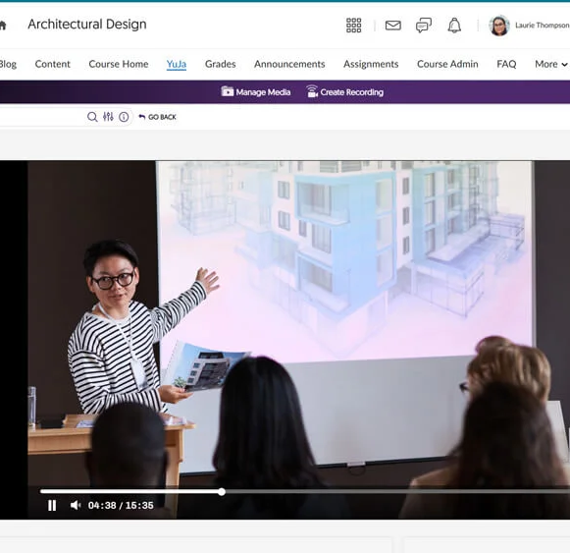
From Long Lectures to Short, Targeted Segments
Replaced 45-minute lectures with 8 to10-minute video introductions
Paired videos with brief readings and focused activities
Benefit to Instructor: Easier to update and align with key concepts
Benefit to Students: More manageable, engaging content
Resulted in:
Higher completion rates
Better preparation for class
Deeper, more meaningful discussions
Less is more when it’s purposeful
Notes:
A communications professor boosted student engagement by replacing traditional 45-minute recorded lectures with shorter, 8 to10 minute video introductions. Each video was paired with a brief, targeted reading and a focused activity designed to reinforce key concepts. This modular approach made the content more accessible and manageable for students, especially in an online or hybrid environment. Rather than passively watching lengthy lectures, students interacted with shorter, high-impact materials that held their attention and encouraged active learning. As a result, completion rates increased significantly, and students began arriving to class more prepared, contributing more meaningfully to discussions and demonstrating a stronger grasp of the material. The shift illustrated how breaking down content into smaller, purposeful segments can lead to deeper engagement and better learning outcomes.
Finally, a simple weekly checklist added to the top of each module helped another faculty member cut down on student confusion and late submissions. These small changes added up to big wins: clearer courses, more confident students, and less stress for instructors.

Slide 31
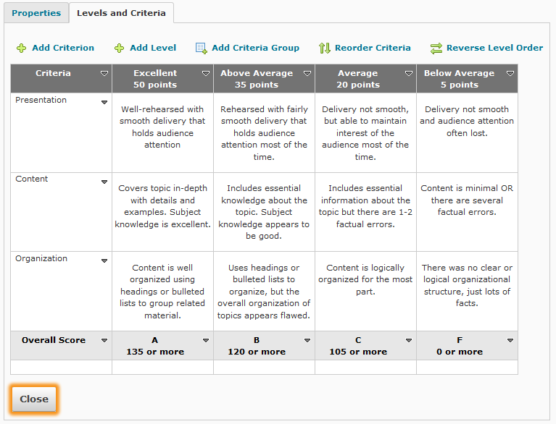
Using LMS Tools to Streamline Grading
Instructor used D2L’s rubric feature for quick-click grading
Replaced long narrative comments with clear criteria and targeted feedback
Benefit to Instructor: Grading became faster and more consistent
Benefit to Students: Clearer expectations and more actionable feedback
Resulted in:
Improved transparency
Increased grading efficiency
Stronger student performance
Built-in tools, better outcomes
Notes:
Others found success by making better use of tools already built into their learning management system (LMS). For instance, one instructor used the rubric feature in D2L (Desire2Learn) to simplify and speed up the grading process. Instead of writing lengthy narrative comments for each assignment, the instructor created clear, criterion-based rubrics with quick-click scoring options and a space for brief, focused feedback. This shift significantly reduced the time spent grading while still offering students meaningful, personalized input. Perhaps more importantly, the rubric gave students a clearer understanding of what was expected of them and how their work would be evaluated. The transparency and consistency of the feedback improved student confidence and performance, and the instructor benefited from a more manageable grading workload—all without sacrificing instructional quality.

Slide 32
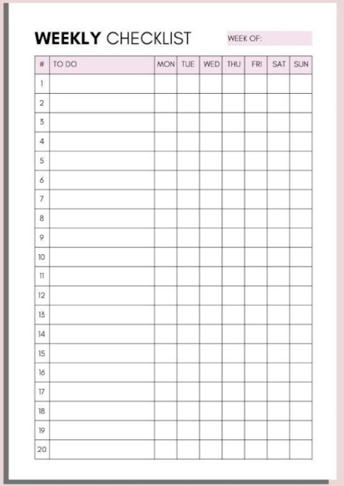
Adding a Weekly Checklist for Clarity
Added a simple weekly checklist at the top of each module
Benefit to Instructor: Reduced student confusion and repetitive questions
Benefit to Students: Clear outline of tasks, deadlines, and expectations
Resulted in:
Fewer late submissions
Improved time management
Increased student confidence
A small checklist for smoother course flow
Notes:
Finally, one faculty member found that adding a simple weekly checklist to the top of each course module made a significant difference in reducing student confusion and improving time management. The checklist outlined exactly what students needed to complete that week—readings, assignments, quizzes, and deadlines—in a clear, concise format. This straightforward addition helped students stay organized, plan ahead, and avoid missing tasks, which in turn led to fewer late submissions and panicked emails. While small in scope, this change had a big impact on the overall flow of the course. Students felt more confident navigating the content, and the instructor experienced less frustration related to repeated questions or miscommunication. Taken together, these small, strategic adjustments led to clearer courses, more prepared students, and a less stressful teaching experience.

Slide 33

Common Pitfalls to Avoid
Notes:
Even with the best intentions, course design can sometimes become more complicated than it needs to be. In our efforts to be thorough, engaging, or innovative, we may unintentionally overwhelm students—or ourselves. That’s why it’s just as important to know what to avoid as it is to know what to include. In this section, we’ll look at some of the most common pitfalls in course design—such as overloading content, inconsistent navigation, and unclear expectations—and offer simple ways to prevent them. By recognizing these patterns, we can build courses that are not only efficient and effective, but also supportive, streamlined, and easier to maintain over time.

Slide 34
Oversimplifying Too Much
What It Is
Removing too much content or rigor in the name of simplicity
Why It’s a Problem
Can lead to under-engagement, lower expectations, and missed opportunities for deeper learning
How to Avoid It
Simplify structure, not substance
Focus on clarity, not content reduction
Use fewer but more meaningful assessments
Keep cognitive challenge while reducing cognitive overload
Better Approach
Make learning manageable, not minimal.
Notes:
While simplifying your course can improve clarity and reduce unnecessary complexity, it’s important not to swing too far in the other direction. Oversimplifying content—by removing too many assignments, reducing reading load excessively, or avoiding rigorous assessments—can unintentionally undercut the intellectual challenge that students need to grow. Students often rise to meet high expectations when they are clearly communicated and supported. A streamlined course should still invite critical thinking, meaningful application, and skill development. The goal is not to dilute the content, but to deliver it in a more intentional and accessible way. Instead of reducing depth, focus on reducing redundancy and distractions. For instance, rather than assigning less demanding work, offer fewer but more purposeful tasks that align tightly with learning outcomes. Simplification should serve learning—not soften it.
Appendix I in the PDF shows how simplification can retain (and even increase) challenge by focusing on depth over quantity.

Slide 35

Relying Too Heavily on Automation
What It Is
Overusing auto-graded tools and scheduled messages without live or personal engagement
Why It’s a Problem
Makes the course feel impersonal and instructor-absent Reduces student motivation and connection
How to Avoid It
Use automation for efficiency, not as a substitute for presence.
Pair auto-graded tools with real feedback or follow-up.
Make announcements feel human—not just scheduled reminders.
Show up in discussion forums or video check-ins.
Better Approach
Balance convenience with authentic instructor presence.
Notes:
Automation tools—such as auto-graded quizzes, scheduled announcements, and templated feedback—can be lifesavers when it comes to saving time and maintaining consistency. However, relying too heavily on automation can make a course feel impersonal or disconnected from the instructor. Students may begin to perceive the course as “set-it-and-forget-it,” which can lead to lower engagement and a diminished sense of community. Learning is a human process, and students still need opportunities to interact with their instructor and feel that someone is present, responsive, and invested in their success. The key is to strike a balance: use automation to streamline routine tasks, but pair it with timely communication, personalized feedback, and real-time interactions—such as discussion posts, announcements with a personal tone, or occasional check-in messages. Even small signs of instructor presence can go a long way in keeping students motivated and connected.

Slide 36
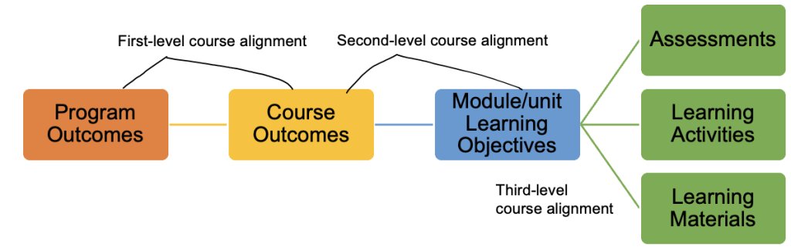
Confusing Student Engagement With Academic Rigor
What It Is
Designing engaging activities that aren’t clearly tied to learning outcomes
Why It’s a Problem
Leads to busywork or confusion
Reduces learning impact
Makes assessment feel disconnected from preparation
How to Avoid It
Always start with clear objectives
Check that activities and assessments directly support those goals
Choose depth over novelty—rigor comes from purpose, not complexity
Better Approach
Align activities, assessments, and outcomes for cohesive, meaningful learning
Notes:
One of the most common missteps in course design is confusing student engagement with academic rigor. While it’s important to create interactive and stimulating learning environments, activities that are exciting or time-consuming aren’t necessarily meaningful unless they are aligned with clear learning objectives. For example, assigning a group project or an interactive discussion might increase participation, but if those tasks don’t directly support what students need to know or be able to do, they can become busywork. Alignment means ensuring that every major activity and assessment is purposefully connected to the course’s learning goals. When alignment is overlooked, students may feel confused about what’s expected or frustrated that their efforts aren’t clearly tied to what they’ll be assessed on. Rigorous courses are not defined by workload or novelty, but by the depth of thinking and mastery they require. Strong alignment ensures that every element—objectives, activities, and assessments—works together to support meaningful learning.

Slide 37
Aligned vs.
Misaligned Activity
🎯 Learning Outcome:
“Students will be able to evaluate the credibility of sources in a research context.”
✅ Aligned Activity Example
Task: Students complete a guided source analysis worksheet using two articles—one peer-reviewed and one from a blog.
Why It Works: This directly supports the objective by helping students practice evaluation and compare source credibility in a structured way.
❌ Misaligned Activity Example
Task: Students create a digital collage representing the theme of “truth in media.”
Why It Falls Short: While creative and engaging, this task doesn’t practice or assess the skill of evaluating source credibility. It may feel enriching, but it doesn’t meet the intended outcome.
Notes:
To illustrate the importance of alignment, consider a course with the objective: “Students will be able to evaluate the credibility of sources in a research context.” An aligned activity might involve students analyzing two contrasting sources—such as a peer-reviewed journal article and a popular blog—using a structured worksheet that guides them to examine authorship, evidence, bias, and publication standards. This activity directly supports the learning goal by giving students hands-on practice with the very skill they’re expected to develop and demonstrate.
Now contrast that with a misaligned activity: asking students to create a digital collage representing the theme of “truth in media.” While this task may spark creativity and even engagement, it doesn’t provide practice in evaluating source credibility, nor does it assess students’ ability to do so. The result may be a visually interesting product, but one that doesn’t move students closer to the stated learning objective. Alignment ensures that every part of a course—objectives, activities, and assessments—works together intentionally to promote deep, relevant learning.
An example of an aligned and misaligned activity can be found in Appendix J of the PDF.

Slide 38

Simplify Without Sacrificing
Clarity supports learning Streamlined design helps students stay focused and confident.
Efficiency supports you Smart tools and simplified structures reduce workload and stress.
Purpose drives everything Align content, activities, and assessments to what matters most.
Small changes, big wins Start with one improvement—reuse a template, cut a redundant task, or clarify a module.
Design with intention, not just activity Simpler doesn’t mean easier—it means more focused, more effective, and more human.
Notes:
In conclusion, simplifying your course design is not about reducing academic rigor or compromising the quality of your instruction. Instead, it’s about making thoughtful, intentional choices that prioritize clarity, coherence, and student success. A simplified design helps ensure that every element of the course—from objectives to assessments—works in harmony to support meaningful learning. When we remove unnecessary complexity and streamline content delivery, we don’t dilute the material; we enhance students’ ability to focus, connect concepts, and engage more deeply. A well-designed course acts as a roadmap, guiding students smoothly from learning goals to activities to evaluation, eliminating confusion and fostering confidence. This kind of clarity is especially beneficial for students balancing school with work, family, or other life responsibilities, and it supports all learners by reducing cognitive overload and increasing accessibility.
Simplification also serves instructors. When we take advantage of tools like LMS templates, auto-captioning, embedded rubrics, and time-saving assessment strategies, we ease the burden of course upkeep and reduce the invisible workload that often leads to burnout. With more efficient systems in place, instructors can shift their energy toward what matters most: connecting with students, giving timely and meaningful feedback, and refining content to stay relevant and engaging. Even small shifts—such as consolidating assignments, reusing consistent module layouts, or creating weekly checklists—can have a powerful cumulative effect. These “small wins” improve both instructional efficiency and student outcomes.
Ultimately, simplifying course design is an act of intentionality. It’s not about doing less for the sake of convenience—it’s about focusing on what matters most for teaching and learning. By embracing alignment, structure, and the thoughtful use of available tools, we can craft courses that are not only easier to manage but also more impactful, inclusive, and enduring. When we design with simplicity and purpose, we create learning environments that benefit everyone—semester after semester.

Slide 39

5 Tips for Engaging Online Course Design. The Patricia Cross Academy, The University of Alabama.
Anselmo, L., Kelly, P., Yu, L., and Bair, H. Innovative Approaches to Course Design. Taylor Institute for Teaching and Learning. University of Calgary.
Bain, A. Addressing the Challenges of Program and Course Design in Higher Education with Design Technologies. ResearchGate.
Bridge to Quality: A QM Online Course Guide. Quality Matters.
Darby, F., & Lang, J. M. (2019). "What Works in College Teaching: Simplifying the Complex to Strengthen Learning." The Chronicle of Higher Education.
Design. The Derek Bok Center for Teaching and Learning. Harvard University.
Edgecomb, A.D., and Vahid, F. Simplifying a Course to Reduce Stress so Students Can Focus Again on Learning. ASEE 123rd Annual Conference and Exposition.
Evidence-Based Course Design. The Harriet W. Sheridan Center for Teaching and Learning. Brown University.
Fink, L. D. (2013). Creating Significant Learning Experiences: An Integrated Approach to Designing College Courses (2nd ed.). Jossey-Bass.
Lang, J. M. . Small Teaching: Everyday Lessons from the Science of Learning. Dokumen Pub.
Morris, C. (2020). "Keep it Simple: Strategies for Streamlining Course Design in Higher Education." Faculty Focus.
Sejdic, A. Designing College Curricula for Student Success. Faculty Focus.
The Spark of Learning. Episode 135 on the Teaching in Higher Education Podcast.
Wiggins, G., & McTighe, J. (2005) Understanding by design (2nd ed.). Alexandria, VA: Association for Supervision and Curriculum Development ASCD.
References

