Slide 1

Studying Isn’t One-Size-Fits-All
Making Disciplinary Learning Visible to Students
Faculty Focus: Innovative Teaching Techniques for College Success Series
Notes:
Think about how you prepare in your discipline. How do you read an article, solve a problem, analyze a case, or practice a skill? Now imagine a student trying to prepare for your course using generic study advice they learned years ago. The gap between those two approaches explains a great deal of student struggle. This presentation focuses on closing that gap by making disciplinary thinking visible to students.

Slide 2


Why “Studying” Is a Discipline-Specific Skill
Studying is often taught as generic—but learning is discipline-specific.
Students struggle when study habits don’t match disciplinary thinking.
Experts study differently, but those practices are rarely visible.
Making expectations explicit improves learning and equity.
Teaching students how to study is teaching the discipline.
Notes:
Students often arrive believing that studying is universal: read the material, review notes, highlight key points, and repeat. When these strategies fall short, students frequently interpret the result as a lack of ability or effort rather than a mismatch between how they studied and how learning works in a specific discipline. This misunderstanding contributes to frustration, disengagement, and unnecessary self-doubt.
In reality, studying is not a generic activity—it is a learned practice shaped by the ways knowledge is created, used, and assessed within a field. Each discipline values different types of thinking. Some emphasize problem-solving and application, others analysis and interpretation, and others decision-making under constraints. Effective studying requires alignment with these disciplinary expectations.
Experts intuitively study differently because they have internalized how their field works. They know what details matter, how concepts connect, where mistakes are likely, and how understanding is demonstrated. Students, however, rarely see these expert processes. What feels “obvious” to faculty is often invisible to novices. Without explicit guidance, students default to familiar habits that may be ineffective for the task at hand.
This gap is not a matter of motivation—it is a matter of access. Many students, particularly first-generation college students, have never been taught the unwritten rules of disciplinary learning. When expectations remain implicit, students are left guessing how to prepare, practice, and succeed. Making study strategies explicit reduces this hidden curriculum and supports more equitable outcomes.
Teaching students how to study in your discipline is not an add-on or a remedial intervention. It is a core instructional practice. When faculty intentionally model expert thinking, name effective strategies, and clarify what successful preparation looks like, students move from simply spending time on coursework to engaging in purposeful learning. The result is deeper understanding, stronger performance, and greater confidence—without increasing instructional workload.

Slide 3

What Experts Do
Look for patterns, relationships, and underlying principles
Focus on why something works, not just what it is
Practice applying knowledge to new problems or situations
Anticipate common mistakes and learn from errors
Check understanding by explaining, solving, or performing
Adjust study strategies based on task and feedback
Notes:
Faculty often forget how much of their disciplinary thinking has become automatic. Years of study and practice have shaped how experts approach texts, problems, cases, labs, performances, or projects. These habits guide what they pay attention to, how they practice, and how they judge whether they are truly prepared. Students, however, rarely see this process in action.
Experts do not simply reread or review content. They actively interrogate material, looking for patterns, relationships, and underlying principles. They know which details signal deeper understanding and which are peripheral. When working through problems or scenarios, experts anticipate common pitfalls, recognize meaningful errors, and use mistakes as diagnostic tools rather than signs of failure.
Experts also study strategically. They choose approaches based on the type of thinking required—analysis, application, synthesis, or judgment—rather than relying on a single routine. They test
their understanding through retrieval, application, or explanation, adjusting their strategies when something doesn’t make sense. This self-monitoring happens almost unconsciously.

Slide 4

What Students Often Do
Reread notes or slides without active engagement
Highlight or review content without checking understanding
Memorize information instead of applying concepts
Study longer rather than differently when struggling
Prepare based on effort or time spent
Assume confusion means they lack ability
Notes:
Students, by contrast, often equate studying with time spent. They reread notes, highlight passages, or review slides without checking whether they can actually use the information. Because expert habits are rarely named or modeled, students assume that effective studying looks the same across all courses. When that assumption fails, they blame themselves rather than the strategy.
The challenge is not that students are unwilling to study—it is that they are missing access to expert thinking. When faculty pause to explain how they approach learning tasks in their discipline, students gain insight into what preparation really means. Making these invisible practices visible helps students move from guessing what works to studying with intention and confidence.

Slide 5
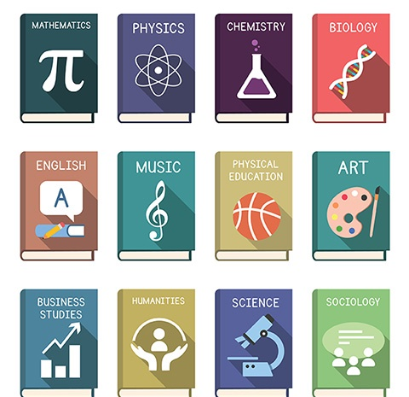
What “Studying” Looks Like Across Disciplines
Notes:
Once we recognize that studying is discipline-specific, the next step is to make those differences visible. What counts as effective preparation in one field may be ineffective—or even misleading—in another. A strategy that works well in a reading-intensive course may fall short in a problem-based or performance-based course.
Each discipline emphasizes distinct ways of thinking, practicing, and demonstrating understanding. Some prioritize analysis and interpretation, others application and precision, and others decision-making under real-world constraints. As a result, successful studying looks different depending on the type of learning students are being asked to do.
Students are rarely taught these differences explicitly. Without guidance, they assume that effort alone will transfer across courses. When it doesn’t, they experience confusion, frustration, or misplaced self-doubt. Making disciplinary study practices explicit helps students understand how to prepare—not just how much to prepare.
The following examples illustrate how studying varies across disciplines and highlight opportunities for faculty to model expert thinking in ways that help students study more effectively and with greater confidence.

Slide 6
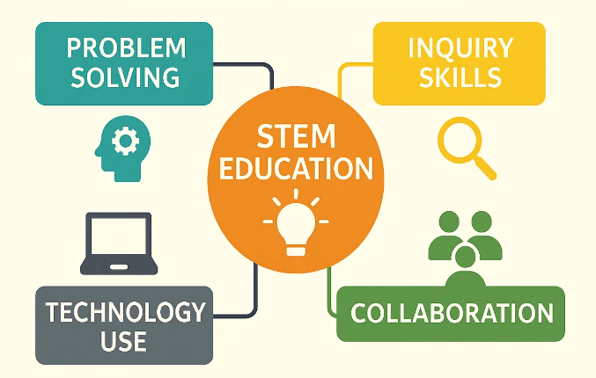
STEM and Quantitative Disciplines
Effective studying focuses on application—not memorization.
Experts:
Apply concepts across problem types
Focus on why solutions work
Learn from errors
Students often:
Reread notes or examples
Memorize steps
Avoid unfamiliar problems
Key takeaway:
Practice thinking, not just remembering.
Notes:
In STEM and quantitative disciplines, studying is fundamentally about application, precision, and conceptual understanding—not memorization. Experts approach studying by working through problems that require them to apply principles in varied contexts. Rather than focusing on arriving at the correct answer, they attend closely to why a solution works and how different concepts connect.
Students, however, often rely on passive strategies such as rereading notes or reviewing worked examples without attempting similar problems independently. These approaches can create a false sense of familiarity that disappears under assessment conditions. When students encounter unfamiliar problem types, they may struggle not because they lack understanding, but because they have not practiced adapting their knowledge.
Effective studying in these disciplines involves repeated problem-solving, analyzing errors, and reflecting on decision points within the solution process. Experts use mistakes as diagnostic tools to identify gaps in understanding. When faculty model this reasoning—narrating how they select an approach, recognize errors, and adjust strategies—students gain insight into how studying actually works in the discipline.

Slide 7

Humanities and Reading-Intensive Disciplines
Effective studying focuses on interpretation, synthesis, and argument.
Experts:
Read actively and question ideas
Identify themes, claims, and evidence
Connect texts and perspectives
Write to test and refine thinking
Students often:
Reread or highlight passively
Focus on details instead of meaning
Memorize rather than interpret
Key takeaway:
Studying means making meaning, not memorizing content.
Notes:
In humanities disciplines, studying centers on interpretation, synthesis, and argumentation. Experts read actively and purposefully, engaging with texts by questioning assumptions, identifying themes, and considering multiple perspectives. Studying is not about memorizing content but about developing the ability to analyze and construct meaning.
Students often approach reading as a passive activity, highlighting or rereading without engaging deeply with ideas. They may focus on recalling details rather than understanding arguments or relationships between texts. This misalignment can lead to difficulty in discussions, essays, or exams that require interpretation rather than recall.
Effective studying in humanities disciplines involves annotating texts, summarizing arguments in one’s own words, and making connections across readings. Experts often write as a way of thinking—using short reflections or informal notes to test interpretations. When faculty demonstrate how they read and make meaning from texts, students learn that studying is an active, analytical process rather than a memorization task.

Slide 8

Social Sciences
Effective studying focuses on applying theories to explain real-world behavior.
Experts:
Apply theories to cases and scenarios
Compare models and perspectives
Evaluate evidence and claims
Explain why a concept fits a situation
Students often:
Memorize terms and definitions
Study theories in isolation
Struggle to apply concepts to examples
Key takeaway:
Studying succeeds when theories are used as tools, not memorized facts.
Notes:
In social sciences, studying emphasizes applying theories and frameworks to understand human behavior, institutions, and social systems. Experts study by examining how concepts explain real-world phenomena, comparing models, and evaluating evidence. Understanding emerges through analysis, not isolated definitions. Students may struggle when they treat theories as static information to be memorized rather than tools for analysis. They often focus on learning terminology without practicing how concepts operate in context. This can result in difficulty applying ideas to case studies, data sets, or exam scenarios. Effective studying in social sciences involves working through examples, applying theories to new situations, and articulating reasoning clearly. Experts constantly ask whether evidence supports a claim and how different perspectives shape interpretation. When faculty explicitly model this analytical process, students gain clarity about how to study and how understanding is demonstrated in the discipline.

Slide 9

Technical and Workforce Programs
Effective studying focuses on process, precision, and performance.
Experts:
Practice skills repeatedly
Refine techniques and procedures
Understand why each step matters
Reflect on errors to improve performance
Students often:
Focus on task completion
Skip reflection on process
Miss opportunities to transfer skills
Key takeaway:
Studying means mastering the process, not just finishing the task.
Notes:
In technical and workforce programs, studying emphasizes procedural fluency, accuracy, and reflection on process. Experts study by practicing skills repeatedly, refining techniques, and understanding why each step matters. Learning is demonstrated through performance and consistency, not just completion.
Students may focus on finishing tasks rather than mastering processes. They may overlook the importance of reflecting on errors or documenting how decisions were made. This can limit skill transfer and workplace readiness.
Effective studying in these programs involves hands-on practice, step-by-step review, and reflection on outcomes. Experts continually evaluate their process and make adjustments to improve efficiency and quality. When faculty ask students to explain or document their approach, studying becomes a tool for deeper learning and professional growth.

Slide 10

Studying in Health Sciences
Effective studying integrates knowledge, judgment, and decision-making.
Experts:
Work through realistic case scenarios
Prioritize information and make decisions
Reflect on errors and adjust reasoning
Study consistently over time
Students often:
Memorize lists or procedures
Focus on recall instead of judgment
Struggle with complex scenarios
Key takeaway:
Studying prepares students for professional decisions, not just exams.
Notes:
In health sciences, studying requires integrating knowledge with judgment, accuracy, and contextual decision-making. Experts prepare by working through case scenarios that simulate real clinical or professional situations. Studying is continuous and cumulative, as concepts build toward safe and effective practice.
Students often approach studying by memorizing lists, procedures, or terminology without fully understanding how information is applied in context. This approach can feel productive but may fall apart when students are asked to make decisions, prioritize information, or respond to complex scenarios.
Effective studying in health sciences involves repeated exposure to case-based questions, reflection on errors, and deliberate practice over time. Experts regularly evaluate their own reasoning and adjust based on feedback. When faculty model clinical thinking and emphasize decision-making processes, students begin to see studying as preparation for professional judgment rather than short-term recall.

Slide 11

Fine and Performing Arts
Effective studying emphasizes
Focused, intentional practice
Technique, interpretation, and control
Ongoing reflection and adjustment
Students often
Repeat entire pieces
Practice what feels comfortable
Mistake repetition for improvement
Experts study by
Isolating problem areas
Practicing slowly and deliberately
Using feedback to refine performance
Key takeaway:
Studying in the arts is about refinement, not repetition.
Notes:
In Fine and Performing Arts, studying centers on intentional practice, interpretation, and refinement of technique over time. Experts prepare by breaking work into components—isolating difficult passages, techniques, or expressive choices—and practicing them deliberately rather than repeatedly performing the entire piece. Studying is iterative and cumulative, as skills build through feedback, reflection, and adjustment.
Students, however, often equate studying with repetition. They may rehearse a piece from start to finish, redraw or replay familiar sections, or focus on completion rather than control. While this can feel productive, it may mask persistent weaknesses and limit growth, especially when performances require precision, expression, or adaptability under pressure.
Effective studying in Fine and Performing Arts involves slow, focused practice, targeted repetition, and critical self-assessment. Experts regularly pause to evaluate what is improving, what remains unstable, and why. Feedback—from instructors, peers, recordings, or self-observation—is used to guide next steps rather than simply confirm effort. When faculty model this reflective, intentional approach, students begin to see studying not as repetition, but as purposeful preparation for performance, expression, and professional artistry.

Slide 12
Discipline | Studying Works Best When Students…
STEM and Quantitative | Apply concepts to varied problems, analyze errors, and focus on why solutions work
Humanities and Reading-Intensive | Interpret texts, synthesize ideas, and build arguments rather than memorize content
Social Sciences | Apply theories to real-world situations, evaluate evidence, and explain reasoning
Health Sciences | Practice clinical decision-making through cases, reflection, and cumulative learning
Technical and Workforce | Master procedures through hands-on practice, precision, and reflection on process
Fine and Performing Arts | Refine technique and expression through focused practice, feedback, and reflection on performance choices
Notes:
This slide shows that effective studying looks different across disciplines. Students often use the same study habits in every course, but this table makes clear that success depends on matching study strategies to how learning is demonstrated in the field.

Slide 13

Common Study Missteps Students Make
Notes:
Students generally approach studying with good intentions, but many rely on strategies that feel familiar rather than effective. These habits are often carried over from previous courses or educational experiences, even when they no longer align with the demands of a new discipline. When studying doesn’t produce the expected results, students may assume the problem is effort or ability instead of strategy.
Understanding common study missteps helps shift the conversation from why students didn’t try to how students prepared. By identifying where study strategies break down, faculty can better support students in adjusting their approaches and studying in ways that align with disciplinary expectations and learning goals.

Slide 14

Rereading Without Engagement
Feels productive, but rarely builds understanding
Students often:
Reread notes or text
Recognize ideas without using them
Leads to:
False confidence
Difficulty applying knowledge
Better move:
Practice explaining or using the content.
Notes:
Rereading notes, slides, or textbook chapters is one of the most common study strategies students use because it feels productive and familiar. Time is being spent with the material, and content often looks more recognizable with each pass. However, recognition is not the same as understanding. Rereading rarely requires students to actively process information or test whether they can use it.
This strategy can create a false sense of confidence. As students reread, the material begins to feel easier, leading them to believe they are prepared. That sense of familiarity often disappears when students are asked to apply concepts, analyze information, or make decisions in new contexts. When performance falls short, students may conclude that they “didn’t study enough,” rather than recognizing that the strategy itself was ineffective.
Rereading without engagement is especially limiting in disciplines that require application, interpretation, or judgment. Without opportunities to retrieve information, explain ideas in their own words, or practice disciplinary thinking, learning remains shallow. Students are not doing anything with the content—they are simply revisiting it.
Helping students move beyond rereading does not require additional assignments. Small instructional moves—such as modeling how to turn notes into questions, asking students to explain a concept aloud, or encouraging brief practice or reflection—can shift studying from passive exposure to active learning. When students understand why rereading alone is insufficient, they are more willing to adopt strategies that lead to deeper understanding.

Slide 15

Cramming Instead of Spacing
Cramming:
Short-term focus before assessments
High effort, low retention
Information fades quickly
Spacing:
Learning spread over time
Repeated retrieval and refinement
Stronger understanding and transfer
Key takeaway:
Learning sticks when practice is spaced, not rushed.
Notes:
Cramming is a common response to time pressure and heavy course loads. When deadlines approach, students often concentrate their studying into a single session, believing that intense focus right before an assessment will compensate for limited preparation earlier. While cramming can produce short-term recall, it rarely leads to durable understanding.
This approach places a heavy cognitive load on students and limits opportunities to revisit, connect, and refine ideas. Information learned through cramming is more likely to fade quickly, making it difficult for students to apply concepts later in the course or in subsequent classes. In cumulative disciplines, this pattern can create ongoing gaps that compound over time.
Spacing learning across multiple, shorter study sessions supports deeper understanding and retention. When students return to material after time has passed, they are forced to retrieve information, recognize what they do and do not understand, and make stronger connections between ideas. Experts naturally engage in spaced practice because it mirrors how understanding develops over time.
Helping students move away from cramming does not require increasing workload. Encouraging regular practice, quick self-checks, or brief cumulative activities can reinforce the value of spacing. When students experience improved learning through distributed practice, they are more likely to adopt strategies that support long-term success.

Slide 16

Studying What Feels Easy Instead of What’s Difficult
Students often:
Review familiar material
Avoid challenging concepts
Mistake comfort for mastery
Effective studying
Experts:
Target areas of confusion
Use difficulty as feedback
Focus effort where growth happens
Key takeaway:
Learning happens where the work feels hard.
Notes:
Students naturally gravitate toward material that feels familiar or comfortable. Reviewing content they already understand provides reassurance and a sense of progress, especially when time is limited. While this approach can boost confidence, it often leaves the most important learning undone.
Challenging material is where learning actually deepens. Concepts that feel difficult often signal gaps in understanding, misconceptions, or areas that require more practice. Avoiding these areas may protect confidence in the short term, but it prevents students from developing mastery and adapting knowledge to new situations.
Experts intentionally focus their study time on what they do not yet understand. They use difficulty as feedback, directing effort toward areas that need the most attention. This targeted approach leads to more efficient learning and stronger performance.
Helping students recognize the value of productive struggle can shift their study habits. When faculty normalize difficulty as part of learning and provide strategies for tackling challenging material, students are more willing to engage with what feels hard—and more likely to improve.

Slide 17

Confusing Familiarity with Understanding
What feels like learning:
Recognizing terms or examples
Content feels easier to review
“I know this” sensation
What understanding requires:
Explaining ideas without notes
Applying concepts in new situations
Identifying gaps and misconceptions
Key message:
This is a strategy misalignment—not a motivation problem.
Notes:
One of the most common study misalignments occurs when students mistake familiarity for understanding. As students reread notes, review slides, or recognize terms they’ve seen before, the material begins to feel easier. This sense of ease can be reassuring, leading students to believe they are prepared—even when they have not practiced using the knowledge.
Familiarity is passive. Understanding is active. Students may recognize a concept when they see it but struggle to explain it, apply it, or use it in a new context. This gap often becomes visible during exams, discussions, or performance-based tasks that require reasoning, transfer, or judgment.
This misalignment is not about effort or motivation. Students are often spending time studying, but their strategies do not require them to retrieve information, make decisions, or test their thinking. Because familiarity feels like progress, students may not realize that deeper practice is needed until it is too late.
Experts rarely rely on familiarity as a measure of readiness. Instead, they test their understanding by solving problems, explaining concepts aloud, or applying ideas in unfamiliar situations. When faculty help students distinguish between recognizing information and truly understanding it, students are better equipped to choose study strategies that lead to meaningful learning rather than surface-level confidence.

Slide 18

Ignoring Feedback Once the Grade Is Earned
Students often:
Check the grade and move on
Skip comments or explanations
Repeat the same mistakes
Why it happens:
Feedback feels final or unclear
No obvious next step
Better approach:
Use feedback to adjust strategies
Apply comments to future work
Key message:
Feedback supports learning only when students use it.
Notes:
Once a grade is received, many students mentally close the assignment and move on to what’s next. This response is understandable in fast-paced courses where deadlines are constant, but it often means that valuable feedback goes unread or unused. The focus shifts to the score rather than the learning opportunity.
Ignoring feedback is rarely a sign that students don’t care. More often, students are unsure how to use feedback or do not see its relevance once an assignment is completed. Without explicit guidance, feedback can feel overwhelming, unclear, or disconnected from future work.
Feedback is most powerful when it informs next steps. Experts routinely review outcomes, identify patterns in errors, and adjust their approach before the next attempt. When students skip this step, the same mistakes often reappear across assignments, exams, or courses.
Helping students engage with feedback does not require more grading. Small instructional moves—such as asking students to reflect on one comment, revise a portion of their work, or identify one strategy to change—can shift feedback from a final message to an ongoing learning tool. When students understand that feedback is meant to guide improvement rather than simply justify a grade, they are more likely to use it productively.

Slide 19

Not Adjusting Strategies When One Isn’t Working
Students often:
Repeat the same study approach
Study longer instead of differently
Assume poor results reflect ability
Experts do:
Treat results as feedback
Adjust strategies intentionally
Focus on what to change next
Key takeaway:
Learning improves when strategies change—not just effort.
Notes:
When students encounter difficulty, many respond by doubling down on the same study strategies they have always used. If rereading notes or reviewing slides did not lead to success the first time, students may assume they simply need to spend more time doing the same thing. This persistence is often mistaken for resilience, but without reflection, it rarely leads to improvement.
The challenge is not a lack of effort. Students are frequently working hard, but they may not know how to diagnose what went wrong or how to choose a different approach. Without guidance, it is easier to repeat familiar habits than to experiment with new strategies that feel uncertain or uncomfortable.
Experts approach learning differently. When a strategy fails, they treat it as feedback rather than a personal shortcoming. They ask what didn’t work, why it didn’t work, and what adjustment might lead to better results. This ability to adapt strategies is a key component of effective learning and professional practice.
Supporting students in adjusting their study strategies can be simple and low-stakes. Brief reflection prompts, exam wrappers, or conversations about preparation methods can help students connect outcomes to approaches. When students learn to adjust how they study—not just how long—they become more strategic, confident, and independent learners.

Slide 20

Teaching Students How to Study—Without Adding Work
Notes:
When faculty hear “teach students how to study,” a common concern is added time, added content, or added responsibilities in an already full course. The reality is that helping students study more effectively does not require redesigning assignments or increasing workload—for faculty or students. Much of this work can be done by making expert thinking visible in moments that already exist: narrating how you approach a problem, clarifying what effective preparation looks like, or naming strategies that align with how learning is assessed. Small, intentional shifts in how expectations are communicated can have a meaningful impact on student learning and reduce the need for reteaching later. This section focuses on practical, low-effort strategies that fit naturally into existing courses. These approaches support student success while respecting faculty time and maintaining academic rigor.

Slide 21

Modeling How You Approach a Problem or Text
Why it matters
Expert thinking is often invisible to students.
Outcomes are shown, but processes are hidden.
What to model
How you decide where to start
What you pay attention to
How you check understanding
How you respond to confusion or errors
Key takeaway:
When students see how experts think, they learn how to study.
Notes:
One of the most powerful ways to help students study more effectively is to make expert thinking visible. Faculty often solve problems, read texts, or analyze information quickly and intuitively because years of experience have shaped their approach. For students, however, these steps are invisible. They see the outcome, not the process.
When instructors model how they approach a problem or text, they reveal the decision-making that students need in order to study effectively. This includes explaining why a particular strategy is chosen, what cues signal importance, how to check for understanding, and how to respond when something doesn’t make sense. Modeling shifts studying from guessing what to do to understanding how experts think.
This practice does not require extra content or assignments. A brief think-aloud during class, a short annotation demonstration, or a narrated example in a slide or video can give students insight into effective study habits. Over time, these small moments help students internalize strategies they can apply independently.

Slide 22
Discipline | What the Instructor Models (Think-Aloud)
Humanities and Reading-Intensive | “I pause here because this claim feels important. I’m tracking the main idea and how it’s supported—not trying to remember every detail.”
Social Sciences | “I choose this theory because it best explains what’s happening in this situation. A different model would lead to a different interpretation.”
Health Sciences | “I prioritize these symptoms because they signal higher risk. If I’m wrong, I want to know where my reasoning broke down.”
Technical and Workforce Programs | “This step matters because it affects safety later. If something goes wrong, I backtrack here to check the process—not just the outcome.”
Fine and Performing Arts | “I slow this section down because control breaks here. I’m focusing on one technique at a time, not running the whole piece.”
Business | “I pause here because this recommendation drives the decision. I’m identifying the core problem, evidence, and assumptions—not memorizing details.”
Notes:
This slide illustrates how instructors across disciplines can make expert thinking visible by briefly narrating how they approach a problem, text, case, or performance. Rather than focusing on procedures or final answers, the examples show how experts decide what matters, what to prioritize, and how to respond when something doesn’t make sense. By hearing these short think-alouds, students gain insight into how to study more effectively in the discipline. This approach does not add new content or assignments—it simply makes disciplinary decision-making explicit so students can transfer these habits to their own studying.

Slide 23
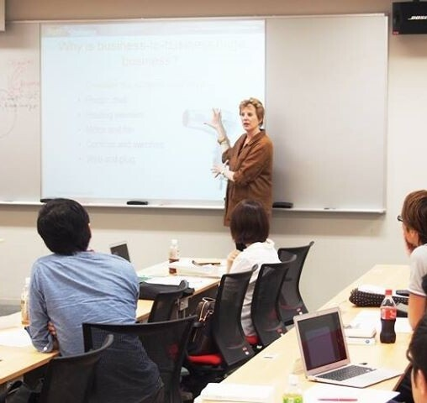
Naming Effective Strategies During Class
Why it matters
Students often don’t know how to study effectively
Generic habits don’t match disciplinary expectations
What to do
Briefly name how you would study the material
Connect strategies to upcoming tasks or assessments
Example
“Here’s how I’d study this…”
Key takeaway:
Small cues help students study with purpose.
Notes:
Students often leave class knowing what content was covered but unsure how to study it effectively. Without explicit guidance, they default to familiar habits—rereading notes, highlighting, or reviewing slides—regardless of whether those strategies align with the discipline or the assessment.
Naming effective study strategies during class helps bridge this gap. When faculty pause to say, “Here’s how I’d study this,” they make expectations visible and reduce guesswork. This brief, intentional guidance helps students understand what matters most, how to practice, and where to focus their effort.
This strategy requires no additional assignments or materials. It fits naturally into existing instruction—at the end of a problem, after discussing a text, or while reviewing an example. Over time, these small moments help students internalize discipline-specific study habits and become more strategic, independent learners.

Slide 24
Discipline | Named Study Strategy | How You Say It in Class
STEM and Quantitative | Problem Variation | “To study this, practice the same concept with different problem types so you’re choosing the method, not memorizing steps.”
Humanities and Reading-Intensive | Argument Tracking | “Use argument tracking—identify the main claim, then trace how each section supports or complicates it.”
Social Sciences | Theory-to- Case Mapping | “Study by applying one theory to a real-world case and testing how well it explains what’s happening.”
Health Sciences | Case-Based Reasoning | “Prepare using case-based reasoning—practice making decisions with scenarios, not memorizing lists.”
Technical and Workforce | Process Rehearsal | “Use process rehearsal—practice each step deliberately and reflect on where errors occur.”
Fine Arts | Focused Practice | “Study through focused practice—work on one technique or section at a time instead of repeating the whole piece.”
Notes:
This slide shows how instructors can support student learning by explicitly naming the study strategies that work best in their discipline. Rather than modeling the full process, the focus here is on labeling the strategy students should use outside of class and connecting it to upcoming tasks or assessments. By clearly naming strategies such as problem variation, argument tracking, or case-based reasoning, instructors reduce guesswork and help students transfer effective study habits beyond the classroom. These brief cues reinforce discipline-specific expectations without adding work for faculty or students.

Slide 25

Embedding Quick Self-Checks
Why it matters
Familiarity can hide gaps in understanding
Students often don’t know if they’re ready
What to embed
Short, ungraded checks
“Can I do this without notes?” moments
Key takeaway:
Self-checks help students study with evidence, not assumptions.
Notes:
Many students finish studying without knowing whether they truly understand the material. Familiarity feels reassuring, but it doesn’t reveal gaps until an exam, performance, or high-stakes task exposes them. Quick self-checks help students replace guesswork with evidence.
Embedding quick self-checks means giving students simple ways to test their understanding—without adding assignments or grading. These checks are brief, low-stakes prompts that students can use independently to answer one question: Can I actually do this on my own?
Experts constantly self-check. They pause to explain an idea without notes, attempt a problem before reviewing an example, or mentally walk through a process to see where uncertainty appears. Students often don’t do this unless prompted. When faculty intentionally build and name self-checks, students learn how to study more strategically and adjust before it’s too late.

Slide 26
Discipline | Named Self-Check Strategy | How You Frame It for Students
STEM and Quantitative | No-Notes Problem Attempt | “Before checking your notes, try solving one problem cold. If you get stuck, that’s where to focus your studying.”
Humanities and Reading-Intensive | Explain the Argument from Memory | “Close the text and explain the author’s main claim and evidence in a few sentences.”
Social Sciences | Concept-in-Context Check | “Pick a real-world example and explain how this theory applies—without looking it up.”
Health Sciences | Case Walkthrough | “Talk through how you’d respond to a case scenario before reviewing the answer key.”
Technical and Workforce | Process Recall Check | “Describe each step of the procedure out loud before performing it.”
Fine and Performing Arts | Targeted Performance Check | “Perform one section or technique without stopping and reflect on what breaks down.”
Notes:
This slide highlights simple, discipline-specific self-checks students can use to test their understanding while studying. Each example names a quick strategy that helps students move beyond familiarity and gather evidence of learning. Rather than adding assignments or grading, these self-checks prompt students to ask whether they can apply, explain, or perform without support. By naming and normalizing these checks, instructors help students identify gaps early and adjust their study strategies before assessments or performances.

Slide 27
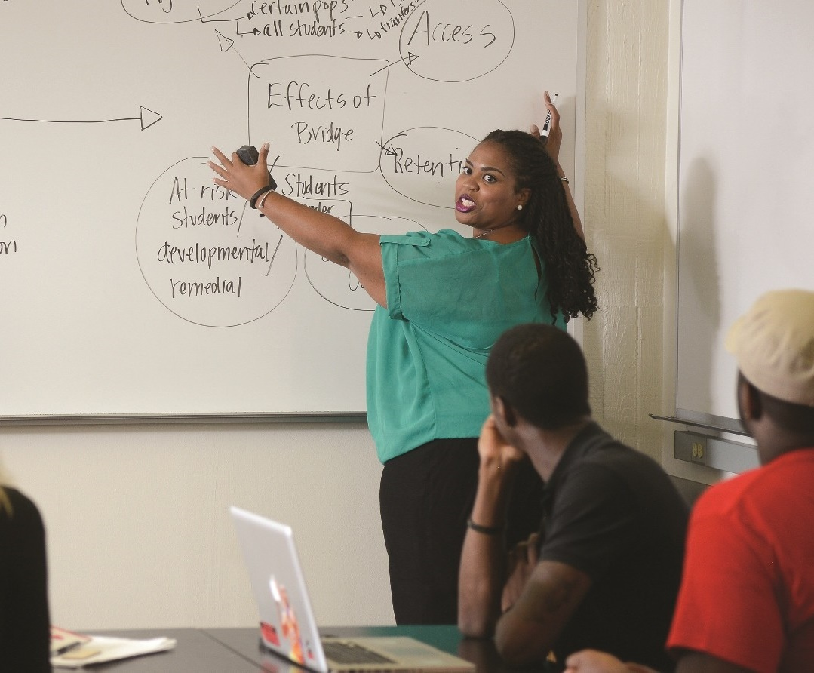
Clarifying What “Being Prepared” Means
Problem
Students prepare—but not in the right way.
Solution
Name what students should be able to do.
Key takeaway
Preparation improves when expectations are explicit.
Notes:
Students often arrive unprepared not because they didn’t try, but because they misunderstood what preparation required. “Read the chapter” or “study for the exam” can mean very different things depending on the discipline. Without clarity, students default to generic habits that may not align with expectations. Clarifying what “being prepared” looks like helps students focus their effort productively. This does not require additional assignments—just explicit language about what students should be able to do when they come to class or an assessment. When preparation is defined in terms of actions rather than time spent, students study more effectively and with greater confidence.

Slide 28
Discipline | What “Prepared” Means
STEM and Quantitative | “Being prepared means you can attempt problems without notes—not that you reread the chapter.”
Humanities and Reading-Intensive | “Prepared means you can summarize the author’s argument and raise one question about it.”
Social Sciences | “Prepared means you can apply the theory to a real example, not just define it.”
Health Sciences | “Prepared means you can prioritize information in a case, not list symptoms.”
Technical and Workforce | “Prepared means you can explain the steps and safety checks before performing the task.”
Fine and Performing Arts | “Prepared means you’ve practiced the difficult section slowly, not just run the whole piece.”
Notes:
This table shows how clarifying what it means to be prepared can dramatically improve how students study. These brief clarifications help students focus their effort productively and arrive better prepared for learning, discussion, performance, or assessment.

Slide 29

Using Exam Wrappers and Post-Task Reflections
Purpose
Help students learn from results.
Ask students
How did I prepare?
What worked? What didn’t?
What will I change next time?
Key takeaway:
Reflection turns performance into learning.
Notes:
After assessments, students often focus only on the grade and move on. Exam wrappers and post-task reflections interrupt this pattern by prompting students to reflect on how they prepared, what worked, and what they would change next time. These reflections do not require extensive writing or grading. Even a few targeted questions can help students connect outcomes to strategies and make intentional adjustments. Over time, students learn to treat results as feedback rather than judgment.

Slide 30
Discipline | Reflection Focus
STEM and Quantitative | “Which problem types did I practice—and which ones caused difficulty on the exam?”
Humanities and Reading-Intensive | “Which feedback comment appears most often, and how will I address it next time?”
Social Sciences | “Which theory was hardest to apply, and why?”
Health Sciences | “Where did my clinical reasoning break down in this case?”
Technical and Workforce | “Which step caused the most difficulty, and how will I practice it differently?”
Fine and Performing Arts | “Which section of the performance was least controlled, and how will I refine it?”
Notes:
This slide illustrates how short, targeted reflections can help students learn from assessments and performances rather than simply move on after receiving a grade. These brief reflections build metacognition, encourage strategic adjustment, and turn performance feedback into a tool for improvement—without adding grading or workload.

Slide 31

Turning Assignments into Study Tools
Students often see assignments as endpoints, not opportunities for learning.
When work is treated only as a product, its value ends at submission.
A Small Shift
Use assignments as preparation, not just evaluation.
Ask students to revisit, revise, apply feedback, or extract key takeaways.
Why It Works
Turns existing work into study material
Promotes disciplinary thinking, transfer, and durable learning
Notes:
Students often see assignments as endpoints rather than learning tools. When assignments are framed only as products, students miss opportunities to use them for studying and growth. Small shifts can reposition assignments as preparation for future tasks. Assignments can become study tools when students are asked to revisit, revise, apply feedback, or extract key takeaways. This approach does not add new work—it helps students get more learning value from work they are already doing.

Slide 32
Discipline | How Assignments Become Study Tools
STEM and Quantitative | “Review past homework to identify recurring error patterns before the exam.”
Humanities and Reading-Intensive | “Use feedback from one essay to revise how you develop arguments in the next.”
Social Sciences | “Apply feedback from one case study to a new scenario.”
Health Sciences | “Compare two cases to track how your clinical reasoning has improved.”
Technical and Workforce | “Redo a task focusing only on the step that caused problems last time.”
Fine and Performing Arts | “Use critique notes from one performance to shape the next.
Notes:
This slide highlights how existing assignments can be leveraged to support studying and long-term learning. These small shifts help students extract more learning value from work they are already doing and promote retention, transfer, and continuous improvement.

Slide 33
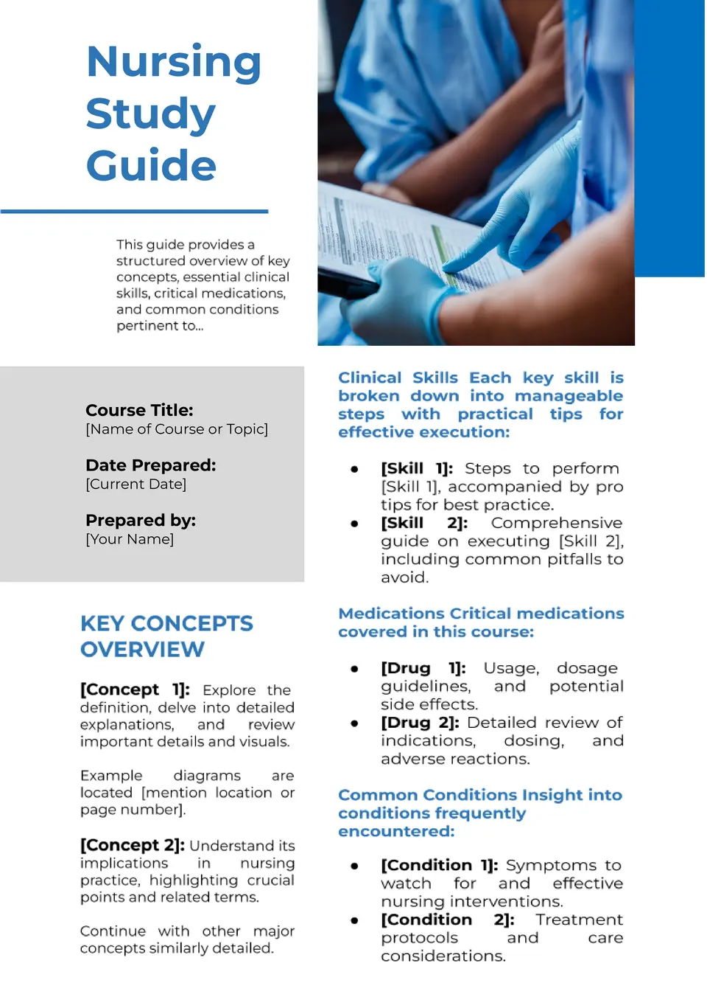
Providing Discipline-Specific Study Guides or Examples
Why it matters
Students often don’t know what to prioritize
Generic study advice doesn’t transfer across disciplines
What to provide
Key questions or concepts to focus on
Sample problems, cases, or excerpts
Examples of strong work or common errors
Key takeaway:
Clear guidance helps students study with focus and purpose.
Notes:
Many students want to study effectively but are unsure where to focus their time and attention. General advice such as “review the material” or “study your notes” leaves students guessing which concepts matter most and how deeply they should understand them. Discipline-specific study guides or examples help bridge this gap by clarifying what successful preparation looks like in a particular field.
These guides do not need to be comprehensive or time-consuming to create. Even a short list of guiding questions, a sample problem with annotations, or an example of strong work can help students align their studying with disciplinary expectations. The goal is not to narrow learning, but to make priorities visible—what to practice, what to explain, and what to be able to do independently. When students use study guides or examples that mirror the intellectual work of the discipline, they study more strategically, waste less time on low-impact strategies, and arrive better prepared to learn, apply, and perform.

Slide 34
Discipline | What the Study Guide or Example Emphasizes
STEM and Quantitative | A short list of representative problem types with notes on common errors and decision points.
Humanities and Reading-Intensive | Guiding questions that focus on the author’s argument, use of evidence, and key themes rather than details.
Social Sciences | A brief set of prompts showing how to apply theories to real-world scenarios or case examples.
Health Sciences | Sample case questions that highlight prioritization, decision-making, and clinical reasoning.
Technical and Workforce | A step-by-step checklist emphasizing process accuracy, safety checks, and quality control.
Fine and Performing Arts | An annotated example identifying which techniques, sections, or skills deserve focused practice.
Notes:
This slide highlights how discipline-specific study guides or examples help students focus their studying on what matters most. Rather than offering generic advice, these guides clarify priorities, illustrate expectations, and show how learning is assessed in the discipline. Even brief examples—such as guiding questions, sample problems, or annotated work—can reduce guesswork and help students study more strategically. By aligning study guidance with disciplinary thinking, instructors support student confidence and improve preparation without adding workload.

Slide 35
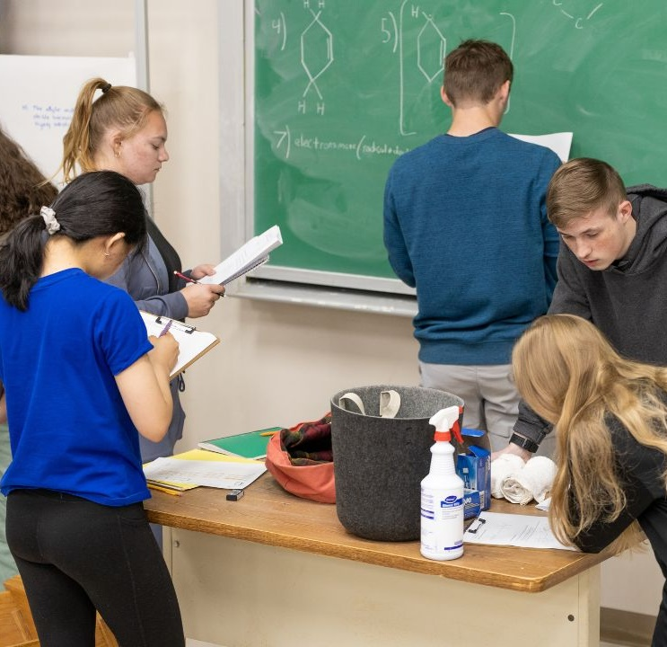
Using Quick Practice Checks Instead of Re-Teaching Content
Common response
Re-explain the content
More effective move
Ask students to practice briefly
Why it works
Reveals gaps quickly
Targets what needs attention
Key takeaway:
Practice exposes understanding better than repetition.
Notes:
When students struggle, the instinct is often to reteach material. While reteaching can feel supportive, it does not always address the underlying issue. Frequently, students understand the explanation but have not yet practiced using the knowledge in a way that reveals gaps or misconceptions.
Quick practice checks shift the focus from repeating instruction to testing understanding. These brief, low-stakes opportunities ask students to apply, explain, or perform—often revealing where confusion remains. Instead of assuming students need more explanation, practice checks provide immediate information about what they can and cannot yet do.
This approach saves time and supports learning. Practice checks can take just a few minutes and fit naturally into class or study routines. They also empower students to see struggle as feedback rather than failure, helping them adjust strategies before misunderstandings solidify.

Slide 36
Discipline | Quick Practice Check Example
STEM and Quantitative | Ask students to solve one problem variation independently before reviewing the solution.
Humanities and Reading-Intensive | Have students write a one-sentence interpretation or claim before discussing the text again.
Social Sciences | Ask students to apply a theory to a new scenario in one or two sentences.
Health Sciences | Present a short case prompt and ask students to identify the first decision they would make.
Technical and Workforce | Ask students to demonstrate or verbally walk through one step of a procedure.
Fine and Performing Arts | Have students perform or rehearse a short section to identify where technique breaks down.
Notes:
This slide shows how brief practice checks can replace the need for reteaching. By prioritizing practice over repetition, faculty help students learn more efficiently and build confidence without adding time or workload.

Slide 37
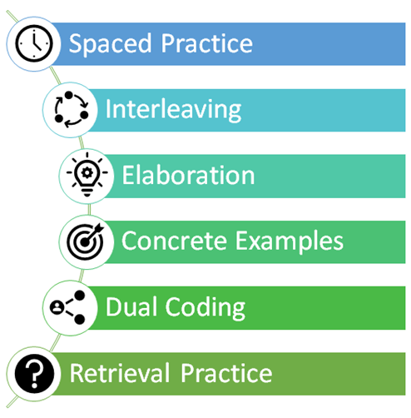
Making Study Strategies Explicit
Notes:
Students often struggle not because they lack effort, but because they are unsure how to study effectively for a particular course or discipline. Much of what faculty assume students know about studying remains unspoken, leaving students to rely on trial and error or habits that may no longer work in college-level learning.
Making study strategies explicit helps remove this guesswork. When instructors name, model, and reinforce how learning works in their discipline, students gain clearer pathways to success. This transparency supports student confidence, improves preparation, and strengthens learning—without adding content or workload.

Slide 38

Explain Why Certain Strategies Work in the Discipline
Name the strategy (e.g., retrieval practice, elaboration, interleaving)
Explain why it fits the discipline and how knowledge is used or assessed
Connect it to expert practice so studying feels purposeful, not arbitrary
Result: Students understand that effective studying is discipline-specific and aligned with how learning is demonstrated.
Notes:
Students are more likely to adopt effective study habits when faculty explicitly name the strategy and explain why it works in that discipline. Without this clarity, advice such as “practice problems,” “annotate the text,” or “use cases” can feel arbitrary or optional rather than purposeful.
Each field values distinct ways of thinking and doing, and specific strategies support those goals. Retrieval practice prepares students for independent problem-solving, elaboration supports interpretation and meaning-making, interleaving strengthens decision-making across similar cases, spaced practice builds durable skills over time, and concrete examples anchor learning in real-world application. When faculty explain how a named strategy mirrors expert practice or aligns with assessments, students better understand how studying leads to success.
This does not require lengthy instruction. A brief explanation—naming the strategy and connecting it to disciplinary expectations—is often enough to shift student behavior. By making these connections explicit, students see that effective studying is intentional, discipline-specific, and aligned with how knowledge is used and evaluated.

Slide 39
Discipline | What This Looks Like
Humanities and Reading Intensive | Elaboration — Studying means explaining ideas in your own words and connecting texts, because the discipline values interpretation, argument, and meaning-making.
STEM and Quantitative | Retrieval Practice — Effective studying involves solving problems from memory and explaining steps, reflecting how discipline assesses independent reasoning and accuracy.
Natural Sciences | Dual Coding — Students learn by pairing concepts with diagrams, models, and data visuals, mirroring how science uses visual representations to explain phenomena.
Health Sciences | Interleaving — Mixing cases and conditions prepares students for clinical judgment, where distinguishing between similar scenarios is essential.
Social Sciences | Spaced Practice — Revisiting theories over time supports analysis and comparison, aligning with how understanding deepens across contexts.
Fine and Performing Arts | Spaced Practice — Distributed rehearsal builds skill, precision, and expressive control, reflecting how performance expertise develops.
Technical / Workforce Programs | Concrete Examples — Hands-on tasks and simulations reflect fields that value procedural accuracy and real-world application.
Notes:
This slide shows how explicitly naming a study strategy—and explaining why it aligns with disciplinary thinking and assessment—helps students understand that effective studying is intentional, not arbitrary.

Slide 40

Clarifying Exam or Performance Preparation
Common student assumption
“Study everything” or “memorize the material”
More helpful guidance
Name what students must do during the exam or performance
Clarify the type of thinking or practice required
Examples
Apply concepts to new problems
Interpret or synthesize information
Make decisions in context
Perform skills accurately and consistently
Key takeaway:
Students prepare more effectively when expectations are explicit.
Notes:
Students often prepare for exams or performances by relying on familiar habits rather than on what the assessment actually demands. Without clear guidance, preparation becomes guesswork: rereading notes for an exam that requires application, memorizing details for a task that requires interpretation, or practicing broadly for a performance that requires focused refinement.
Clarifying what preparation actually requires helps students align their studying with expectations. This means explicitly naming the types of thinking, practice, or decision-making students will need to demonstrate—such as solving unfamiliar problems, interpreting evidence, applying theories, making judgments, or performing specific skills under constraints.
This strategy does not involve giving away exam questions or lowering rigor. Instead, it makes assessment demands transparent. When students understand whether an exam emphasizes application over recall, reasoning over definitions, or performance over completion, they can choose study strategies that are more effective and less stressful.

Slide 41
Discipline | What Preparation Actually Requires
STEM and Quantitative | Preparing means practicing unfamiliar problem types and explaining why a solution works—not memorizing formulas.
Humanities and Reading-Intensive | Preparing means being ready to interpret texts, synthesize ideas, and construct arguments—not recall details.
Social Sciences | Preparing means applying theories to new scenarios and explaining reasoning—not listing definitions.
Health Sciences | Preparing means practicing clinical decision-making and prioritization—not memorizing procedures or symptoms.
Technical and Workforce | Preparing means performing procedures accurately and troubleshooting errors—not just knowing the steps.
Fine and Performing Arts | Preparing means refining specific techniques under performance conditions—not simply repeating the full piece.
Notes:
This slide highlights that exam and performance preparation differs by discipline. By clarifying how students are expected to think or perform, instructors help them align their studying with assessments, reducing anxiety and improving performance without lowering rigor or adding work.

Slide 42

Connecting Assignments to Professional Thinking
Why this matters
Students often see assignments as academic tasks only
Relevance increases engagement and effort
What to make explicit
How the assignment mirrors professional thinking
What skills or decisions professionals use
Why this kind of work matters beyond class
Key takeaway
Assignments feel more meaningful when students see their professional purpose.
Notes:
Students often view assignments as academic tasks designed solely for grading, rather than as opportunities to develop professional ways of thinking and working. When this connection remains implicit, students may focus on completion instead of understanding how the work prepares them for real-world contexts.
Connecting assignments to professional practice helps students see why the work matters. When faculty explain how an assignment mirrors how professionals analyze problems, make decisions, communicate ideas, or refine skills, students begin to approach the task with greater purpose and engagement. The assignment shifts from “something to turn in” to “practice for the field.”
This strategy does not require changing assignments. It simply involves naming the professional thinking embedded in the work—how a problem set reflects analytical decision-making, how an essay mirrors professional argumentation, or how a performance task builds industry-standard skills. These brief explanations help students align their effort with authentic expectations.

Slide 43
Discipline | How the Assignment Reflects Professional Practice
STEM and Quantitative | Problem sets mirror how professionals select methods, test assumptions, and analyze results.
Humanities and Reading-Intensive | Essays reflect how professionals build arguments, interpret sources, and communicate ideas clearly.
Social Sciences | Case studies mirror how analysts apply theories to explain real-world behavior and outcomes.
Health Sciences | Case analyses reflect how practitioners make decisions, prioritize information, and ensure safety.
Technical and Workforce | Skills tasks mirror workplace procedures, quality standards, and troubleshooting processes.
Fine and Performing Arts | Performances and critiques reflect professional rehearsal, refinement, and feedback cycles.
Notes:
In this slide, assignments are framed as practice for professional thinking rather than isolated academic tasks. By briefly explaining how an assignment mirrors real-world decision-making, communication, or performance in the field, instructors help students understand the purpose behind the work.

Slide 44

Helping Students Monitor Their Own Learning
Notes:
Students often spend time studying without knowing whether their efforts are actually working. Familiarity can feel like understanding, and gaps may not become visible until an exam, performance, or high-stakes task reveals them. Helping students monitor their own learning shifts preparation from guesswork to evidence.
When faculty provide simple tools for self-checking, reflection, and adjustment, students learn to evaluate their understanding as they study. These strategies do not add work or reduce rigor—they help students become more aware, strategic, and independent learners. By making learning visible to students themselves, instructors support stronger preparation, persistence, and long-term success.

Slide 45


“What Type of Thinking Does This Require?”
Common student move
Study everything the same way
More effective move
Identify the type of thinking first
Types of thinking may include
Applying concepts
Interpreting or synthesizing ideas
Analyzing evidence
Making decisions or judgments
Performing or creating
Key takeaway:
Study strategies work best when they match the thinking required.
Notes:
Students often approach studying as if all tasks require the same kind of thinking. They may reread, memorize, or review notes regardless of whether an assignment, exam, or performance actually requires application, interpretation, decision-making, or creation. When the type of thinking remains unclear, students misalign their preparation and are surprised by outcomes.
Asking “What type of thinking does this require?” helps students pause and diagnose the task before choosing a study strategy. This question shifts attention away from how long to study and toward how to study. It encourages students to match their preparation to the cognitive demands of the discipline—whether that means solving unfamiliar problems, synthesizing ideas, applying theories, making judgments, or refining performance.
This strategy is simple but powerful. Faculty can model it briefly when introducing an assignment, reviewing an assessment, or debriefing feedback. Over time, students internalize the habit of asking the question themselves, leading to more intentional studying and better transfer of learning.

Slide 46
Discipline | How the Question Guides Studying
STEM and Quantitative | Students identify that the task requires applying concepts to new problems, so they practice problem-solving rather than memorization.
Humanities and Reading-Intensive | Students recognize the task requires interpretation and argument, so they focus on synthesizing ideas instead of recalling details.
Social Sciences | Students see that the task requires applying theories to contexts, so they practice using concepts in real-world scenarios.
Health Sciences | Students identify that the task requires clinical judgment, so they prepare through case-based decision-making.
Technical and Workforce | Students recognize the task requires procedural accuracy, so they practice steps and troubleshooting rather than reviewing notes.
Fine and Performing Arts | Students see that the task requires performance refinement, so they focus on targeted practice instead of repetition.
Notes:
This slide emphasizes the importance of helping students identify the kind of thinking a task requires before they choose how to study. By consistently asking this question, you help students become more intentional, strategic learners who can monitor and adjust their own preparation.

Slide 47

“What Mistakes Am I Repeating?”
Common student response
Focus on the grade
Move on quickly
More effective move
Look for patterns in errors
Ask yourself
What keeps showing up?
Where do I lose points or control?
What strategy needs to change?
Key takeaway:
Improvement starts by noticing patterns—not single mistakes.
Notes:
Students often experience the same errors across assignments, exams, or performances without recognizing a pattern. When feedback is viewed as isolated comments rather than as information about learning habits, mistakes are likely to repeat. Asking “What mistakes am I repeating?” helps students shift from reacting to outcomes to diagnosing their learning.
This question reframes errors as data. Instead of focusing on what went wrong once, students look for trends—misapplied concepts, weak explanations, rushed steps, or incomplete preparation. Identifying patterns allows students to adjust strategies intentionally rather than studying more of the same way.
Faculty can support this habit by prompting brief reflection after assessments, highlighting common patterns during review, or asking students to name one recurring issue they plan to address. Over time, students learn to anticipate errors and intervene earlier in their studying.

Slide 48
Discipline | How the Question Guides Learning
STEM and Quantitative | Students notice repeated setup or reasoning errors and adjust how they analyze problems before calculating.
Humanities and Reading-Intensive | Students identify recurring feedback on thesis clarity or evidence use and revise how they plan arguments.
Social Sciences | Students recognize repeated difficulty applying theories and practice connecting concepts to cases.
Health Sciences | Students notice recurring decision-making gaps and focus on prioritization during case practice.
Technical and Workforce | Students identify repeated process or safety errors and rehearse specific steps more deliberately.
Fine and Performing Arts | Students recognize repeated technical breakdowns and target those areas in focused practice.
Notes:
This slide highlights how identifying recurring mistakes helps students monitor and improve their learning.

Slide 49

“What Strategy Helped Most This Week?”
Common student focus
Did I do well or not?
More effective reflection
What actually helped me learn?
Ask yourself
Which strategy made the biggest difference?
When did learning feel clearer?
What should I keep doing next week?
Key takeaway
Improvement comes from repeating what works—not guessing.
Notes:
Students often focus on outcomes—grades, scores, or performance quality—without reflecting on how they prepared. As a result, effective strategies may go unnoticed, while ineffective ones continue out of habit. Asking “What strategy helped most this week?” helps students identify what is actually supporting their learning.
This question shifts reflection from judgment to insight. Instead of asking whether studying worked or didn’t work, students consider which strategy made the biggest difference. This builds awareness of cause and effect: how specific approaches—practice, self-checks, spacing, feedback use—contribute to understanding and performance.
Faculty can support this habit with brief, low-stakes prompts at the end of a week, module, or assignment. Over time, students begin to build a personalized toolkit of strategies they know are effective for them and for the discipline. This supports transfer across courses and increases confidence.

Slide 50
Discipline | How the Question Builds Learning
STEM and Quantitative | Students recognize that practicing varied problems clarified concepts more than rereading notes.
Humanities and Reading-Intensive | Students identify that summarizing arguments in their own words improved understanding.
Social Sciences | Students note that applying theories to real-world examples made concepts stick.
Health Sciences | Students realize that working through case scenarios improved decision-making.
Technical and Workforce | Students see that repeated hands-on practice strengthened accuracy and confidence.
Fine and Performing Arts | Students recognize that focused practice on weak sections led to noticeable improvement.
Notes:
This slide encourages students to reflect on which study strategies had the greatest impact on their learning.

Slide 51

Start Small—One Discipline-Specific Shift
Notes:
Supporting students in how they study does not require redesigning a course or adding new responsibilities. Meaningful change often begins with a single, intentional adjustment that fits naturally within your discipline and teaching style. Small shifts—naming a strategy, clarifying expectations, or prompting reflection—can significantly improve how students prepare and engage.
This section focuses on simple, discipline-specific moves you can try right away. By starting small and building gradually, you can support student learning more effectively while maintaining rigor and respecting your time.

Slide 52

One Concept to Model How to Study
Start small
Choose one key concept
Make thinking visible
What you focus on
How you practice or apply
How you check understanding
Why it works
Gives students a concrete example
Creates a study template they can reuse
Key takeaway
One well-modeled example can change how students study all semester.
Notes:
When instructors think about teaching students how to study, it can feel overwhelming to address every topic or skill at once. A more effective and manageable approach is to start with a single, high-impact concept and use it to model how studying works in the discipline.
Choosing one concept allows faculty to slow down and make expert thinking visible without sacrificing content coverage. By narrating how you approach understanding, practicing, or applying that concept—what you focus on, how you check understanding, and how you respond to confusion—students gain a concrete example of what effective studying looks like. This example then becomes a template students can reuse across the course.
This strategy works because it reduces cognitive overload for both faculty and students. Rather than abstract advice, students see a specific instance of disciplinary studying in action. Over time, students begin to transfer these habits to new concepts independently.

Slide 53
Discipline | What You Model
STEM and Quantitative | How to choose an approach, set up a problem, check assumptions, and analyze errors—not just calculate.
Humanities and Reading-Intensive | How to identify a central claim, track evidence, and interpret meaning rather than highlight details.
Social Sciences | How to apply one theory to a real-world case and evaluate whether it explains the situation.
Health Sciences | How to prioritize information and make decisions while working through a case scenario.
Technical and Workforce | How to follow a procedure with accuracy, note where errors occur, and check quality and safety.
Fine and Performing Arts | How to isolate a problem area and practice one technique intentionally rather than repeat the whole piece.
Notes:
This slide shows how modeling just one key concept can help students learn how to study more effectively.

Slide 54
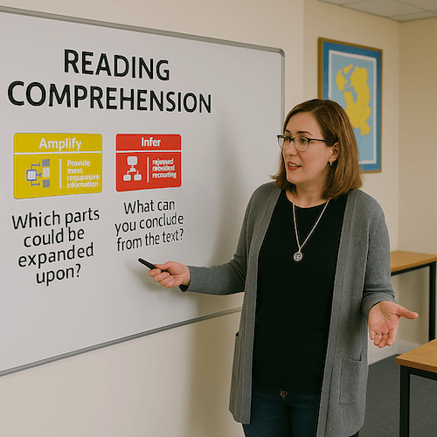
One Assignment to Add Reflection
Start small
Choose one existing assignment
Add a brief reflection
How did I prepare?
What worked? What didn’t?
What will I change next time?
Why it works
Turns completion into learning
Helps students adjust strategies
Key takeaway:
One reflection can improve learning across the course.
Notes:
Adding reflection does not require redesigning a course or creating new assignments. A simple and effective starting point is to choose one existing assignment and add a brief reflection that helps students think about how they prepared, what they learned, and what they would change next time.
This small addition helps students connect effort to outcomes. Instead of viewing the assignment as a finished product, students are prompted to consider the strategies they used, where they struggled, and what supported their learning. Over time, this reflection builds metacognitive habits that improve studying across tasks and courses.
Reflection works best when it is focused and low-stakes. One or two targeted questions—completed after submission or feedback—are enough to help students pause and learn from experience. Faculty gain insight into student preparation, and students gain clearer direction for improvement.

Slide 55
Discipline | What Reflection Focuses On
STEM and Quantitative | Which problem types were hardest and what strategy would help next time.
Humanities and Reading-Intensive | How feedback on argument or evidence will shape the next paper.
Social Sciences | Which theory was most difficult to apply and why.
Health Sciences | Where decision-making broke down during a case or simulation.
Technical and Workforce | Which step caused errors and how practice will change.
Fine and Performing Arts | Which section or technique needs more focused rehearsal.
Notes:
This slide highlights how adding reflection to just one assignment can help students learn more effectively.

Slide 56

One Exam Wrapper or Practice Prompt
Start small
Choose one exam, quiz, or performance
Add a short prompt
How did I prepare?
What worked? What didn’t?
What will I change next time?
Why it works
Turns results into feedback
Helps students adjust strategies
Key takeaway:
One well-timed prompt can improve future performance.
Notes:
Exam wrappers and practice prompts help students pause and learn from assessments rather than moving on once a grade is posted. Starting with one exam wrapper or practice prompt keeps the strategy manageable while providing high impact. The goal is not to add writing or grading, but to help students connect preparation strategies to performance.
A short set of targeted questions—completed after an exam, quiz, performance, or practice task—encourages students to identify what worked, what didn’t, and what they will do differently next time. This reflection turns results into feedback and helps students adjust their studying before patterns of misunderstanding become habits.
Practice prompts can serve the same purpose before an assessment. Asking students to try a brief, representative task helps them check readiness and focus their preparation. Whether used before or after, these prompts support metacognition without increasing workload.

Slide 57
Discipline | What the Prompt Focuses On
STEM and Quantitative | Which problem types caused difficulty, and which practice strategies would help next time.
Humanities and Reading-Intensive | How preparation supported interpretation and argument quality on the exam or essay.
Social Sciences | Which theories were hardest to apply and how studying could better support transfer.
Health Sciences | Where clinical reasoning or prioritization broke down during the exam or simulation.
Technical and Workforce | Which steps or procedures caused errors and how practice will change.
Fine and Performing Arts | Which performance elements were least controlled and how rehearsal strategies will adjust.
Notes:
This slide shows how adding one exam wrapper or practice prompt can help students learn from assessments.

Slide 58
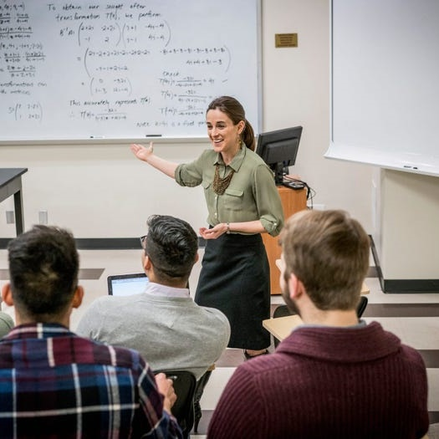
Teaching Students How to Study—Key Takeaways
What students need
Clear signals about how to study
Strategies that match the discipline
Tools to monitor and adjust learning
What faculty can do
Make expert thinking visible
Name and explain effective strategies
Start small with one intentional shift
The result
Better preparation
Stronger learning
Less frustration for everyone
Final message
When study strategies are explicit, students learn how to learn.
Notes:
In conclusion, students do not automatically know how to study effectively in college, and they often rely on strategies that worked in the past but no longer align with disciplinary expectations. When study strategies remain implicit, students are left guessing how to prepare, how to monitor their learning, and how to improve.
Throughout this presentation, the focus has been on making study strategies visible, discipline-specific, and manageable—for both students and faculty. By modeling expert thinking, naming effective strategies, clarifying expectations, and helping students reflect on what works, faculty reduce the hidden curriculum and support more intentional learning.
The strategies shared do not require redesigning courses or adding workload. Instead, they leverage moments that already exist—explaining a concept, returning an assignment, preparing for an exam—and use them to guide students toward more effective preparation. Small, intentional shifts help students move from passive studying to purposeful practice.
When students understand how learning works in a discipline, they study with greater confidence, efficiency, and persistence. Teaching students how to study is not extra work—it is an extension of strong teaching, disciplinary expertise, and care for student success.

Slide 59

Biwer, F., Egbrink, M. G. A. o., Aalten, P., & de Bruin, A. B. H. (2020). Fostering effective learning strategies in higher education. Journal of Applied Research in Memory and Cognition, 9(2), 186-203.
Bjork, R. A., Dunlosky, J., & Kornell, N. (2013). Self-regulated learning: Beliefs, techniques, and illusions. Annual Review of Psychology, 64, 417–444.
Boser, U. Teaching the Skill of Learning to Learn. Inside Higher Ed.
Chew, S. Teaching study skills (not just study tips) in introductory psychology. American Psychological Association.
Chew, S. Teaching Students How to Study. The Teaching Professor.
Davies, L. J. Teaching University Students How to Learn. Improving College and University Teaching Vol. 31, No. 4 (Fall, 1983), pp. 160-165 (6 pages). Published By: Taylor & Francis, Ltd.
Del Tufo, S. and Mouza, C. Helping Instructors Teach Students “How to Learn”. Center for Teaching and Learning, University of Delaware.
Discipline-Based Education Research : Understanding and Improving Learning in Undergraduate Science and Engineering. The National Academies Press. 10.17226/6548.
Help Students Learn How to Learn. Center for Teaching and Assessment of Learning, DePaul University.
McGuire, S. Teach Students How to Learn: Strategies You Can Incorporate Into Any Course to Improve Student Metacognition, Study Skills, and Motivation. Sylus Publishing.
Perrodin, L. Teaching Your Students to Study. University of California Riverside, Extension.
Tanner, K. Order Matters: Using the 5E Model to Align Teaching with How People Learn. National Library of Medicine.
References

