Slide 1
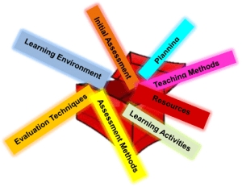
Teaching Toolbox Tune-Up
Prepare Now for a Stronger Start Next Semester
Faculty Focus: Innovative Teaching Techniques for College Success Series
Notes:
The end of the semester often feels like a finish line, but it is also a critical transition point. The insights you have right now—what worked, what didn’t, and how students responded—are at their most accurate and actionable. If they are not captured, they are often lost or become difficult to recall with clarity. Taking a small amount of time now allows you to turn these experiences into intentional improvements. Rather than starting over next semester, you begin with a stronger foundation built on what you already know.

Slide 2

Think Like a Pit Stop
Make Targeted Adjustments:
Not a full course redesign
Focus on high-impact changes
Quick, efficient improvements
Refine what already works
Notes:
A pit stop is designed for precision, not overhaul. The goal is to make targeted adjustments that improve performance without taking the system apart. This same principle applies to your teaching at the end of the semester. Rather than redesigning your entire course, you focus on identifying a few key areas where small changes will have the greatest impact—clarifying an assignment, adjusting pacing, reorganizing materials, or refining instructions.

Slide 3

Why a Tune-Up Matters
Avoid Repeating the Same Challenges:
Problems resurface each semester
Materials become difficult to locate
Assignments remain unclear
Time spent recreating instead of refining
Notes:
Without this intentional effort, it is easy to fall into a cycle of repetition. The same challenges—unclear assignments, disorganized materials, or student confusion—tend to carry over from one semester to the next. Over time, this increases workload and limits progress.
A short, focused investment at the end of the semester interrupts this cycle. By capturing insights and making targeted adjustments now, you shift from recreating to refining. This approach not only saves time but also leads to stronger course design, smoother delivery, and improved student outcomes.

Slide 4
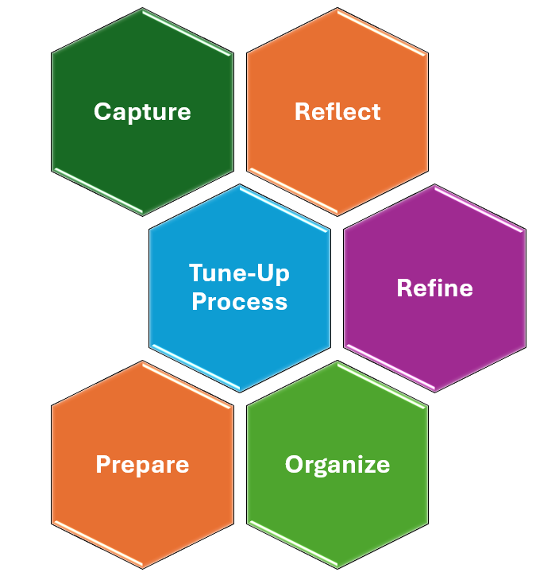
The Tune-Up Process
Notes:
The Teaching Toolbox Tune-Up provides a structured approach to improving your course without overwhelming your time or effort. By breaking the process into five steps—capture, reflect, refine, organize, and prepare—you create a clear pathway from experience to action. Each step builds on the previous one, ensuring that your improvements are intentional and aligned to student learning. This framework keeps the process focused and manageable while supporting continuous growth in your teaching practice.

Slide 5
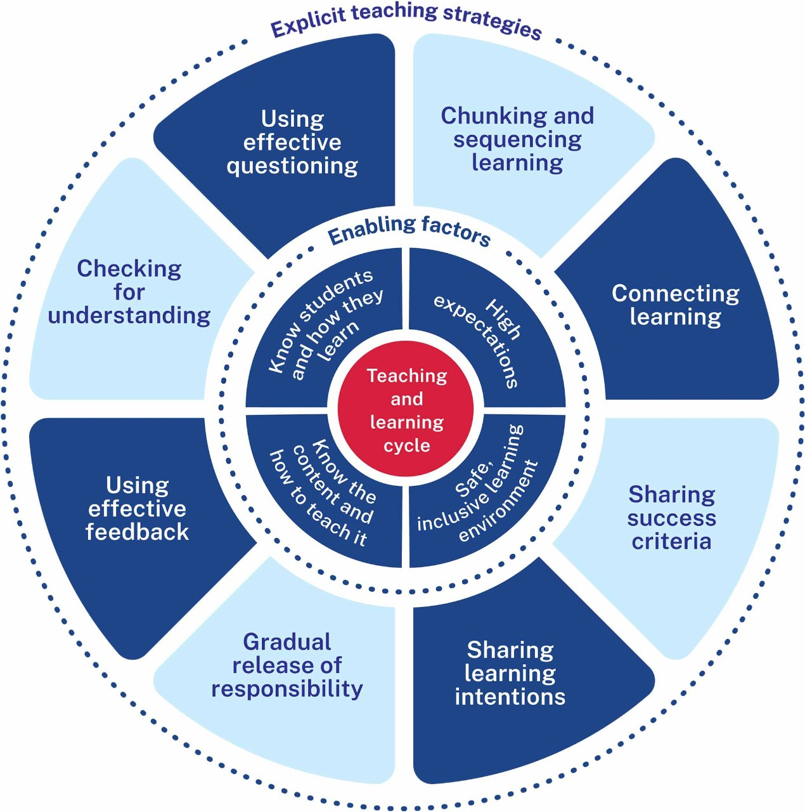
Capture What Worked
Identify and Preserve Effective Practices:
What engaged students most?
Which assignments produced strong outcomes?
What strategies improved understanding?
Capture now while it’s fresh.
Step 1: Capture
Notes:
The first step in the Teaching Toolbox Tune-Up is to capture what stood out during the semester while it is still fresh in your mind. This includes both what worked well and what did not go as expected. Think about the moments when students were most engaged, the assignments that produced strong results, and the strategies that helped clarify difficult concepts.

Slide 6

Identify What to Adjust
Turn Challenges into Improvements:
Where did students struggle?
What caused confusion or low engagement?
Which activities fell short of expectations?
Capture issues to guide adjustments.
Step 1: Capture
Notes:
Equally important is identifying what did not work as expected. This is not about criticism—it is about improvement. Every course provides insight into where students struggled, where instructions may have been unclear, or where engagement dropped. These moments are valuable because they point directly to opportunities for refinement.

Slide 7

Capture Notes
Start with What You Know:
Jot down what worked well.
Note where students struggled.
Record ideas for improvement.
Capture insights while they’re fresh.
Step 1: Capture
Notes:
This step is not about analysis—it is about preservation. You are collecting raw observations that will later guide improvement. Without capturing these insights now, even your most valuable experiences can fade or become difficult to recall accurately.
The process does not need to be complex. A simple list, quick notes, or brief reflections are enough. The goal is to document your experience so it can be used intentionally rather than relying on memory later. These notes become the foundation for the next steps in the process, helping you move forward with clarity and focus.

Slide 8

Reflect on Your Observations
Look for Patterns and Meaning:
What trends do you notice?
What impacted learning most?
Where are the gaps?
Step 2: Reflect
Notes:
Once you have captured your observations, the next step is to reflect on them to identify patterns and meaning. Reflection moves you beyond individual moments and helps you understand how students experienced your course as a whole. Instead of focusing on isolated successes or challenges, you begin to see trends—where students consistently performed well, where they struggled, and what may have influenced those outcomes.
This is where you ask deeper questions. Were challenges related to unclear instructions, pacing, or prior knowledge gaps? Did certain strategies consistently improve engagement or understanding? Reflection allows you to connect your teaching practices to student outcomes in a more intentional way, helping you determine what had the greatest impact on learning.

Slide 9

Review Feedback and Data
Use Evidence to Guide Improvement:
Identify patterns in student performance.
Look for common errors or challenges.
Review student feedback.
Use insights to inform changes.
Step 2: Reflect
Notes:
Using feedback and data strengthens this process. Reviewing performance trends, common errors, and student feedback provides a clearer picture of how your course functioned. Rather than relying on perception alone, you are using evidence to guide your understanding.
When multiple students encounter the same difficulty, it often signals an opportunity for improvement. These patterns help you identify what to reinforce and what may need to change. By reflecting in this way, you move from observation to insight, creating a clear direction for the next step in the process.

Slide 10

Strengthen What You Built
Make Targeted Improvements:
Clarify assignments.
Adjust pacing or structure.
Strengthen alignment.
Focus on specific, high-impact changes.
Step 3: Refine
Notes:
Refinement is the step where insights turn into action. Based on what you observed and reflected on, you make targeted adjustments to your course. This may involve clarifying assignment instructions, adjusting pacing, improving alignment between activities and learning outcomes, or modifying how content is delivered.
The key is to focus on specific, high-impact changes rather than attempting a full course redesign. Refinement is about strengthening what already exists, not replacing it. By making small, intentional improvements, you enhance clarity, reduce confusion, and create a more effective learning experience.

Slide 11

Update Your Syllabus
Strengthen Clarity and Expectations:
Clarify expectations and policies.
Adjust timelines based on experience.
Simplify language for better understanding.
Address common questions upfront.
Step 3: Refine
Notes:
The syllabus is one of your most important communication tools. It sets the tone for the course, establishes expectations, and provides a roadmap for students. Small updates based on real experience—such as clarifying language, adjusting timelines, or refining policies—can make a significant difference in how students navigate the course.
When expectations are clear, students are less likely to experience confusion or frustration. This reduces misunderstandings and allows them to focus more on learning. Refining your syllabus creates a stronger foundation for the next semester.

Slide 12
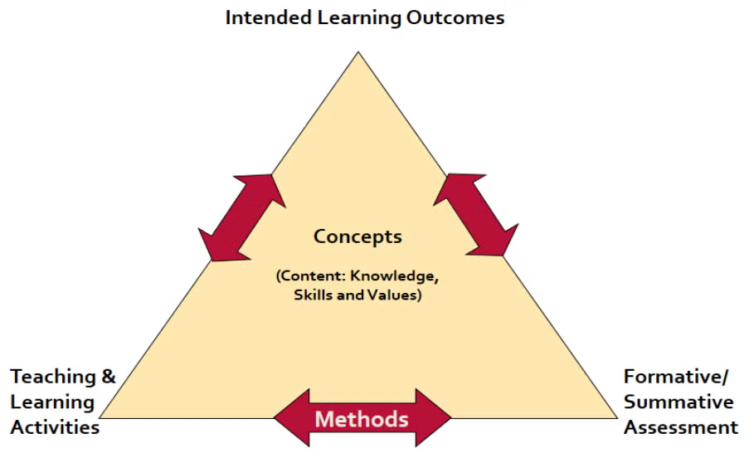
Refine
Assignments
Align Work to Learning:
Ensure alignment to learning outcomes.
Clarify instructions and expectations.
Adjust scope and workload.
Focus on meaningful learning.
Step 3: Refine
Notes:
Assignments should clearly reflect what students are expected to learn. When tasks are aligned to course outcomes, they become purposeful rather than procedural. Refining assignments may involve clarifying instructions, adjusting scope, or rethinking how learning is measured. Clear expectations and appropriate workload increase engagement and improve the quality of student work. Well-designed assignments reduce confusion and make your course more effective.

Slide 13

Save Strong Examples
Make Expectations Visible
Collect high-quality student work.
Use examples to model success.
Highlight what strong work looks like.
Reduce ambiguity for future students.
Step 3: Refine
Notes:
Examples provide clarity for future students by making expectations concrete and visible. When students can see what strong work looks like, they better understand how to approach assignments and what is required for success. This reduces uncertainty and helps them focus their efforts more effectively. Saving high-quality examples—whether from assignments, discussions, or projects—creates a valuable teaching resource. These models allow you to demonstrate key elements such as organization, depth of analysis, and clarity of communication. By using examples intentionally, you set clearer expectations, improve the quality of student work, and make your course more transparent and accessible.

Slide 14
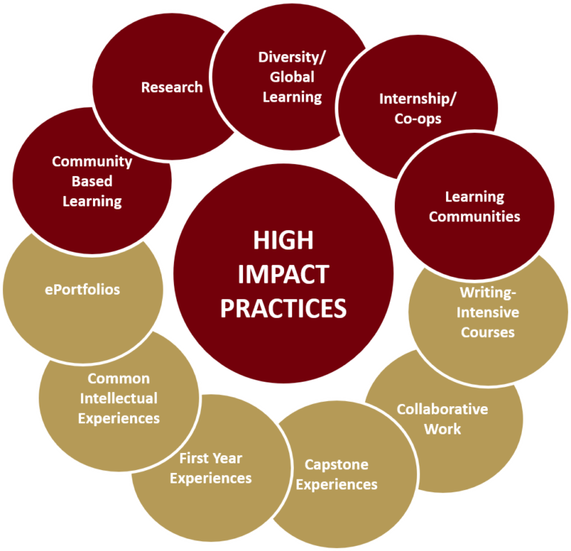
Streamline Your Workflow
Work Smarter, Not Harder:
Identify time-consuming tasks.
Simplify grading and processes.
Use tools to increase efficiency.
Focus on high-impact practices.
Step 3: Refine
Notes:
Efficiency is critical to sustaining effective teaching. When too much time is spent on repetitive or low-impact tasks, it limits your ability to focus on what truly improves student learning. Streamlining your workflow allows you to reduce unnecessary workload while maintaining—or even enhancing—the quality of your instruction.
This may involve simplifying grading processes, using templates, or leveraging digital tools more effectively. The goal is to eliminate inefficiencies so your time and energy are directed toward high-impact teaching practices such as feedback, engagement, and course design. By working more efficiently, you create a more manageable and sustainable approach to teaching that benefits both you and your students.

Slide 15

Reuse and Update Content
Build, Don’t Rebuild
D2L: Clone and update your course.
Canva: Refresh templates and slides.
Revise recorded videos as needed.
Reuse and refine existing materials.
Build on past content to save time and improve each term.
Step 3: Refine
Notes:
Reusing and updating course content is one of the most effective ways to save time. Instead of starting from scratch, you can build on what you’ve already created. Tools like D2L allow you to clone your course, while platforms like Canva make it easy to update templates and materials.
You can also revise recorded content rather than recreating it. By refining existing resources, you reduce preparation time while continuing to improve your course each semester.

Slide 16

Organize
Materials
Create a System That Works:
Use shared folders (Google Drive/Dropbox) for submissions and materials.
Label and organize by assignment, module, or student.
Upload materials to D2L for easy access.
Ensure students can quickly find what they need.
Streamline access to save time and stay organized.
Step 4: Organize
Notes:
After refining your materials and strategies, the next step is to organize them in a way that supports efficiency and ease of use. Organizing student materials for easy access ensures that both you and your students can quickly find and use course resources when needed.
Tools like Google Drive or Dropbox allow you to create shared folders for submissions, presentations, and course materials. By labeling folders clearly and organizing them by assignment, module, or student, you create a streamlined system that reduces time spent searching for files. Uploading materials to your course platform also ensures students can easily access important resources, even after the course ends. This structure minimizes confusion, reduces follow-up requests, and supports a smoother flow of information throughout the course.

Slide 17

Impact to Efficiency and Effectiveness
Eliminate Inefficiency:
Disorganization wastes time
Materials become hard to locate
Increases frustration and workload
Takes time away from teaching
Step 4: Organize
Notes:
Organization is not just about neatness—it directly impacts your efficiency and effectiveness as an instructor. When course materials are disorganized, inconsistently labeled, or scattered across multiple locations, even simple tasks can become time-consuming. Time that could be spent preparing lessons, providing feedback, or engaging with students is instead spent searching for files, recreating materials, or troubleshooting avoidable issues.
This inefficiency compounds over time. Small moments of disorganization—such as unclear file names or duplicate documents—add up, creating unnecessary workload and frustration. It can also affect consistency in your course, as using outdated or incorrect materials becomes more likely when organization is lacking.
By recognizing the cost of disorganization, this step becomes more than a housekeeping task—it becomes a strategic move to improve how you manage your course. When materials are easy to find and use, you are able to focus your time and energy on what matters most: supporting student learning.

Slide 18

Prepare for Next Semester
Start with Clarity and Purpose:
Plan early engagement.
Finalize key materials.
Set one improvement goal.
Step 5: Prepare
Notes:
The final step is preparation—positioning yourself for a strong and confident start to the next semester. With your materials captured, reflected on, refined, and organized, you now focus on how you will begin. This includes planning early engagement, finalizing key course components, and identifying one priority area for continued improvement.
Preparation ensures that you are proactive rather than reactive. Instead of scrambling to get ready at the start of the semester, you begin with clarity, structure, and purpose already in place. This not only reduces stress but also allows you to focus immediately on supporting student learning. A strong start sets the tone for the entire course, and this step ensures that you are ready to create that momentum from day one.

Slide 19

Plan Early Engagement
Set the Tone from Day One:
Design strong first-week activities.
Establish clear expectations early.
Create early opportunities for success.
Build connection and momentum.
Step 5: Prepare
Notes:
The start of the semester sets the tone for everything that follows. Early experiences shape how students perceive the course, their level of engagement, and their confidence in succeeding. Planning for early engagement ensures that students are actively involved from the beginning rather than trying to catch up later.
This includes designing purposeful first-week activities, clearly communicating expectations, and providing early opportunities for success. When students understand what to do and feel capable of doing it, they are more likely to stay engaged and persist. By being intentional at the start, you build momentum that carries through the entire semester and supports stronger retention and overall student success.

Slide 20
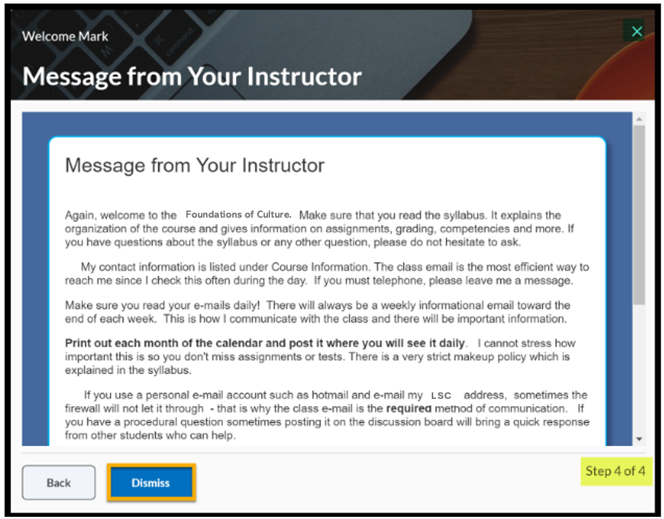
Set Up Course Communication
Create Clear, Consistent Communication:
Create channels for announcements, assignments, and questions.
Establish clear communication expectations.
Automate introductory messages.
Schedule reminders for key deadlines.
Keep students informed and on track.
Step 5: Prepare
Notes:
Setting up course communication in advance ensures smooth, consistent engagement with your students. Create clear channels for announcements, assignments, and questions so students know where to go for information. You can also automate introductory messages to outline key expectations, deadlines, and policies. Scheduling reminders for assignments and exams helps keep students on track without requiring constant manual communication. By organizing communication ahead of time, you create a more structured and proactive learning environment.

Slide 21

Plan and Schedule Ahead
Stay Organized and On Track:
Set reminders for key tasks and deadlines.
Plan your course timeline in advance.
Organize tasks (materials, meetings, assignments).
Break work into manageable steps.
Reduce last-minute stress and stay on track.
Step 5: Prepare
Notes:
Planning ahead helps you stay organized and reduces last-minute stress. Tools like Google Calendar allow you to set reminders for key tasks such as updating materials, preparing syllabi, and scheduling meetings. Using a planning tool like Trello can also help you map out your course timeline and organize tasks such as updating resources, scheduling office hours, and preparing assignments. Breaking work into manageable steps creates a clear roadmap and ensures a more efficient and organized start to the semester.

Slide 22
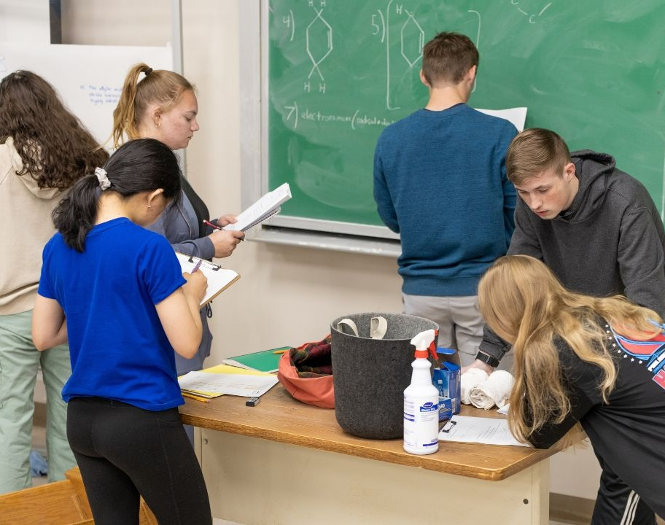
Better Outcomes for Students
Impact What Matters Most:
Improve clarity and consistency.
Increase engagement and participation.
Support stronger performance.
Promote persistence and completion.
Notes:
The ultimate goal of a teaching toolbox tune-up is to improve outcomes for students. When your course is clear, organized, and intentionally designed, students are better able to focus on learning rather than navigating confusion. Clear expectations, well-structured materials, and purposeful assignments create an environment where students can engage more fully and perform at a higher level. These improvements also influence persistence. When students feel supported, understand what is expected, and experience early success, they are more likely to stay engaged and complete the course. By making small, targeted changes to your teaching now, you create a more effective learning experience that leads to stronger performance, increased confidence, and better overall student success.

Slide 23
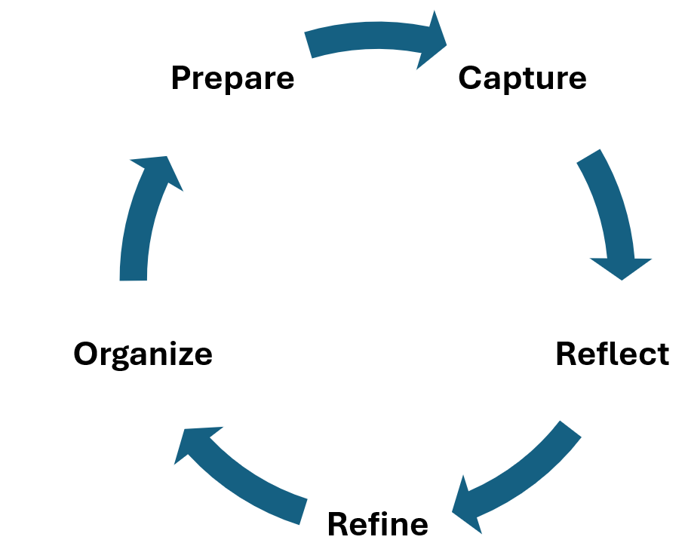
The Tune-Up Cycle
From Experience to Improvement:
Steps create a continuous cycle of improvement.
Each step builds on the last.
Turn insights into action.
Be intentional with what you already know.
Strengthen your course each semester.
Improve student outcomes.
Notes:
Together, these five steps—capture, reflect, refine, organize, and prepare—create a continuous cycle of improvement. Each step builds on the previous one, turning experience into action and action into impact. This process is not about doing more; it is about being intentional with what you already know. By following this framework, each semester becomes an opportunity to strengthen your teaching and improve student outcomes in a focused, manageable way.

Slide 24

End Strong. Start Smarter.
Capture insights from this semester.
Make small, high-impact improvements.
Organize and prepare for next term.
Set the stage for student success.
Tune-Up for Success
Notes:
In conclusion, a teaching toolbox tune-up is a simple but powerful way to turn one semester into a foundation for the next. By taking time to capture what worked, reflect on what can be improved, and make targeted adjustments, you move from reacting to planning with purpose. This process ensures that your teaching continues to evolve—becoming more efficient, intentional, and effective over time.
The key is not to do everything, but to focus on what matters most. Small, focused actions—organizing materials, refining assignments, and clarifying expectations—lead to meaningful improvements without adding unnecessary workload. These adjustments reduce stress, streamline preparation, and position you to begin the next semester with clarity and confidence.
Ultimately, this work is about impact. When your course is well-structured and intentionally designed, students are better able to engage, understand, and succeed. A small investment of time now creates a stronger learning experience later—ensuring that each semester builds on the last in a continuous cycle of improvement.
Take 30–60 minutes now to complete this tune-up—you’ll start your next semester more prepared, more confident, and more effective. Use the Teaching Toolbox Tune-Up Guide at the end of the PDF to walk through each step—capture, reflect, refine, organize, and prepare—and focus on one or two high-impact actions. This simple process will help you turn your insights into clear, intentional improvements for the next term.

Slide 25

Eggleston, T., and Smith, G. Parting Ways: Ending Your Course. Teaching Tips. Association for Psychological Science.
Ending the Semester. Center for New Designs in Learning and Scholarship. Georgetown University.
Fournier, E. How to End a Course: Teaching Tips. Center for Teaching and Learning. Washington University in St. Louis.
Hardy, J. End-of-the-year reflection: Tools for validation, celebration, gratitude and planning ahead. Office of Student Care Coordination. Vanderbilt University.
Himelein, M. Activities for the Last Day of Class. Teaching Tips. Brigham Young University.
Korgeski, M. Closing the Semester Strong: Essential Tips for Online Instructors. Digital Learning Hub. College of Applied Human Sciences. West Virginia University.
Last Day of Class. Center for Teaching and Learning. University of California Berkeley.
Preparing for the End of the Semester. Center for Teaching Innovation. Cornell University.
Richter, S. Looking back, moving forward, and saying good-bye: Strategies for ending the semester. Center for Innovative Teaching and Learning, Northern Illinois University.
Van Leusen, P. 5 Things Successful Instructors Do When the Semester is Over. Design for Online Learning Toolkit. Arizona State University.
References

