Slide 1
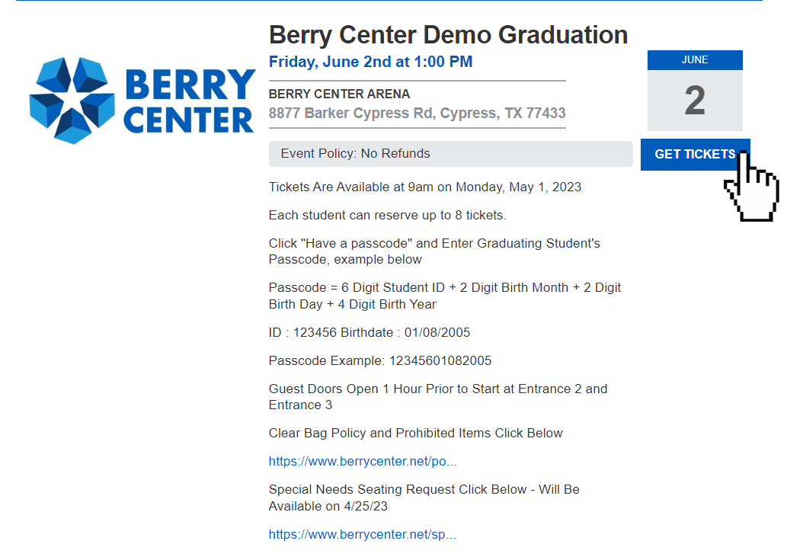
CLICK “GET TICKETS”

Slide 2
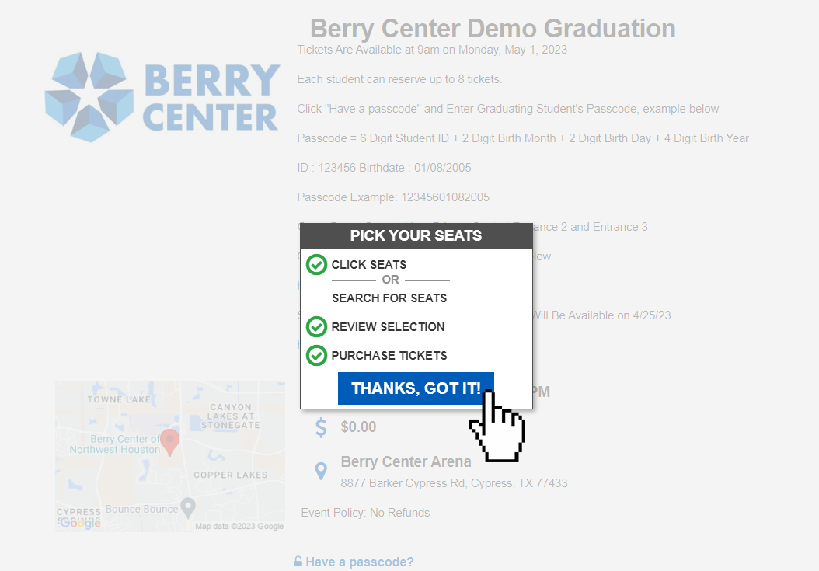
CLICK “THANKS, GOT IT”

Slide 3
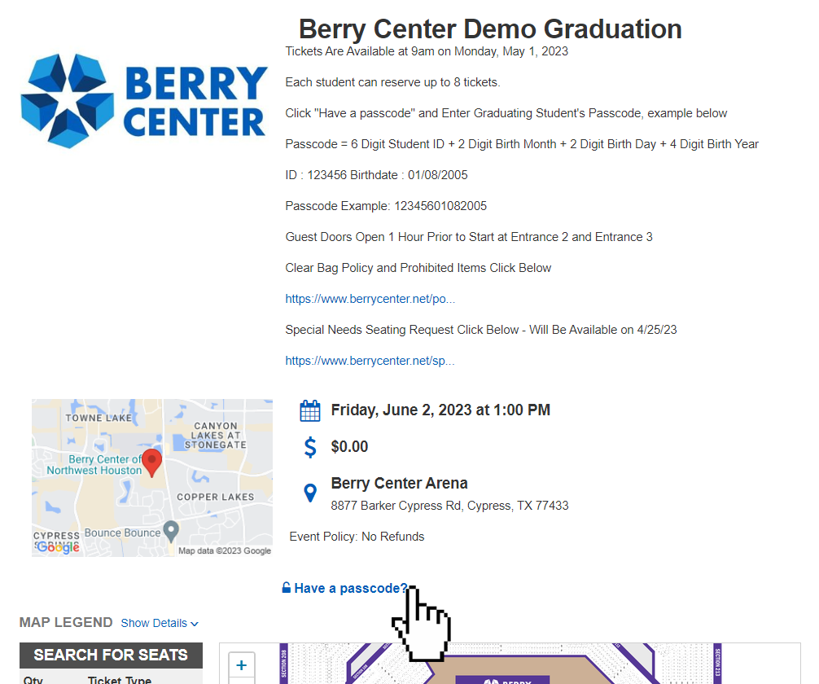
CLICK “HAVE A PASSCODE?”

Slide 4
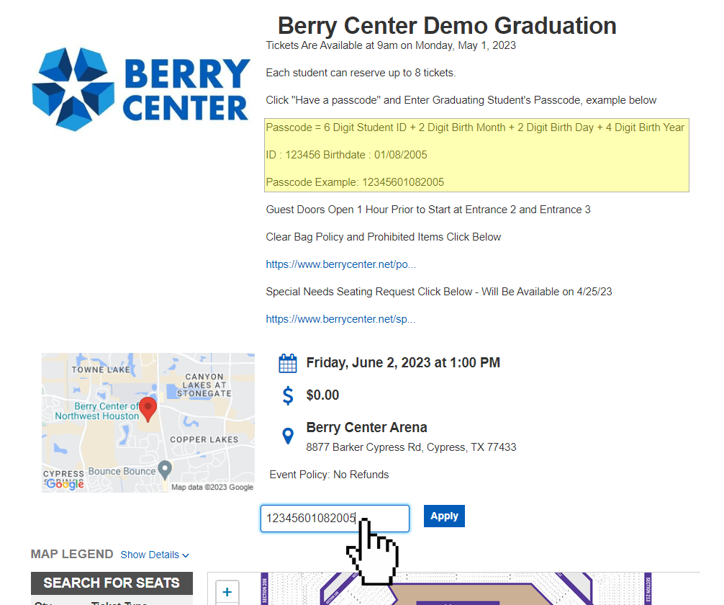
ENTER PASSCODE “STUDENT ID AND 8 DIGIT BIRTHDATE”

Slide 5
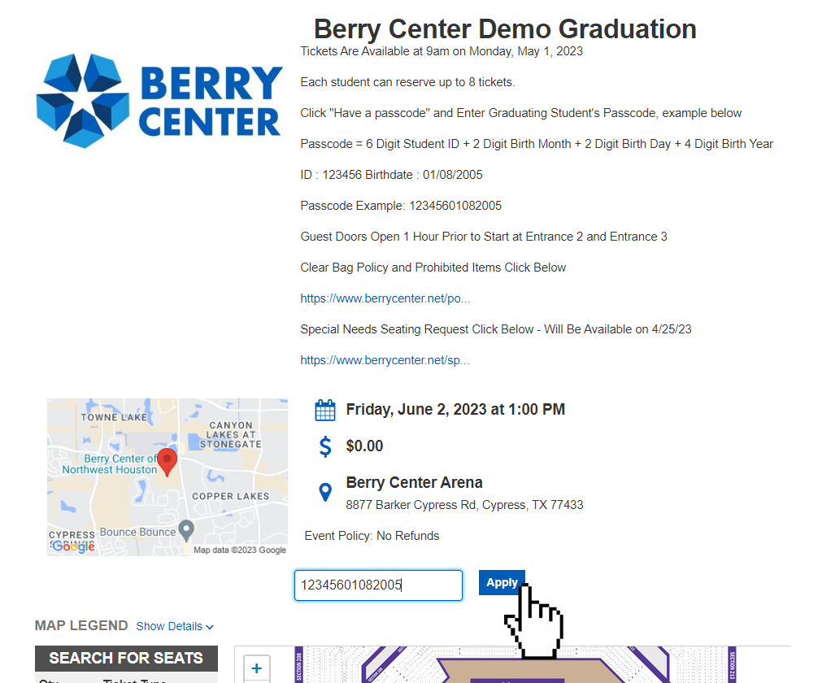
CLICK “APPLY”

Slide 6
CLICK “THANKS, GOT IT” AGAIN

Slide 7
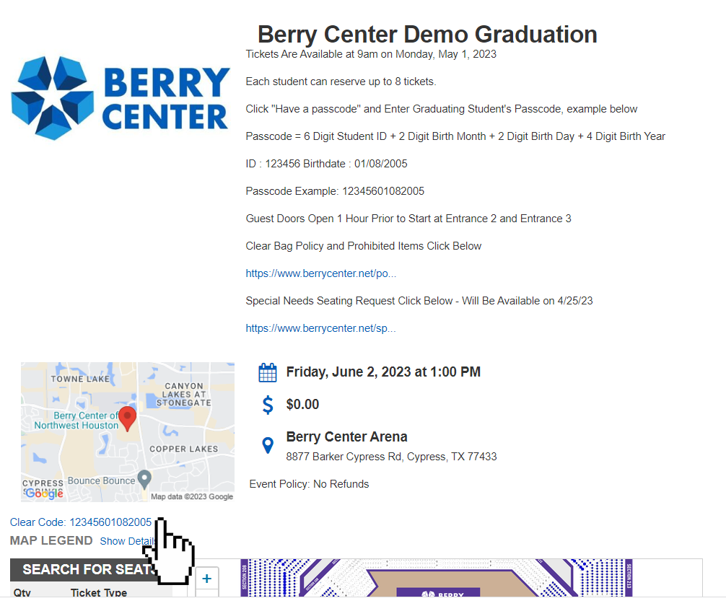
IF YOUR CODE IS CORRECT IT WILL SHOW UP BELOW THE DRIVING MAP

Slide 8
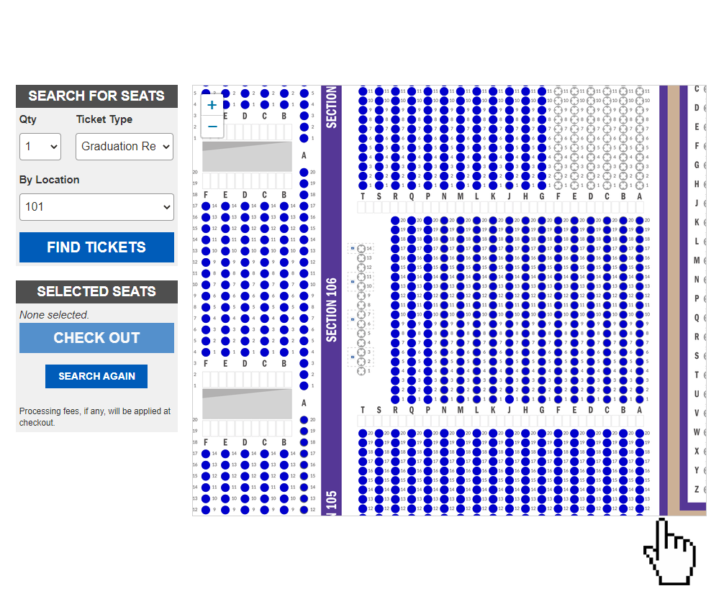
ZOOM IN ON THE MAP TO SEE SECTION NUMBERS AND AVAILABLE “BLUE” SEATS

Slide 9
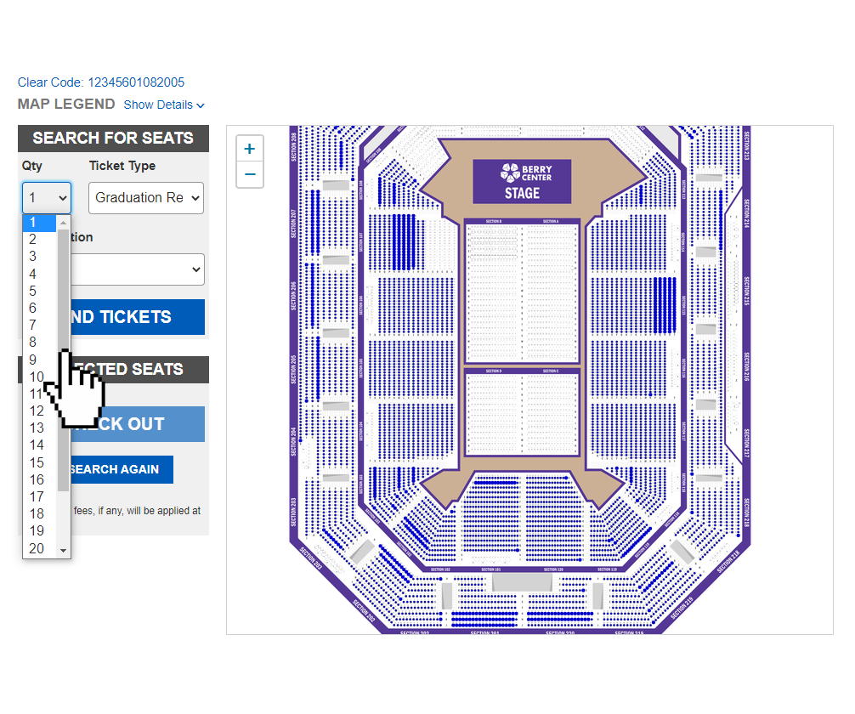
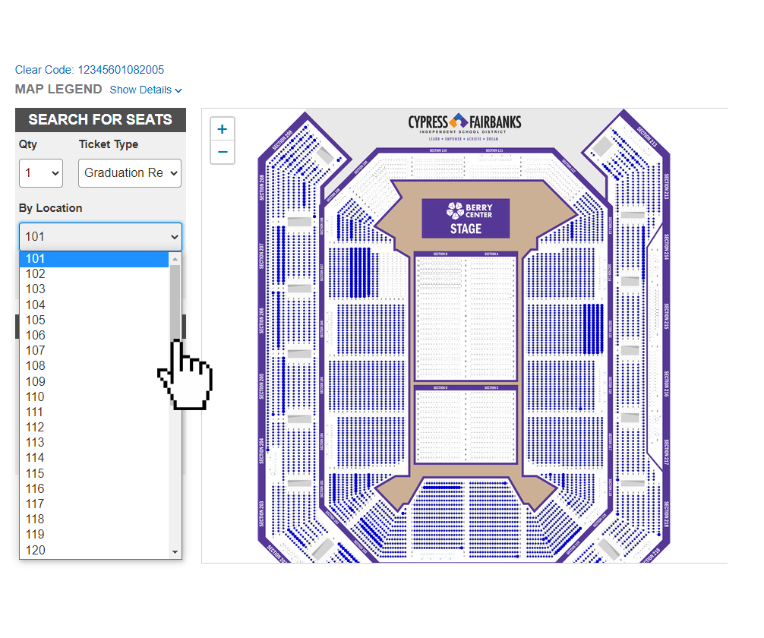
FASTEST WAY TO RESERVE, SELECT THE QUANTITY AND SECTION YOU WANT TO SIT AND CLICK “FIND TICKETS”

Slide 10
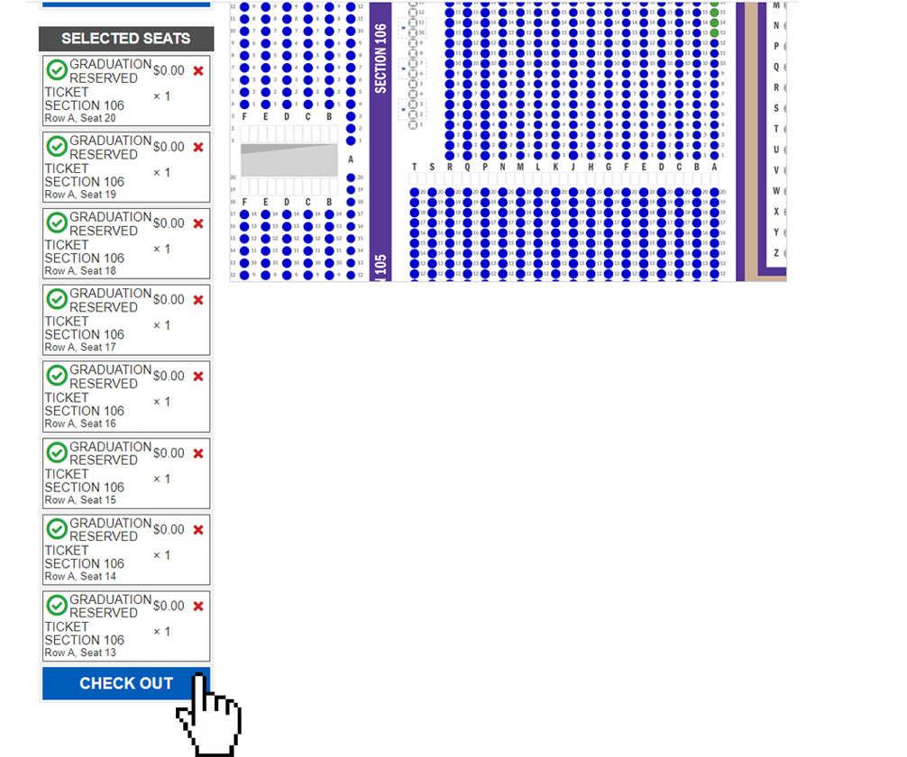
CLICK “CHECKOUT”
IF THERE ARE SEATS NEXT TO EACH OTHER IN THE SAME ROW FOR THE NUMBER YOU REQUEST, THE SYSTEM WILL SELECT THEM FOR YOU
ALL OF THE SELECTED SEATS WILL SHOW UP IN THE SELECTED SEATS PORTION FOR YOU TO REVIEW PRIOR TO CLICKING “CHECKOUT”
THE SEATS IN THE SELECTED SEATS SECTION ARE NOT IN YOUR CART YET. YOU WILL HAVE TO CLICK “CHECK OUT” TO CONFIRM THE SEATS.
IF SOMEONE HAS ALREADY CHECKED OUT WITH 1 OR MORE OF THE SEATS THAT YOU HAVE SELECTED YOU WILL HAVE TO RESTART THE PROCESS TO SELECT NEW SEATS.

Slide 11
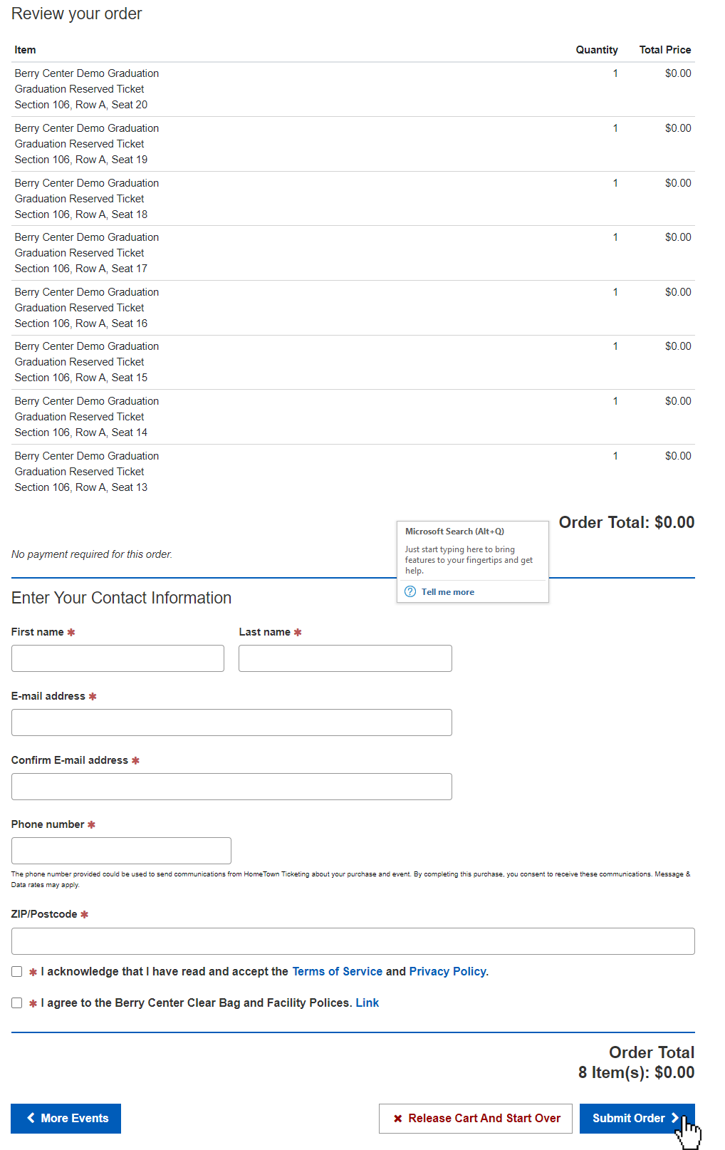
REVIEW YOUR SEATS AND ENTER YOUR CONTACT INFORMATION BEFORE CLICKING “SUBMIT ORDER”

Slide 12
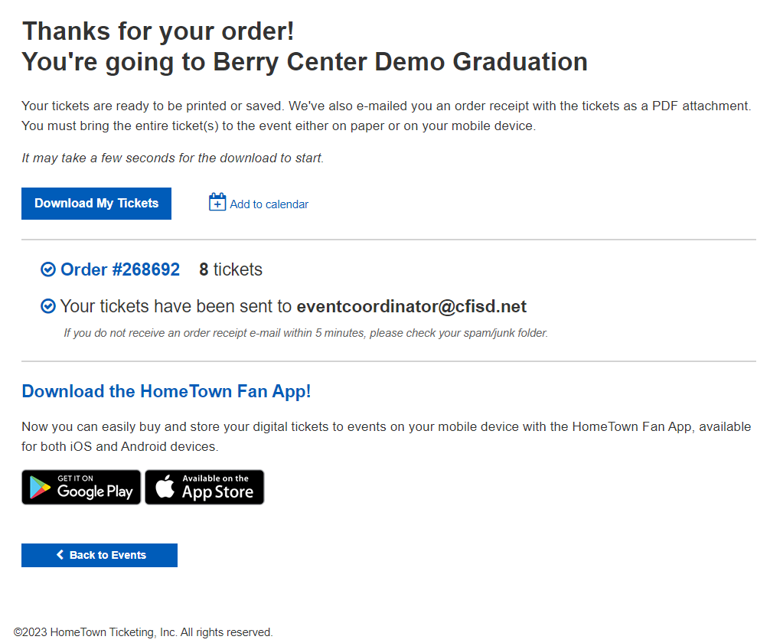
YOU WILL BE TAKEN TO THE CONFIRMATION SCREEN AND YOUR TICKETS WILL BE EMAILED TO YOU

Slide 13
TO SELECT SPECIFIC SEATS, ZOOM IN ON THE MAP

Slide 14
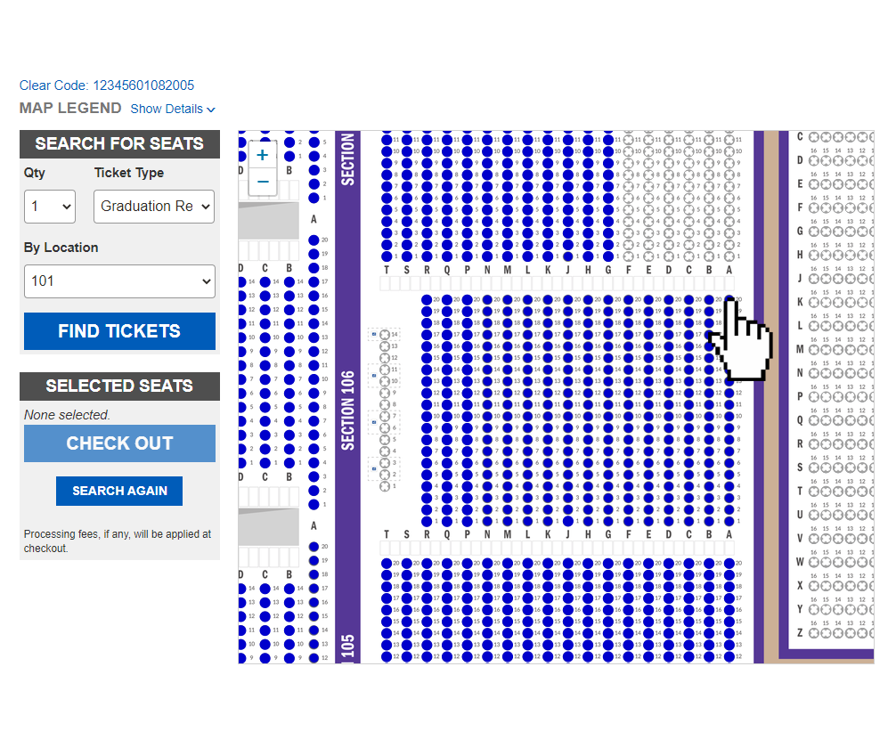
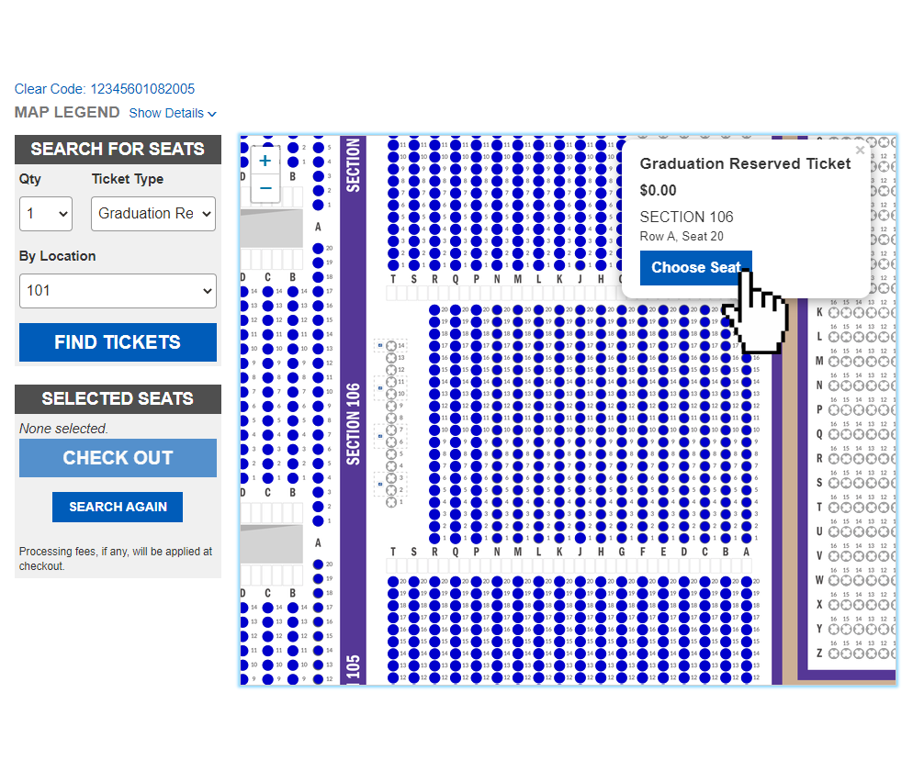
CLICK THE AVAILABLE “BLUE” SEAT THEN CLICK “CHOOSE SEAT” FOR EACH SEAT

Slide 15
CLICK “CHECKOUT” AND THIS WILL OFFICIALLY PUT THE SEATS ON HOLD FOR YOU IN YOUR CART
ALL OF THE SELECTED SEATS WILL SHOW UP IN THE SELECTED SEATS PORTION FOR YOU TO REVIEW PRIOR TO CLICKING “CHECKOUT”
THE SEATS IN THE SELECTED SEATS SECTION ARE NOT IN YOUR CART YET. YOU WILL HAVE TO CLICK “CHECK OUT” TO CONFIRM THE SEATS.
IF SOMEONE HAS ALREADY CHECKED OUT WITH 1 OR MORE OF THE SEATS THAT YOU HAVE SELECTED YOU WILL HAVE TO RESTART THE PROCESS TO SELECT NEW SEATS.

Slide 16
REVIEW YOUR SEATS AND ENTER YOUR CONTACT INFORMATION BEFORE CLICKING “SUBMIT ORDER”

Slide 17
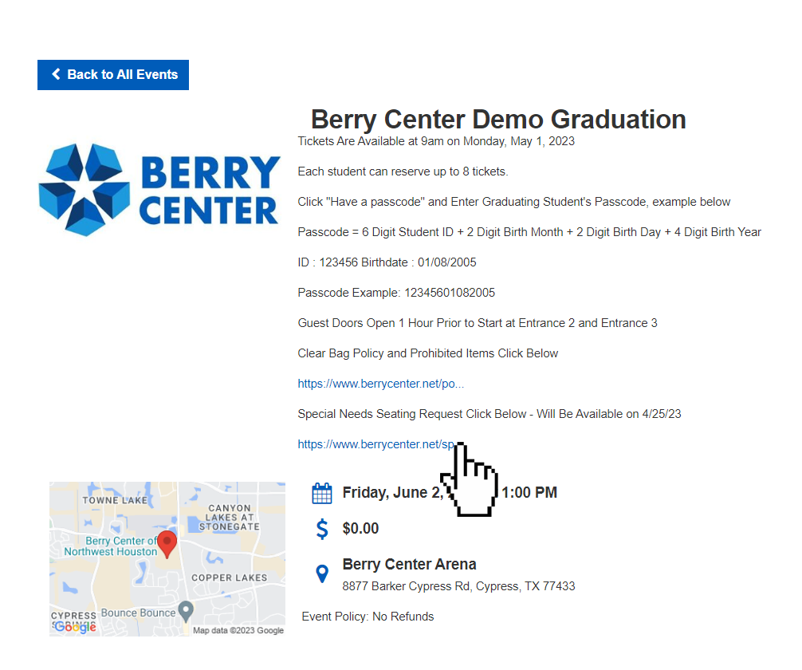
SELECTING SPECIAL NEEDS SEATING: CLICK “SPECIAL NEEDS SEATING REQUEST LINK”

Slide 18
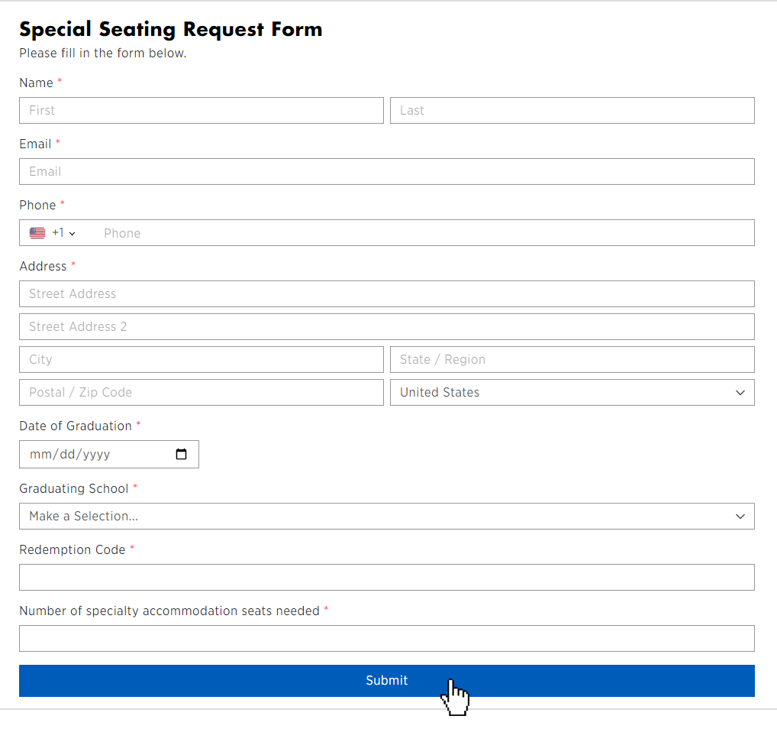
FILL OUT THE ENTIRE FORM AND CLICK “SUBMIT” OUR STAFF WILL CONTACT YOU TO FULFILL YOUR ORDER

Slide 19
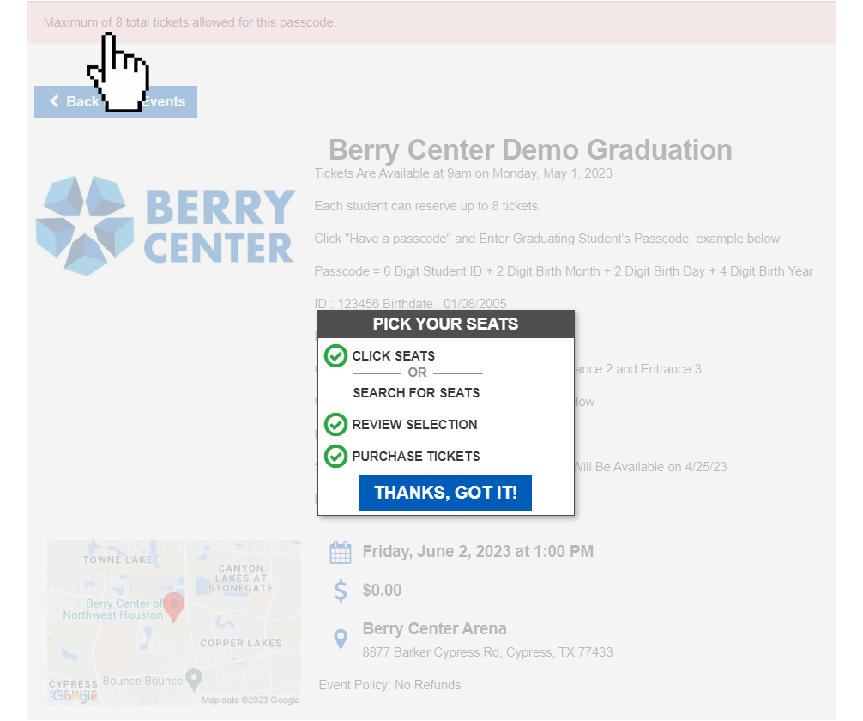
TROUBLESHOOTING : ERROR MESSAGE AFTER CLICKING “CHECK OUT”
ALL GRADUATES ARE LIMITED IN THE MAXIMUM NUMBER OF TICKETS ACROSS ALL ORDERS
IF YOU EXCEED THE MAXIMUM IN ANY ORDER WHEN YOU CLICK CHECK OUT, YOU WILL NOT BE ALLOWED TO COMPLETE YOUR ORDER AND WILL BE PROMPTED BY THIS MESSAGE AT THE TOP OF THE SCREEN
YOU WILL NEED TO REPEAT THE PROCESS AND SELECT FEWER TICKETS TO NOT EXCEED THE MAXIMUM ALLOTTED TO THE STUDENT

Slide 20
IF YOU ARE HAVING ISSUES, CALL THE BERRY CENTER OFFICE AT (281) 894-3900

