Slide 1
Sept. 21, 2014
International Travel Orientation
Office of Risk Management
2022

Slide 2
LSC Travel Abroad Insurance
In this segment of training, you will learn the following:
LSC Travel Abroad Insurance requirement;
Enrollment process for Travel Abroad Insurance;
Helpful Tools for Travel Abroad ; and
Contact information for the Office of Risk Management
Notes:
In this segment of training, you will review the following information:
Travel Abroad Insurance requirement;
Enrollment process for Travel Abroad Insurance;
Helpful Tools for Travel Abroad ; and
Contact information for the Office of Risk Management

Slide 3
Introduction
Effective evaluation of potential risks and proper preparation to mitigate those risks is necessary to maintain the safety of faculty, staff and students.
During your travel planning stage you may need to consult several areas of expertise:
Risk Management;
Office of Emergency Management;
International Programs;
Administrative Services;
Student Success;
Instruction; and
Office of General Counsel;
In planning and implementing an international trip you are often asked to be a travel agent, bookkeeper, safety officer, first aid administrator, and 24-hour companion!
Notes:
LSC offers international travel opportunities for our students, faculty and staff, so it is important to recognize and properly evaluate the risks that are inherent with these opportunities.
Effective evaluation of potential risks and being prepared to properly mitigate those risks is necessary to maintain the safety of faculty, staff and students. Risk Management is everyone’s responsibility.
You may need to consult several areas of expertise during the travel planning stage. These areas may include many different departments such as: Risk Management, Administrative Services, Student Success, Instruction, Office of General Counsel, International Programs and the Office of Emergency Management.
Please consider when beginning to plan a trip, event, or activity, you may often be asked to be a travel agent, bookkeeper, safety officer, first aid administrator, and 24-hour companion!

Slide 4
Travel Risks
International travel comes with its own set of unique risks.
Students, faculty and staff traveling abroad may be faced with unexpected emergency situations.
Unexpected emergency situations may include accidents, disease, natural disasters, political uprisings and more.
Notes:
Lone Star College students, faculty and administration members traveling abroad may be faced with unexpected emergency situations during overseas travel – like accidents, disease, natural disasters, political uprisings and more. As we’ve seen with the recent COVID-19 pandemic, these situations can become very serious very quickly.
It is very important for LSC travel to be properly documented and registered before leaving for your destination. Documentation prior to the trip assures the traveler’s supervisor and/or department head is aware of the activity, funds are available for reimbursement of expenses, travel is allowable on the funds, traveler is covered under worker compensation insurance, and enrollment in the LSC Travel Abroad Insurance Plan.
The Office of Risk Management (ORM) maintains the LSC travel registry and the LSC Travel Abroad Insurance Plan.

Slide 5
LSC Travel Aboard Insurance Plan
LSC requires all Faculty, Staff or Students traveling aboard in affiliation with the College to participate in the LSC Travel Abroad Insurance Plan. All students are strongly encouraged to maintain their U.S. health insurance coverage in case treatment is necessary upon return to the United States.
The 2022 cost for the insurance is $1.57 per enrolled person per day.
The LSC Travel Abroad Insurance Plan covers accident and sickness, evacuation, and repatriation insurance for all students registered with the LSC, traveling outside of the United States for LSC sponsored study abroad trip and all employees of the LSC traveling outside of the United States for (i) study abroad programs and (ii) any business related to LSC.
The international trip must be registered in the Office of Risk Management (ORM).
Notes:
LSC requires all Faculty, Staff or Students traveling aboard, in affiliation with the College, to be purchase and enroll in the LSC Travel Abroad Insurance Plan. Cost for the insurance plan is $1.57 per enrolled person per day.
The LSC Travel Abroad Insurance Plan includes accident and sickness, evacuation, and repatriation insurance. Coverage is for all students registered with the LSC, traveling outside of the United States for LSC sponsored study abroad trip and all employees of the LSC traveling outside of the United States for (i) study abroad programs and (ii) any business related to LSC. The insurance is provided by UnitedHealthcare Global (UHCG).
In order to purchase and enroll in the LSC Travel Abroad Insurance Plan, the international trip must be registered in the Office of Risk Management (ORM).

Slide 6
Enrollment Process
Enrollment is managed by the LSC Office of Risk Management.
Enrollment Process:
To activate travel abroad insurance coverage, the Trip Plan and Trip Roster form must be completed; and
2. The completed form must be submitted to the LSC Office of Risk Management at LSC-RiskManagement@LoneStar.edu
Notes:
The enrollment process includes two (2) steps:
To enroll you must complete the Trip Plan and Roster form, #ORM-T-2013-02A; and
2. Send the completed form to the Office of Risk Management at RiskManagement@LoneStar.edu
In order to ensure participants are enrolled with the Travel Abroad Insurance Plan and listed in the LSC travel registry, 30 days prior to departure, the Trip Plan and Roster form must be received by the Office of Risk Management. This allows the Office of Risk Management to review the form and request additional information if necessary.
The Office of Risk Management (ORM) maintains the LSC travel registry and the LSC Travel Abroad Insurance Plan

Slide 7
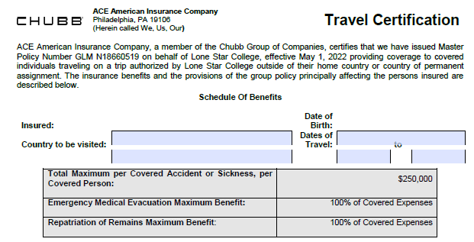
Additional Requirements Enrollment
Open and print the Travel Assistance Program Insurance ID Card.
2. Read, understand and print Travel Assistance Services Document and the Summary of Benefits Document; and
3. Fill out the Chubb Travel Certification.
Notes:
1. Now that you have completed the enrollment process, the first additional step you need to complete is to open up the Chubb ID Card and print the card. You may want to make several copies to keep in various places. I will email a copy to everyone on call after meeting.
2. I will also send everyone a copy of the Travel Assistance Services Document & Summary of Benefits Document that contains detailed summaries of coverages and definitions of those coverages.
3. Fill out the Chubb Travel Certification for each participant.

Slide 8
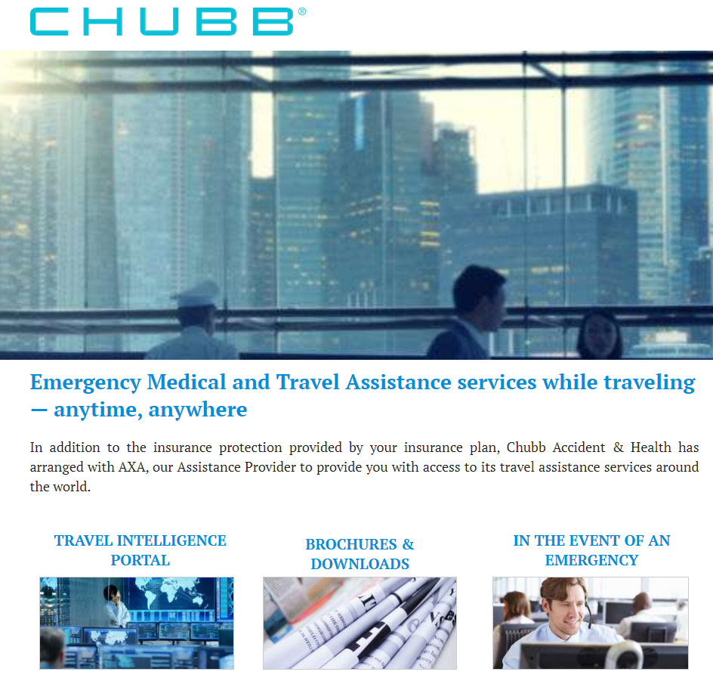
Additional Requirements Enrollment
Travelassistance.chubb.com
Notes:
We also recommend that all parties visit travelassistance.chubb.com for access to global threat assessments and location based intelligence portal.
Participants will be able to create a Travel Intelligence Portal, which offers personalized intelligence for the life cycle of your trip. You can access real-time destination-based tips, alerts, country and city risk analysis, and an international medical network and more.

Slide 9
In Case of Emergency
In case of an emergency:
If life-threatening emergency, contact local emergency number. Please take time to learn your destination’s emergency number before you travel.
Contact Chubb’s Travel Assistance Services’ 24-Hour Access.
Advise LSC Office of Risk Management of the emergency at 832-813-6752; LSC-RiskManagement@Lonestar.edu.
Advise LSC Police Department of the emergency at 281-290-5911; LSC-Police@Lonestar.edu.
Notes:
Should there be an emergency during International Travel, please contact the following parties.

Slide 10
Mitigate Risk
Research your destination
Monitor Travel Alerts and Warnings and Travel Health Notices regularly for your destination.
Learn about your destination’s Risks, Visa, Passport and Vaccination requirements.
Learn about your destination’s Embassy.
Review a Traveler’s Checklist
Pack
Pack Smart. Pack light, make sure you are not carrying banned items or substances, and have vital documents within reach.
Pack a travel health kit.
Take care of health matters and follow health and safety best practices
Talk to your doctor about vaccines recommended for your destination.
Learn how to transport your medication. Check with your destination’s embassy here in the U.S.
Follow safety and security recommendations, reduce exposure to illness and be transportation smart.
Notes:
Mitigate risk for your international travel by researching your destination, packing appropriately, taking care of health matters and follow health and safety best practices.

Slide 11
Helpful Tools
Smart Traveler Enrollment Program (STEP) U.S. Department of Homeland Security U.S. Department of State – Passports & International Travel U.S. Passports & International Travel – Worldwide Caution Center for Disease Control and Prevention (CDC) – Traveler’s Health Chubb Travel Assistance Services
Office of Risk Management (ORM) Website
Notes:
Critical information for your international travel is available on these helpful links.

