Slide 1
Lab 12 : Part 6
Parasitic Worms and Arthropod Vectors

Slide 2
Prepared Slides

Slide 3
Playhelminths (flatworms)

Slide 4
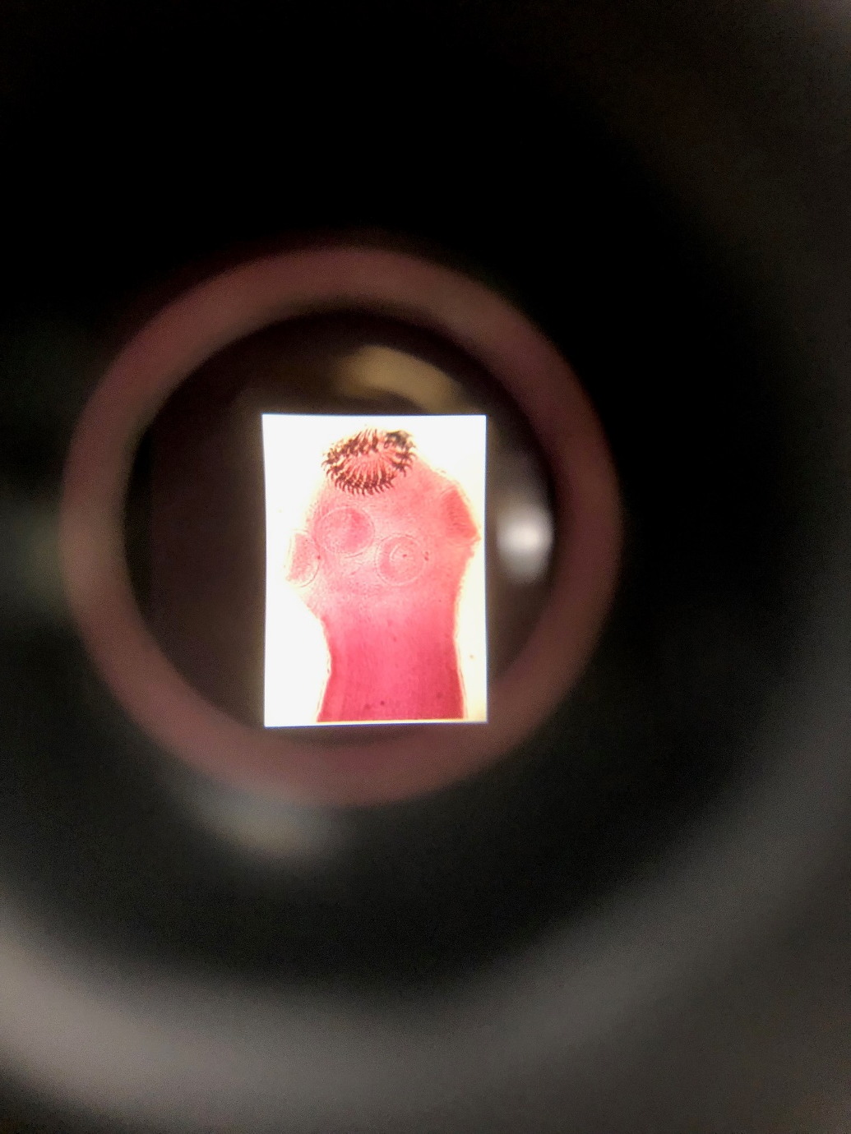
Taenia (TAPWORM) SCOLEX
The anterior scolex region attaches the tapeworm to the intestinal lining with hooks (H) and suckers (S). Immature reproductive segments called proglottids (P) continually bud at the base at the base of the scolex.
H
S
P

Slide 5
Taenia (TAPWORM) SCOLEX
Label the following arrows
1
2
hooks
suckers
proglottids
3

Slide 6
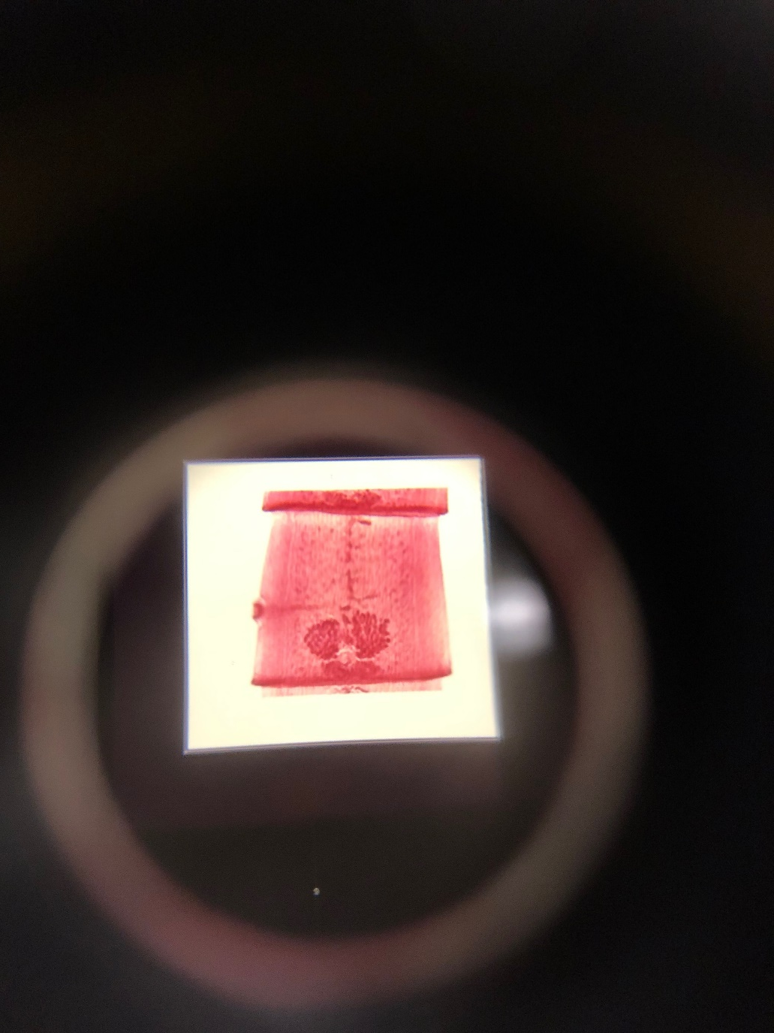
Taenia (TAPEWORM) MATURE PROGLOTTID
Tapeworms are monoecious; each mature proglottid contains ovaries (O), and numerous testes (T), a storage uterus (U) and a genital pore (G). Mature proglottids like this comprise the middle third of the worm.
U
T
G
O

Slide 7
Taenia (TAPEWORM) MATURE PROGLOTTID
Label the following arrows
ovaries
uterus
genital pore
testes
2
4
3
1

Slide 8
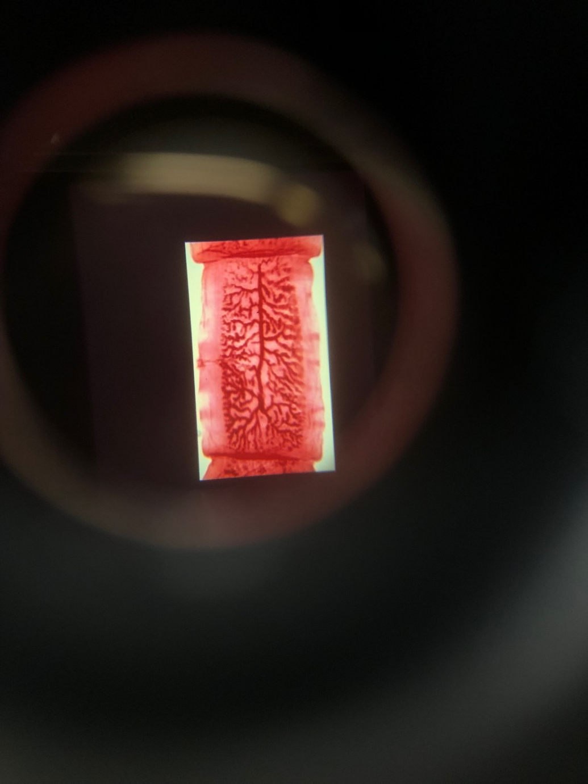
Taenia (TAPEWORM) GRAVID PROGLOTTID
Ovaries and testes degenerate following fertilization; A very expanded uterus is filled with fertilized eggs in each large, gravid proglottid. Gravid proglottids like this are at the posterior end of the worm. They break off and exit with the feces.

