Slide 1
Lab 12 : Part 7
Parasitic Worms and Arthropod Vectors

Slide 2
Nematodes (roundworms)

Slide 3
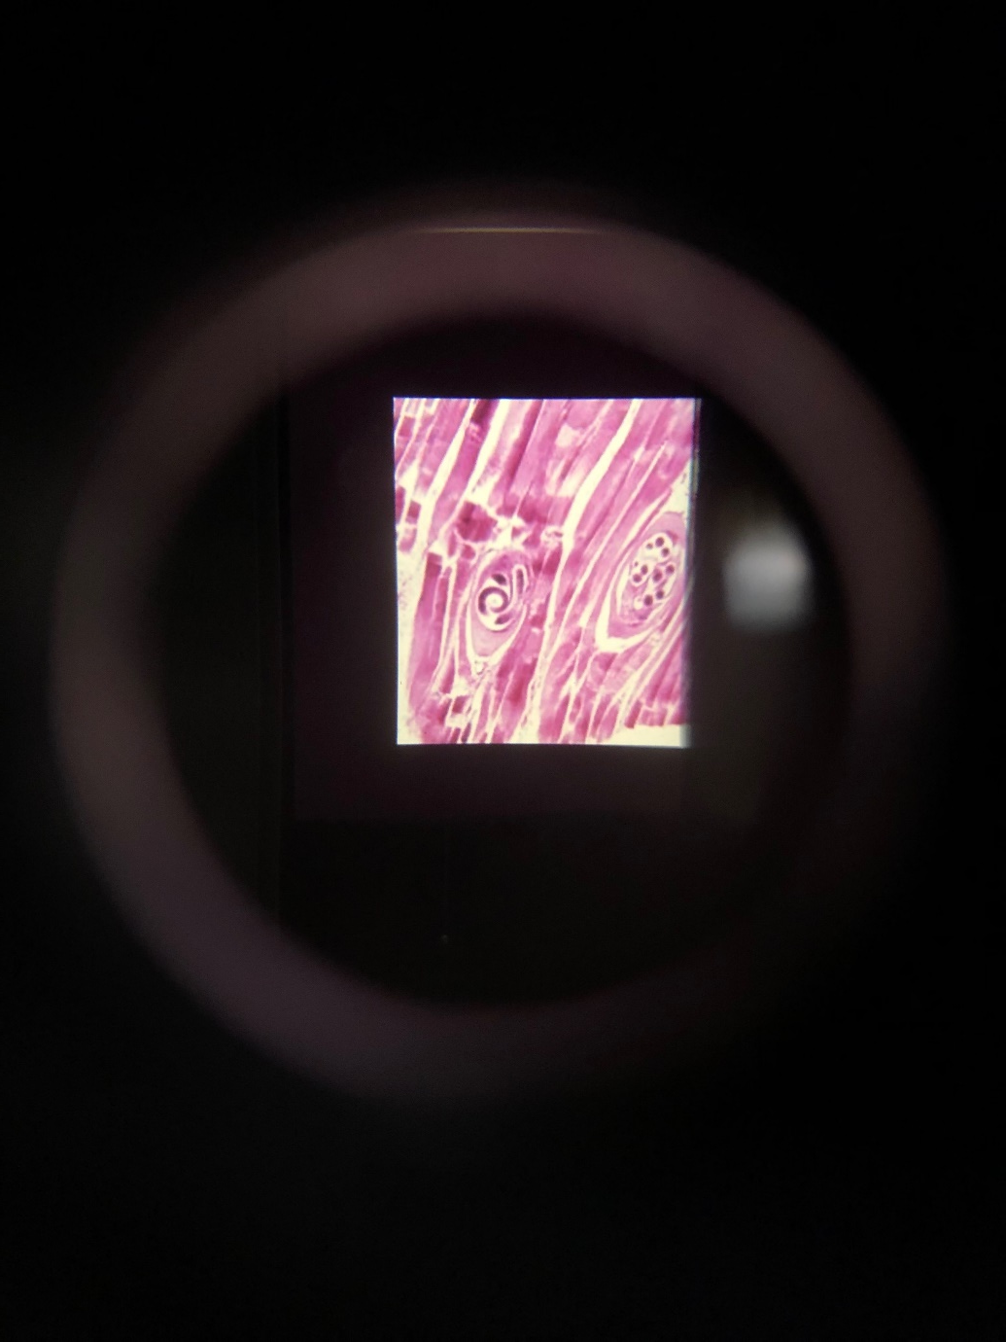
Trichinella spiralis (TRICHINA WORM) CYSTS
Ingestion of under-cooked pork containing microscopic encysted Trichinella spiralis larve results in trichinosis.

Slide 4
Arthropod Vectors
Arachnids and Insects

Slide 5
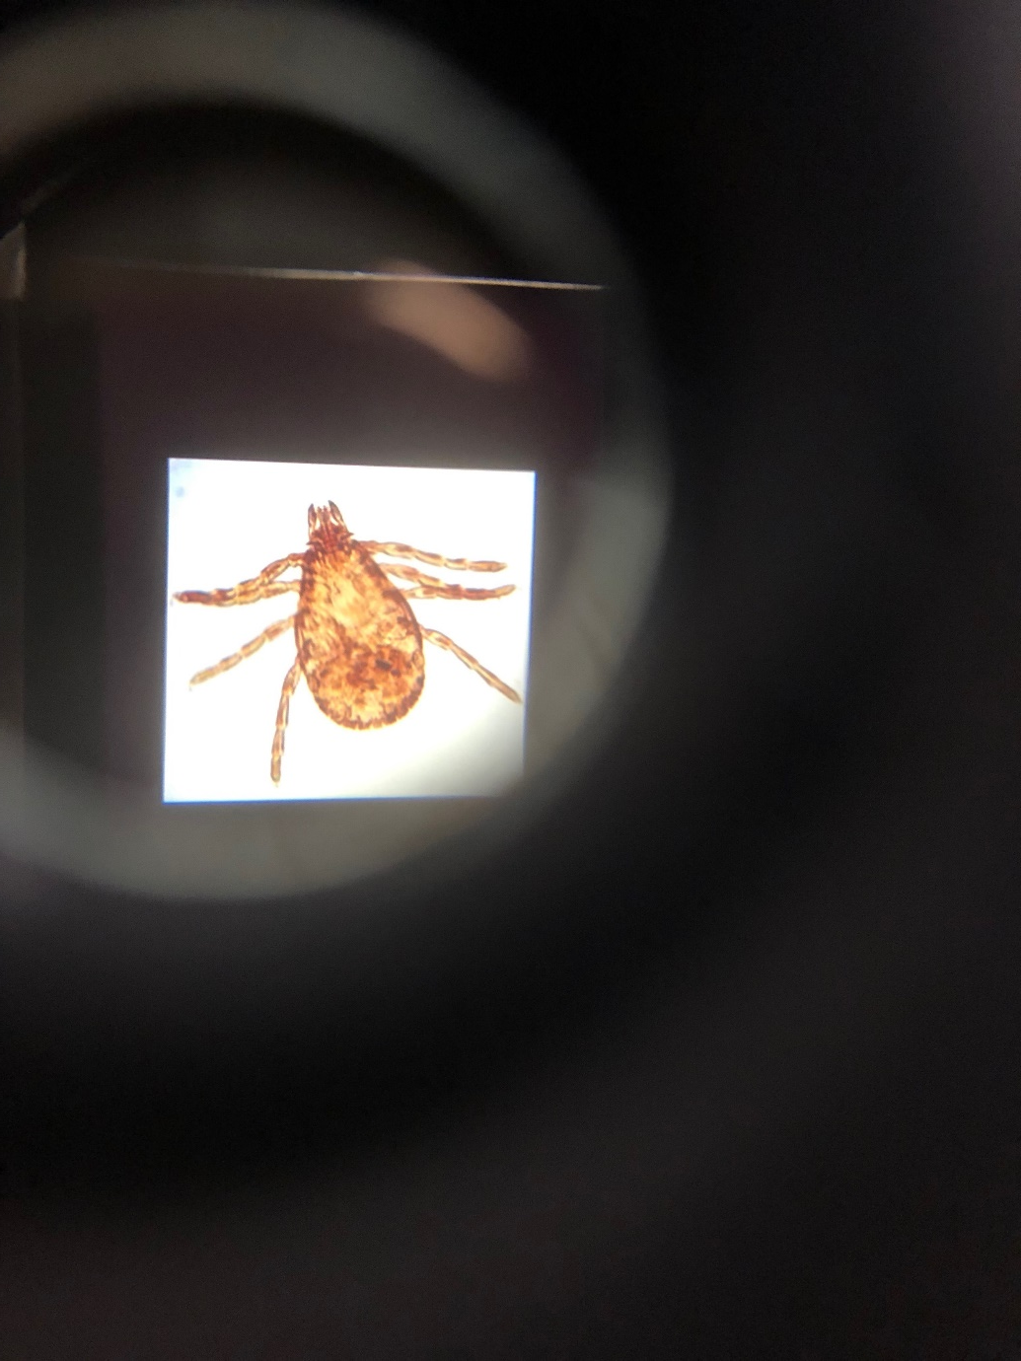
TICK
Arthropods blood-feeders such as ticks are often disease vectors. Dermacentor (dog and wood ticks) may transmit Rickettsia rickettsii, the bacterium which causes Rocky Mountain spotted fever. Ixodes (deer ticks) may transmit Borrelia burgdorferi, the bacterium which causes Lyme disease.

Slide 6
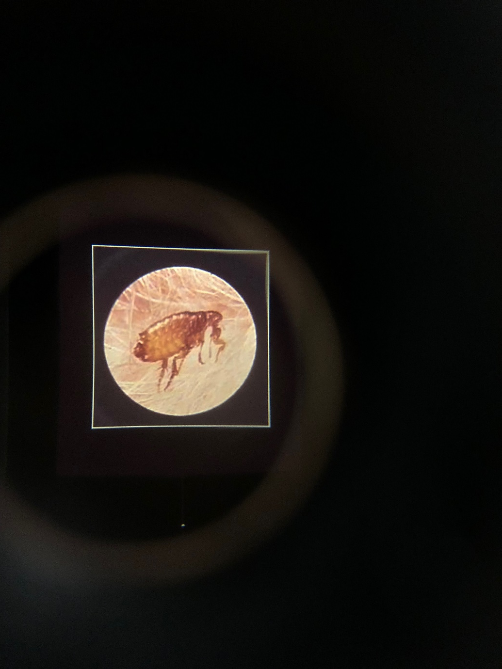
FLEA
Xenopsylla (the rat flea) was the vector for Yersinia pestis, the bacterium that caused the bubonic plague epidemic of 1350.

