Slide 1
Lab 9 – Part 2
Prokaryotes

Slide 2
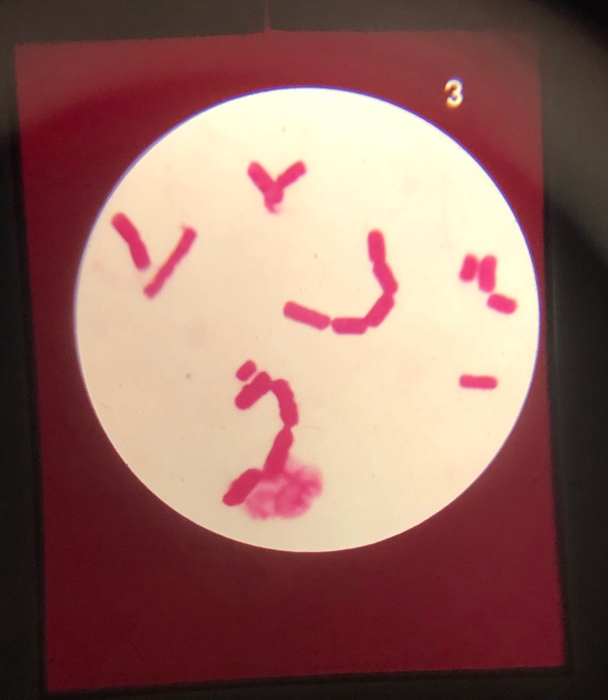
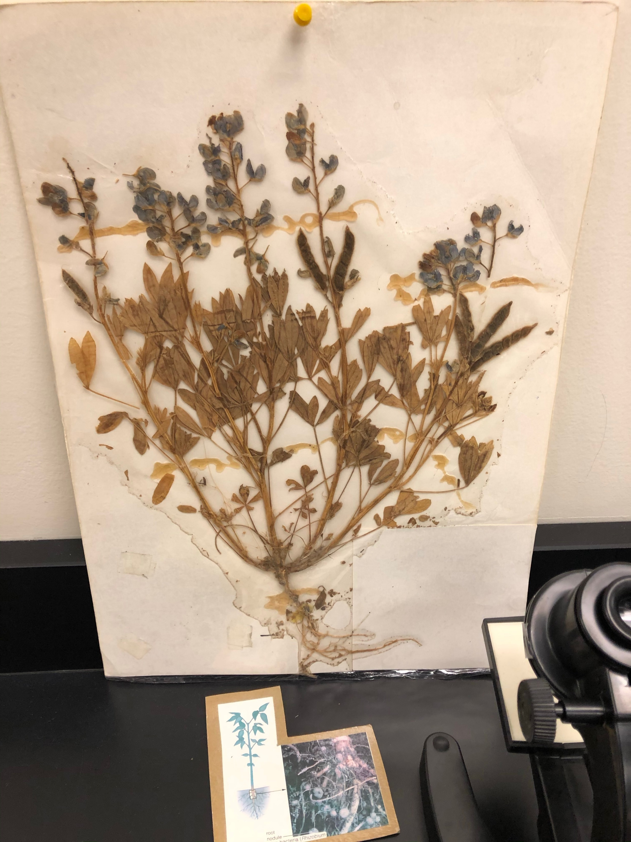
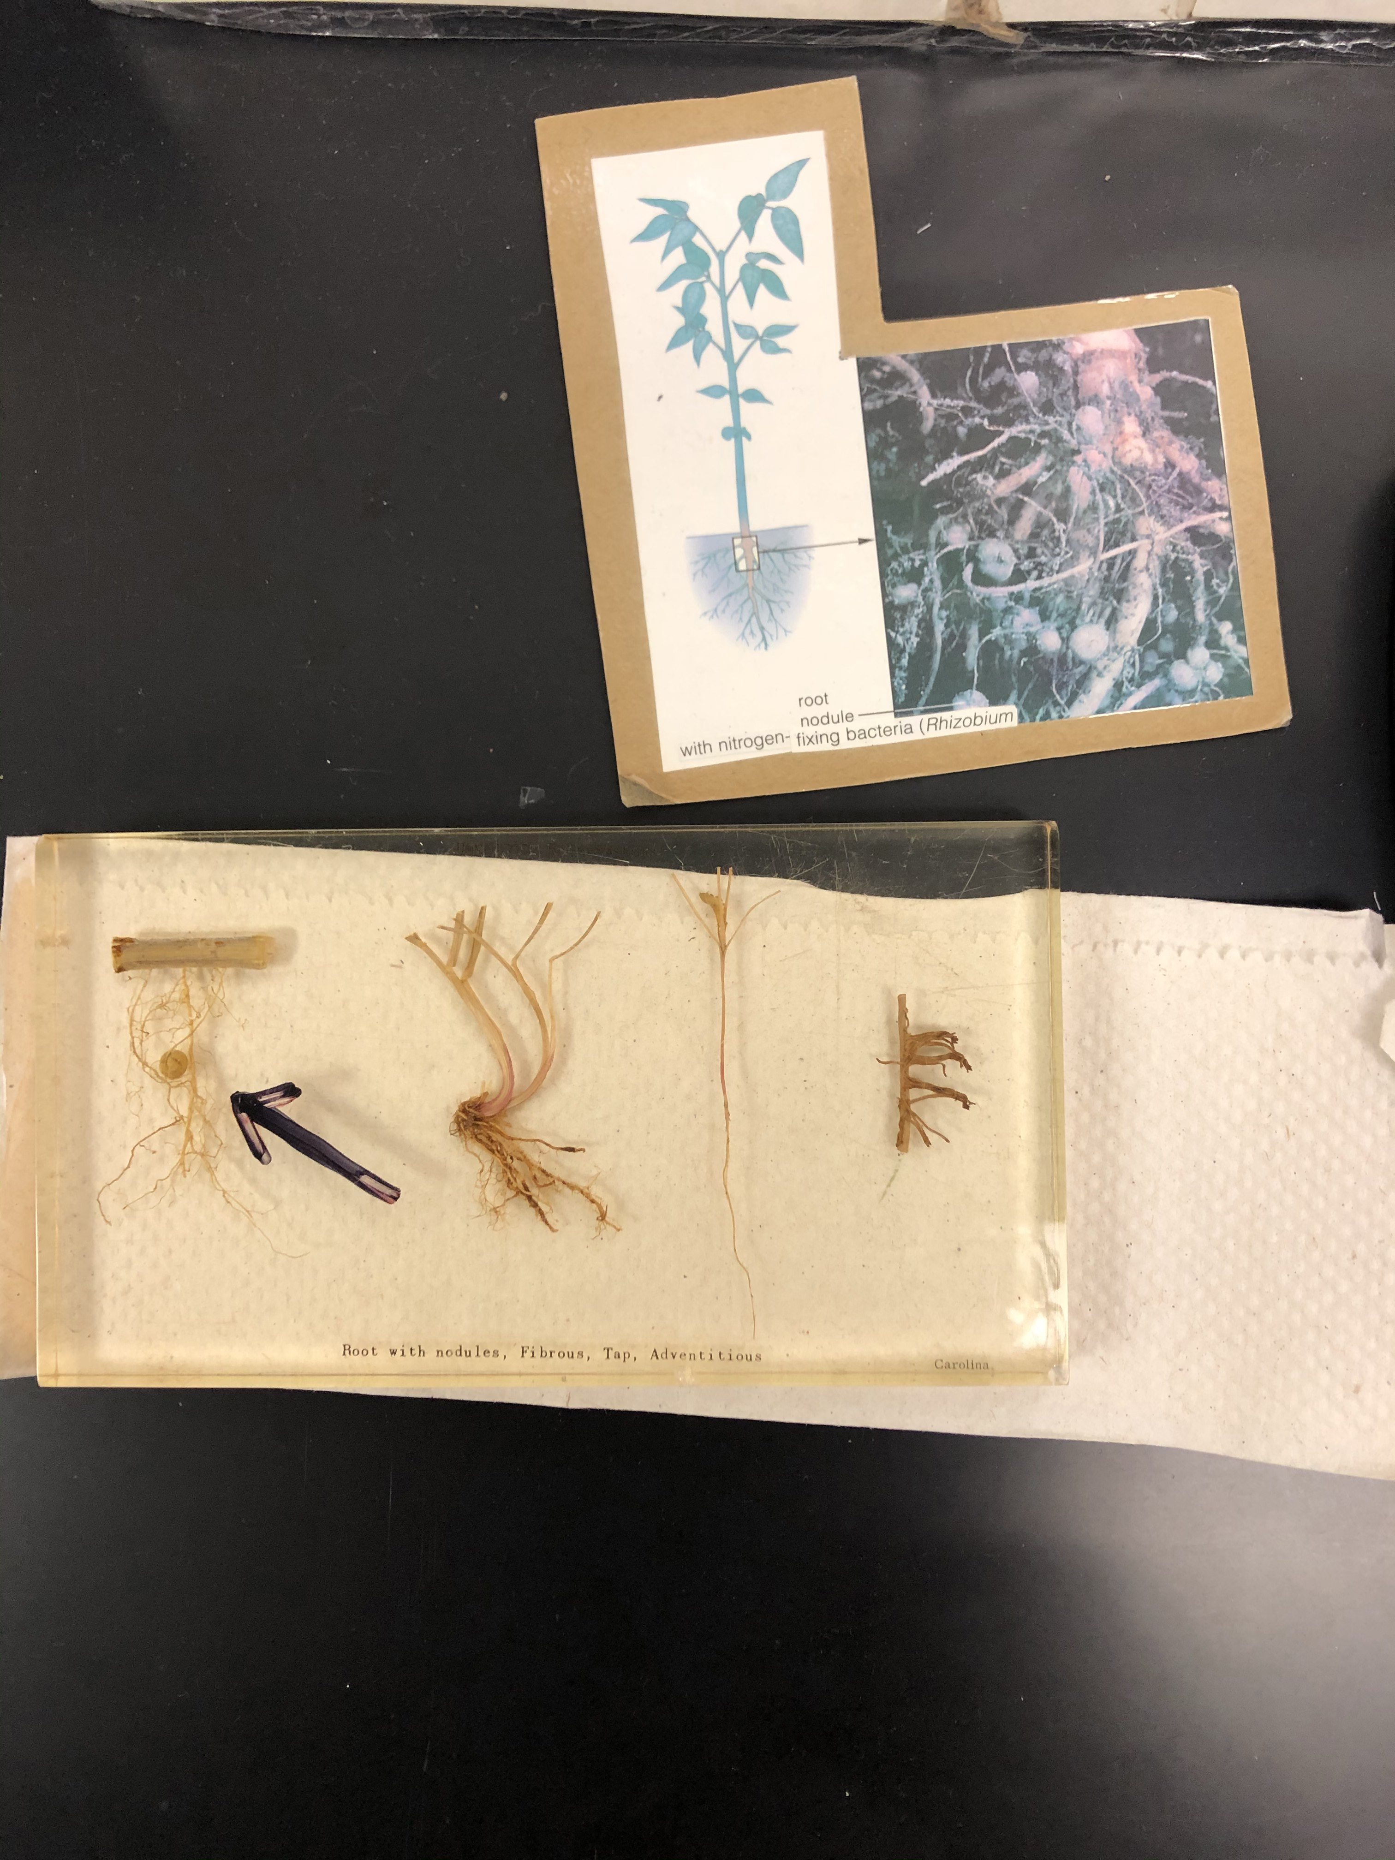
Station 4
Rhizobium is a Gram-negative bacillus that lives in legume root nodules where it undergoes nitrogen-fixation.

Slide 3
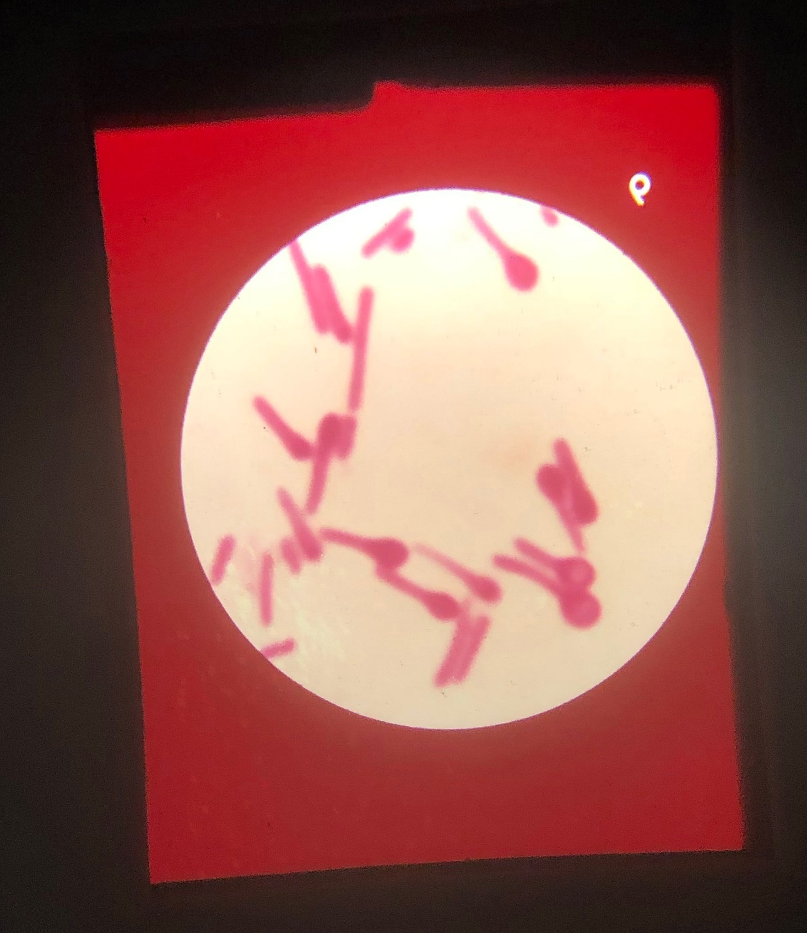
Station 5
Clostridium botulinum produces an endospore at one end of the cell, giving the cell a ‘spoon’ appearance. The botulinum neurotoxin is one of the most potent toxins known. By blocking acetylcholine release, it causes flaccid paralysis.

Slide 4
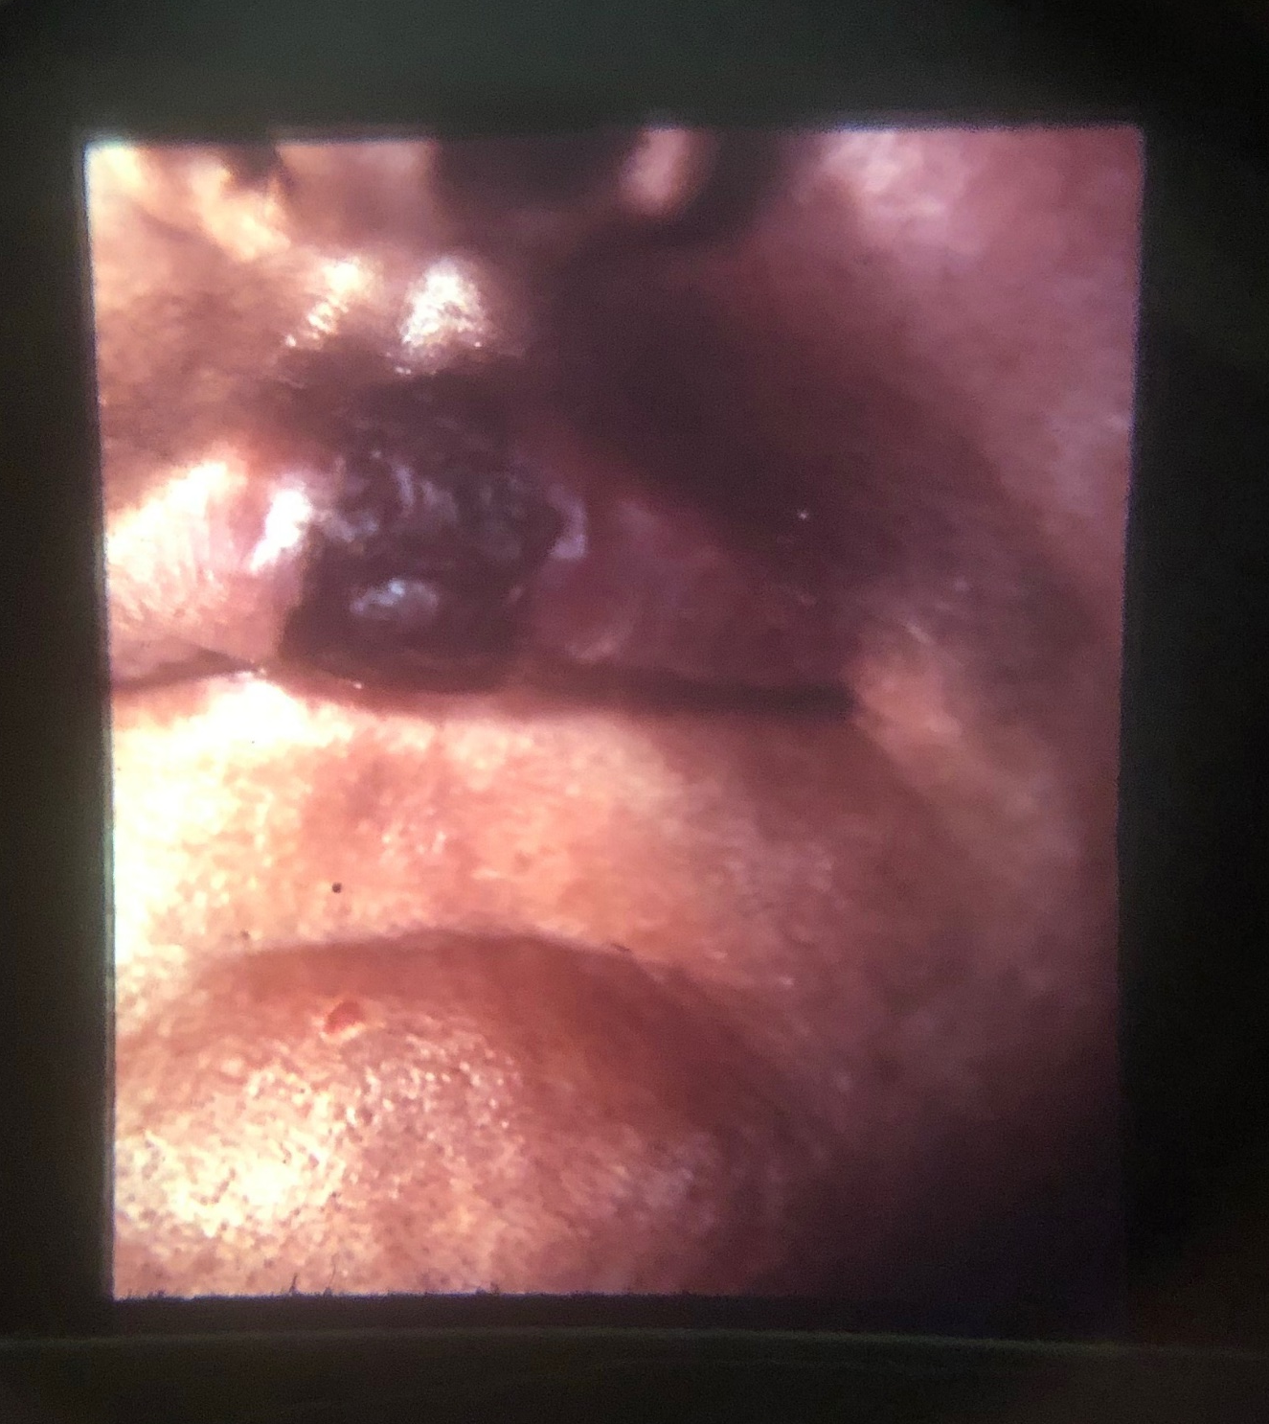
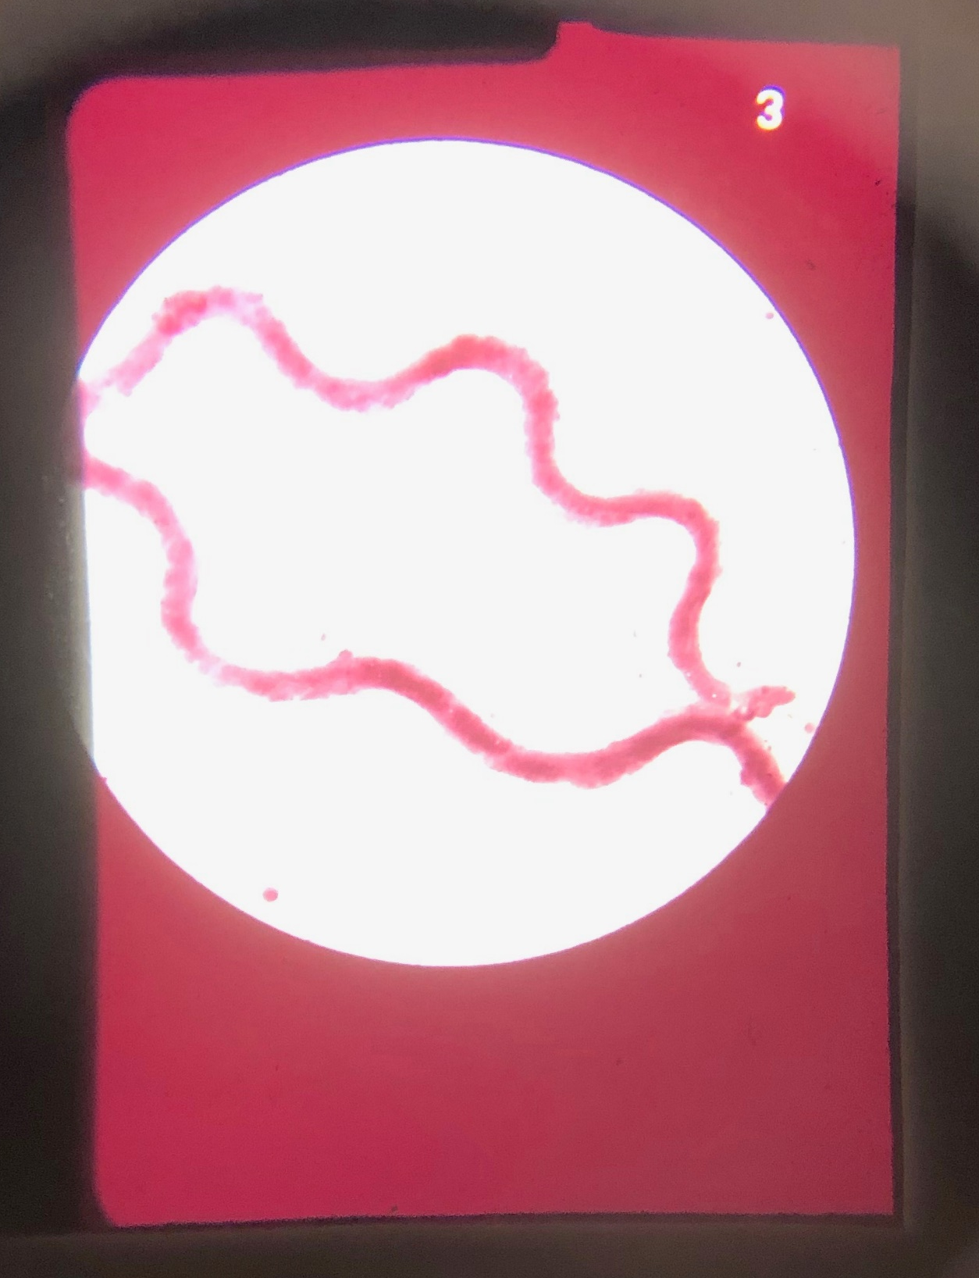
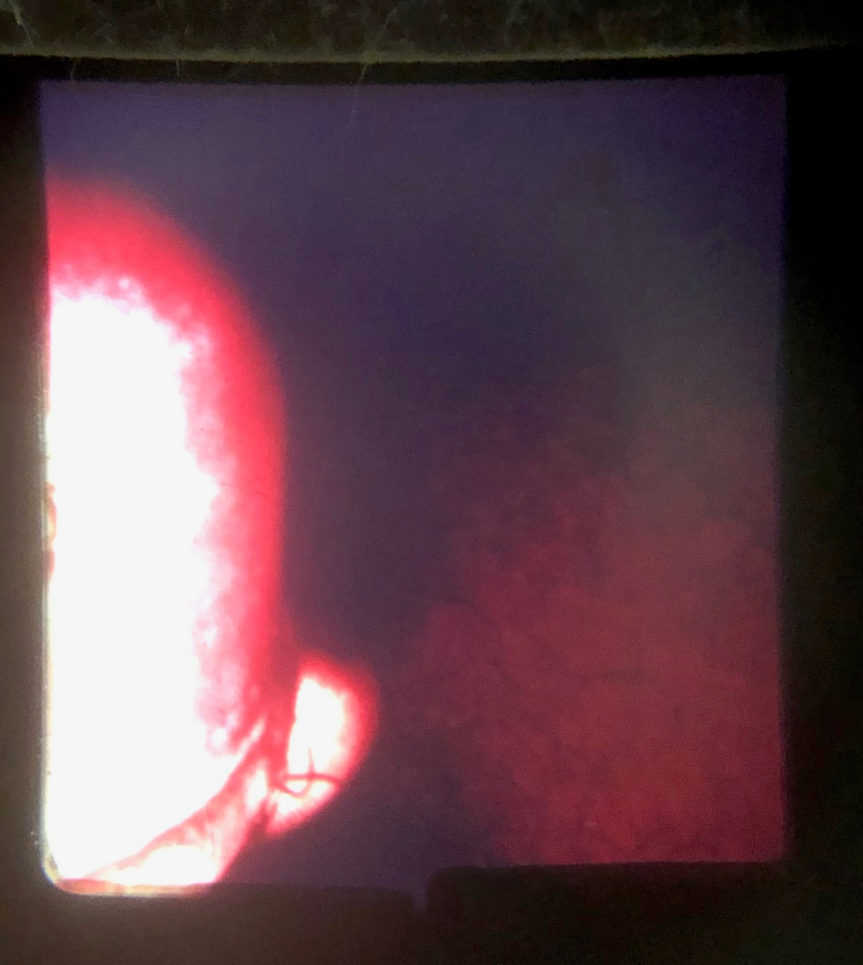
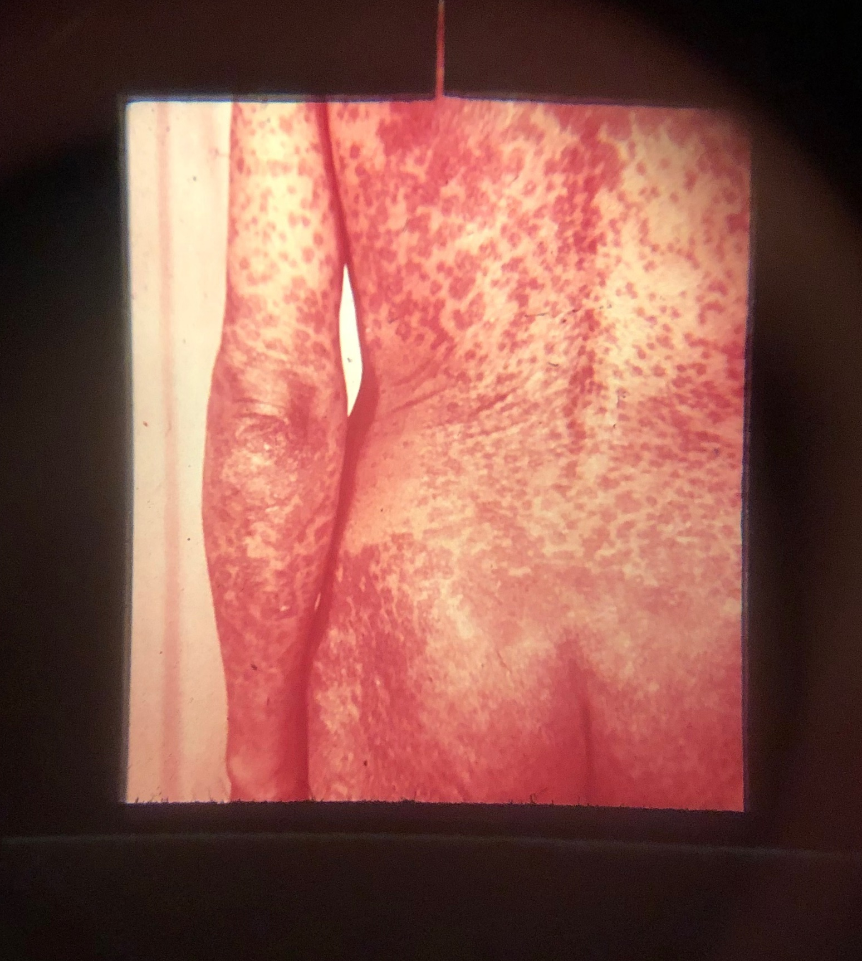
Station 6
Treponema pallidum (at 34,000x) is the spirochete that causes syphilis.

Slide 5
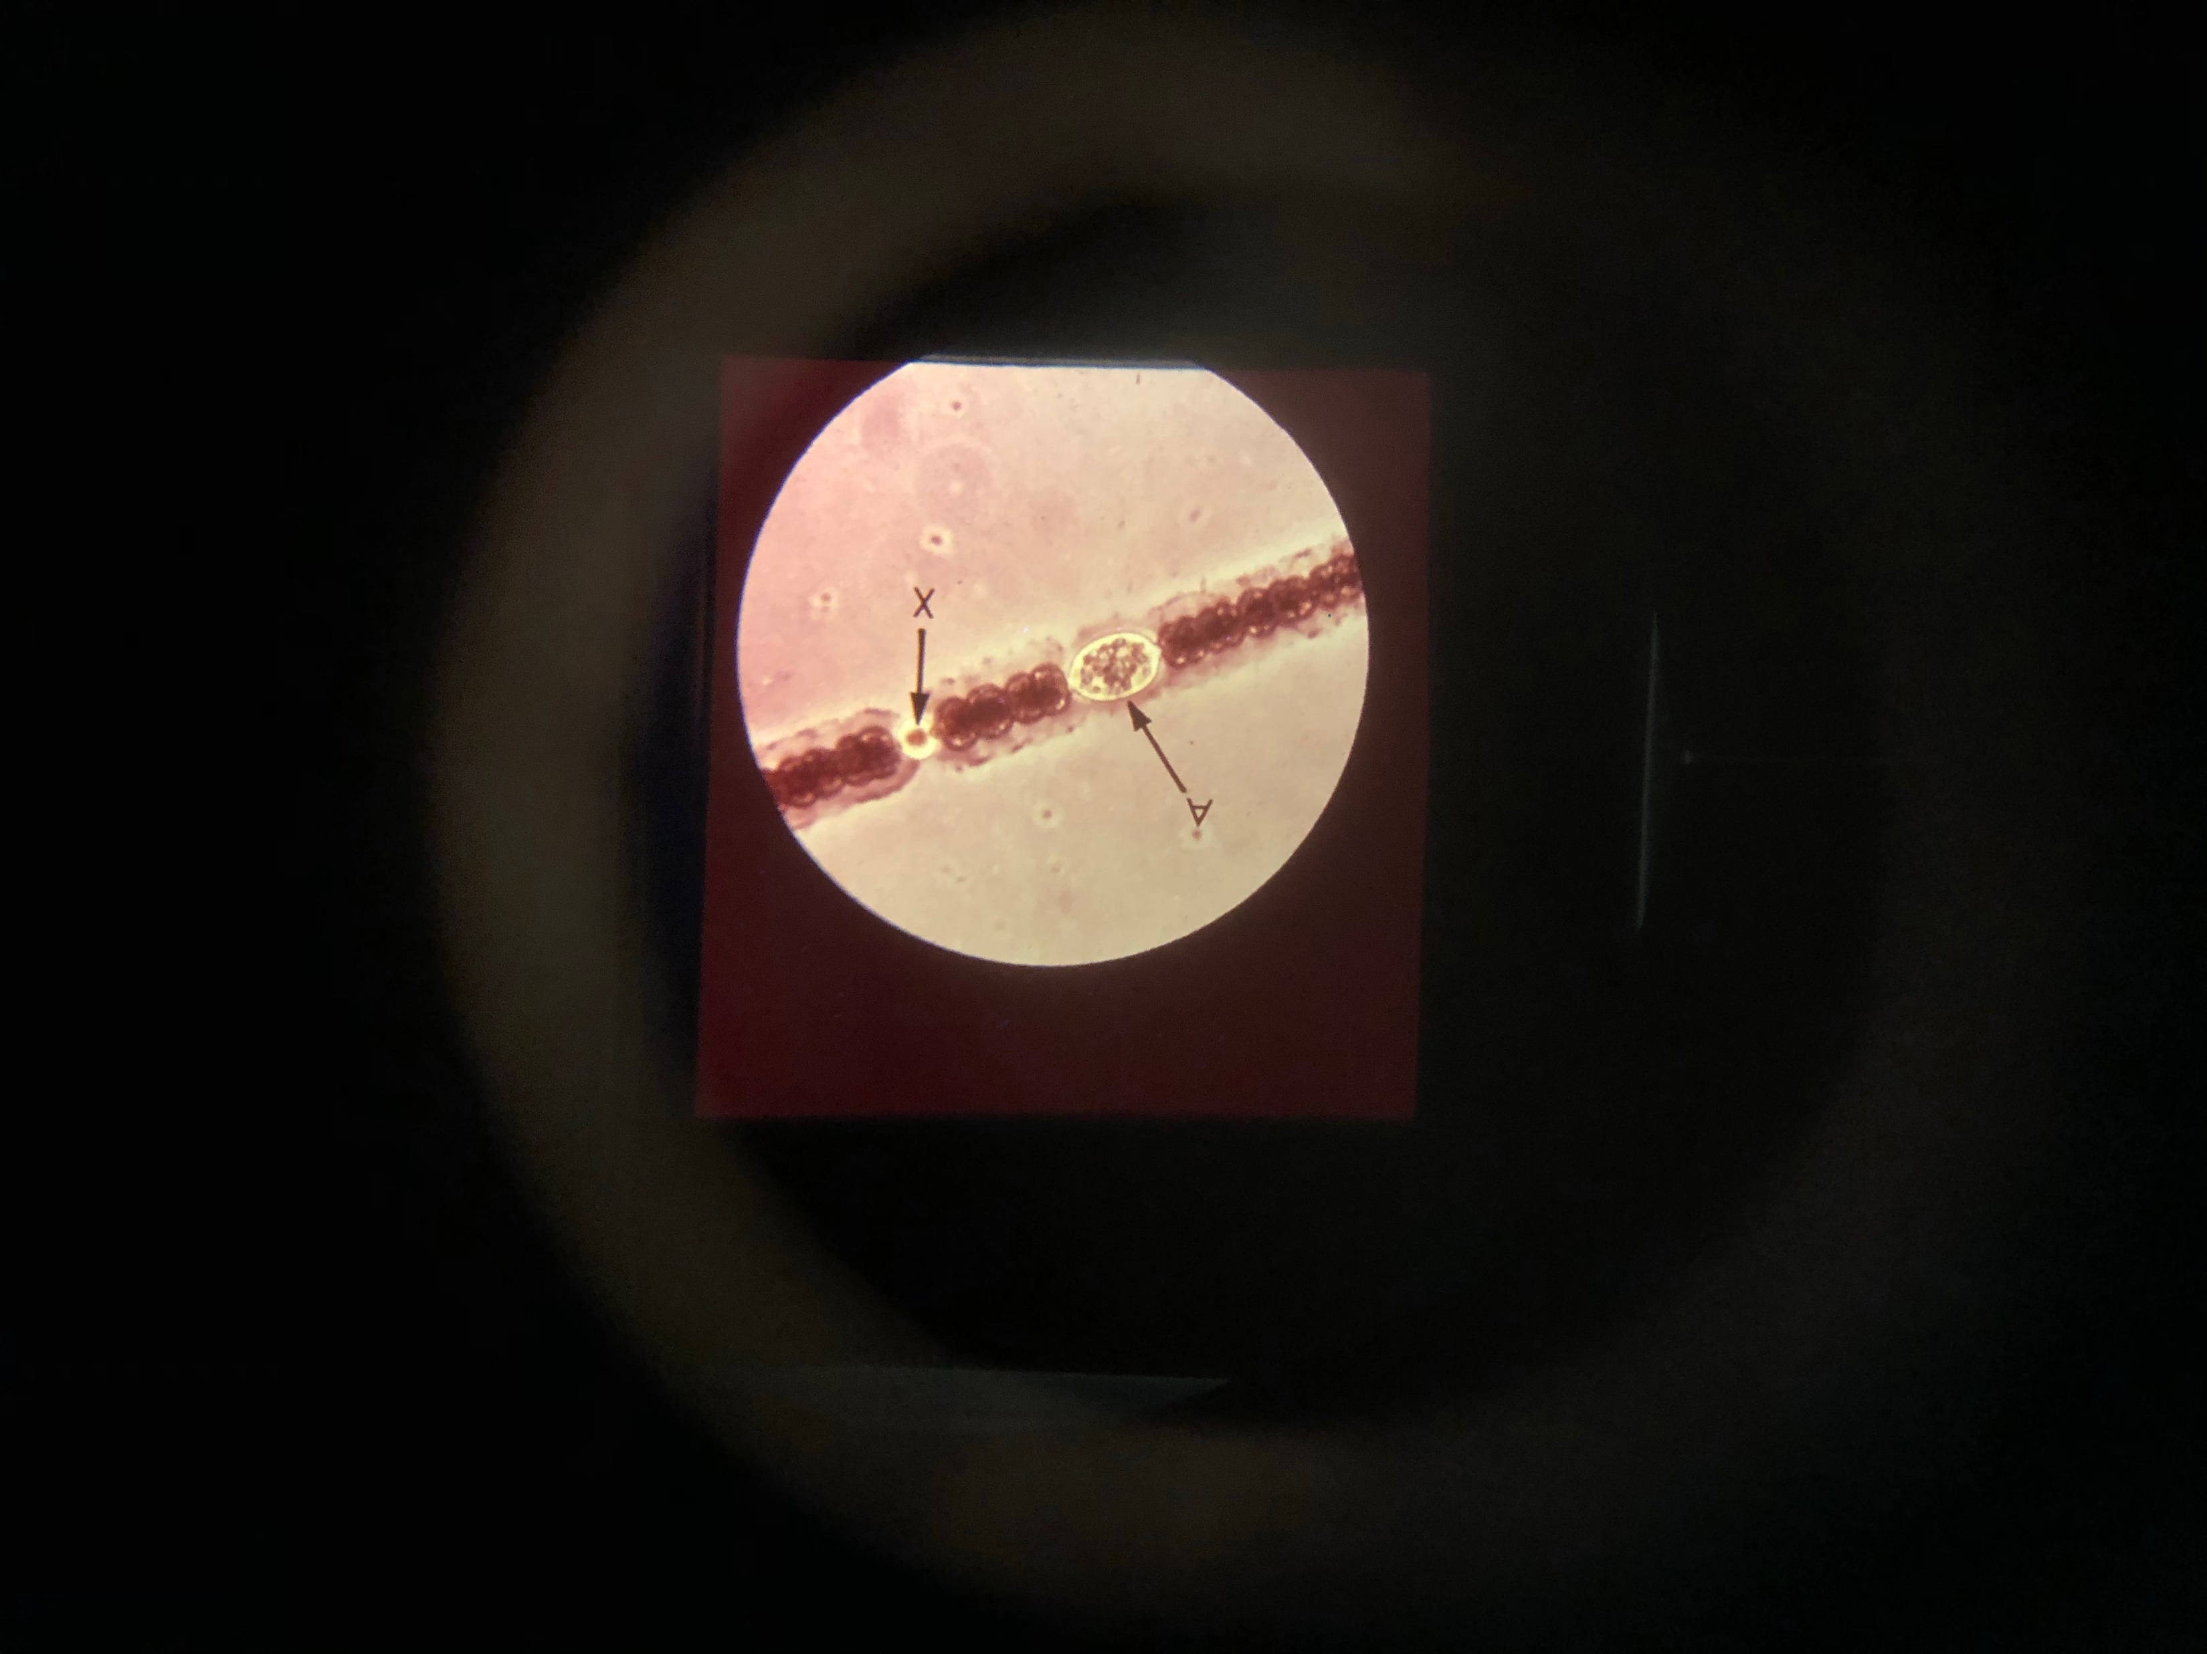
Station 7
Y
Anabaena is a filamentous freshwater cyanobacterium surrounded by a gelatinous sheath (S).
A = survival akinete
X = nitrogen-fixing heterocyst
Y = photosynthetic vegetative cells
S

Slide 6
Station 7
Y
What does each letter stand for?
S = sheath
A = survival akinete
X = nitrogen-fixing heterocyst
Y = photosynthetic vegetative cells
S

Slide 7
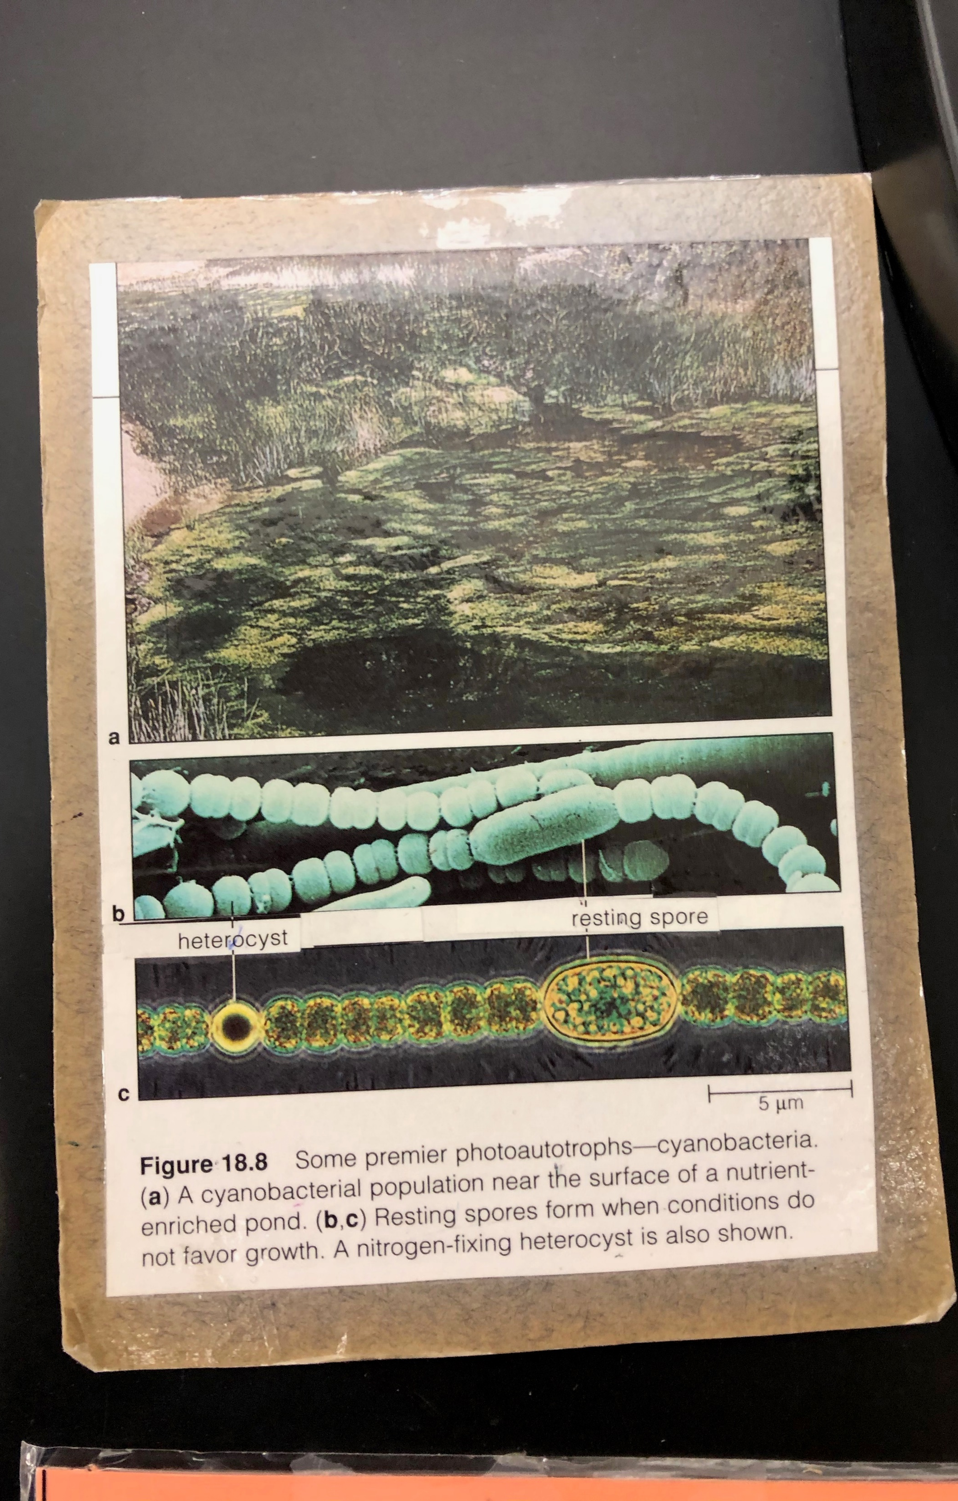
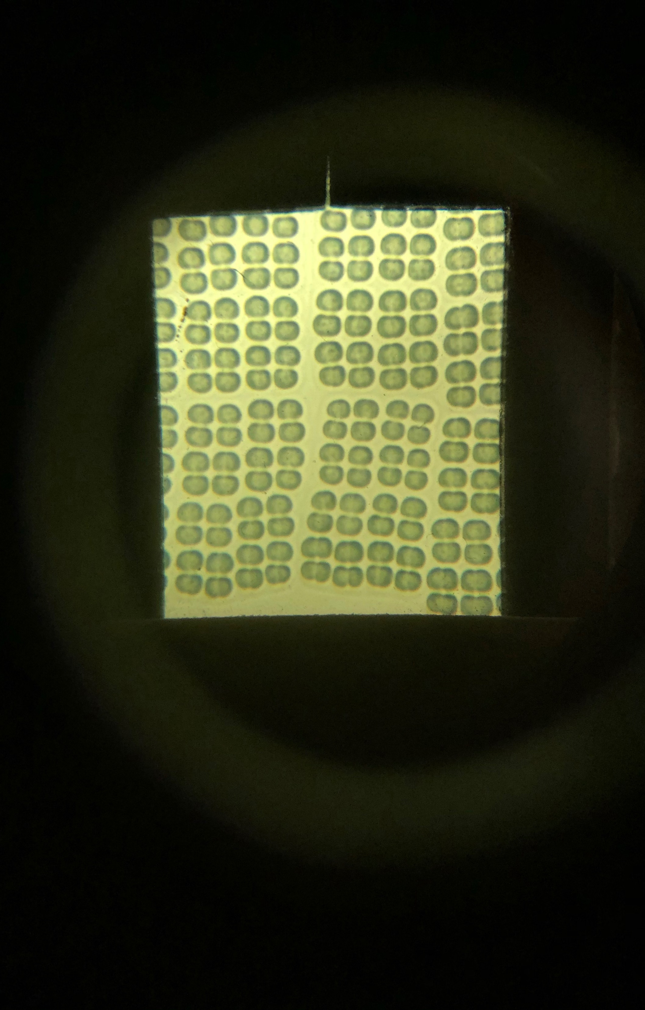
Station 8
S
Merismopedia is a freshwater cyanobacterium that forms a flat colony of cells surrounded by a gelatinous sheath (S)

