Slide 1
Title III and V Eligibility

Slide 2
What is Title III & V Eligibility?
Eligibility identifies an institution of higher education (IHE) as:
  Eligible to apply for funding under Titles III and V of the Higher Education Act.
  Eligible for certain non-Federal cost-share waivers for one year.

Slide 3
Purpose
The purpose of the Title III & V programs is to provide funds to eligible IHE’s to increase their self-sufficiency by improving their academic programs, institutional management, and fiscal stability.

Slide 4
Title III & V Eligibility
To be deemed a Hispanic Serving Institution by the Department of Education, a college must be Title III & V Eligible and meet additional requirement.

Slide 5



Eligibility is Based on IPEDS Data
25% FTE Hispanic Student Enrollment
50% of Hispanic Students are Low-Income
Core Expenditures <$15,641 per FTE Student
Enrollment of Needy Students
*Eligibility thresholds are set by ED annually and based on Integrated Postsecondary Education Data System (IPEDS) from previous academic years (excluding foreign students). Information above based on 2022 ED Title III & V Eligibility Handbook for 2-year institutions and is subject to change

Slide 6
Why is this important?
System-wide effects
Eligible to apply for Title III & V Grants
  Cost Share Waiver for Federal Work Study Program
  Cost Share Waiver for Federal Supplemental Education Opportunity Grants, such as TRIO SSS.
  Title III: Strengthening Institutions Program (SIP)
  Title III: HSI STEM
  Title V: Developing Hispanic Serving Institutions (HSI)

Slide 7
How is Eligibility Determined?
IPEDS Data Reviewed
Initial Eligibility Determined
If Not Eligible, Waiver Required
Waiver Application Reviewed by ED
Final Eligibility Determined

Slide 8
Waiver Application
If an IHE does not meet eligibility based on IPEDS data, a waiver application is submitted.
Typically, all eligible LSC Colleges require a waiver application.

Slide 9
RDA Needs Your Help!
Waiver Questionnaire
RDA has developed a college-specific questionnaire to collect information regarding programs, activities, and strategies focused on Hispanic students.
Responses from each college will be collected using Microsoft Teams and used to develop the strongest possible waiver application for your college.
Questionnaire is based on the previous academic year

Slide 10
Why We Need Your Help
You are the EXPERTS who can ensure that the waiver application incorporates ALL college services and programs targeted to Hispanic students.
=
Competitive Application
DETAILS

Slide 11
TEAM APPROACH
  Transfer Centers
  Admissions/Outreach
  Human Resources
  Advising/Counseling
  Office of Diversity, Equity, and Inclusion

Slide 12
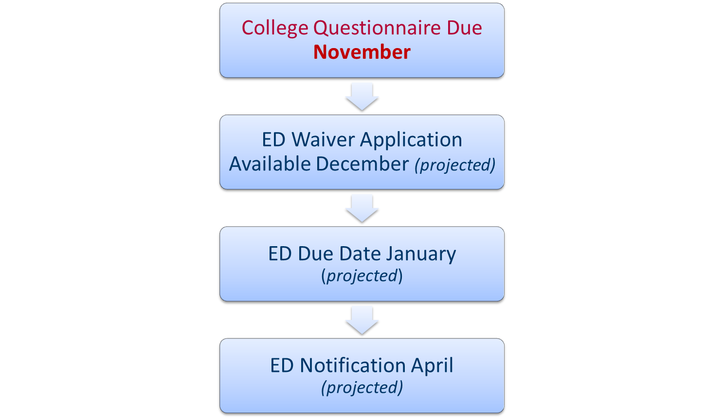
Timeline

Slide 13
RDA Contacts
Charis Prejean
Charis.A.Prejean@Lonestar.edu
Jennifer Trice
Jennifer.Trice@lonestar.edu

