Slide 1

Risk Management Training For Student Organizations
Office of Student Life
Notes:
Thank you all for being in attendance today for our RMT presentation. We will be sending out this presentation after to all of those in attendance, and we have also added it on the website for you to refresh with.

Slide 2
Risk Management Training Topics
Adoption of the Risk Management Program
Possession, use, & penalties for alcohol & drugs
Drug/Alcohol Overdose & Response
Hazing
Sexual Misconduct/Abuse/Harassment
Fire & Safety Issues (incl. Firearms, Weapons, Explosives)
Issues/Accommodations for Students with Disabilities
Student Travel Policy & Procedures
Behavior at RSO Events
COVID-19
Notes:
Today these are the risk management training topics we are going to discuss

Slide 3
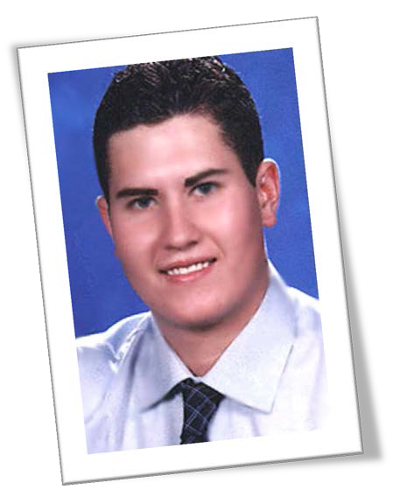
Clay’s Bill/
House Bill 2639
Clay R. Warren was an ambitious Texas Tech freshman whose life was tragically cut short in an automobile accident while returning home from his fraternity’s event on September 21, 2002.
Clay’s Bill/House Bill 2639 went into effect September 1, 2007.
Notes:
Clay Warren was a student at Texas Tech who tragically passed away in a car accident coming from his fraternity event in 2002 and by 2007 Clay’s Bill, otherwise known as House Bill 2639 came into affect

Slide 4
Clay’s Bill/
House Bill 2639
Effective September 1, 2007, the 80th Texas Legislature enacted HB 2639/SB 1138 (Texas Education Code Section 51.9361) regarding risk management education for members and advisors of student organizations registered at postsecondary educational institutions.
Under the law, Registered Student Organizations (RSO) Officers and Advisors are required to attend an annual Risk Management Program.
Advisors and Officers are required to report information gathered here to the entire organization’s membership after the Training.
Notes:
The bill made it mandatory for risk management education to be presented to all Student Organizations, requiring Officers and Advisors to attend the training and requiring the reporting of training information to all RSO members

Slide 5
Clay’s Bill/
House Bill 2639
“The goal is to make sure that everyone on campus knows there are some guidelines to follow before planning activities, such as parties and trips, and just as important – to discourage hazing, boozing and other illegal activities.”
– Rep. John Smithee
VI.D.1.05 Required Risk Management Training for Student Groups
Notes:
Just read this over

Slide 6
Risk Management Policy
The intent of this training is to make sure that all Registered Student Organizations at LSC-Kingwood keep risk management at the forefront when planning and organizing events. In order to do this, Student Life requires student organizations to register all student events. Each event is reviewed by the Office of Student Life, who may respond with various risk management questions.
It is the responsibility of each student organization to consider potential risks when planning student events to minimize risk to participants and to LSC. If sufficient planning is not completed on the part of the student organization, the event may be denied.
The safety and wellbeing of students is always a primary concern, and we will do everything we can to ensure that all Student Life experiences are safe and enjoyable.
Notes:
Risk Management is a very important aspect of being involved in a Registered Student Organization on campus, requiring this information to help with the planning and organizing of events on campus. It is the RSOs responsibility to consider potential risk management risks with all meetings, events, and travel to ensure the safety and wellbeing of the students.

Slide 7
Lone Star College
Risk Management Training
http://www.lonestar.edu/student-welfare-rights.htm
VI.D.1.05 Required Risk Management Training for Student Groups
The College will provide a Risk Management Program for registered student organizations at least once each academic year. The College requires the Student Organization Representatives and its Student Organization Advisor(s) to attend. The College must record the program’s attendance and keep those records for at least three years after the program is held. Other student organization members may attend the program. Student Organization Advisors or Student Organization Representatives will brief the entire student organization on the program’s contents at the next full membership meeting.
Notes:
This shows the LSC policy VI.D.1.05 within the policy manual where RSOs are required to attend Risk Management Training. Note that it does state that the representatives/officers of the RSO will provide a overview of the contents from this training at the next full membership meeting. We know you all are working on boosting your membership back up after COVID & with students graduating, however, you will still need to present this at your next full membership meeting. When you do, please email me the date that you presented this overview so that we can send this information to System Office

Slide 8

What is
Risk Management?
Risk Management is the process of
• considering the potential risks to Students and the College when planning for events
AND
• monitoring organization activities and taking both proactive steps and corrective action to minimize injury and/or loss
BY
- adjusting behavior and/or processes
OR
- eliminating the activity altogether.
Notes:
Risk Management as we’ll discuss is the process of considering potential risks to students and the college when planning events, monitoring the RSOs activities and taking steps to minimize risk factors in any way possible

Slide 9
Types of Risk
Physical – can include things such as food poisoning, injuries that may result from physical activities, injuries that may result from travel related accidents
Reputation – those things that may result in negative publicity for your organization, Lone Star College, your advisor, and/or a venue where you are holding an event
Emotional – those things that can cause a participant at your event to feel alienated or negatively impact the feelings of a member or members of the LSC community
Financial – those things that can negatively impact the fiscal stability of your organization and/or any organizations financially supporting your event.
Facilities – those things which may cause property damage, prevent your event from being held (bad weather, not enough space for the number of participants, lack of equipment or materials needed for the event, etc.)
Source: Student Risk Management at Arizona State University
Notes:
The types of risks that we identify through risk management are physical, reputation, emotional, financial, and facilities

Slide 10

Alcohol & Drugs
Notes:
First we will talk discuss alcohol and drugs

Slide 11
Alcohol & Illegal Drugs:
What’s the Big Deal?
Over 1,825 students ages 19-24 die annually from alcohol-related injuries.
More than 97,000 students ages 18-24 are victims of sexual assault or date rape that involved alcohol.
About 25% of college students report academic consequences of their drinking including missing class, falling behind, and doing poorly on exams.
In 2018, 31.9 million, or 11.7% of the population over age 12 in the US were current illegal drug users (had used within the previous month)
In 2018 67,367 drug overdose deaths occurred in the US
Sources: https://www.niaaa.nih.gov/publications/brochures-and-fact-sheets/alcohol-facts-and-statistics & https://drugabusestatistics.org/
Notes:
Over time, I’m sure we’ve all heard the different statistics involved with alcohol and drugs. Over 1,825 students 19-24 die annual from alcohol-related injuries and 67,367 drug overdose deaths occurred in 2018

Slide 12
Drug & Alcohol Abuse
Drug and alcohol abuse always carries the risk of serious side effects, including overdose. Whether you abuse alcohol, an illegal drug such as cocaine, or medications prescribed by a doctor—such as opioid painkillers—addiction development will always be a concern. And in many cases, if substance abuse behavior persists, there remains a real possibility of a drug overdose.
Any drug overdose can be either accidental or intentional.
Notes:
There are major effects from drug and alcohol abuse. One of the risks is you have a higher chance of developing an addiction which can result in a drug overdose, whether accidental or intentional.

Slide 13
High-Risk Drinking
High-risk college student drinking includes the following:
Underage drinking
Drinking and driving including other activities where the use of alcohol is dangerous
Drinking when health conditions and/or medications make the use of alcohol dangerous
Binge drinking
Men = 5 drinks concurrently
Women = 4 drinks concurrently
Notes:
What we consider as high-risk drinking includes underage drinking, drinking and drive and similar activities, when mixing medications and health conditions with drinking, and binge drinking

Slide 14
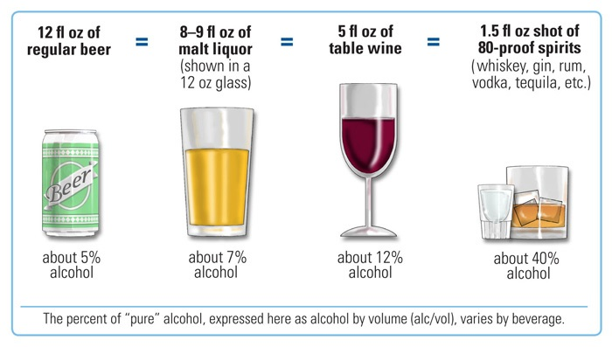
A Standard Drink
Notes:
This is an image of a standard drink, and how different alcohol stacks up against each other. As you can see, as the percentage of alcohol in the drink gets higher, the volume of liquid gets lower.

Slide 15
Lone Star College
Alcohol Policy
VI.E.1.03.
As part of the commitment to the provision of high quality and effective service to our students, employees, and the public we serve, LSCS strives to provide an alcohol and drug free workplace and learning environment. Toward that end, the unlawful manufacture, distribution, dispensation, possession, or use of a controlled substance or unauthorized drug, or the unauthorized possession and use of alcohol are prohibited in and on property owned and controlled by the System.
II.D.1.07. - Alcohol in Facilities
No group or individual will be permitted to serve or bring alcoholic beverages in or upon System facilities except as allowed by this Section.
Violation of this or other policies may result in disciplinary action from the college, including written warning, probation, suspension, expulsion, or other penalty deemed appropriate under the circumstances.
Notes:
LSC has policies which relate to alcohol. LSC strives to provide an alcohol and drug free workplace and learning environment. It is important to note that no group or individual will be permitted to serve or bring alcoholic beverages in or upon LSC facilities which includes any RSO events. In other words, we are a dry campus and any violation of being a dry campus could result in disciplinary action.

Slide 16
Providing Alcohol
to Minors
Providing alcohol to a minor is a Class A misdemeanor.
Punishable by a fine up to $4,000, confinement in jail for up to a year, or both.
Providing alcohol to a minor at a gathering that involves binge drinking and/or coerced drinking could also result in community service and enrollment in an alcohol awareness program.
Providing alcohol to minors could prevent potential employment opportunities to students pursuing careers in education, law, criminal justice, and other fields.
Notes:
Providing alcohol to minors is a Class A misdemeanor, which is punishable by a fine up to $4,000 and/or jail time. This can affect your future employment as well as the miners future employment in certain careers

Slide 17
DUI/DWI Offenses
Driving UNDER the Influence
Texas has a ZERO Tolerance law for minors (under 21) who operate a motor vehicle in a public place while having any amount of alcohol in their system.
Class C misdemeanor, punishable up to a $500 fine.
Community Service (approximately 8-40 hours required).
Driver’s license suspended for 30-180 days.
Required to be enrolled in an alcohol awareness course.
Driving WHILE Intoxicated
Defined as any person who is intoxicated while operating a motor vehicle in a public place. DWI is classified as a Class B misdemeanor which results in confinement in jail for a minimum of 72 hours.
Driving WHILE Intoxicated with an Open Container
Section 49.04 of the Texas Penal Code. Classified as a Class B misdemeanor, with a minimum term of confinement of 6 days.
Notes:
Texas has a ZERO tolerance law for minors driving with any alcohol in their system. As you can see from this slide, there are multiple consequences for minors driving under the influence. In addition, any person driving while intoxicated in a public place will result in jail confinement

Slide 18
When Medical Assistance Is Needed: 911 Lifeline Law
Effective: September 1, 2011
The Texas Legislature passed a law that enables a person under 21 to not be charged by the police for possessing and/or consuming alcohol if the person calls 911 in the case of someone having alcohol poisoning.
This limited immunity applies only to the first person to call for medical assistance and requires the caller to remain at the scene until medical assistance arrives and cooperates with EMS and law enforcement officers.
Notes:
In 2011 Texas passed the 911 Lifeline Law, which states that if a person under 21 calls 911 for someone who has alcohol poisoning as a way to save their life, they will not be charged for possessing and/or consuming alcohol. However, this only applies to the first person that calls for medical assistance, and call must remain at the scene and cooperate with EMS and law enforcement in order for them to not be charged.

Slide 19
Symptoms/Signs of Alcohol Overdose/Poisoning
Common signs and symptoms of alcohol overdose/alcohol poisoning can include:
Mental confusion
Difficulty remaining conscious
Vomiting
Seizure
Difficulty breathing
Slow heart rate
Clammy skin
Bluish or pale skin
Slow responses (such as gag reflex)
Extremely low body temperature
Notes:
Some common signs and symptoms of alcohol overdose/poisoning are listed on this slide. Take a look at these systems so that you are able to detect if someone you know is exhibiting any of them.

Slide 20
What to Do if You Overdose on Alcohol?
If you or a loved one has potentially overdosed on alcohol or is suspected to have alcohol poisoning, seek immediate medical attention by calling 911 to receive emergency help right away. You might also implement a few of the following procedures while waiting for medical personnel to arrive. However, be sure to avoid putting your own safety at risk.
Check the person’s breathing and heart rate.
If the person is unconscious, try to get a response. Ask the person questions to assess their level of alertness and to calmly keep them engaged, if possible.
Keep the person on their side, no their back (next slide for Bacchus Maneuver)
If you are medically qualified to do so, provide CPR if necessary.
Before touching the person, tell them what you are going to do. Beware of any signs of aggression.
Give first aid as directed by 911 operators.
Do not try to reason with the person or give your opinions about the situation.
Do not give them food, drink, or medication of any kind.
Walking, showering, or drinking coffee will not help
Stay as calm as possible while waiting for medical personnel arrive.
Assure the person that help is coming.
Notes:
If someone in your presence is overdosing on alcohol, immediately call 911. In addition, any of the following procedures will help while waiting for medical personnel to arrive. Make sure that you are not putting your own safety at risk performing any of these procedures.

Slide 21
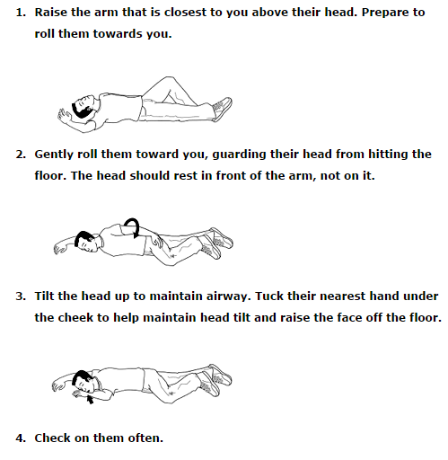
Bacchus Maneuver
Notes:
One procedure that can be life-saving which I want to highlight is known as the bacchus maneuver. [Read steps off the slide]

Slide 22
Preventing Alcohol Overdose/Poisoning
Of course, not consuming alcohol is the most advisable way to prevent an overdose/poisoning. But certain steps can help decrease the likelihood of overdose/poisoning, including:
Know your alcohol limits for your body and set your limit before you start.
Avoid drinking games.
Use caution when sick or tired.
Alternate with non-alcoholic beverages and have no more than 1 drink per hour. Sip your drink instead of chugging. On average it takes most people nearly 3 hours to eliminate the alcohol of 2 standard drinks.
Avoid “mega” drinks that contain more alcohol than a standard drink.
Eat before and while drinking. Alcohol is absorbed slower when there is food in your stomach.
Avoid mixing alcohol with other drugs.
Use a designated driver or use a driving app (Uber, Lyft, etc.).
Time is the ONLY thing that can sober a person up
Notes:
Not consuming alcohol is the best way to prevent an overdose/posioning, however taking any of the steps below will help to decrease the likelihood of an overdose/poisoning for yourself or those you love. These include knowing your limits, avoid mixing alcohol, and using a designated driver while drinking.

Slide 23


Drug Use
Drug abuse can affect a person’s mental alertness, consciousness, cognitive and neurological functions, as well as lead to death, homelessness, loss of family and friends and even prison
It is illegal to use, manufacture, own, sell, and/or distribute substances defined and regulated under Chapters 481-485 of the Texas Health and Safety Code.
Notes:
Drug use and abuse can affect a person in many different ways whether physical, emotional, and especially financial and reputational. Please note it is illegal to use, manufacture, own, sell, and/or distribute any substances

Slide 24
Controlled Substances/ Drug Possession under Texas Law
Also known as CDS, or controlled dangerous substances, these drugs include: heroin; cocaine; meth; marijuana, as well as the compounds used to manufacture narcotics, synthetic steroids, depressants, and stimulants. These are substances with high potential for abuse which may lead to severe psychological or physical dependence.
Texas state law imposes penalties that range from a relatively minor misdemeanor to severe felony charges. Depending on certain factors or circumstances charges could be drug possession or drug possession with intent to distribute. Determining factors are:
Quantity
How the drug was concealed or stored
Possession of drug with paraphernalia (scale)
Drugs found with a large amount of money
Past convictions/prior offenses
Notes:
Controlled Dangerous Substances include heroin, cocaine, meth, marijuana, manufactured narcotics, steroids, depressants, and stimulants. The possession of these can range in penalties from a misdemeanor to severe felony charges based on the determining factors highlighted on the slide.

Slide 25
Symptoms/Signs of Drug Overdose
The physical and psychological signs of a drug overdose can vary depending on the type of drug taken, and whether the drug was taken in combination with other substances.
Common signs and symptoms of a drug overdose can include:
Dilated pupils.
Unsteady walking.
Chest pain.
Severe difficulty breathing, shallow breathing, or complete cessation of breath.
Gurgling sounds that indicate the person’s airway is blocked.
Blue lips or fingers.
Nausea or vomiting.
Abnormally high body temperature.
Violent or aggressive behavior.
Disorientation or confusion.
Paranoia.
Agitation.
Convulsions or tremors.
Seizures.
Unresponsiveness.
Unconsciousness.
Death.
Notes:
Some common signs and symptoms of drug overdose are listed on this slide. Take a look at these systems so that you are able to detect if someone you know is exhibiting any of them.

Slide 26
What to Do if You Overdose on Drugs?
If you or a loved one has potentially overdosed on drugs, seek immediate medical attention by calling 911 to receive emergency help right away. You might also implement a few of the following procedures while waiting for medical personnel to arrive. However, be sure to avoid putting your own safety at risk since certain drugs can prompt violent or unpredictable behavior in the person taking them.
Check the person’s breathing and heart rate.
If the person is unconscious, try to get a response. Ask the person questions to assess their level of alertness and to calmly keep them engaged, if possible.
If the person is not breathing, turn them on their side.
If you are medically qualified to do so, provide CPR if necessary.
Give first aid as directed by 911 operators.
Do not allow the person to take any more of the substance.
Obtain as much information as possible, including the dose & the last time the person took the drug.
If prescription medications or otherwise labeled substances have been used, take the container with you to the ER, even if it is empty.
Make note of any identifying paraphernalia, or bring along any containers of other drugs or substances the person may have taken.
Do not try to reason with the person or give your opinions about the situation.
Stay as calm as possible while waiting for medical personnel arrive.
Assure the person that help is coming.
Notes:
If someone in your presence has overdosed on drugs, immediately call 911. In addition, any of the following procedures will help while waiting for medical personnel to arrive. Make sure that you are not putting your own safety at risk performing any of these procedures.

Slide 27
Preventing Drug Overdose
Of course, not using drugs is the most advisable way to prevent an overdose. But if you, or someone you care about, is already suffering from an addiction or demonstrating problematic substance use behavior, taking certain steps can help decrease the likelihood of overdose, including:
Increasing your awareness of overdose signs and risks.
Knowing the drug and dose of the drug you are taking.
Avoiding multiple substance use (e.g., do not drink alcohol if you are using any drug).
Starting with a low dose if you haven’t used in a while.
Using in the presence of another person, if you must use. If you do overdose, the person can seek help.
Seeking substance abuse treatment if you think you have an addiction.
Notes:
Not using drugs is the best way to prevent an overdose, however taking any of the steps below will help to decrease the likelihood of an overdose for yourself or those you love. These include increasing your awareness, avoiding multiple substance use, and seeking treatment.

Slide 28
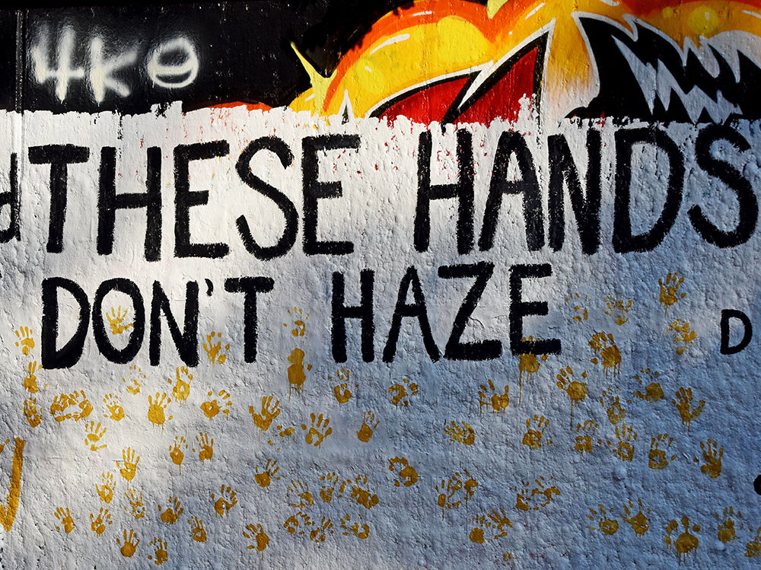
Hazing
Notes:
Next we will discuss hazing

Slide 29
What is Hazing?
College Hazing is a ritual that involves risk, pain, or harm to gain some form of initiation. College hazing often involves excessive alcohol consumption or ritualized pain endurance. Fifty-five percent of students involved in athletics or clubs have experienced hazing. Hazing deaths on college campuses have led to anti-hazing laws across the country.
Notes:
Hazing is a ritual that involves risk, pain, or harm to gain some form of initiation which can involve alcohol consumption or ritualized pain endurance. Hazing has led to deaths on college campuses, which has led to anti-hazing laws in the United States.

Slide 30
What is Hazing? (continued)
The term includes, but is not limited to:
Any type of physical brutality, such as whipping, beating, striking, branding, electronic shocking, placing of a harmful substance on the body, or similar activity.
Any type of physical activity, such as sleep deprivation, exposure to the elements, confinement in a small space, calisthenics, or other activity that subjects the student to an unreasonable risk of harm or that adversely affects the mental or physical health or safety of the student.
Any activity involving consumption of a food, liquid, alcoholic beverage, liquor, drug, or other substance which subjects the student to an unreasonable risk of harm or which adversely affects the mental or physical health or safety of the student.
Any activity that intimidates or threatens the student with ostracism, that subjects the student to extreme mental stress, shame, or humiliation, or that adversely affects the mental health or dignity of the student or discourages the student from entering or remaining registered in an educational institution, or that may reasonably be expected to cause a student to leave the organization or the institution rather than submit to acts described in this subsection.
Any activity that induces, causes, or requires the student to perform a duty or task that involves a violation of the Penal Code.
Notes:
This slide discusses in detail what the term hazing includes. To summarize, it can include physical brutality and any physical activities that provide risks to mental or physical health, or the safety of the student

Slide 31
LSC Hazing Policy
As of Spring 2020, in compliance with Texas law, a report will be published on the LSC website identifying any hazing incidents reported against an organization that is registered or recognized by the College. When incidents are reported, the public report will contain:
The organization name with information on disciplinary action taken by the College against an organization for hazing
The date of the hazing incident or that the citation was issued and a description of the incident
The date the College’s investigation began
A list of the code of conduct violations or of criminal charges file
The findings of the College or court and sanctions imposed on the organization
The date the disciplinary process was resolved or the date the conviction became final
Information on all hazing convictions during the past three years
Notes:
As of Spring 2020 a report will be published on the LSC website that identifies any hazing incidents again an organization registered or recognized by the College. The public report will contain information about who committed the hazing and who it was against, when it occurred, the date of investigation, what violations were involved and the criminal charges filed including any findings and sanctions imposed on the organization.

Slide 32
LSC Hazing Policy Definition
VI.E.1.02 Definitions
(f) Hazing means any intentional, knowing, or reckless act directed against a student that endangers the student’s mental health, physical health, or safety. A student organization cannot require such acts to initiate, affiliate, appoint, or maintain membership in any student organization. Whether the act occurs on or off the College’s property remains irrelevant.
- - - - - - - - - - - - - - - - - - - - - - - - - - - - - - - - - - - - - - - - - - - - - -
All reports of hazing will be treated as serious matters and will be investigated. Report any rumors or actual incidents of hazing to Student Life immediately.
Notes:
LSC has policies which relate to hazing. Hazing as defined in these policies is any intentional, knowing, or reckless act against a student that endangers their mental health, physical health or safety. An RSO cannot require such acts for membership whether on or off the College's property. All reports of hazing are treated as serious matters and should be reported to Student Life immediately.

Slide 33
Hazing Laws
(continued)
PERSONAL HAZING OFFENSE:
A person commits an offense if the person: Engages in hazing; solicits, encourages, directs, aids or attempts to aid another in engaging in hazing; intentionally, knowingly, or recklessly permits hazing to occur; or has firsthand knowledge of the planning of a specific hazing incident that has occurred, and knowingly fails to report said knowledge in writing to Student Life or other appropriate official(s) of the institution.
ORGANIZATIONAL HAZING OFFENSE:
An organization commits an offense if the organization condones or encourages hazing or if an officer or any combination of member(s), pledge(s), or alumni of the organization commit(s) or assist(s) in the commission of hazing.
Notes:
Personal hazing offenses occur when a person engages in hazing or helps others to engage in hazing. Organizational hazing offenses occur when an organization condones or encourages hazing or assists in hazing.

Slide 34
Hazing Laws
(continued)
ORGANIZATIONAL HAZING OFFENSE:
In the prosecution of an offense under this subchapter, the court may grant immunity from prosecution for the offense to each person who is subpoenaed to testify for the prosecution and who does testify for the prosecution. Any person reporting a specific hazing incident involving a student in an educational institution to Student Life or other appropriate official of the institution may be immune from liability, civil or criminal, that might otherwise be incurred or imposed as a result of the report. Immunity extends to participating in any judicial proceeding resulting from the report. A person reporting in bad faith or with malice is not protected by this section.
Notes:
This is a continuation of the laws regarding the prosecution of an offense stating that the court may grant immunity from prosecution for the offense to those subpoenaed to testify for the prosecution and who does testify for the prosecution.

Slide 35
Reporting Hazing
A written report should be submitted to your campus Student Life Office, reporting your firsthand knowledge that a hazing incident is being planned or has occurred.
The fact that a person consented to or acquiesced in a hazing activity s not a defense to prosecution for hazing under the law. The penalty for failure to report hazing activities is a fine not to exceed $2,000 and/or up to 180 days of confinement in jail.
Notes:
To report hazing, please submit a written report to the Student Life Office. This is a continuation of the laws, including the statement that a person consenting to a hazing activity is not a defense to prosecution. Hazing is never tolerated whether it is consensual or not.

Slide 36

Sexual Misconduct, Abuse & Harassment
Notes:
Now we will cover sexual misconduct, abuse, and harassment

Slide 37
LSC Sexual Misconduct Policies
IX.A.1.1. Policy
This policy specifically covers sexual misconduct including sexual harassment, violence, discrimination, and retaliation as prohibited by applicable laws and the College. The College also prohibits unlawful discrimination based on other protected categories and discusses such prohibitions in the human resources and student policy sections. The College does not tolerate retaliation against anyone who complains about sexual misconduct or cooperates in a sexual misconduct investigation.
Notes:
This is the LSC policies relating to misconduct. The college covers this material in IX.A.1.1 and it is important to know that the College does not tolerate sexual misconduct or retaliation against anyone who complains about sexual misconduct.

Slide 38
Sexual Misconduct
Terms & Definitions
IX.A.1.2. Definitions
(f) Sexual harassment (a form of sex discrimination) includes two categories:
(1) hostile work environment sexual harassment, and
(2) quid pro quo sexual harassment.
Hostile work environment sexual harassment means verbal, physical, or visual forms of harassment that are sexual in nature, unwelcome, and severe, persistent, or pervasive. A hostile environment is often created by a series of incidents. However, a single severe incident, such as sexual assault, could create a hostile environment.
Conversely, quid pro quo sexual harassment means “this for that.” An example of this form of sexual harassment occurs if a faculty member (or staff member) stipulates that a student’s grade or performance rating (or participation on a team, in a play, etc.) will be based on whether that student submits to unwelcome sexual conduct.
Notes:
Some of the terms of sexual misconduct are listed here. The first is sexual harassment which includes hostile work environment and quid pro quo sexual harassment. Hostile work environment harassment includes verbal, physical, or visual forms of harassment that are sexual in nature, unwelcome, and creates a hostile work environment for the individual. Quid pro quo refers to a form of harassment where a person of power stipulates that a grade/performance will be based on whether the person submits to unwelcome sexual conduct.

Slide 39
Sexual Misconduct
Terms & Definitions
SEXUAL ASSAULT: Sexual assault is an offense that meets the definition of rape, fondling, incest, or statutory rape as stated in the Federal Bureau of Investigation’s Uniform Crime Reporting Program.
SEXUAL DISCRIMINATION: Sexual discrimination, including sexual harassment, is illegal under both federal and Texas state law and is strictly prohibited by the College.
SEXUAL VIOLENCE: Sexual violence means a physical sexual act perpetrated without the complainant’s consent. This includes situations where a person is incapable of giving consent because of drug or alcohol impairment or a mental or physical disability
Notes:
We have some more definitions. Sexual assault includes rape, fondling, incest, or statutory rape. Sexual discrimination includes any discrimination on the basis of sex. Sexual violence is any physical sexual act without a person’s consent.

Slide 40
Sexual Misconduct
Terms & Definitions
CONSENT: Sexual activity requires consent. Consent is defined as a voluntary and positive agreement between the participants to engage in sexual activity.
STALKING: Stalking is defined as engaging in a course of conduct (two or more acts), including, but not limited to, a pattern of repeated and unwanted attention, harassment, or conduct, directed at a specific person that would cause a reasonable person to fear for his or her safety, the safety of others, or suffer substantial emotional distress.
TITLE IX HARASSMENT: Acts of Title IX harassment may take many different forms. Title IX harassment includes sexual harassment, gender-based harassment, and sexual violence.
For the full LSC Section IX.A Sexual Misconduct Policy visit https://www.Lonestar.Edu/ixa-sexualmisconduct
Notes:
Consent is a voluntary and positive agreement between those engaging in sexual activity. Stalking includes any repeated or unwanted attention, harassment, or conduct where a person fears for their safety or the safety of others. Title IX harassment includes sexual harassment, sexual discrimination, and sexual violence. To read the full section on sexual misconduct please visit the link listed on the slide.

Slide 41
When Confronted with Sexual Misconduct
Report to the Police
Submit firsthand written documentation
Seek a network of support
Seek professional counseling
Utilize campus resources/advocates
Implement protective/restraining order
Notes:
Here are the steps for if you are confronted with sexual misconduct [read steps from the slide]

Slide 42
Resources for
Complainants
Internal: Any LSC Office of Student Services
LSC Police Department, 281-290-5911
LSC Office of Emergency Management, 281-290-2891
Title IX Coordinator Karen Miner, 832-813-6614, Karen.L.Miner@Lonestar.edu
External: Family Time Crisis Counseling Center (Humble), 281-446-2615
Domestic Violence Hotline, 713-528-2121 / 713-528-3625 (TDD)
Sexual Assault Hotline, 713-528-7273 / 713-528-3691 (TDD)
Montgomery County Women’s Shelter, 713-528-7273, 24-Hour Hotline 936-441-7273
Northwest Assistance Ministries, 281-885-4673
Ben Taub Hospital, 713-873-2000
MHMR Authority of Harris County, 7011 Southwest Freeway, Houston 77074,
Crisis Telephone 866-970-7770, Main Telephone 713-970-7000,
http://www.mhmraharris.org/
Houston Police Department Mental Health Unit, 1502 Ben Taub Loop, Houston 77030
Tri-County MHMR Services, 1506 Old Montgomery Rd., Conroe, 77304, Crisis Phone
800-659-6994, Main Phone 936-756-8331, http: www.tcmhmrs.org/
Notes:
This slide is very important for you to review. It includes all internal and external resources for sexual misconduct complaints or events that occurs.

Slide 43

Fire Safety, Weapons, & Other Campus Safety
Notes:
Now we will move onto discussing fire safety, weapons, and other campus safety information

Slide 44
Fire Safety
Always have a plan
Fire alarm = evacuate building immediately
Help others if necessary/possible ▪ Have a meeting place
Call in the exact location of the fire (911)
Sign up for LSC Text & E-mail Alerts in your myLoneStar portal.
Notes:
Here are some fire safety tips [read off the slide]

Slide 45
LSC Policy
On Weapons
VI.E.1.02 Definitions
(c) Prohibited weapons include:
1. Firearms*
2. Ammunition
3. Explosive Weapon (bomb, grenade, rocket…)
4. Illegal Knife (blade over 5 ½ inches, switchblade, spear)
5. Taser
6. Knuckles (or similar device)
7. Chemical Dispensing Device
8. Zip Gun
9. Club (designed for inflicting bodily harm)
These are the abbreviated definitions. For full definitions in the policy, please follow the link above.
Notes:
Here we discuss LSC policies as it relates to the definition of prohibited weapons. For full definitions, please see the link that takes you to the policy on the website.

Slide 46
Campus Carry
The law allows Lone Star College some latitude in establishing rules and regulations to designate certain areas gun-free zones. These rules and regulations are determined based on the nature of the student population, specific safety considerations, and the uniqueness of the campus environment. The designation of these gun-free zones can only be approved by the Chancellor.
Starting August 1, 2017, a LTC holder may carry his or her firearm into campus buildings unless it is part of an “exclusion zone” that has been identified by Lone Star College policy or State or Federal law. These exclusion zones are clearly marked.
Details can be found at: https://www.lonestar.edu/departments/campuspolice/CampusCarryBasics.pdf
Notes:
As far as campus carry, Lone Star College has designated certain rules and regulations regarding gun-free zones. The designation of these zones can only be approved by the Chancellor. As of 2017, an LTC holder may carry their firearm into campus buildings unless it is an exclusion zone, which will be clearly marked.

Slide 47
In Case of Emergency
The LSC Office of Emergency Management has developed posters which are displayed in offices and classrooms throughout campus. These posters have information on what to do in case of:
• Fire
• Suspicious Person/Object or Active Shooter
• Bomb Threat/Explosion
• Hazardous Materials
• Medical Alert
• Severe Weather
• Power Failure
• Campus Warnings
There is also helpful information on what to do when law enforcement arrives on the scene.
LSC Police/Medical: 5911 (from campus phone) or 281.290.5911
Fire: 9911 (from campus phone) or 911, then call 5911
Notes:
There are posters displayed all around campus about information for what to do in the following emergencies. It is very helpful to review information regarding these scenarios, especially after the scenario that occurred last fall with our lockdown on campus. It is also important to save the phone number for campus police listed below into your mobile device.

Slide 48

Issues/Accommodations for Disabilities
Notes:
Next we will discuss issues and accommodations for disabilities

Slide 49
Regarding Persons with Disabilities
Section 504 of the Rehabilitation Act of 1973 prohibits discrimination against people with disabilities in programs that receive federal financial assistance
Section 504 works together with the ADA and IDEA to protect children and adults with disabilities from exclusion, and unequal treatment in schools, jobs and the community.
Student Organizations do not discriminate against persons with disabilities. All are welcome and encouraged to participate in groups and activities that are of interest.
Should you need an accommodation to fully participate in the group of activities, the organization and the Disability Services Office will work together with you to make sure you have full access!
Notes:
Section 504 prohibits the discrimination against people with disabilities and works with ADA and IDEA to protect children and adults with disabilities from exclusion or unequal treatment. Student organizations do not discriminate against persons with disabilities. All are welcomed to participate. If you or any students you know do need any accommodations to participate in any RSO activities, please refer them to the Disabilities Services Office!

Slide 50
LSC Board Policy:
Students w/ Disability Rights
VI.D.11 Students with Disability Rights
The College recognizes and supports the principles set forth in federal and state laws designed to eliminate discrimination against qualified individuals with disabilities. The College believes in equal access to educational opportunities for all individuals. The College is committed to making reasonable accommodations, including furnishing auxiliary aids and services, for qualified individuals with disabilities as required by law.
Notes:
The LSC policy on this slide is directly related to the rights for students with disabilities. The College believes in equal access to educational opportunities and has committed to making reasonable accommodations for qualified individuals with disabilities.

Slide 51
LSC Board Policy:
Students w/ Disability Rights
VI.D.11.02. Student Responsibility to Request Accommodation
Students with disabilities have the right to an equal opportunity to participate in and benefit from College services, programs, facilities or activities. Students are responsible for identifying themselves as individuals requesting accommodation based on a qualifying disability each semester. Students shall direct accommodation requests to one of the College’s Disability Services Offices (see Kingwood info below).
Sharon Kenemore
CLA 201J
Phone: 281-312-1574
Sharon.L.Kenemore@lonestar.edu
Notes:
Students are responsible for identifying themselves as individuals requesting accommodations for a qualified disability. Lee Ann is our Disability Services Counselor here at the Kingwood Campus. If you or a student you know needs accommodations, her contact information is listed on this slide.

Slide 52

Student Travel Policies & Procedures
Notes:
Next we will briefly touch on student travel policies and procedures. As we mentioned in our RSO Town Hall, there will be no traveling prohibited for the Fall and Spring semesters, but you will want this information for traveling in the future.

Slide 53
Non-Academic
Student Travel
Travel is considered to be required by a registered student organization when the travel is a part of the organization’s official activities, including attendance and participation at conventions, workshops, athletic events, and non-athletic competitions.
Modes of transportation used for student travel may include, but are not limited to, commercial airlines, college-owned or leased cars or vans, or commercially owned and operated buses or vans.
Before departing on a trip covered by LSCS, a trip plan and appropriate emergency information must be submitted to and reviewed by college representatives.
Notes:
Travel can include an organization participating in conventions, workshops, athletic events/competitions, and non-athletic events/competitions. Modes of transportation may vary from airplanes, college-owned or leased cars or vans, commercially owned and operated buses or vans, and personal vehicles.

Slide 54
Non-Academic
Student Travel (continued)
Travel requiring Student Travel Paperwork applies to travel that meets the following conditions:
1. Must be at least farther than 25 miles from the closest LSC campus or
center to the final destination.
2. Not directed by instructional employee to achieve academic objective.
3. Either (a) the College funds the travel and uses college-owned or –
leased vehicle, OR (b) an RSO requires the travel. Definition of required is ”travel related to the organization’s official activities, including attending and participating at conventions, workshops, athletic events, and non-athletic competitions. The definition does not include social or optional events…”
Student Life may occasionally require Student Travel Paperwork even if all these conditions don’t exist, (e.g. if travel included overnight lodging).
Notes:
Travel that requires paperwork must meet the following conditions. Please note that there may be travel that does not meet all conditions and Student Life may still require paperwork.

Slide 55
Necessary Student Travel Paperwork
Within five (5) business days of the activity and/or event, individuals or groups intending to travel under this policy will complete and submit the following documents to the Office of Student Life:
Request for Approval of LSC Sponsored Student Travel & Trip Plan and Trip Roster (combined)
Release & Indemnification Agreement (completed by students)
Student Travel Waiver and Hold Harmless Agreement (if transportation not provided by the College)
Approval of College Sponsored Student Travel (Student Life will route for signatures. This form must be completed and signed before making trip arrangements)
All student travel forms can be found at https://www.lonestar.edu/rso-resources.htm. Visit with the Office of Student Life for any questions prior to making trip arrangements.
Notes:
The list of documents below includes what must be submitted to the Office of Student Life for travel. You can find the forms on the website at the link included on the slide.

Slide 56
Student-Provided
Transportation
The following apply when student-owned vehicles are used for Non-Academic Student Travel:
1. Students are not covered by the College’s vehicle insurance policies and
cannot be College-approved drivers,
2. adult students drive their own private vehicles a their discretion and peril,
3. adult students riding with another student do so at their discretion and peril,
4. College employees cannot arrange for students to drive other students,
5. all student drivers must sign a liability waiver for driving their own vehicle and
submit this in accordance with the Necessary Student Travel Paperwork,
6. all student-owned vehicle accidents and collisions must be covered by the
student’s vehicle insurance policy,
7. the Non-Academic Student Travel conditions must be detailed in the
appropriate form submitted with the Necessary Student Travel Paperwork, and
8. the College must provide student drivers with directions to the intended
destination.
Notes:
Occasionally students will use student-owned vehicles for travel. In these cases the following list applies.

Slide 57
College-Provided
Transportation
A driver transporting students in College-owned, -leased, or –rented vehicles must meet the following qualifications:
a. be a College employee approved by the Chief Student Services Officer
b. have a valid driver’s license appropriate for the vehicle being driven, and
c. have a satisfactory driving record.
Driver Responsibilities:
• Ensure that passenger numbers do not exceed the vehicle’s designated
passenger capacity-each passenger must be secured by a seat belt.
• Driver may not drive more than 3 consecutive hours without a 15-minute break
from driving.
• Driver may not read emails or text messages while driving students.
• Driver must obey all safety procedures and traffic laws.
Notes:
Other times the college will provide transportation. A driver that transports students must be a College employee that is approved, must have a valid driver’s license and have a satisfactory driving record. There are also some driver responsibilities listed below.

Slide 58
Student Travel
Summary
The full student travel policy can be found in the LSC Policy Manual on the college website (www.lonestar.edu/student-welfare-rights.htm - VI.D.1.03).
When planning student travel, it’s important to keep some basics in mind:
Plan ahead!
Think about safety in your planning.
Think through your travel itinerary and communicate that clearly with all participants.
Ensure that students on the trip are all currently-registered students
Advisors will need a T&E Card or ProCard when traveling.
Remember that all college policies apply for college-sponsored activities, even when they occur off college premises.
Direct any questions to full-time Student Life personnel, who will help you to navigate the process.
Notes:
In summary, you can view the student travel policy on the website but it is important to remember that planning ahead is the key when it comes to student travel. If you ever have any additional questions about travel, please reach out to myself or another full-time Student Life staff member and we can assist you further.

Slide 59

RSO Events
Notes:
Now we will discuss briefly about RSO events

Slide 60
Events
When planning social events, there are some guidelines to help keep things safe and fun:
All RSO events requiring the use of funds must complete the RSO-Fund Request Form. This will be submitted for approval to the Office of Student Life. Please plan ahead for all events.
All LSC policies apply for student organization events, whether held on campus or off campus.
When planning social functions, student organizations must consider the potential risks and work to minimize them for the safety of participants and the college.
Participants in off campus events are serving as ambassadors for the College. Therefore, they must exhibit behaviors that are appropriate for such representation. Students can be sanctioned by the College for inappropriate behaviors at off campus college-sanctioned events where college policy is violated.
Notes:
When hosting events that will require the use of funds, please make sure to complete the RSO-Fund Request Form for approval. All LSC policies for student organization events apply whether held on or off campus, and ti is important to consider all potential risks and work to minimize them for all participating in the event.

Slide 61

COVID-19
Notes:
Lastly, I wanted to briefly touch on COVID-19 information.

Slide 62
COVID-19 Symptoms
Coronavirus disease (COVID-19) is an infectious disease that mainly attacks the respiratory system. People with COVID-19 can display a wide range of symptoms from mild to severe. Symptoms may appear 2-14 days after exposure to the virus. People with these symptoms may have COVID-19:
Fever or chills
Cough
Shortness of breath or difficulty breathing
Fatigue
Muscle or body aches
Headache
New loss of taste or smell
Sore throat
Congestion or runny nose
Nausea or vomiting
Diarrhea
Notes:
Here are the most common symptoms with COVID-19. As we know, these can be displayed differently in others and may take 2-14 days to even show symptoms.

Slide 63
What to Do if You’re Sick?
If you are sick with COVID-19, here are some steps to follow:
Do not leave your home, except to receive medical care.
Get rest and stay hydrated.
Stay in touch with your doctor.
Stay in a specific room away from others you live with.
Monitor your symptoms and immediately seek medical care if they worsen.
Wear a mask over your nose and mouth.
Wash your hands often.
Avoid sharing household items with others who are not sick in your home.
Notes:
If you are sick, here are some steps to follow which include staying home unless to receive medical care, getting lots of rest and staying hydrated, and washing your hands and other frequently used surfaces often.

Slide 64
COVID-19 Prevention
The best way to prevent being infected with COVID-19 is to avoid being exposed to the virus. The prevention tips below will help keep you safe during the pandemic:
Wash your hands often especially before & after eating/preparing food, leaving public places, using the restroom, etc.
If you do not have access to soap and water, use a hand sanitizer with at least 60% alcohol.
Avoid touching your face throughout the day.
Put 6 feet of distance between yourself and other people who are sick or with people who don’t live in your household.
Wear a mask over your nose and mouth when around others, especially in public settings.
Cover coughs and sneezes.
Clean and disinfect frequently touched surfaces daily.
Monitor your health for any symptoms of the disease.
Notes:
Here are some tips for preventing COVID-19. The biggest prevention tip is to stay home and wear a mask if you are around others, but other important tips are listed on the slide.

Slide 65
Questions?
Notes:
Does anyone have any questions?

Slide 66
Your Task!
All Advisors, Officers, and Members of all Registered Student Organizations must complete this training. Once completed, they must take the Risk Management Training quiz located on the website. The questions are based directly on this training. The link to this training is below:
https://kingwoodstudentlife.formstack.com/forms/risk_management_training
This must be completed before using RSO funds.
Notes:
Now that you have completed this training you will use the link below to complete the Risk Management Training quiz. It has 12 questions which cover information that was covered in the training. This must be completed by September 1st by all required Officers and Advisors of your RSO in order to use your funds. We will add the link to the form in the chat for you to click on.

Slide 67

Contact Information
Alexandra Brown, Student Organizations Specialist
Email: Alexandra.Brown@Lonestar.edu
Phone: 281.312.1799
Notes:
If you guys have any additional questions, here is my contact information. Thank you for joining this presentation today, have a wonderful day!

