Slide 1
Transferring to a
4-Year University
Notes:
Do you plan to transfer from Lone Star College Tomball to a university? If so, it is NEVER too early to start the planning process. My name is Chinda Acosta, and I am the Academic Transfer Advisor at Lone Star College Tomball. Today, I’m going to share a few tips to help make your transition as smooth as possible. At the end of the presentation, we will provide resources and contact information for any additional questions.

Slide 2
Choose a Major
Declare a major
  Meet with an Academic Advisor
  Review degree plans
Undecided on a major
  Meet with a Career Counselor
  Do What You Are Assessment
Notes:
Let’s being with choosing a major.
Some students know exactly what they want to pursue while others are still undecided. Choosing a major is critical because it will ensure that the courses you take at Lone Star will not only transfer but will count towards your degree at the university level.
If you HAVE decided on a major you should meet with an advisor to discuss your degree plan at LSC Tomball. You also need to review the transfer guide for your school of choice to make sure the courses you’re taking at LSC Tomball will transfer to the university and count towards your degree plan.
If you are UNDECIDED on a major, consider meeting with a Career Counselor to discuss your options. We also offer the “Do What You Are” assessment, at no cost to our students, to help you determine which area of study fits you best. Contact the Advising and Counseling office to schedule an appointment with our Career Counselor so that you can match your interests with your abilities to determine suitable career choices.

Slide 3
Choose a College/University
Location
Size
Majors and Programs offered
Financial Aid and Scholarships
Housing
Notes:
Once you have chosen your major, it’s time to research colleges and universities that offer your desired program. In order to determine the best fit, consider these things:
Location - Do you want to stay local or go outside of the city or state?
Size - Do you want to attend a small or large college?
Majors/Programs - Which schools offer your major and have well reputed programs?
Financial Aid/Scholarships - What types of financial aid and scholarships are available to transfer students?
Housing - Will you be required to live on or off campus?
Many universities offer Open House or Preview Day where prospective students can visit the campus, take a tour, visit with admissions counselors and engage in campus life in order to decide if the school is a good fit. Check with our Advising and Counseling Office for updates!

Slide 4
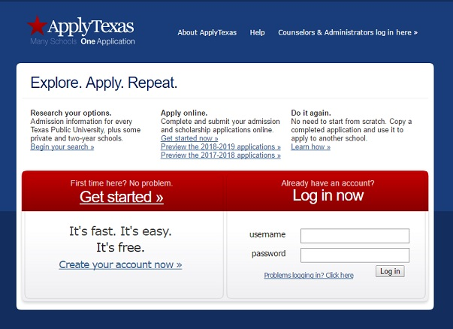
Apply for Admission
Notes:
Once you have decided on your transfer school, it’s time to start the application process. If you plan to attend a Texas university, most institutions use the Apply Texas Application. Be aware that you will most likely be required to pay an application fee before you can start. Some private schools may have their own application provided on their website.
https://www.applytexas.org/adappc/gen/c_start.WBX

Slide 5
Apply for Admission
Apply early
Submit additional required documents
Prepare admissions essay
Notes:
Apply early – Check the university’s website for admission deadlines. Submitting your application at least 6 months in advance is highly encouraged. Applying early could also increase your chances of receiving transfer scholarships.
Submit Documents – Pay attention to additional required documents such as official transcripts, test scores, and essays. Each university has different requirements.
If you are still taking courses at Lone Star when you apply, you will need to submit another official transcript once your last courses here are complete.
Prepare Admissions Essay – If the institution requires an admissions essay, begin working on a 500 word essay describing your purpose for applying to that specific institution and informing the admissions committee of any valuable information that they cannot obtain simply by looking over your transcript.

Slide 6

Apply for Financial Aid
Notes:
Once you have submitted your application for admission, you should apply for financial aid by submitting your FAFSA – Free Application for Federal Student Aid.
https://fafsa.ed.gov/
Completing the FAFSA will allow your transfer institution to determine if you qualify for financial aid, what types of aid you are eligible for, and how much aid you can receive.
Early completion of the FAFSA ensures you have time to collect any additional documentation needed so that your funds are ready in time for enrollment.
Many universities offer scholarships that transfer students are awarded automatically if certain GPA and credit qualifications are met. Be aware that some institutions may require you to fill out a separate scholarship application apart from FAFSA.

Slide 7
Important Transfer Policies
Transfer Credit Maximum
Special Admissions Requirements
6 Drop Rule
Notes:
Here are some important transfer policies to be aware of:
Transfer Credit Maximum – Most universities will only accept up to 66 hours of transfer credit from another institution. Be sure to check with your transfer school because this can vary.
Special Admission Requirements – Some majors/colleges will impose special admission criteria in addition to general transfer admission standards for specific programs regarding GPA, the number of allowable transfer credits etc.
Six Drop Rule – As of Fall 2007, students are only allowed six Ws (withdrawals) throughout an entire undergraduate career.

Slide 8
Resources
LSC Tomball’s Transfer Page
  http://www.lonestar.edu/transfer-tomball.htm
Apply Texas
  https://www.applytexas.org/adappc/gen/c_start.WBX
FAFSA
  https://fafsa.ed.gov/
College For All Texans
  http://www.collegeforalltexans.com/
Notes:
Here are quick links to great resources that can assist you with the transfer planning process.
LSC Tomball specifically offers a transfer page that includes information about transfer admission requirements, transfer scholarships, transfer guides, and more for multiple schools in Texas.

Slide 9
LSC Tomball Advising and Counseling
Location
Office C-100
Phone Number
281.351.3310
Email
tcinfo@lonestar.edu
Office Hours
Monday -Thursday
8:00 a.m. - 7:00 p.m.
Friday
8:00 a.m. - 4:30 p.m.
Saturday
9:00 a.m. - 2:00 p.m.
Notes:
For additional questions and assistance, please stop by our Advising and Counseling office or contact us by phone or email.
Thank you for joining me and have a great day!

