Slide 1

RSO
Risk Management Training
The Office of Student Life

Slide 2
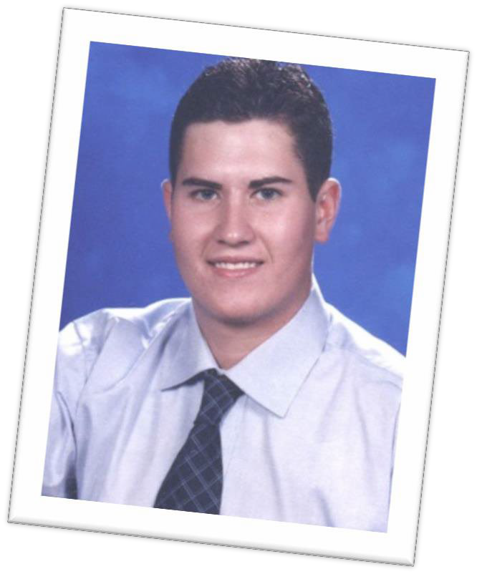
Clay’s Bill / House Bill 2639
Clay R. Warren was an ambitious Texas Tech freshman. Tragically his life was cut short in an automobile accident while returning home from his fraternity’s event on September 21, 2002. This accident could have been prevented. The driver had stayed up pretty late the night before and was sleep deprived.
Moreover, if the fraternity Clay belonged to had some guidelines on trips and other activities, Clay would not have died.

Slide 3
Clay’s Bill / House Bill 2639
Effective September 1, 2007, the 80th Texas Legislature enacted HB 2639/SB 1138 (Texas Education Code Section 51.9361) regarding risk management education for members and advisors of student organizations registered at postsecondary educational institutions.
Under the law, Registered Student Organization (RSO) Advisors and Officers are required to attend an annual Risk Management
Program.
Advisors and Officers are required to then report on the information gathered here to the entire organization’s membership after the Training event.

Slide 4
Clay’s Bill / House Bill 2639
REP. JOHN SMITHEE – Main Author of the Bill
“The goal is to make sure that everyone on campus knows there are some guidelines to follow before planning activities, such as parties and trips, and just as important – to discourage hazing, boozing, and other illegal activities.”
VI.D.1.05 Required Risk Management Training for Student Groups

Slide 5
Risk Management Training Topics
Risk Management Program Overview
Accommodations for Students with Disabilities
Alcohol & Illegal Drugs
Drug/Alcohol Overdose & Response
Hazing
Sexual Abuse & Harassment
Fire & Safety Issues
Travel Policies & Procedures
Behavior at Registered Student Organization Events

Slide 6
What is Risk Management?
Risk Management is the process of:
  Advising organizations of the potential and perceived risks involved in their activities
  Providing education about the guiding boundaries established for organizations
  Taking corrective actions and proactive steps to minimize accidental injury and/or loss.
The goal of our proactive risk management guidelines is to ensure that student organizations plan and host events where everyone involved has a safe and fun experience!

Slide 7
Types of Risk
Physical - Bodily injuries that occur from participation in an activity
  Obvious risks such as rope climbing
  Less obvious such as food-borne illnesses from a picnic
  Other: injury, illness, death, hazing, sexual assault, high-risk, excessive drinking
Reputation - Incidents that may lead to defamation or portray a bad image of the individual officers and members present, the reputation of the student organization, and the reputation of the university as a whole.
  The media, alumni, family, donors, views from other members of the community

Slide 8
Types of Risk
Emotional – Incidents that alienate or harm the feelings of members of the community
  Selecting a theme for your event that stereotypes/offends a particular group
  Psychological, hazing, sexual assault, eating disorders, alcohol and drug abuse
Financial - Occurrences that negatively impact the fiscal stability of the organization
  Paying for damages incurred by a band you booked to play on campus
  Theft or misuse of funds due to poor accounting, money handling, fundraising, budgets, or financial oversight

Slide 9
Types of Risk
Facilities - include both the safety of the facilities used for your members/participants and the maintenance of the facilities used by your members/participants.
  Fire safety, property damage, exceeding room capacity, crowd control, driving, weather
  Reserving a space that is too small for the number of participants that show up

Slide 10


Accommodations for Students with Disabilities

Slide 11
Students with Disabilities
Student Organizations do not discriminate against persons with disabilities. All are welcome and encouraged to participate in groups and activities that are of interest
Should a student need an accommodation to fully participate in the group of activities, the organization and the Disability Services Office will work together with students to make sure they have full access!
Section 504 of the Rehabilitation Act of 1973 prohibits
discrimination against people with disabilities in programs that receive federal financial assistance
Section 504 works together with the ADA and IDEA to protect children and adults with disabilities from exclusion, and unequal treatment in schools, jobs and the community

Slide 12
LSC Accommodation Policies
VI.D.11 Students with Disability Rights
The College recognizes and supports the principles set forth in federal and state laws designed to eliminate discrimination against qualified individuals with disabilities. The College believes in equal access to educational opportunities for all individuals. The College is committed to making reasonable accommodations, including furnishing auxiliary aids and services, for qualified individuals with disabilities as required by law.
VI.D.11.02. Student Responsibility to Request Accommodation
Students with disabilities have the right to an equal opportunity to participate in and benefit from College services, programs, facilities or activities. Students are responsible for identifying themselves as individuals requesting accommodation based on a qualifying disability each semester. Students shall direct accommodation requests to one of the College’s Disability Services Offices.

Slide 13


Alcohol & Illegal Drugs

Slide 14
Staggering Statistics
Alcohol Consumption: About four in five of all college students drink, including nearly 60% of students aged 18 to 20.
Binge Drinking: More than 40% of college students have reported engaging in binge drinking at least once during the past 2 weeks.
Deaths: An estimated 1,825 college students between the ages of 18 to 24 die each year from unintentional, alcohol-related injuries, including motor vehicle crashes.
Injuries: An estimated 599,000 students between the ages of 18 and 24 are unintentionally injured under the influence of alcohol each year.
Assaults: An estimated 696,000 students between the ages of 18 and 24 are assaulted by another student who has been drinking each year.
Sexual Abuse: An estimated 97,000 students between the ages of 18 and 24 are victims of alcohol-related sexual assault

Slide 15
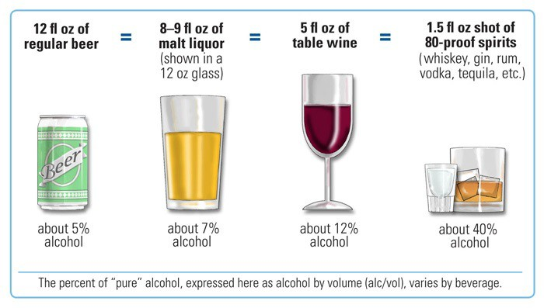
Standard Drink Size

Slide 16
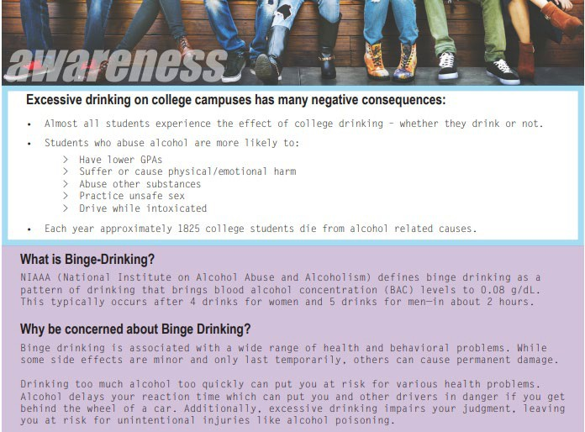
Standard Drink Size

Slide 17
Texas Alcohol Laws
Minimum Age Laws in Texas
People must be at least 21 years of age to legally consume alcoholic beverages in Texas with certain exceptions, as in any other state in the United States. However, employment at a company serving alcoholic beverages can be entered into at age 18 provided they get certified by the Texas Alcoholic Beverage Commission.

Slide 18
Providing Alcohol to Minors
Providing alcohol to a minor is:
  A Class A misdemeanor.
  Punishable by a fine up to $4,000, confinement in jail for up to a year, or both.
  Could also result in community service and enrollment in an alcohol awareness program.
  Could prevent potential employment opportunities to students pursuing careers in education, law, criminal justice, and other fields.

Slide 19
Driving Under the Influence
Texas has a ZERO Tolerance law for minors (under 21) who operate a motor vehicle in a public place while having any amount of alcohol in their system.
Class C misdemeanor, punishable up to a $500 fine.
Community Service (approximately 8-40 hours required).
Driver’s license suspended for 30-180 days.
Required to be enrolled in an alcohol awareness course.

Slide 20
Driving While Intoxicated
A DWI is defined as any person who is intoxicated while operating a motor vehicle in a public place. DWI is classified as a Class B misdemeanor which results in confinement in jail for a minimum of 72 hours.
Driving WHILE Intoxicated with an Open Container Section 49.04 of the Texas Penal Code. Classified as a Class B misdemeanor, with a minimum term of confinement of 6 days.

Slide 21
What is the 911 Lifeline Law?
Fact: The legal drinking age in Texas is 21
Fact: Many Texas teens under the legal drinking age drink
Fact: Many of these Texas teenagers die from alcohol poisoning
Fact: Many of these deaths could have been avoided if a friend had called 911
Section 106.04 of the Texas Alcohol Beverage Code was amended in 2011 by the
Texas Legislature to address alcohol poisoning. Under the law, a person under 21 cannot be charged by the police for possessing or consuming alcohol if the person calls 911 because someone else might have alcohol poisoning. This limited immunity applies only to the first person to call for medical assistance. To qualify for immunity, the caller must remain on the scene until medical assistance arrives and must cooperate with EMS and law enforcement.

Slide 22
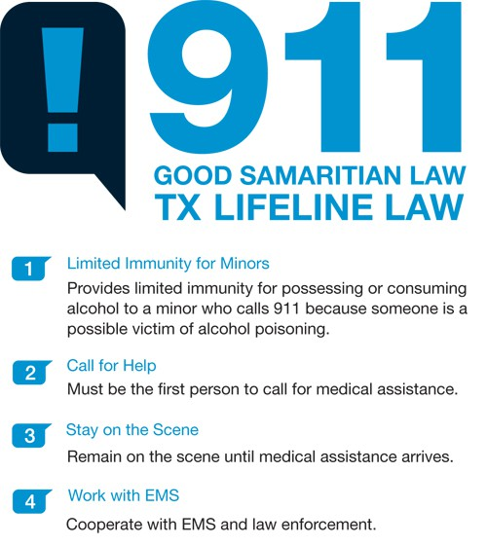
What is the 911 Lifeline Law?

Slide 23
LSC Student Responsibilities
VI.E.1. NON-ACADEMIC STUDENT CODE OF CONDUCT
VI.E.1.01 POLICY - The College provides a safe and responsive learning environment for all students. The College achieves that environment by enforcing the Lone Star College System Non-Academic Student Code of Conduct. The Non-Academic Student Code of Conduct applies to all students enrolled in a credit or non-credit course at the College. It also applies to all online-only and hybrid students.
For the full Listing of LSC Student Responsibilities, visit: www.lonestar.edu/student-responsibilities

Slide 24
Illegal Drug Use
Drug abuse can affect a person’s mental alertness, consciousness, cognitive and neurological functions, as well as lead to death, homelessness, loss of family and friends and even prison.

Slide 25
Controlled Substances under Texas Law
Also known as CDS, or controlled dangerous substances, these drugs include: heroin ; cocaine; meth; marijuana, as well as the compounds used to manufacture narcotics, synthetic steroids, depressants, and stimulants . These are substances with high potential for abuse which may lead to severe psychological or physical dependence.

Slide 26
Drug Possession in Texas
Texas state law imposes penalties that range from a relatively minor misdemeanor to severe felony charges. Depending on certain factors or circumstances charges could be drug possession or drug possession with intent to distribute.
Determining factors include:
Quantity
How the drug was concealed or stored
Possession of drug with paraphernalia (scale)
Drugs found with a large amount of money
Past convictions/prior offenses

Slide 27


Drug/Alcohol Overdose & Response

Slide 28
Drug/Alcohol Overdose & Response
Drug and alcohol abuse always carries the risk of serious side effects, including overdose.
Whether you abuse alcohol, an illegal drug such
as Cocaine, or Medications Prescribed by a doctor—such as Opioid painkillers—addiction development will always be a concern.
In many cases, if substance abuse behavior persists, there remains a real possibility of a drug overdose.
Any drug overdose can be either accidental or intentional.

Slide 29
Signs & Symptoms of Drug/Alcohol Overdose
The physical and psychological signs of a drug overdose can vary depending on the type of drug taken, and whether the drug was taken in combination with other substances.

Slide 30
Common Signs & Symptoms
Mental Confusion Unresponsiveness Snoring or Gasping Throwing Up
Hypothermia Erratic Breathing
Loss of Consciousness
Pale or blue skin

Slide 31
What to do in the Event of an Overdose?
If you or a loved one has potentially overdosed on drugs, seek immediate medical attention by calling 911 to receive emergency help right away. You might also implement a few of the following procedures while waiting for medical personnel to arrive.
However, be sure to avoid putting your own safety at risk since certain drugs can prompt violent or unpredictable behavior in the person taking them.

Slide 32
What to do in the Event of an Overdose?
Check the person’s breathing and heart rate.
If the person is unconscious, try to get a response. Ask the person questions to assess their level of alertness and to calmly keep them engaged, if possible.
If the person is not breathing, turn them on their side.
If you are medically qualified to do so, provide CPR if necessary.
Give first aid as directed by 911 operators.
Do not allow the person to take any more of the substance.
Obtain as much information as possible, including the dose and the last time the person took the drug.

Slide 33
What to do in the Event of an Overdose?
If prescription medications or otherwise labeled substances have been used, take the container with you to the ER, even if it is empty.
Make note of any identifying paraphernalia, or bring along any containers of other drugs or substances the person may have taken.
Do not try to reason with the person or give your opinions about the situation.
Stay as calm as possible while waiting for medical personnel arrive.
Assure the person that help is coming.

Slide 34
Preventing Drug & Alcohol Overdose
Of course, not using drugs is the most advisable way to prevent an overdose. But if you, or someone you care about, is already suffering from an addiction or demonstrating problematic substance use behavior, taking certain steps can help decrease the likelihood of overdose, including:
Increasing your awareness of overdose signs and risks
Knowing the drug and dose of the drug you are taking
Avoiding multiple substance use (e.g., do not drink alcohol if you are using any drug)
Starting with a low dose if you haven’t used in a while
Using in the presence of another person, if you must use. If you do overdose, the person can seek help
Seeking substance abuse treatment if you think you have an addiction

Slide 35

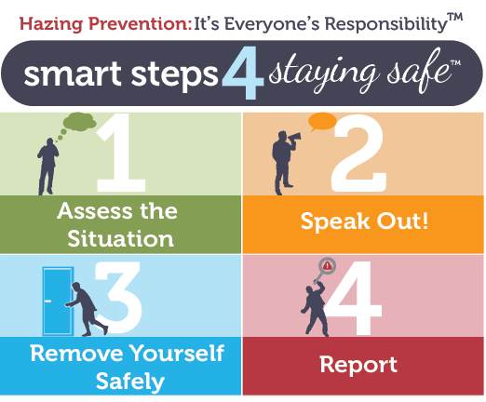
Hazing

Slide 36

What is Hazing?
College Hazing is a ritual that involves risk, pain, or harm to gain some form of initiation . College hazing often involves excessive alcohol consumption or ritualized pain endurance .
Fifty-five percent of students involved in athletics or clubs have experienced hazing.
Hazing deaths on college campuses have led to anti-hazing laws across the country.

Slide 37




LSC Hazing Policy
VI.E.1.02 Definitions
f. Hazing means any intentional, knowing, or reckless act directed against a student that endangers the student’s mental health, physical health, or safety. A student organization cannot require such acts to initiate, affiliate, appoint, or maintain membership in any student organization. Whether the act occurs on or off the College’s property remains irrelevant.
THE LSC HAZING WEBSITE IS LOCATED AT: HTTP://WWW.LONESTAR.EDU/HAZING

Slide 38
LSC Hazing Policy
As of Spring 2020, in compliance with Texas law, a report will be published on the LSC website identifying any hazing incidents reported against an organization that is registered or recognized by the College. When incidents are reported, the public report will contain:
The organization name with information on disciplinary action taken by the College against an organization for hazing
The date of the hazing incident or that the citation was issued and a description of the incident
The date the College’s investigation began
A list of the code of conduct violations or of criminal charges filed
The findings of the College or court and sanctions imposed on the organization
The date the disciplinary process was resolved or the date the conviction became final
Information on all hazing convictions during the past three years

Slide 39
Hazing Offenses
Personal Hazing Offense:
A person commits an offense if the person: Engages in hazing; solicits, encourages, directs, aids or attempts to aid another in engaging in hazing; intentionally, knowingly, or recklessly permits hazing to occur; or has firsthand knowledge of the planning of a specific hazing incident that has occurred, and knowingly fails to report said knowledge in writing to Student Life or other appropriate official(s) of the institution.
Organizational Hazing Offense:
An organization commits an offense if the organization condones or encourages hazing or if an officer or any combination of member(s), pledge(s), or alumni of the organization commit(s) or assist(s) in the commission of hazing.

Slide 40
Organizational Hazing Offense , cont.
In the prosecution of an offense under this subchapter, the court may grant immunity from prosecution for the offense to each person who is subpoenaed to testify for the prosecution and who does testify for the prosecution.
Any person reporting a specific hazing incident involving a student in an educational institution to Student Life or other appropriate official of the institution may be immune from liability, civil or criminal, that might otherwise be incurred or imposed as a result of the report.
Immunity extends to participating in any judicial proceeding resulting from the report.
A person reporting in bad faith or with malice is not protected by this section.

Slide 41
Reporting Hazing
A written report should be submitted to your campus Student Life office, reporting your firsthand knowledge that a hazing incident is being planned or has occurred.
The fact that a person consented to a hazing activity is not a defense to prosecution for hazing under the law. The penalty for failure to report hazing activities is a fine not to exceed $2,000 and/or up to 180 days of confinement in jail.

Slide 42

Sexual Abuse & Harassment

Slide 43
LSC Sexual Misconduct Policies
IX.A.1.1. Policy
“This policy specifically covers sexual misconduct including sexual harassment, violence, discrimination, and retaliation as prohibited by applicable laws and the College.
The College also prohibits unlawful discrimination based on other protected categories and discusses such prohibitions in the human resources and student policy sections.
The College does not tolerate retaliation against anyone who complains about sexual misconduct or cooperates in a sexual misconduct investigation.…”

Slide 44

Sexual Misconduct Terms & Definitions
SEXUAL ASSAULT: Sexual assault is an offense that meets the definition of rape, fondling, incest, or statutory rape as stated in the Federal Bureau of Investigation’s Uniform Crime Reporting Program.
SEXUAL DISCRIMINATION: Sexual discrimination, including sexual harassment, is illegal under both federal and Texas state law and is strictly prohibited by the College.
SEXUAL HARASSMENT (a form of sex discrimination) includes two categories: (1) hostile work environment sexual harassment, and (2) quid pro quo sexual harassment.
SEXUAL VIOLENCE: Sexual violence means a physical sexual act perpetrated without the complainant’s consent. This includes situations where a person is incapable of giving consent because of drug or alcohol impairment or a mental or physical disability

Slide 45





Sexual Misconduct Terms & Definitions
Consent: Consent is defined as a voluntary and positive agreement between the participants to engage in sexual activity.
Stalking: Stalking is defined as engaging in a course of conduct (two or more acts), including, but not limited to, a pattern of repeated and unwanted attention, harassment, or conduct, directed at a specific person that would cause a reasonable person to fear for his or her safety, the safety of others, or suffer substantial emotional distress.

Slide 46
TITLE IX HARASSMENT
Acts of Title IX harassment may take many different forms. Title IX harassment includes sexual harassment, gender-based harassment, and sexual violence. The following types of actions serve as non-exhaustive examples of Title IX harassment prohibited by this policy if sufficiently severe or pervasive:
Physical sexual acts perpetrated against a person’s will or when a person is incapable of giving consent
Direct or implied sexual statements or threats, demands for sexual favors, or sexual advances, accompanied by implied or actual promises of preferential treatment for submission to such demands
Any of the following if persistent and unwelcome: flirtation, requests for dates, staring, advances, or sexual propositions
Gratuitous displays of sexually suggestive objects or pictures
A pattern of conduct unrelated to an academic course or the requirements of the workplace intended to cause discomfort or humiliation
Treating individuals adversely because they do not conform to stereotypical norms of feminine or masculine gender behavior.
FOR THE FULL LSC SECTION IX.A SEXUAL MISCONDUCT POLICY VISIT WWW.LONESTAR.EDU/IXA-SEXUALMISCONDUCT

Slide 47
Reporting Sexual Misconduct
Report to the Police or campus official
Submit firsthand written documentation
Seek a network of support and/or professional counseling
Utilize campus resources/advocates
Implement protective/restraining order

Slide 48
LSCS Non-Academic Code of Conduct
LSCS Policy VI.E.1.03
Prohibited Conduct Examples
This policy strictly prohibits actions that harm or disrupt the college environment. This list is illustrative, not exhaustive, and applies to both on-campus and online interactions.
Threatening Behavior: Any action (physical or psychological) intended to instill fear, injury, or harm of others.
Physical Disruptions: Yelling, slamming objects, or other behavior that disrupts the flow of instruction or normal college operations.

Slide 49
LSCS Non-Academic Code of Conduct
LSCS Policy VI.E.1.03
Threatening Communication: Using oral or electronic language (messages, email, etc.) that threatens or is reasonably perceived as threatening the health and safety of others.
Other Conduct: Abuse, bullying, harassment, or intimidation that creates a hostile environment or interferes with an individual's ability to benefit from College services are also violations.

Slide 50
Reporting Process & Responsibilities
Prompt and thorough reporting is crucial for maintaining a safe environment.
Immediate Safety Concerns
  Crime in Progress / Immediate Danger: Call the LSC Police Department immediately at 281-290-5911 (or 911 off-campus).
  Non-Emergency LSC Police: 832-813-6800.
Filing an Official Report
  The College uses a centralized system for non-academic misconduct reports.
  Advisors: BIT Form
  Students: Complaints Form
Victim's Responsibility: The victim is responsible for officially reporting the incident and filing the appropriate paperwork to initiate a formal conduct review.

Slide 51

How to Report:
  Online: Use the LSC Incident Reporting System.
  By Phone: Call 855-731-8060.
  Details Needed: Reports should be made in writing and include all known facts: dates, times, places, people involved, and available evidence.
Scope of Assistance
  Student Life Role: Student Life and other staff (Campus Security Authorities or RSO Advisors) can assist in giving guidance and/or mediation if needed.
  Limitation: Student Life cannot file the official disciplinary report on the victim's behalf within the student conduct system unless legally required for specific serious offenses like sexual misconduct.
  Protection: Reports made in good faith are protected from retaliation; however, knowingly making false reports is considered misconduct itself.

Slide 52
Internal Resources/Support
Any LSC Office of Student Services
LSC Police Department 281-290-5911
LSC Office of Emergency Management 281-290-2891
Title IX Coordinator 832-813-6614 LSC-TitleIX@LoneStar.edu

Slide 53
External Resources/Support
Northwest Assistance Ministries Family Violence Center
281-885-4673
Family Time Crisis Counseling Center (Humble)
281-446-2615
Domestic Violence Hotline
713-528-2121 / 713-528-3625 (TDD)
Sexual Assault Hotline
713-528-7273 / 713-528-3691 (TDD)

Slide 54
External Resources/Support
Montgomery County Women’s Shelter
713-528-7273 / 24-Hour Hotline 936-441-7273
Ben Taub Hospital
713-873-2000
MHMR Authority of Harris County
7011 Southwest Freeway, Houston 77074
Crisis Telephone: 866-970-7770
Main Telephone: 713-970-7000, Website: http://www.mhmraharris.org

Slide 55


Fire and General Safety

Slide 56
Fire Safety
Always have a plan
Fire alarm = evacuate building immediately
Help others if necessary/possible
Have a meeting place
Call in the exact location of the fire (911)
Sign up for LSC Text & E-mail Alerts in your myLoneStar portal.

Slide 57


LSC Weapons Policy
VI.E.1.02 Definitions
Prohibited weapons include:
  Firearms*
  Ammunition
  Explosive Weapon (bomb, grenade, rocket…)
  Illegal Knife (blade over 5 ½ inches, switchblade, spear)
  Taser
  Knuckles (or similar device)
  Chemical Dispensing Device
  Zip Gun
  Club (designed for inflicting bodily harm)
For full LSC policy listings visit: www.lonestar.edu/student-responsibilities

Slide 58
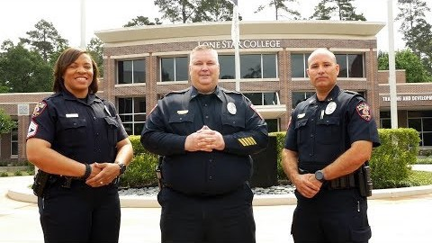
Campus Carry

Slide 59
In Case of Emergency
The LSC Office of Emergency Management has developed posters which are displayed in offices and classrooms throughout each campus. These posters have information on what to do in case of:
Fire
Suspicious Person/Object or Active Shooter
Bomb Threat/Explosion
Hazardous Materials
Medical Alert
Severe Weather
Power Failure
Campus Warnings
Helpful information on what to do when law enforcement arrives on the scene.
LSC Police/Medical: 5911 (from campus phone) or 281.290.5911
Fire: 9911 (from campus phone) or 911, then call 5911

Slide 60


Travel Policies & Procedures

Slide 61

Student Travel
Travel is considered to be required by a registered student organization when the travel is a part of the organization’s official activities, including attendance and participation at conventions, workshops, athletic events, and non-athletic competitions.
Modes of transportation used for student travel may include, but are not limited to, commercial airlines, college-owned or leased cars or vans, or commercially owned and operated buses or vans.
Before departing on a trip covered by LSCS, a trip plan and appropriate emergency information must be submitted to and reviewed by the Office of Student Life and the Office of Risk Management

Slide 62
Non-Academic Student Travel
Travel requiring Student Travel Paperwork applies to travel that meets the following conditions:
Must be at least farther than 25 miles from the closest LSC campus or center to the final destination.
Not directed by instructional employee to achieve an academic objective.
Either: a) The College funds the travel and uses college-owned or –
leased vehicle, OR b) An RSO requires the travel. Definition of required is ”travel related to the organization’s official activities, including attending and participating at conventions, workshops, athletic events, and non-athletic competitions. The definition does not include social or optional events…”

Slide 63
Planning Your Travel
When planning student travel, it is important to keep some basics in mind and direct questions to Student Life,
Plan ahead! Student travel is complicated and will take time to process
Submit an event registration 30 days prior to the date of travel to get the process started
Advisors will need a T&E Card or ProCard when traveling
Think about safety in your planning
Communicate your travel itinerary clearly with all participants
All college policies apply for college-sponsored activities, even when they occur off college premises
The full student travel policy Section VI.D.1.03 can be located at: www.lonestar.edu/student-welfare-rights

Slide 64

Required Travel Paperwork
Approval of College Sponsored Student Travel (TR1) must be completed and signed at least 30 days before a trip occurs. Student Life will route this form for signatures.
Within five (5) business days of the activity and/or event, individuals or groups intending to travel under this policy will complete and submit the following documents to the Student Life office:
Trip Plan and Trip Roster (TR2)
Participant Release & Indemnification Agreement (TR3) and Authorization for Emergency Medical Treatment must be completed by all student participants. Staff/Faculty will need to submit an approved Travel Authorization.
Student Travel Waiver and Hold Harmless Agreement (TR4) (if transportation not provided by the College)
LSC Policy Manual - Section VI.D.1: Link to Non-Academic Student Travel Forms:
HTTP://WWW.LONESTAR.EDU/POLICY

Slide 65
Student-Provided Transportation
The following apply when student-owned vehicles are used for Non-Academic Student Travel:
Students are not covered by the College’s vehicle insurance policies and cannot be College-approved drivers
Adult students drive their own private vehicles at their discretion and peril and adult students riding with another student do so at their discretion and peril.
College employees cannot arrange for students to drive other students
All student drivers must sign a liability waiver for driving their own vehicle and submit this in accordance with the Necessary Student Travel Paperwork
All student-owned vehicle accidents and collisions must be covered by the student’s vehicle insurance policy
The Non-Academic Student Travel conditions must be detailed in the appropriate form submitted with the Necessary Student Travel Paperwork AND the College must provide student drivers with directions to the intended destination

Slide 66
College-Provided Transportation
A driver transporting students in College-owned, -leased, or –rented vehicles must meet the following qualifications:
Be a College employee approved by the Chief Student Services Officer
Have a valid driver’s license appropriate for the vehicle being driven, AND
Have a satisfactory driving record.

Slide 67
Driver Responsibilities
Ensure that passenger numbers do not exceed the vehicle’s designated passenger capacity-each passenger must be secured by a seat belt
Driver may not drive more than 3 consecutive hours without a 15-minute break from driving.
Driver may not read emails or text messages while driving students.
Driver must obey all safety procedures and traffic laws.

Slide 68


Behavior at Registered Student Organization Events

Slide 69

What to Consider when at an event?
Myself
My Family
My Organization
My College
VI.E.1. Non-Academic Student Code of Conduct

Slide 70
When planning social events, there are some guidelines to help keep things safe and fun:
All events must be registered by completing a Student Life Event Registration Form. Events must be submitted for approval by Student Life at least 10 business days prior to the event.
All LSC policies apply for student organization events, whether held on campus or off campus.
When planning social functions, student organizations must consider the potential risks and work to minimize them for the safety of participants and the college.

Slide 71
Participants in off campus events are serving as ambassadors for the College. Therefore, they must exhibit behaviors that are appropriate for such representation. Students can be sanctioned by the College for inappropriate behaviors at off campus college-sanctioned events where college policy is violated.

Slide 72
LSC Student Life Contact Information
Office of Student Life, LSC-North Harris
Kelsey Jackson – Manager, Student Activities Kelsey.Jackson@Lonestar.edu

Slide 73
Thank you
& Be Safe

