Slide 1
How to:
Course Evaluation
ASC Lab

Slide 2
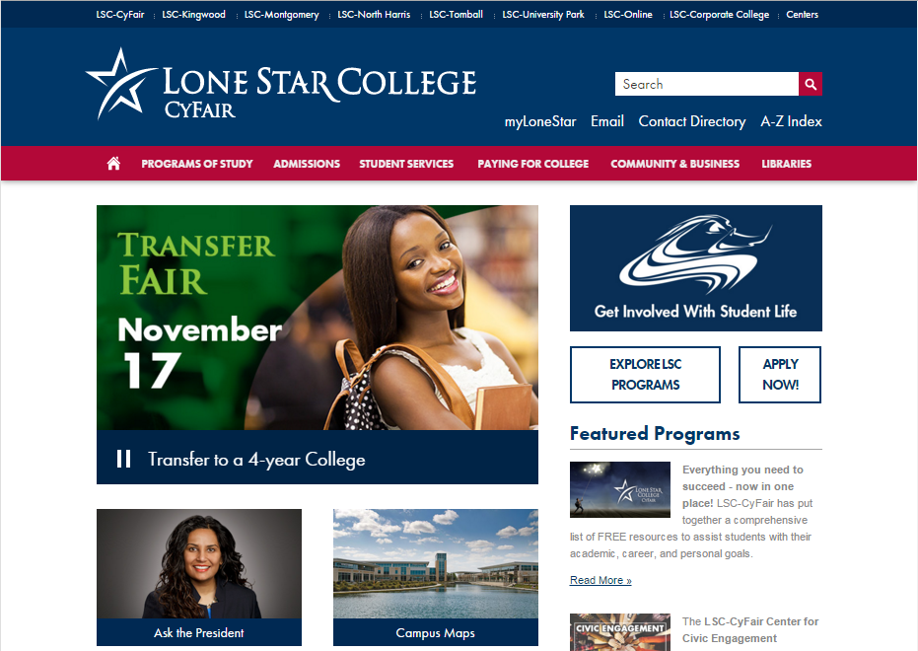
Step 1: Go to LoneStar.edu
Step 2: Click on myLoneStar

Slide 3
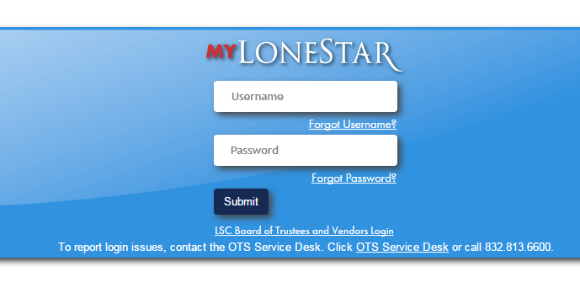
Step 3: Log on
*If you have forgotten your Log-in information, Click on Forgot Username? Or Forgot Password?

Slide 4
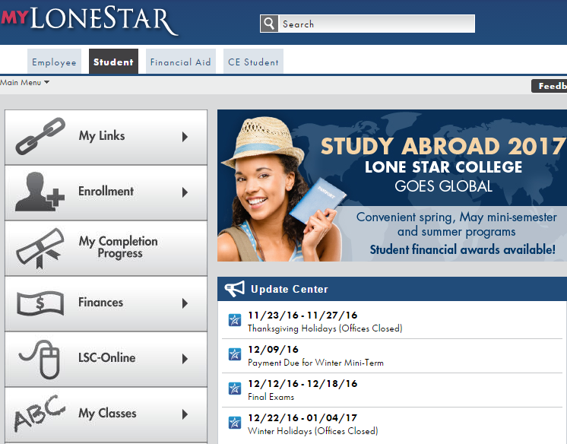
Step 4: Click on Student tab
Step 5: Click on Enrollment tab

Slide 5
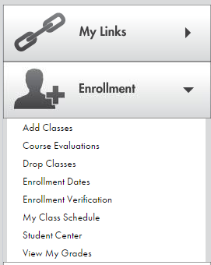
Step 6: Click on Course Evaluation

Slide 6
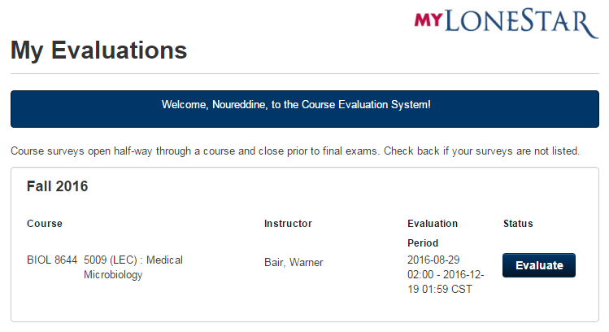
Step 7: Look for your Course and Instructor
Step 8: Click on Evaluate

Slide 7
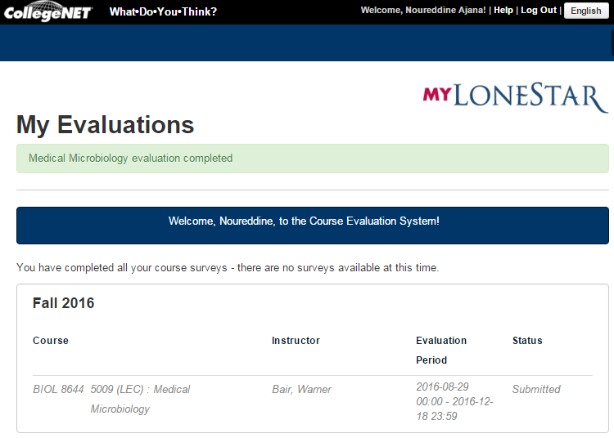
Step 9: Click on Log Out when you have completed your course evaluation

