Slide 1
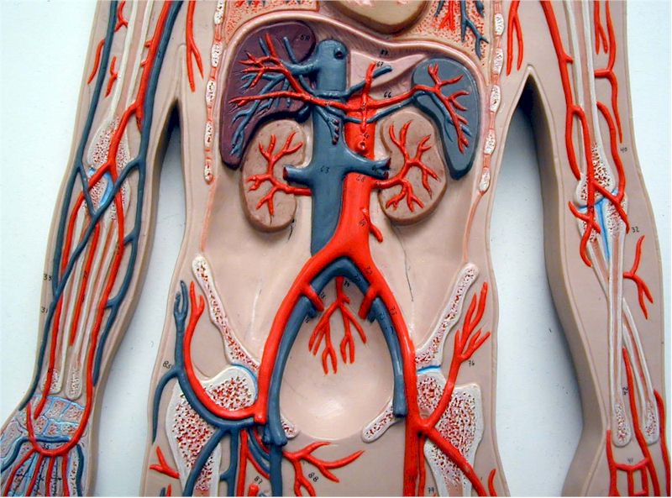
Renal
arteries
What are these?

Slide 2
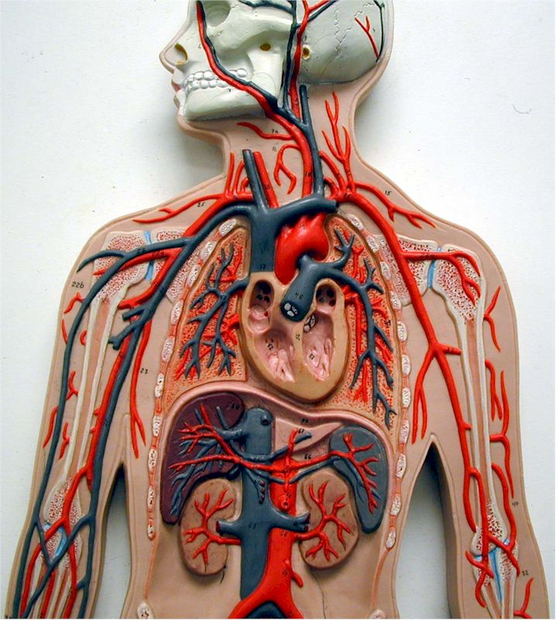
R & L
Subclavian
arteries
What are these?

Slide 3
External
iliac
arteries
What are these?

Slide 4
R & L
axillary
arteries
What are these?

Slide 5
Radial
vein
What is this?

Slide 6
Brachio-
cephalic
veins
What are these?

Slide 7
R & L
brachial
arteries
What are these?

Slide 8
Internal
iliac
arteries
What are these?

Slide 9
Internal
Iliac
veins
What are these?

Slide 10
Jugular
veins
What are these?

Slide 11
Radial
artery
What is this?

Slide 12
Renal
veins
What are these?

Slide 13
What is this?
Aorta

Slide 14
Subclavian
vein
What is this?

Slide 15
Superior
Vena cava
What is this?

Slide 16
Axillary
vein
What is this?

Slide 17
Common
iliac
arteries
What are these?

Slide 18
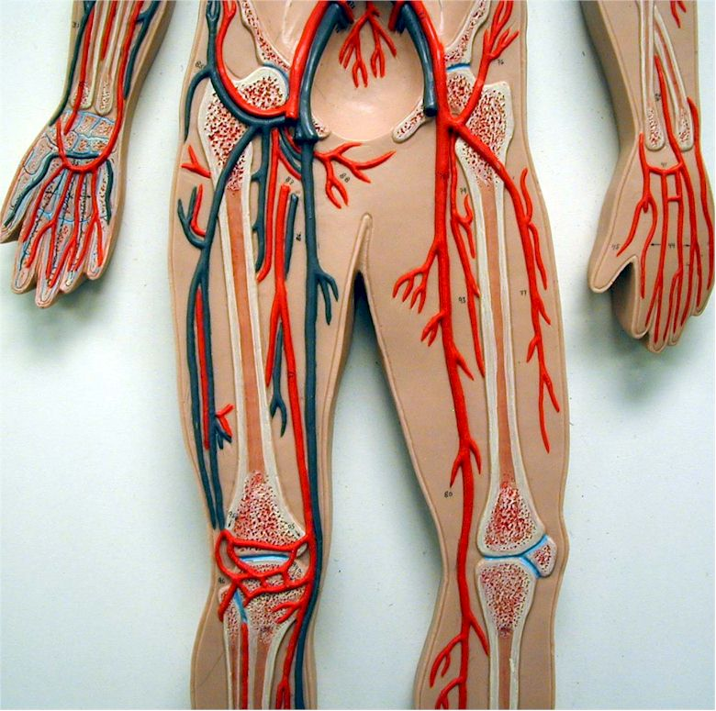
Femoral
artery
What is this?

Slide 19
Common
Iliac
veins
What are these?

Slide 20
Brachial
vein
What is this?

Slide 21
Common
carotids
What are these?

Slide 22
Ulnar
artery
What is this?

Slide 23
External
Iliac
veins
What are these?

Slide 24
Brachio-
Cephalic
trunk
What is this?

Slide 25
Ulnar
Vein
What is this?

Slide 26
Inferior
Vena cava
What is this?

Slide 27
Femoral
vein
What is this?

Slide 28
Celiac
artery
What is this?

