Slide 1
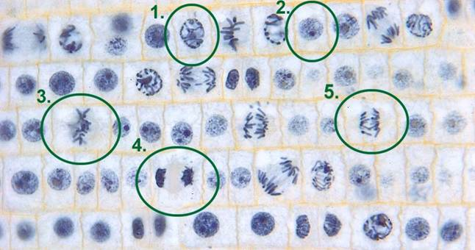
In what phase is cell #1?
prophase

Slide 2
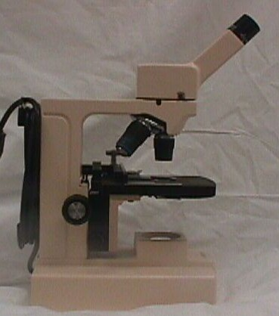
Name this part of the microscope.
arm

Slide 3
In what phase is the cell at the end of the arrow?
interphase

Slide 4
Name this part of the microscope.
body

Slide 5
In what phase is the cell at the end of the arrow?
telophase

Slide 6
Name this part of the microscope.
Coarse
Adjustment
knob

Slide 7
In what phase is cell #3?
metaphase

Slide 8
Name this part of the microscope.
Fine
Adjustment
knob

Slide 9
In what phase is cell #2?
interphase

Slide 10
Name this part of the microscope.
eyepiece

Slide 11
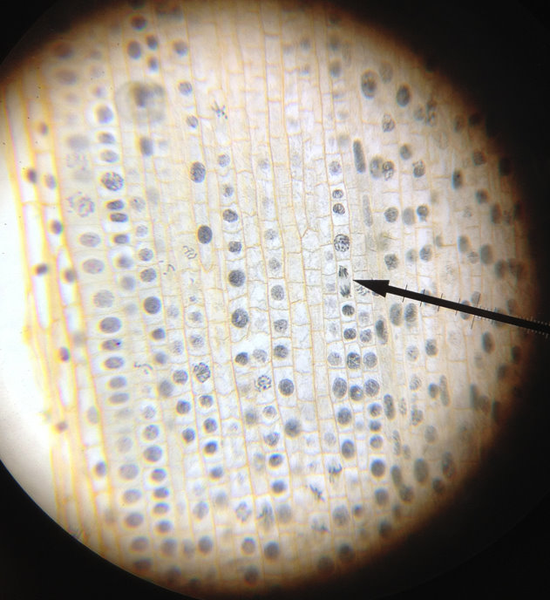
In what phase is the cell at the end of the red arrow?
prophase

Slide 12
Name this part of the microscope.
Stage

Slide 13
In what phase is the cell at the end of the arrow?
anaphase

Slide 14
In what phase is the cell at the end of the pointer?
anaphase

Slide 15
What is the cell structure at the end of the arrow?
nucleus

Slide 16
Name this part of the microscope.
Objective lens
Scanning, low & high
power

Slide 17
In what phase is the cell at the end of the arrow?
metaphase

Slide 18
In what phase is the cell at the end of the arrow?
prophase

Slide 19
Name this part of the microscope.
Coarse
Adjustment
knob

Slide 20
In what phase is cell #5?
anaphase

Slide 21
Name this part of the microscope.
base

Slide 22
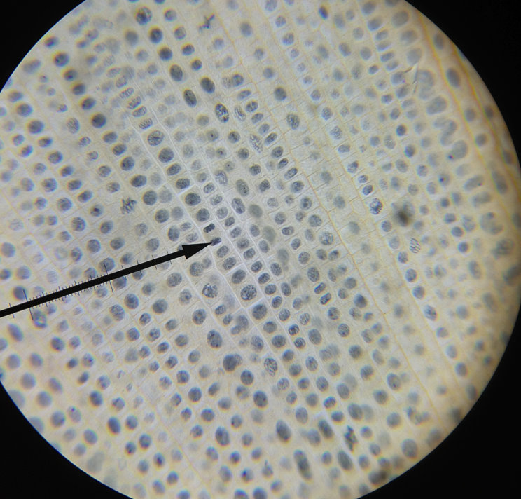
In what phase is the cell at the end of the pointer?
telophase

Slide 23
What part of the cell is at the end of the arrow?
cytoplasm

Slide 24
In what phase is the cell at the end of the red arrow?
metaphase

Slide 25
In what phase is cell #4?
telophase

Slide 26
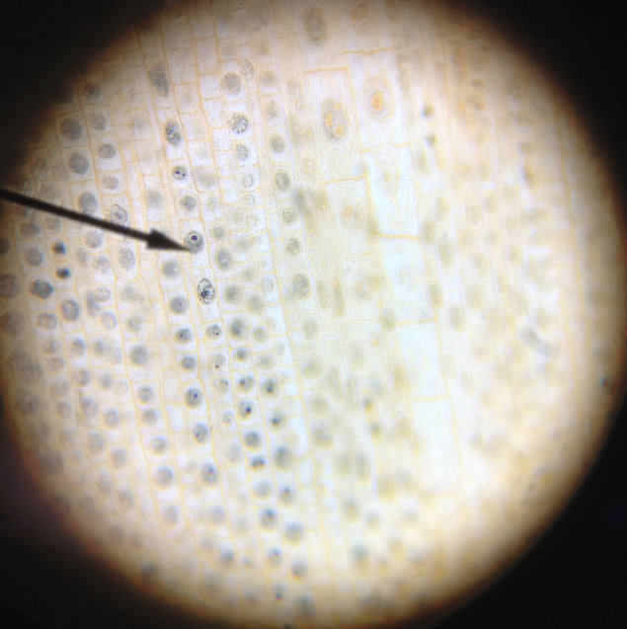
In what phase is the cell at the end of the pointer?
interphase

Slide 27
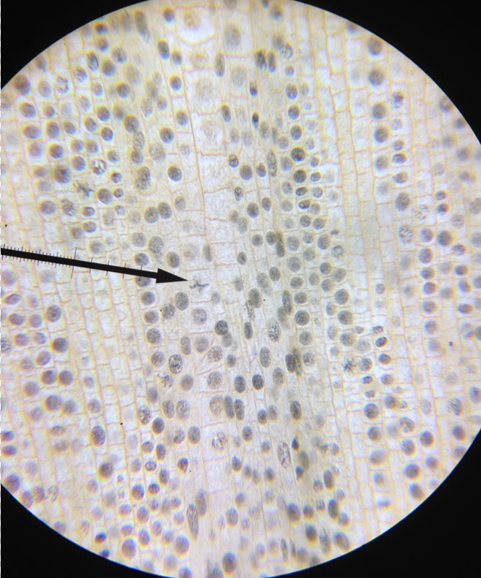
In what phase is the cell at the end of the pointer?
metaphase

