Slide 1
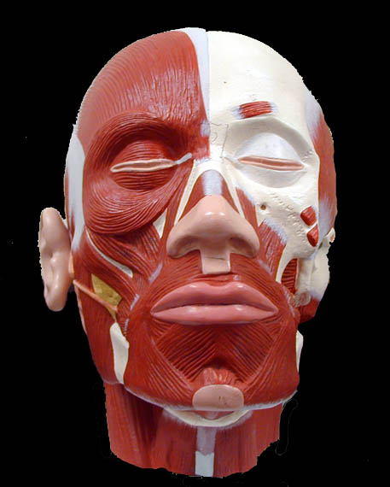
Name this muscle.
Orbicularis
oris

Slide 2
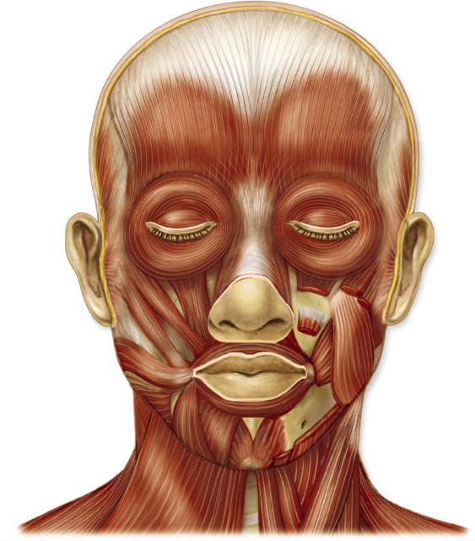
What is the name of these muscles?
Zygomaticus

Slide 3
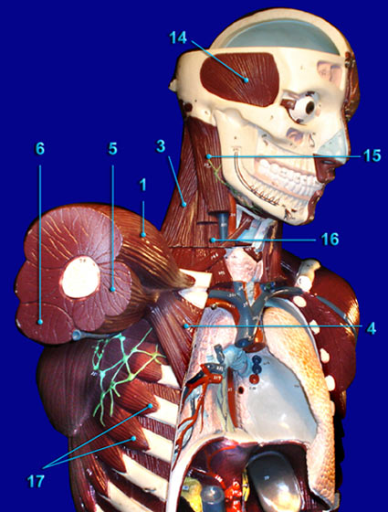
What is the name of 16?
Scalenes

Slide 4
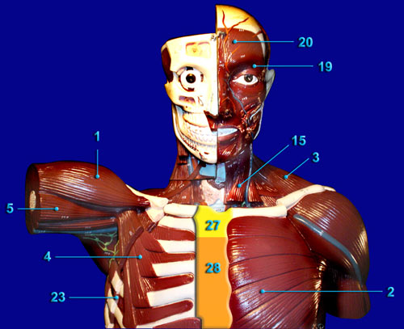
Name muscle #20.
Frontalis

Slide 5
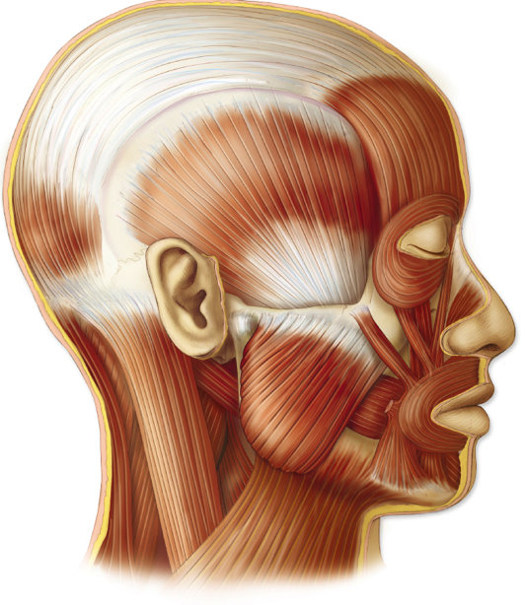
What is the name of this muscle?
Temporalis

Slide 6
What is the name of this muscle?
Biceps
brachii

Slide 7
What is the name of this muscle?
brachialis

Slide 8
What is the name of muscle #15?
Sternocleido-
mastoid

Slide 9
What is the name of muscle #6?
Triceps
brachii

Slide 10
What is the name of muscle 17?
Serratus
anterior

Slide 11
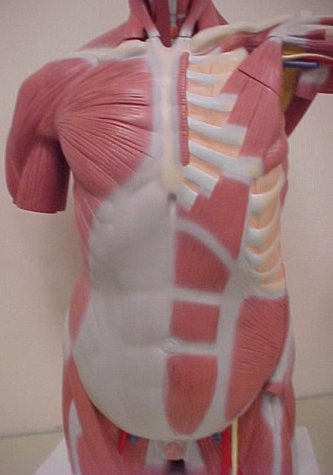
What is the name of this muscle?
Pectoralis
major

Slide 12
What is the action of the triceps brachii?
Extension
of forearm

Slide 13
What is the action of this muscle?
Closes
mouth

Slide 14
What is the name of muscle #5?
Biceps
brachii

Slide 15
What is the name of this muscle?
Rectus
abdominis

Slide 16
What is the action of the trapezius?
Rotation
of scapula

Slide 17
What is the name of this muscle?
Brachio-
radialis

Slide 18
What is the action of this muscle?
Extension
of forearm

Slide 19
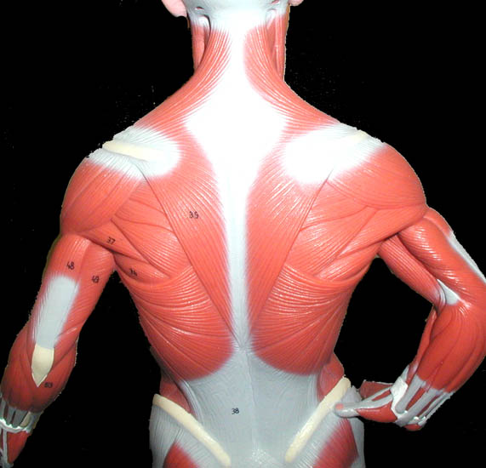
What is the name of these muscles?
Deltoids

Slide 20
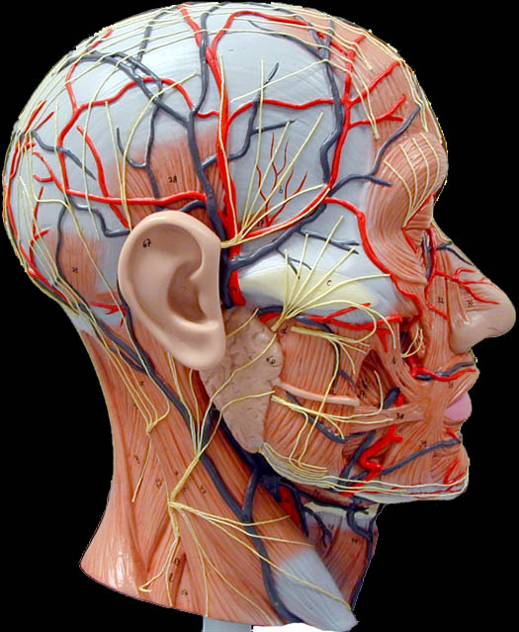
What is the name of this muscle?
Masseter

Slide 21
What is the action of this muscle?
Closes
eye

Slide 22
What is the name of this muscle?
Masseter

Slide 23
What is the action of this muscle?
Rotates
scapula

Slide 24
What is the action of the biceps brachii?
Flexion
of forearm

Slide 25
What is the action of the deltiod?
Abduction of
arm

Slide 26
What is the action of the rectus abdominis?
Compress
Abdominal
region

Slide 27
What is the name of these muscles?
Latissmus
dorsi

Slide 28
What is the name of this muscle?
Trapezius

Slide 29
What is the action of this muscle?
Flexion
of forearm

Slide 30
What is the name of this muscle?
Sternocleido-
mastoid

Slide 31
What is the name of this connective tissue?
Linea
alba

Slide 32
What is the name of this muscle?
Triceps
brachii

Slide 33
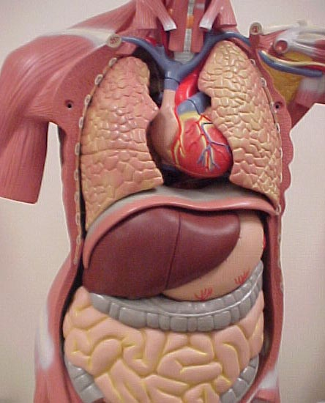
What is the name of this muscle?
diaphragm

Slide 34
What is the action of these muscles?
Abducts
arm

Slide 35
What is the name of this muscle?
Serratus
anterior

Slide 36
Name muscle #19.
Orbicularis
oculi

Slide 37
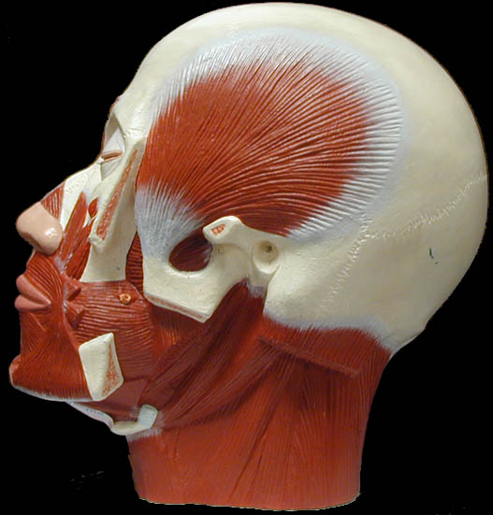
What is the name of this muscle?
Temporalis

Slide 38
What is the action of this muscle?
Elevates
mandible

Slide 39
Which muscle closes the mouth?
Orbicularis
oris

Slide 40
What is the name of this muscle?
Temporalis

Slide 41
Which muscle closes the eye?
Orbicularis
oculi

Slide 42
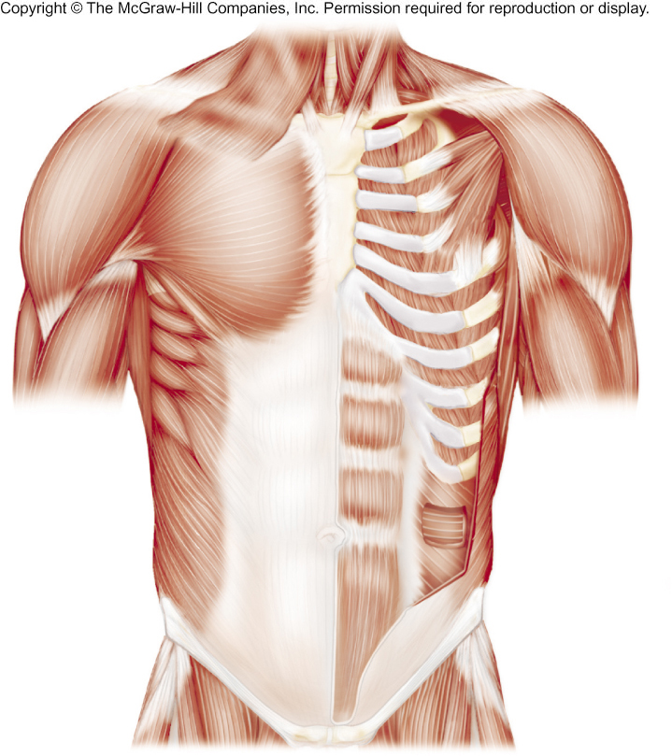
What is the name of this muscle?
Serratus
anterior

Slide 43
Name this muscle.
Frontalis

Slide 44
Name this muscle.
Buccinator

Slide 45
Which muscle elevates the mandible?
masseter

Slide 46
Name this muscle.
Orbicularis
oculi

Slide 47
What is the name of this muscle group?
Scalenes

Slide 48
Name this muscle.
Occipitalis

Slide 49
What is the name of this muscle?
Sternocleido-
mastoid

Slide 50
What is the name of these muscles?
Zygomaticus

