Slide 1
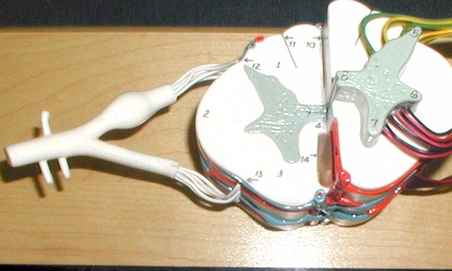
Central
canal
What is this part called?

Slide 2
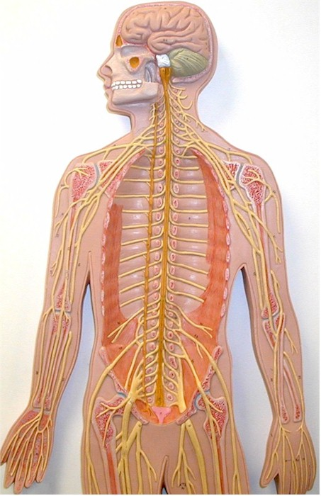
What is this nerve called?
ulnar
nerve

Slide 3
What is this nerve called?
femoral
nerve

Slide 4
What are these called?
Cervical
Spinal
nerves

Slide 5
Dorsal
root
What is this part called?

Slide 6
What are these called?
Sacral
Spinal
nerves

Slide 7
What is this nerve called?
Radial
nerve

Slide 8
Ventral
Root
What is this part called?

Slide 9
What is this nerve called?
median
nerve

Slide 10
Spinal
nerve
What is this part called?

Slide 11
What are these called?
Thoracic
Spinal
nerves

Slide 12
What are these called?
Lumbar
Spinal
nerves

Slide 13
Dorsal
Root ganglion
What is this part called?

