Slide 1

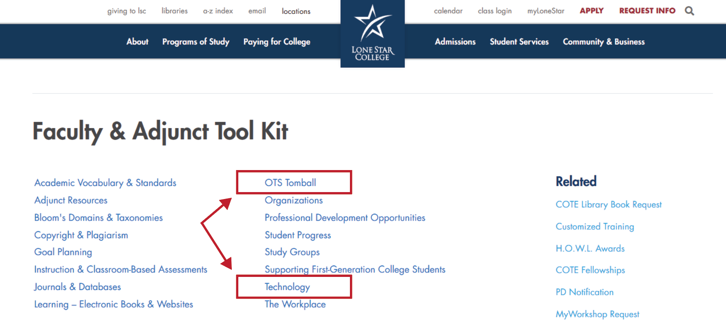
Technology Services (OTS) Information is Available in the Faculty & Adjunct Tool Kit

Slide 2
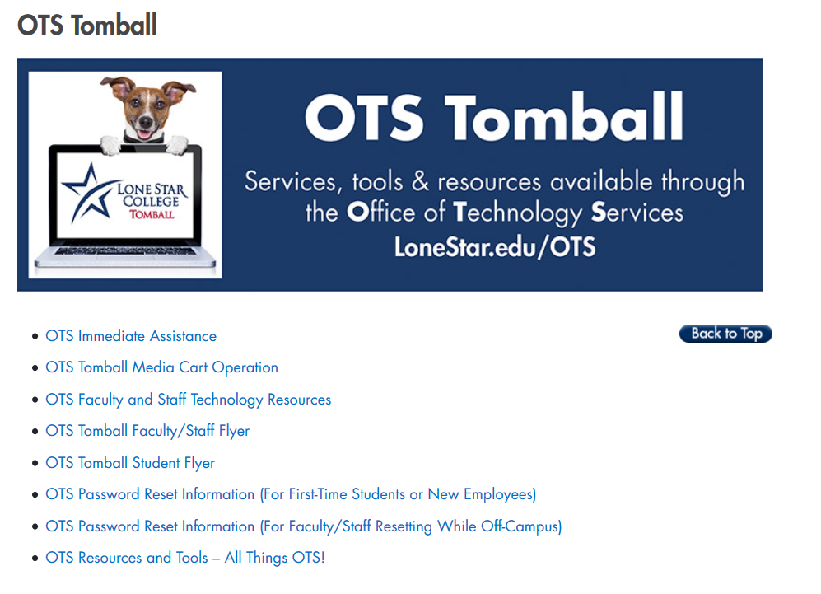
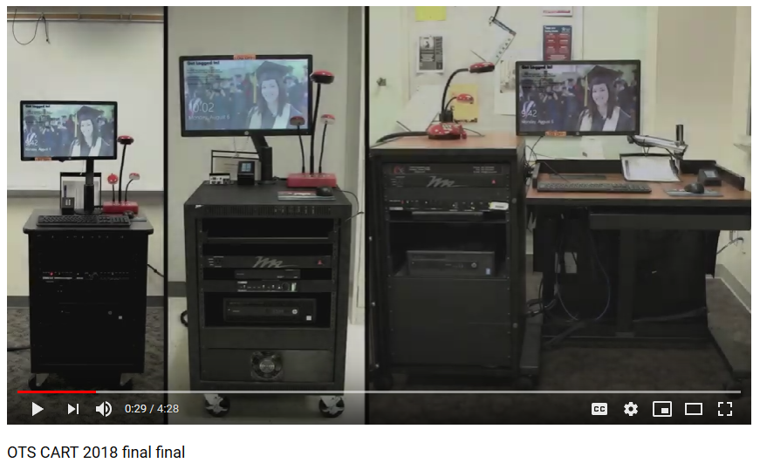
Your Links to
All Things OTS!
Links to all
technology services
are available in the
Faculty & Adjunct Tool Kit.
Media Cart Operation Video
If you will be teaching on campus, get acquainted with the various models of media carts and lecterns that are available at LSC-Tomball locations by viewing the quick video (<5min.).

Slide 3

Need IT assistance during class?
Pick up the Assistance Phone and dial “3”.
Outside of class:
Stop by S209 during campus operating hours
or contact the IT Service Desk.
The IT Service Desk is available 6 a.m. to midnight.
Call 281.318.HELP or go to LoneStar.edu/ITHelp.
We’re happy to help!

