Slide 1








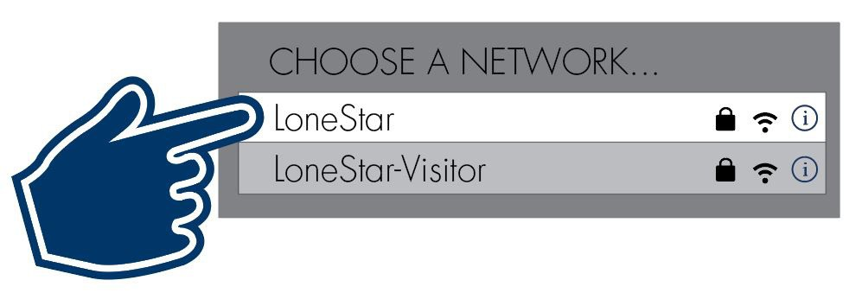
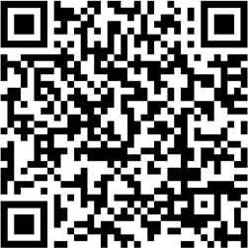
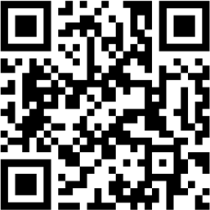
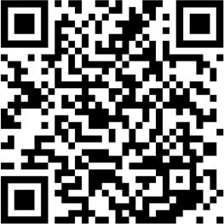
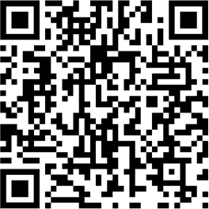
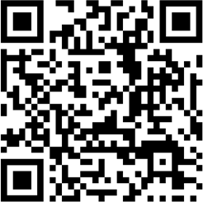
Scan the QR code to access LoneStar.edu/ITHelp
any time for information and links regarding:
getting IT help,
resetting your password,
accessing Webex and LSC Zoom securely,
sharing and storing files,
and MORE!
You Got This!
Wi-Fi Access
Students and employees have access to our secure “LoneStar” wi-fi network anytime while on campus by logging in with their LSC email address and password.
Resetting Your LSC Password When Off Campus
Need to reset your password while off campus? Follow the directions in Resetting Your LSC Password (For Faculty & Staff Resetting While
Off-Campus) to reduce the chance of password syncing issues when you return to campus.
These instructions are also in LoneStar.edu/ServiceCenter-Knowledge
Strengthening Your Skill Set
We highly recommend the fantastic (and free!) video tutorials available on these sites to help you get familiar, or boost your existing skills, with some of the most-used applications across the college:
Udemy Business
(pronounced YOUdehmee) https://lonestar.udemy.com/
Microsoft 365 Training
https://support.microsoft.com/ en-us/training
myLoneStar Tutorials
youtube.com@LSC-myLoneStarTutorials
Training modules on software applications, leadership skills, personal development, and more!
Tutorials for OneDrive, SharePoint, Microsoft Teams, and more!
Quick step-by-step video instructions on how to navigate and complete tasks in myLoneStar.
Links to these training sites are available on LoneStar.edu/ITHelp.
But wait... There’s more!
We also have a robust library of helpful how-to articles available to faculty, staff, and students in the LSC Service Center within ServiceNow (LoneStar.edu/ITHelp > Quicklinks > "How Do I...?"KnowledgeBase). Sign in using your LSC email address and select “Technology Services (OTS).

Slide 2


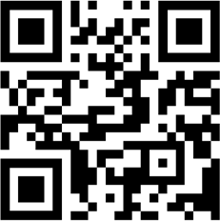
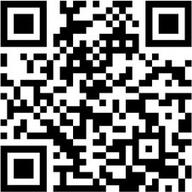
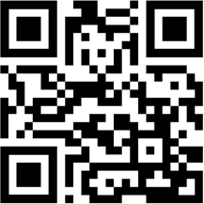

IT Issue During Class? Call Us...
If you are on-site: Pick up the Classroom Assistance Phone in your classroom and dial “3” to be directly connected to the OTS Campus Services team at your location. Let us know what is going on and we will send a technician to your classroom right away to investigate the issue and get it resolved.
If you are off-site: Go to the Technology Services area of the LSC Service Center and select the Chat with IT Service Desk option at the bottom of the page. A chat session will open with one of our agents. If they cannot resolve the issue, they will have a technician contact you right away.
We’re happy to help!
Multiple Ways to Stay Connected
Webex
https://web.webex.com/
LSC Zoom
https://lonestar-edu.zoom.us
Microsoft Teams
https://microsoft365.com
Attend and hold meetings with Webex.
Tip for Faculty! Use your Webex Personal Room to hold virtual office hours
The secure way to Zoom with colleagues or students.
Tip! Do not use a personal or free Zoom account for LSC use.
Create a team when working on a project or committee together to meet and share files.
Links to all three of these virtual meeting tools are available on LoneStar.edu/ITHelp.
Trying to decide which Webex application out of our suite of tools to use can be confusing. The following table outlines which Webex application should be used depending upon the meeting size.
2 to 20 attendees 20 to 1,000 attendees 50+ attendees
Webex Personal Room Webex Meetings Webex Events
Don’t Get Hooked By a Cyber-Criminal
Phishing is a psychological attack used by cyber-criminals to trick you into giving up information or taking an action. These messages may look legitimate and entice you into taking an action, such as clicking on a malicious link, opening an infected attachment, or responding to a scam.
Common Phishing Scams
Part-time job offers
Internships offers
Unread message notices posing as being from college departments
Financial aid notices
IT-related emails instructing the recipient to sign in to enable, validate, confirm, or update their account or risk losing access
Be cyber smart and stay cyber-aware. Keep an eye out for anything that
looks “off” as well as these common scams
One of these is not like the others...
If you receive a suspicious email, call, or text, REPORT IT right away.
Report any suspicious messages to the OTS Phishing Alert Team, so we can investigate.
Click the “Report Phishing” button in Outlook or call the IT Service Desk at 281.318.HELP (4357) or toll-free 866.624.5014.

