Slide 1


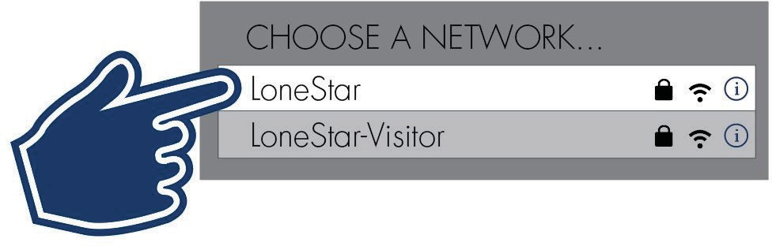










Kickstart Your Semester!
Free Software, Fast Wi-Fi, and Cyber Safety Tips!
Scan the QR code to access LoneStar.edu/ITHelp
for info and links regarding:
resetting your password,
getting FREE software (including Microsoft Office),
sharing and storing files,
accessing LSC Zoom and Webex securely,
and MORE!
IMPORTANT! Check Your LSC Email Regularly
Be sure to check your LSC email every day for important communications.
Expecting an email, but it hasn’t shown up?
Check your “Junk Email” folder for any emails that may have inadvertently been caught in the spam filter.
IT Resources on Campus
Wi-Fi Access
Students and employees have access to our secure “LoneStar” wi-fi network anytime while on campus by logging in with their LSC email address and password.
Computer Labs
All LSC locations have computer labs available to students taking in-person classes.
Most labs are equipped with Windows workstations, printers, and USB ports for access with
Printing
Need to print while on campus? Use the Pay-to-Print and Mobile Print services in our libraries and labs to print your documents.
Please see a Librarian for any assistance with Pay-to-Print services.
compatible flash/USB drives. Mac labs are also available in select locations.

Slide 2

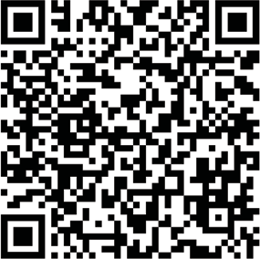

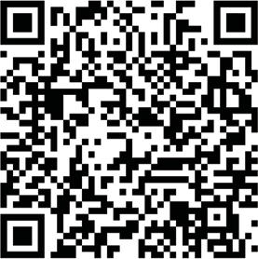

FREE Software Available for Students
Go to LoneStar.edu/ITHelp > Quicklinks > Get Software to find out what software applications are available (at no additional cost).
Sign in using your LSC email address and password.
Don’t Get Hooked By a Cyber-Criminal
Phishing is a psychological attack used by cyber-criminals to trick you into giving up information or taking an action. These messages may look legitimate and entice you into taking an action, such as clicking on a malicious link, opening an infected attachment, or responding to a scam.
Common Phishing Scams
Part-time job offers
Internships offers
Unread message notices posing as being from college departments
Financial aid notices
IT-related emails instructing the recipient to sign in to enable, validate, confirm, or update their account or risk losing access
Be cyber smart and stay cyber-aware. Keep an eye out for anything that
looks “off” and these common scams
One of these is not like the others...
!
Received a suspicious email message or call? Report it.
If you receive a suspicious email, text, or phone call claiming to be Lone Star College:
click the Report Message button in Outlook,
call the IT Service Desk (281.318.HELP (4357)),
or submit the Report a Phishing/Scam/Spam Email form so we can investigate (LoneStar.edu/ITHelp > Quicklinks > Report a Phishing Email)
Watch for Financial Aid Account Changes
Didn’t make a change? It could be a fraud issue.
Treat Your Mobile Devices Like Cash
Cybersecurity scams often target students with
If you had a wad of money sitting out in a public place, would you turn your back on it — even for just a minute? Would you put it in checked luggage? Leave it on the backseat of your car? Of course not. Keep the same watchful eye on your laptop or smartphone as you would on your cash.
scholarship and financial aid fraud schemes. If you
receive a notice from Lone Star College’s payment
system (Nelnet) informing you the information in
your account has changed, DO NOT IGNORE IT.
This could be a fraud issue.
Office of Technology Services (OTS)

