Slide 1

PeopleSoft PeopleTools 8.54
Features Overview

Slide 2
PeopleTools Overview
PeopleTools provides the underlying technology for PeopleSoft applications. All PeopleSoft applications, such as Human Capital Management and Customer Relationship Management are built, deployed, and maintained using PeopleTools.
With PeopleTools you can:
Develop new applications or customize existing applications.
Administer applications that you have deployed within your organization.
Provide decision support and reporting functionality to decision makers.
Integrate PeopleSoft applications with other PeopleSoft applications or third party applications.
Upgrade and update your applications as part of system lifecycle management.
The area of PeopleTools technology contains over 40 tools, utilities, and technologies. This document provides brief introductions of each tool or technology, and presents two frameworks with which you can gain a better understanding of the delivered technology, how to categorize the tools, and when to use particular tools.

Slide 3





PeopleTools 8.54 Categories
Development Tools
Reporting and Analysis Tools
Integration Tools
Administration Tools
Lifecycle Management Tools

Slide 4
Application Engine
Application Engine is designed to help you develop, test, and run background SQL processing programs.
Global Technology
Oracle's PeopleSoft applications are functionally equipped for implementation in global enterprises.
Fluid User Interface Developer’s Guide
The PeopleSoft Fluid User Interface is designed to be a significant enhancement to the PeopleSoft’s “classic” user interface, which has been the interface display on browsers for PeopleSoft end users for well over a decade. The PeopleSoft Fluid User Interface moves away from pixel-perfect page layout and provides greater flexibility with the enhanced use of cascading style sheets (CSS3), HTML5, and JavaScript (if needed). (see example)
PeopleCode API Reference
Contains information about certain application classes delivered with Oracle's PeopleTools, as well as specifics about each class's methods and properties.
PeopleCode Developer’s Guide
PeopleCode is the proprietary language used by PeopleSoft applications.
Development Tools

Slide 5
PeopleCode Language Reference
Contains information about PeopleCode built-in functions, meta-SQL, system variables, and meta-HTML.
Application Designer Developer’s Guide
PeopleSoft Application Designer is the core development tool used to build and modify PeopleSoft applications.
Documents Technology
PeopleSoft documents technology includes a Document Builder, a PeopleCode API, and several utilities that enable you to create, manage, and test documents.
Optimization Framework
PeopleSoft Optimization Framework provides a foundation for building applications that use the optimization-based, decision-making capability in the PeopleTools environment.
Search Technology
The PeopleSoft Search Framework provides a standard, declarative method for creating,
deploying, and maintaining search indexes for all of your PeopleSoft applications.
Development Tools

Slide 6
Mobile Application Platform
The PeopleSoft Mobile Application Platform (MAP) is a framework for building mobile applications.
Portal Technology
In PeopleTools, portal technology consists of PeopleSoft Pure Internet Architecture and the various systems, code, and standards used for creating and managing portals.
Development Tools

Slide 7
Analytic Calculation Engine
Analytic Calculation Engine comprises a calculation engine plus several PeopleTools features that enable application developers to define both the calculation rules and the display of calculated data within PeopleSoft applications for the purposes of multidimensional reporting, data editing, and analysis.
BI Publisher for PeopleSoft
Oracle Business Intelligence Publisher (BI Publisher, formerly XML Publisher) is an enterprise reporting solution that streamlines report and form generation. (see example)
Crystal Reports for PeopleSoft
Crystal Reports for PeopleSoft enables you to generate both standard and custom-printed reports containing data from your PeopleSoft applications. (see example)
PS/nVision
PS/nVision retrieves information from your PeopleSoft database and places it into a Microsoft Excel spreadsheet, in a form that helps you see the big picture, explore details, and make decisions. You use familiar Excel commands to format and analyze the data. With PS/nVision, you spend your time analyzing results rather than summarizing data and entering it into a spreadsheet. (see example)
Reporting and Analysis Tools

Slide 8
Cube Builder
PeopleSoft Cube Builder is an extract-transform and load (ETL) application that enables you to use PeopleSoft Query and PeopleSoft Tree Manager to build Essbase applications and online analytical processing (OLAP) databases. (see example).
Pivot Grid
PeopleSoft Pivot Grid supports operational dashboard reporting within the PeopleTools framework to provide a pivot table and chart representation of data using PSQuery and component data source. The framework also enables you to see different views of the data, as in a Microsoft Excel pivot table, and the same data is also available in a chart view. (see example).
Process Scheduler
PeopleSoft Process Scheduler is a centralized tool that enables application developers, system administrators, and application users to manage PeopleSoft batch processes. (see example)
Query
PeopleSoft Query is an end user reporting tool. With PeopleSoft Query, you can extract the precise information that you are looking for by using visual representations of your PeopleSoft database, without writing SQL statements. (see example).
Tree Manager
PeopleSoft Tree Manager, the PeopleTools feature you use to create and maintain hierarchical relationships, such as trees. With PeopleSoft Tree Manager, you represent data graphically to show a hierarchy.
(see example).
Reporting and Analysis Tools

Slide 9
Reporting Web Services
A web service provides external applications a web-services-based means of accessing PeopleSoft data. Web services are implemented through the PeopleTools Integration Broker (IB) framework. The Integration Gateway web application receives all the web service requests and forwards them to the Integration Engine (application server) for processing. (see example).
SQR Language Reference for PeopleSoft
ASQR for PeopleSoft is a powerful enterprise reporting system that provides direct access to multiple data sources. The SQR for PeopleSoft tools enables you to create clear, professional reports from complex arrays of information systems.
SQR for PeopleSoft Developers
SQR for PeopleSoft is both a language and a set of tools that enables you to create professional reports.
Reporting and Analysis Tools

Slide 10
Feed Publishing Framework
The Feed Publishing Framework provides user interfaces and application programming interfaces (APIs) for feed definition creation and maintenance, feed searching and subscription, as well as feed document generation and delivery. (see example).
Integration Broker Service Operations Monitor
The Integration Broker Service Operations Monitor provides the following features: 1) Status on queues, nodes, and individual service operations. 2) You can also view and edit service operation XML. 3) Control and administration of domains that have publication and subscription (pub/sub) servers running against the current database. 4) Ability to activate or deactivate domains, recover from stalls, and so forth. 5) Workflow notification of error messages and archival of service operations. 6) Batch processes for error notification and service operation archival.
Integration Broker Testing Utilities and Tools
The Integration Testing Utilities and Tools provides Send Master utility, Simple Post utility, Integration point test automation tools, Handler Tester utility, Transformation Test utility, Schema Tester utility, Generate SOAP Template utility, Service Operation Testing utility and Provider REST Template utility.
Integration Tools

Slide 11
Component Interfaces
A component interface is a set of application programming interfaces (APIs) that you can use to access and modify PeopleSoft database information programmatically.
Integration Broker
PeopleSoft Integration Broker performs asynchronous and synchronous messaging among internal systems and third-party systems, exposes PeopleSoft business logic as web services to PeopleSoft and third-party systems, and consumes and invoke web services from third-party and PeopleSoft systems.
Integration Broker Administration
Integration Broker Administration performs system administration tasks in PeopleSoft Integration Broker such as:
Set up and configure integration system components, such as messaging servers, nodes, integration gateways, listening and target connectors, and so on.
Configure the integration system to handle services, including specifying namespaces, setting up UDDI repositories, and so on.
Secure the integration environment by applying security at the web server, gateway, application server, node and service operation level.
Fine tune integration system performance by employing failover, master/slave processing, load balancing, and so on.
And more.
MultiChannel Framework
PeopleSoft MultiChannel Framework (MCF) provides the tools that are required to support multiple channels of communication between customers (users) and agents. Some PeopleSoft applications, such as an email response management system (ERMS) from PeopleSoft CRM, use PeopleSoft MultiChannel Framework or you
can develop your own applications on the framework that is provided.
Integration Tools

Slide 12
Supported Integration Technologies
EDI Manager, Outgoing Forms API and Open Query ODBC Driver and API.
Workflow Technology
Workflow capabilities enable you to efficiently automate the flow of information throughout your enterprise, crossing both application and functional boundaries. PeopleSoft Workflow Technology consists of a powerful set of tools that enables you to automate time-consuming business processes and deliver the right information to the right people at the right time. You can merge the activities of multiple users into flexible business processes to increase efficiency, cut costs, and keep up with rapidly changing customer and competitive challenges.
Integration Tools

Slide 13
Automated Configuration Management
With each new release, Oracle PeopleTools provides new technology to our infrastructure, which adds rich, new features to support the functional requirements of our applications. While the new technology enhances the user experience and capabilities of our applications, the new technology often brings additional steps to the environment configuration and implementation process. This can create challenges for system administrators, development teams, and testing teams who routinely set up numerous environments that need to be refreshed on a regular basis. Oracle PeopleTools and PeopleSoft application teams share that same challenge.
Data Management
PeopleSoft Data Mover, PeopleSoft Data Archive Manager, Data integrity and auditing, Diagnostics Framework and Database platform considerations.
Performance Monitor
The Performance Monitor enables you to view real-time and historical performance data of your PeopleSoft systems. The Performance Monitor provides the information that you need to solve immediate performance issues and analyze trends in system performance.
Security Administration
User security, Lightweight Directory Access Protocol (LDAP), authentication and single signon, data encryption, query and definition security and PeopleSoft personalizations.
Administration Tools

Slide 14
System and Server Administration
PSADMIN, analytic servers, web servers, verify search indexes, PeopleSoft Configuration Manager, PeopleTools utilities, tracing and debugging, Jolt Internet Relay and timeout settings.
Administration Tools

Slide 15
Change Assistant and Update Manager
Oracle's PeopleSoft Change Assistant is a standalone, Windows based, Java program that orchestrates the process of updating or upgrading your PeopleSoft system.
Application Designer Lifecycle Management Guide
Change Impact Analyzer
Change Impact Analyzer is a tool installed separately from PeopleSoft PeopleTools that helps you determine the impact of specific changes you plan to make during an application upgrade. It's an interactive program where you can see the relationships of PeopleSoft definitions in a hierarchical view.
Setup Manager
Setup Manager is a tool that helps you implement PeopleSoft applications by using a project and predefined tasks to produce a setup task list that is specific to your implementation project.
Lifecycle Management Tools

Slide 16
PeopleSoft Test Framework (PTF)
PTF automates various tasks within the PeopleSoft application, primarily functional testing. Automating functional testing enables testers to execute more tests with greater accuracy during a shorter time.
Data Migration Workbench
Data Migration Workbench facilitates the Configuration Management process using Application Data Sets (ADS) as its underlying transport technology.
Lifecycle Management Tools

Slide 17
Activity Management
“Marks and Exams” describes a comprehensive design for calculating results within a course structure. Institutions require granular grading structures and calculation functionality to evaluate a variety of student assignments, attendance and course level examinations. The registry connects to course catalog entries and allows users to define a course calculation structure in a hierarchical design (content tree) where detailed grading rules can be defined. The next step is to carry that structure to the schedule level and allow administrative users to manage and organize class content. (see example).
Evaluation Management System
The Evaluation Management System feature is not tied to a singular module within Campus Solutions (for example, Application Evaluations); it is intended to create a ‘generic’ evaluation solution which can be leveraged across Campus Solutions, including people, organizations, and departments or faculties. The feature is flexible enough that it can support many different models of an evaluation review. It provides institutions with the ability to determine what will be evaluated (for example, Admissions Application), who will evaluate it (such as evaluators and committees), and the ability to determine and configure the business process for the evaluation itself. The feature builds on the existing committee structures and provides an administrative evaluation structure where the evaluation process can be managed. (see example).
Program Enrollment
Program Enrollment describes an educational model where a student must generally complete a strictly defined set of courses towards the completion of their academic objective in a specified sequence; each of which are often structured in a series of levels or stages, where one stage must be successfully completed before a student can progress and enroll in the next set of courses. (see example).
Functional Updates

Slide 18
Research Enrollment Tracking
The Research Enrollment Tracking feature is intended to provide a complete set of operations for administrators to manage their graduate research candidates including:
• Ability to capture and manage research related information in a single location in the Candidate Management component. This component brings together all of the key research related data for a student so that it can be used to track a student’s research progress to the point of thesis submission and result outcome.
• Ability to manage and allocate both internal and external supervisors and link them to various research topics.
• The ability to track and manage the Thesis Submission process in a single location using the Thesis Management administrative component. It provides institutions with the ability to view the details related to submission, progress, and final decisions.
Rules Engine
The Rules Engine provides:
a non-programmer user interface to create complex business rules.
a secure way to retrieve data from the system in a logical manner, perform calculations and evaluations, and update data.
a way to use the Entity Registry, a familiar logical hierarchy, to retrieve data from the system; for example, the curriculum structure of the Academic Item Registry (AIR) or the results structure of the Academic Progress Tracker (APT).
System Variables and Functions for creating Rules.
a compiler (Rule Builder) that compiles and readies Rules for execution.
a means to manage changes to Rules over time and a large number of Rules using versioning.
Functional Updates

Slide 19
Student Activity Guides
Activity guides are a PeopleTools feature that allow you to define guided procedures for a user or group of users to complete. Users are presented with a list of actions, or tasks, that need to be completed to finish the procedure. Activity guides can be useful in a number of procedural scenarios. For example:
The on-boarding of a new employee.
Benefits enrollment.
A life change event, such as a marriage or the birth of a child.
Period end closing.
System or feature configuration.
An activity guide lists the tasks (referred to as action items) that need to be completed by a user or group of users. These tasks are linked to specific local or remote transactions or external URLs. The tasks can be assigned to a specific user by user ID or to a group of users by PeopleTools role. Activity guides provide a hierarchical organization of dependent and sequential tasks.
Functional Updates

Slide 20
Accessibility
PeopleTools provides the underlying technology for PeopleSoft applications. All PeopleSoft applications, such as Human Capital Management and Customer Relationship Management, are built, deployed, and maintained using PeopleTools. PeopleTools is designed to generate HTML content that is coded to standards to work with assistive technology. This HTML content includes several accessibility features to help people who use assistive technology, such as screen readers. PeopleSoft accessibility features include:
Alternate text for images, buttons, collapsible section icons, and hide and expand grid tabs.
Table summaries and row and column headings for tables.
The ability to add links and anchors that enable keyboard-only users to bypass repeated navigation content, such as page tabs.
The removal of icon links within a page and the removal of page links from the bottom of pages to reduce redundancy when using screen reader software.
A feature that presents the elements on the body of a page in a linear format (recommended for blind users who use assistive technology, such as screen readers).
Landmarks that identify page sections.
These landmarks provide a method to programmatically identify web page sections in a consistent way, which enables assistive technologies to provide users with features they can use to identify and navigate to sections of page content.
Application Designer
To align with design standards, for PeopleTools 8.53, pages created with Application Designer will have right aligned field labels. These field labels will be left positioned with no colon display. This feature greatly streamlines the otherwise manual process of field label alignment. Once a field is placed on a page, the developer retains the ability to change the label alignment default in Application Designer where necessary by changing the Align Field Labels checkbox in PeopleTools Options page.
Tools Exclusive and General Updates

Slide 21
Application Engine
PeopleTools 8.54 will include enhancements to streamline Application Engine Trace files.
User Experience Design
A new style sheet makes all aspects of a PeopleSoft application more contemporary and visually pleasing. The new style sheet affects not only colors, but homepages, headers, application pages, and pagelets. Page controls and other design elements are also updated.
Tools Exclusive and General Updates

Slide 22
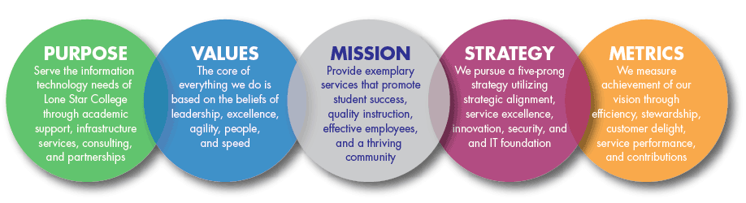
Vision
TO BE THE INNOVATION & SERVICE EXCELLENCE LEADER IN HIGHER EDUCATION
Visit us at LoneStar.edu/OTS

Slide 23
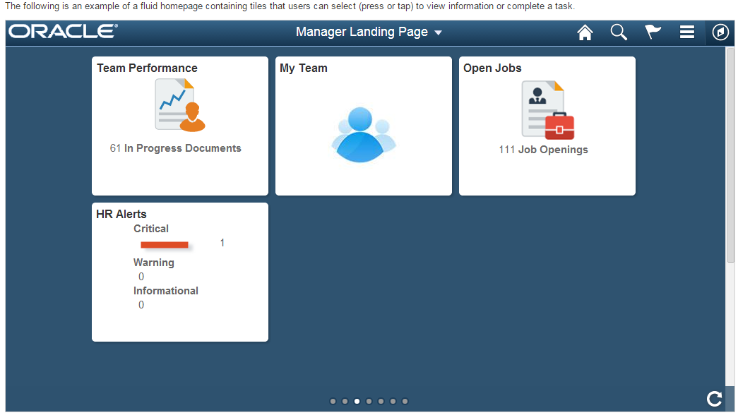
return to slide show

Slide 24
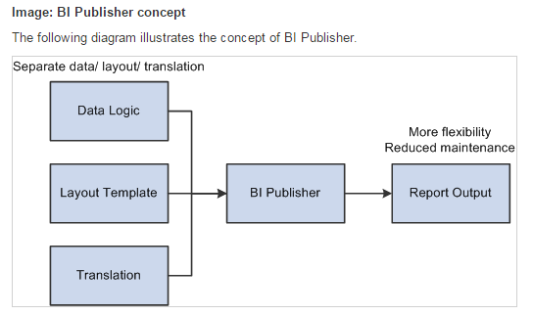
return to slide show

Slide 25
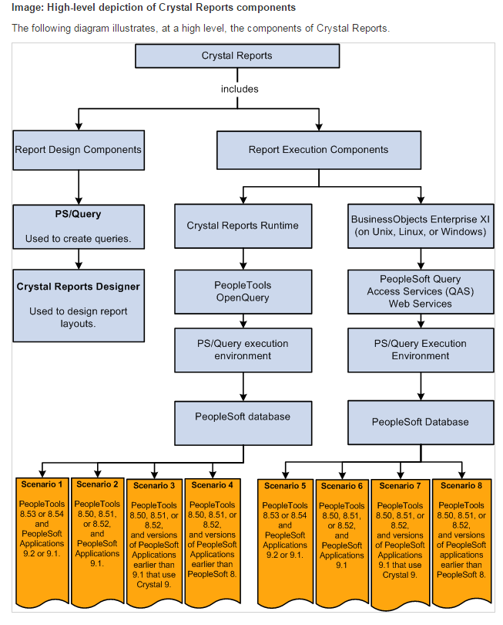
return to slide show

Slide 26
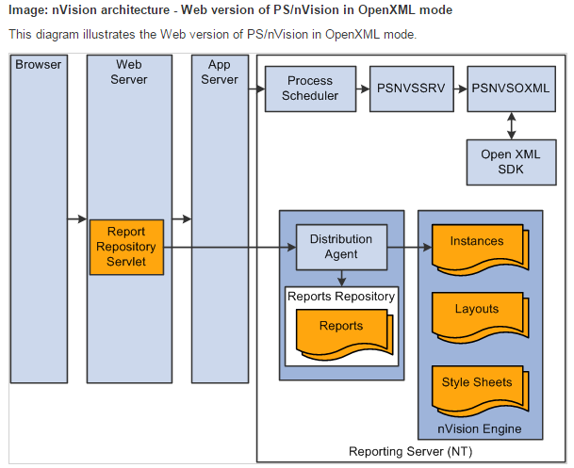
return to slide show

Slide 27
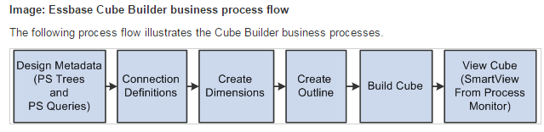
return to slide show

Slide 28
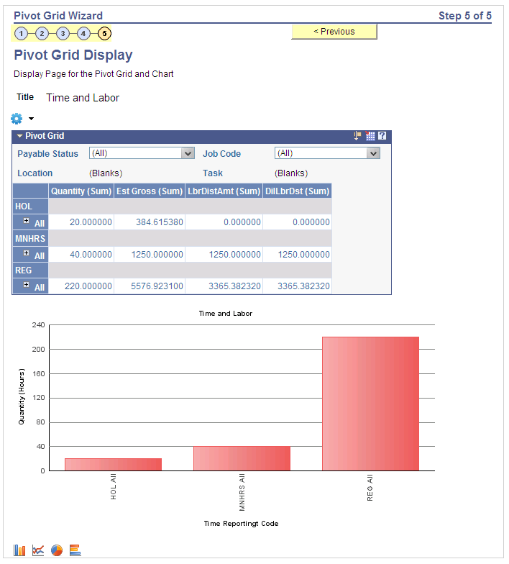
return to slide show

Slide 29
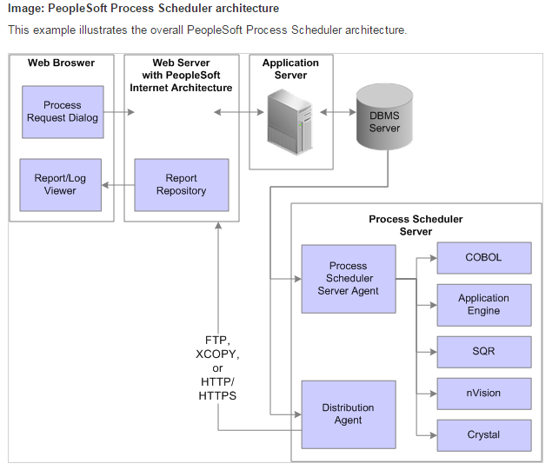
return to slide show

Slide 30
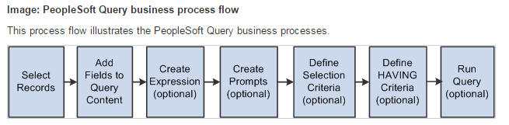
return to slide show

Slide 31
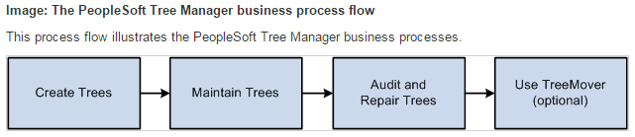
return to slide show

Slide 32
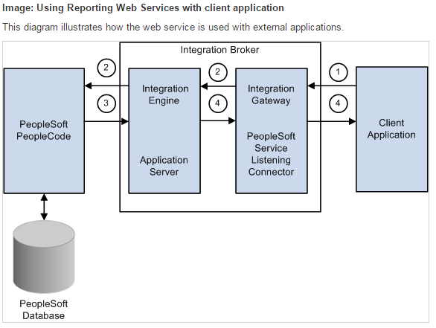
return to slide show

Slide 33
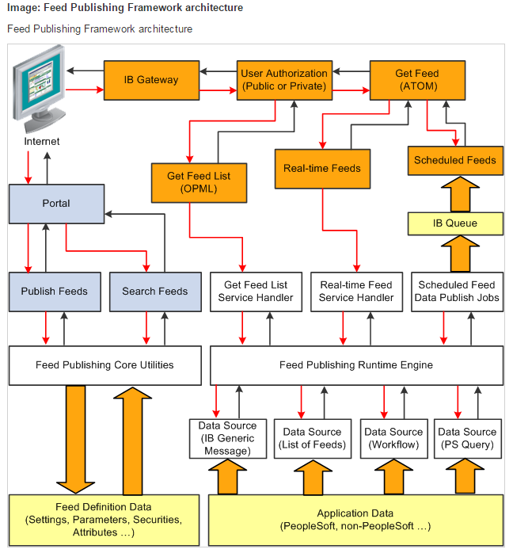
return to slide show

Slide 34
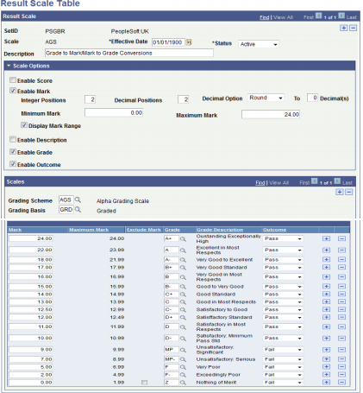
return to slide show

Slide 35
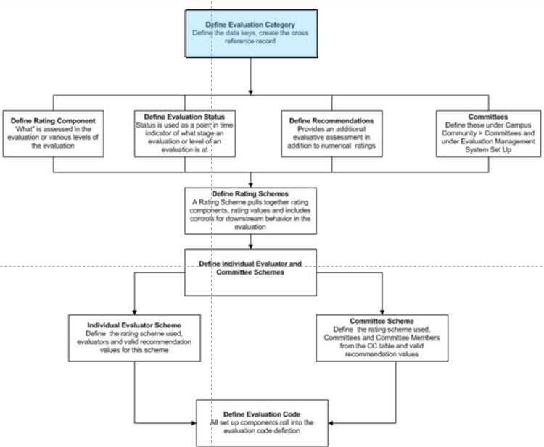
return to slide show

Slide 36
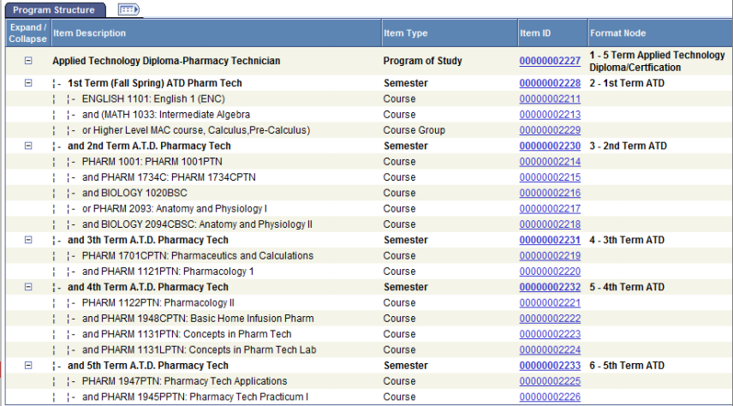
return to slide show

