Slide 1
RSO 101 Session
RSO Budgeting
Wednesday, February 19, 2025

Slide 2
Budget Process

Slide 3
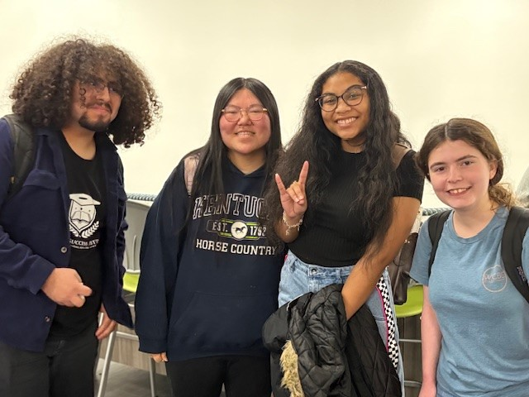
Budgeting Process Overview
The Budget Request Form must be used when an organization wishes to request funding for their organization for the upcoming fiscal year.
Please follow the steps below when filling out your RSO Budget Request Form:
Fill out the RSO Student Activity Fee (SAF) Excel Spreadsheet and save to your computer. You will attach to the Student Activity Fee Request FormStack form.
Fill out and the Student Activity Fee Request FormStack form and attach the RSO Student Activity Fee Excel Spreadsheet within the form.
Schedule a budget hearing time with SFAC here. https://calendly.com/smarino-lonestar/15min
Submit Presentation to Lisa Gutierrez by Thursday, April 3, 2025. Lisa.M.Gutierrez@lonestar.edu with the student organization as the subject line.
Example: 2025-2026 Student Nurses Association Budget Request Presentation.

Slide 4
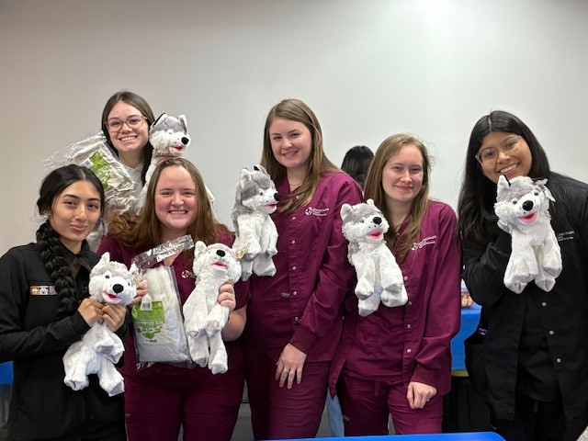
RSO SAFC Presentation
Student organizations at Lone Star College-Tomball are required to present their budget requests for the 2025-2026 academic year to the Student Fee Advisory Committee (SFAC). These presentations should demonstrate how the requested funds will benefit students, align with the mission of Student Experience, and contribute to the broader campus community.
Organizations have 10 minutes to present their budget request.

Slide 5
Presentations

Slide 6
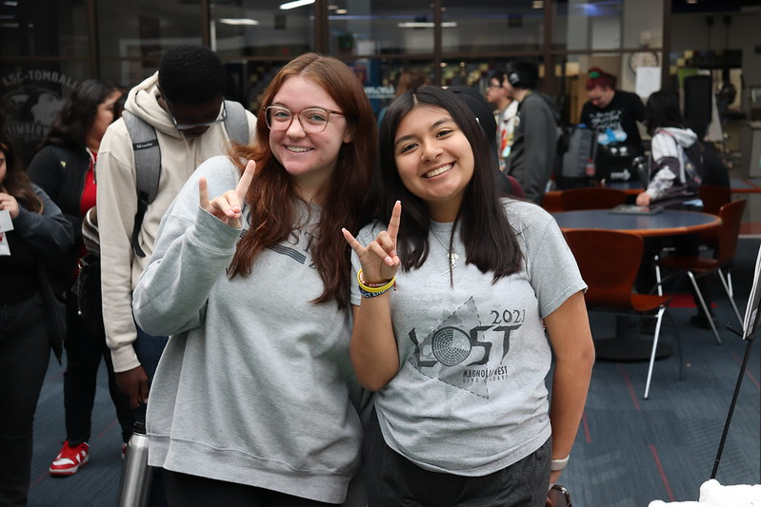
Introduction
Introduce Your Organization
Share your student organization’s name, mission, and primary activities.
State the Purpose
Explain why you are requesting funding for the 2025-2026 academic year.

Slide 7
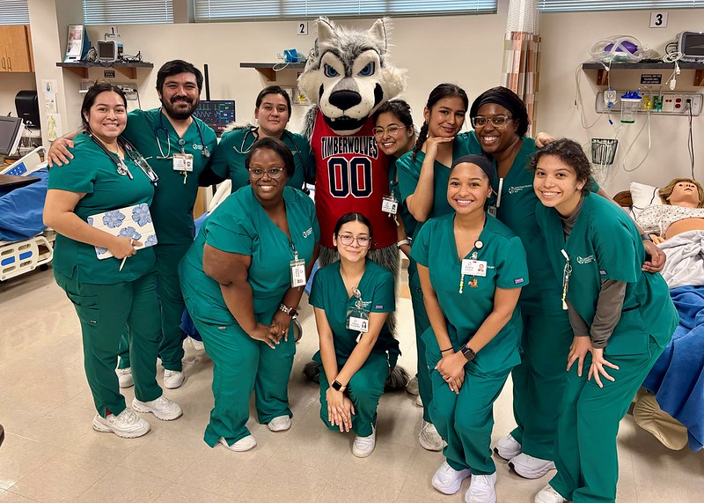
Alignment with Student Experience Mission
Student Experience Mission State
To create a vibrant and supportive student experience that inspires personal growth, fosters inclusivity, and empowers student to thrive academically and beyond.
Review the Mission Statement
Ensure your budget request aligns with the mission of Student Experience at Lone Star College-Tomball.
Demonstrate Alignment
Explain how your organization’s activities support student engagement, leadership, and campus involvement.

Slide 8
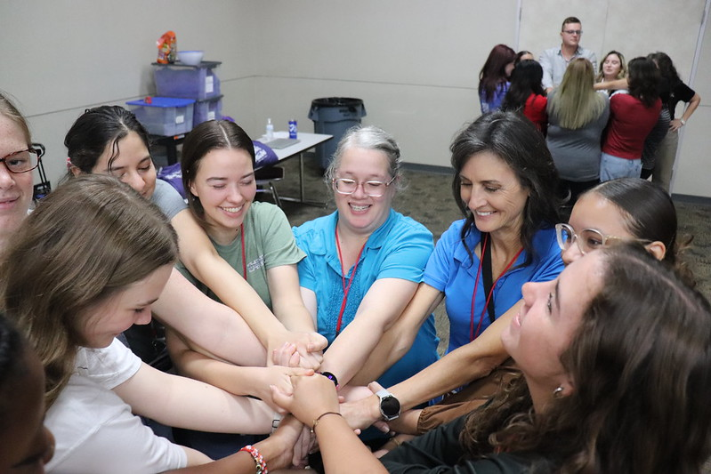
RSO Budget Request Overview
Total Budget Request
Clearly state the total amount being requested.
Breakdown of Expenses
Events (e.g., student workshops, networking mixers, cultural celebrations)
Travel (e.g., conferences, leadership retreats, competitions)
Marketing (e.g., flyers, banners, social media promotions, t-shirts)
Materials & Supplies (office supplies, giveaway items)
Guest Speakers (e.g., honorariums, accommodations, transportation)
Honorariums can not be paid to LSC-Tomball employees from Student Activity Fee money.
Justification for Each Item:
Explain the necessity of each expense.
Highlight the expected impact on students and the broader campus community.

Slide 9
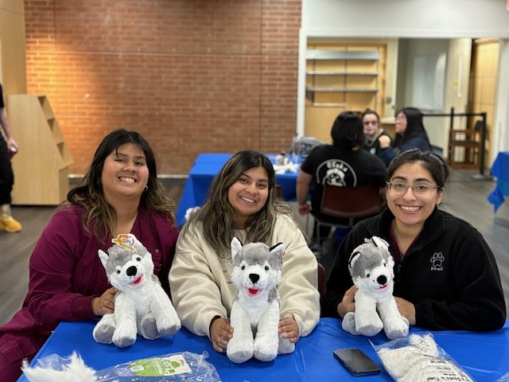
Impact on LSC-Tomball Students
Student Engagement
How does your organization foster a sense of belonging and community?
Leadership Development
How do your programs encourage leadership skills?
Examples of Success
Share data, testimonials, or stories of past impactful initiatives.
Upcoming Initiatives
Outline any new programs or events for the upcoming year.

Slide 10
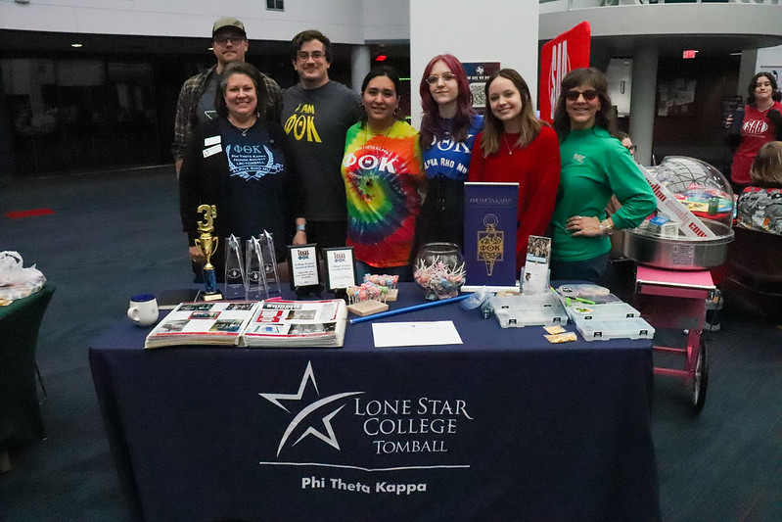
Conclusion & Call to Action
Summarize Key Points
Reinforce the significance of your funding request.
Final Statement
Emphasize how your organization contributes to a vibrant student experience.
Invite Questions: Thank the committee and open the floor for questions.

Slide 11
Presentation Tips/Attire

Slide 12
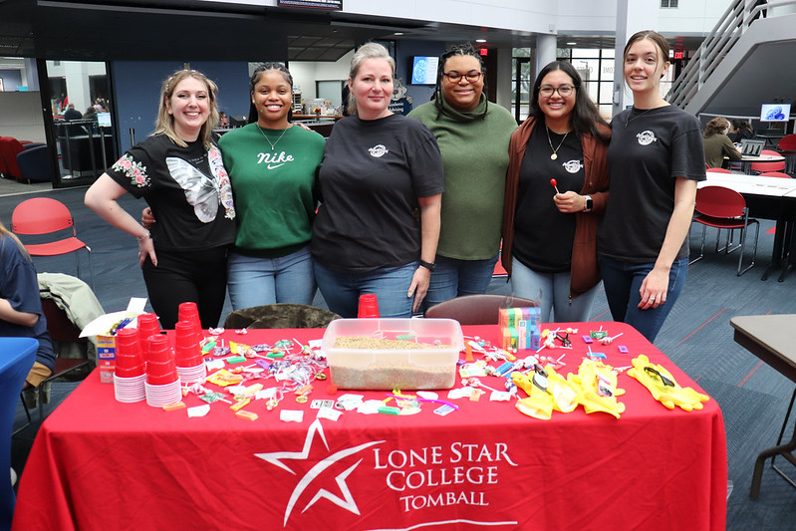
Presentation Tips
Be Prepared
Ensure presenters are knowledgeable about the budget and organization’s impact.
Be Engaging
Use visuals such as slides, charts, and photos.
Be Concise
Stick to the 10-minute time limit and practice ahead of time.
Be Persuasive: Clearly explain why funding is essential for success.

Slide 13
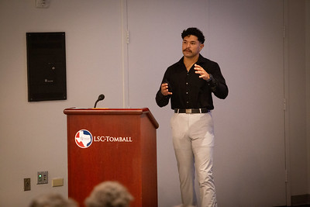
Presentation Tips
Student Leaders
Are presenting the RSO Budget. Advisor may attend presentation for support.
Presentation Time
Ensure that your organization is presentation is within the allotted time. (10 minutes per student organization)
Questions & Answers
Ensure that your organization answers questions professionally.

Slide 14
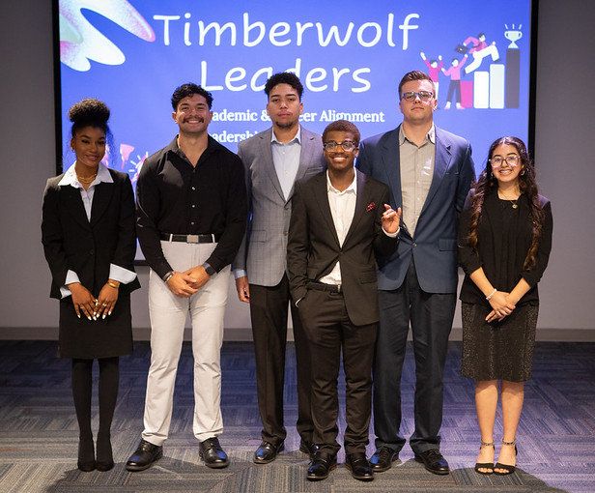
Presentation Attire
Business Casual
Collared shirts, blouses, dress pants, skirts, or dresses.
Avoid Casual Wear
No jeans, t-shirts, flip-flops, or overly casual attire.
Professional Appearance
Ensure clothes are clean and ironed.
Comfortable Yet Polished
Wear something that makes you feel confident and professional.

Slide 15
Important Dates/Links

Slide 16
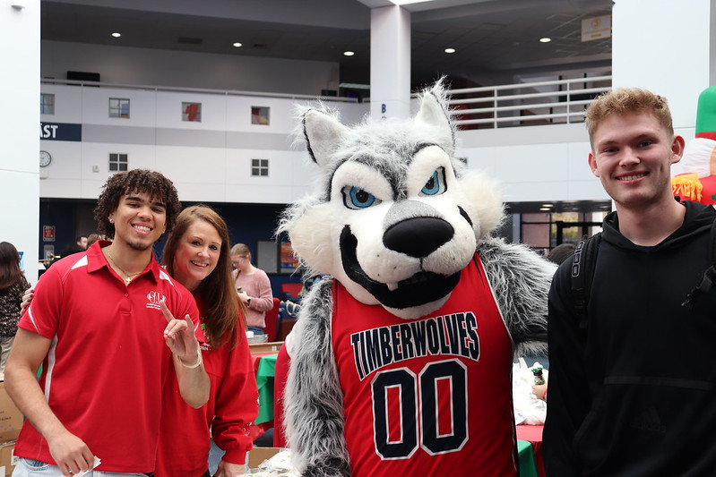
Important Deadlines
Budget Requests Due: Friday, March 7, 2025.
Presentation Submission Deadline: Thursday, April 3, 2025.
Budget Hearings: Week of April 7, 2025.
Questions?
Contact Shannon Marino at smarino@lonestar.edu.

Slide 17
Useful Website Links
RSO Budget Request Form
RSO Budget Request Spreadsheet
RSO Budget Presentation Meeting Sign Ups
RSO Budget Planning
Student Engagement Website
LSC-Tomball Student Organization Website
Event Planning Guide
Catering
Recommended Food Tip Guidelines
RSO Handbook

Slide 18
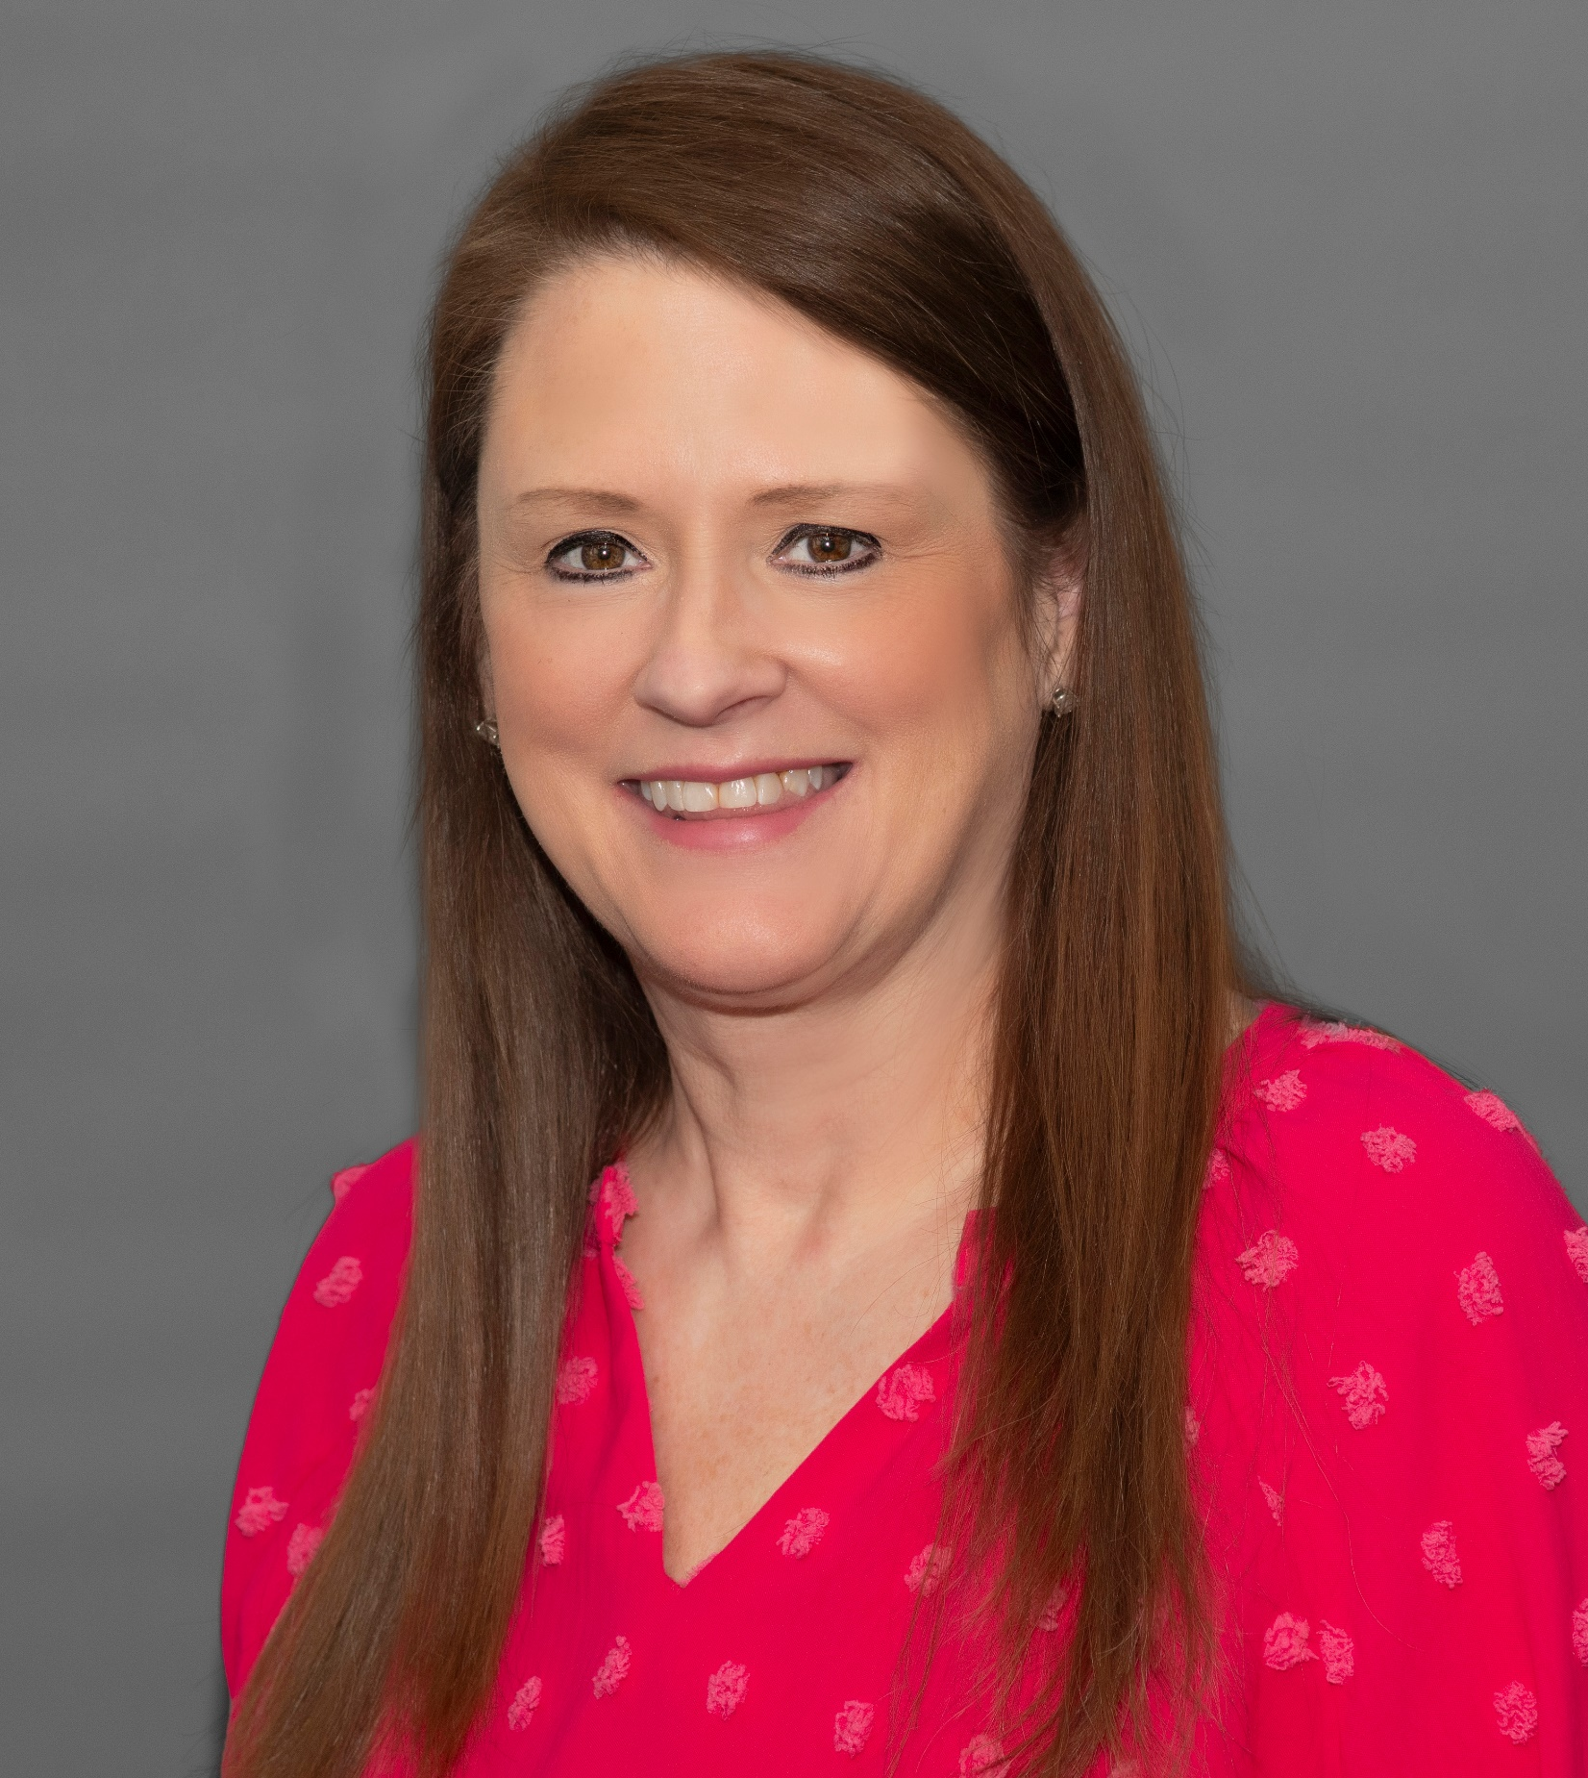
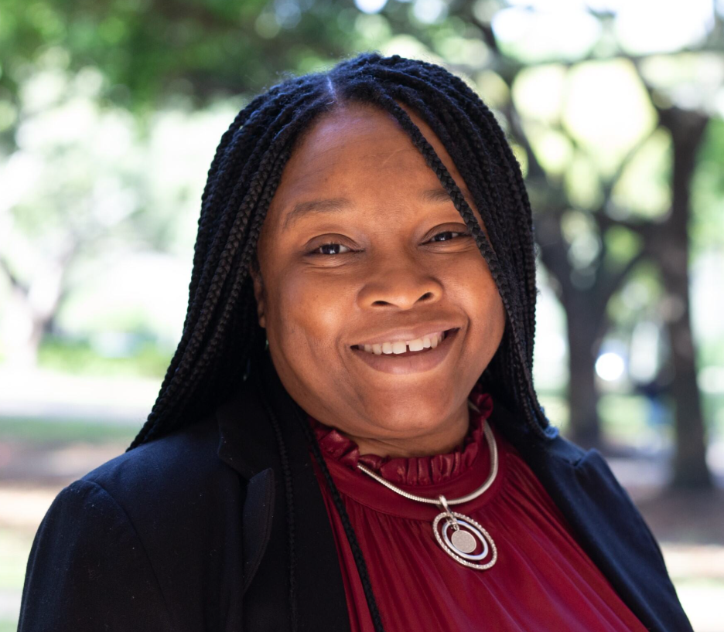
Contact Us!
Shannon Marino
Director, Student Experience
smarino@lonestar.edu
Lisa Gutierrez
Manager, Center for Student Engagement
Lisa.M.Gutierrez@lonestar.edu
Kelly-Ann Monderoy
Coordinator, Student Experience
kelly-ann.monderoy@lonestar.edu

Slide 19
Questions?

Slide 20
Good luck with your presentations!

