Slide 1
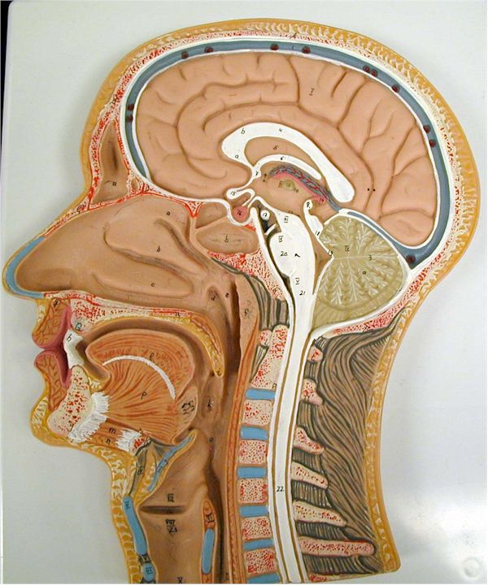
Pharynx
What is this?

Slide 2
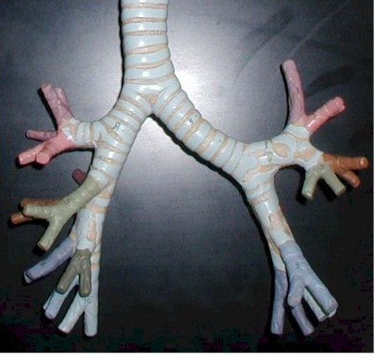
What are these?
Tertiary
(segmental)
bronchi

Slide 3
laryngopharynx
What is this?

Slide 4
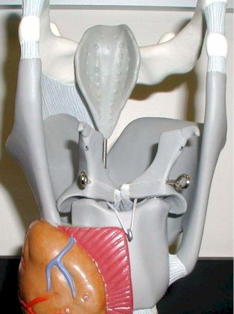
epiglottis
What is this?

Slide 5
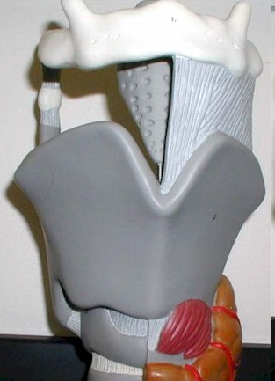
Thyroid
cartilage
What is this?

Slide 6
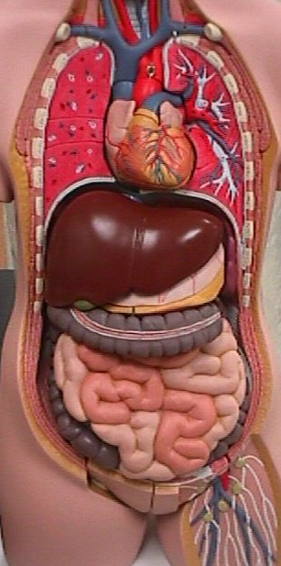
What are these?
Lungs

Slide 7
What are these?
Secondary
(lobar)
bronchi

Slide 8
nasopharynx
What is this?

Slide 9
Nasal
cavity
What is this?

Slide 10
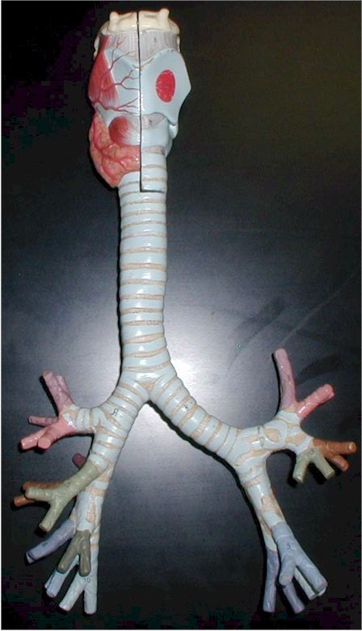
What is this
region called?
Lower
Respiratory
tract

Slide 11
What is this?
trachea

Slide 12
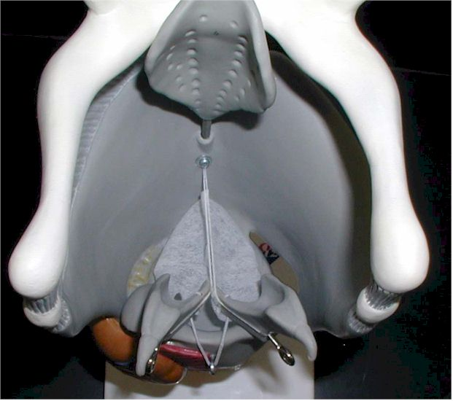
glottis
What is this
opening?

Slide 13
The nasal cavity, pharynx & larynx collectively is the?
Upper
Respiratory
tract

Slide 14
oropharynx
What is this?

Slide 15
True
Vocal
cords
What are these?

Slide 16
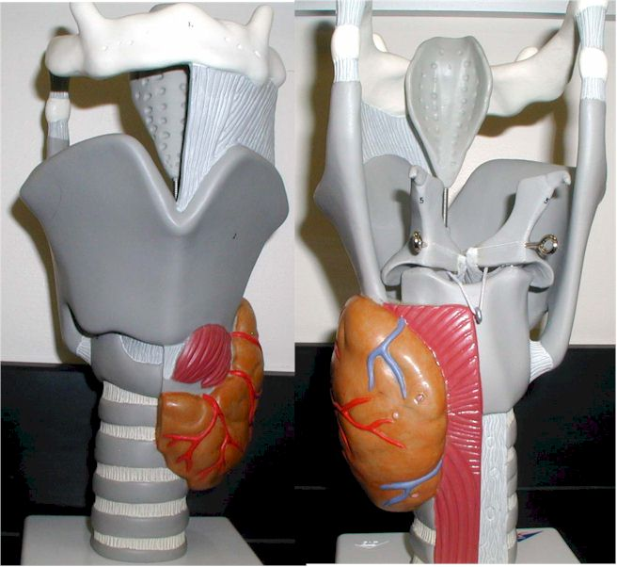
larynx
What is this?

Slide 17
What are these?
Primary
bronchi

